Slide 1
Fundamentals
JavaScript.

Slide 2
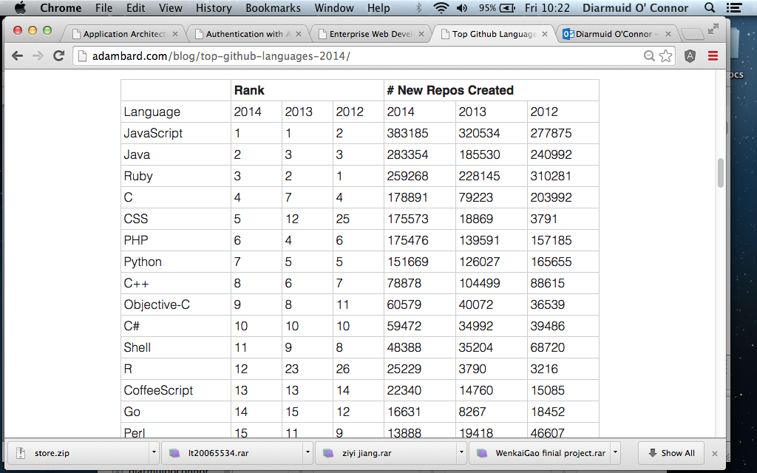

Slide 3
Background.
Javascript is Ubiquitous.
  … also on the server-side (node.js), embedded (Duktape)
Written at Mosaic by Brendan Eich (early 1990s) under the name Mocha and later LiveScript, EMCAScript, and Jscript.
Influenced heavily by Java, Self and Scheme.
Douglas Crockford - JavaScript - Volume 1: The Early Years
Currently Trademarked by Oracle.
ECMA standard 261
  ECMAScript.

Slide 4
JavaScript Data Types.
Language data types:
  Primitives: number, string, boolean, null, undefined.
  Everything else is an object (even functions).
JS is a dynamically typed language.

Slide 5
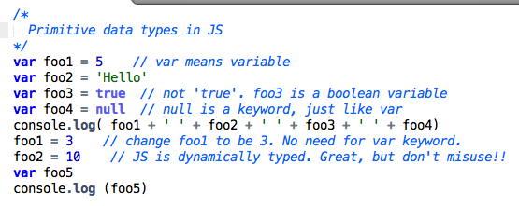
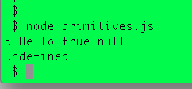
Primitive types.
Suppose this code is in a file, called primitives.js
Thanks to the node.js platform, I can execute this code from the command line – no browser needed.

Slide 6
Primitive types (The syntax).
    var foo = 20
var – keyword to indicate we are declaring something – a primitive number variable in this case.
Identifier – ‘foo’ is an identifier or name for this thing.
  Lots of rules about valid format for identifiers (no spaces, don’t start with numeric character, etc etc)
Operator – +, =, * (multiply), –, [ ] (subscript) etc
  Some rules about where they can appear in a statement.

Slide 7
Objects.
The object - fundamental structure for representing complex data.
A unit of composition for data ( or STATE).
Objects are a set of key-value pairs defining properties.
  Keys (property names) are identifiers and must be unique
  Values can be any type, including other objects (nesting).
Literal syntax for defining an object:
  { <key1> : <value1>, <key2> : <value2>, ...}
  Example:
  var me = { first_name: “Diarmuid”, last_name: “O’Connor” }

Slide 8
Objects.
Two notations for accessing the value of a property:
  Dot notation e.g me.first_name
  Subscript notation e.g. me['first_name’] (Note quotes)
Same notations for changing a property value.
  me.first_name = ‘Jeremiah’
  me[‘last_name’] = ‘O Conchubhair’
Subscript notation allows the subscript be a variable reference.
  var foo = ‘last_name’
  me[foo] = ……..

Slide 9
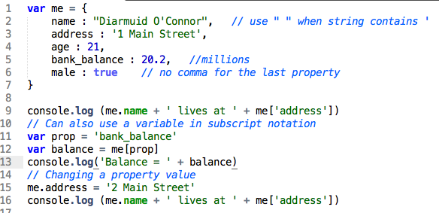
Objects.

Slide 10
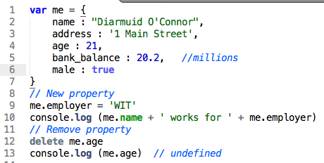
Objects are dynamic.
Properties can be added and removed at any time – JS is dynamic.

Slide 11
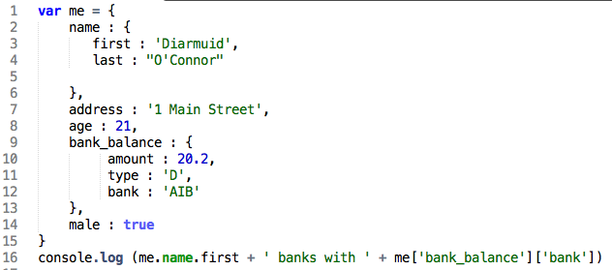

Nested objects.
A property value may be an object structure.
Nesting can be to any depth.

Slide 12
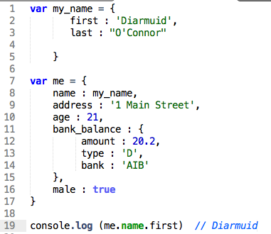
Object property.
A property value can be a variable reference.

Slide 13
Object keys
Internally JS stores keys as strings.
Hence the subscript notation – me[‘age’]

Slide 14
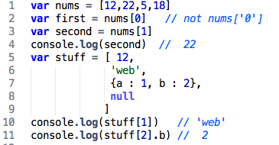
Array data structure.
Dfn: Arrays are an ordered list of values.
  An object’s properties are not ordered.
Literal syntax: [ <value1>,<value2>,... ]
In JS, the array values may be of mixed type.
  Although mixed types may reflect bad design.
Use an index number with the subscript notation to access individual elements:

Slide 15
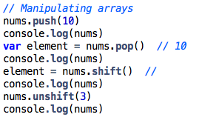
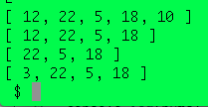
Array data structure.
In JS, arrays are really just ‘special’ objects:
  The indexes are not numbers, but properties - the index number is converted into a string:
nums[‘2’] same as nums[2]
  Special length property, e.g. var len = nums.length // 4
  Some utility methods for manipulating elements e.g push, pop, shift, unshift, join etc
    push/pop – add/remove at the tail.
    shift/unshift – add/remove at the head.

Slide 16
Nested collections.
Arrays and objects can be nested.
Ex.:
  Array of array values.
    array_outer[3][2]
  Array of objects
    array_outer[2],propertyX.
  Object property with an array value.
    objectY.propertyX[2]
  ……….

Slide 17
JS - Behavior structures

Slide 18
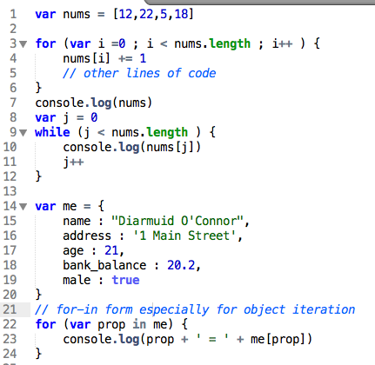
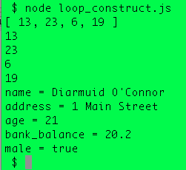
Looping/iteration constructs
A more elegant form later.

Slide 19
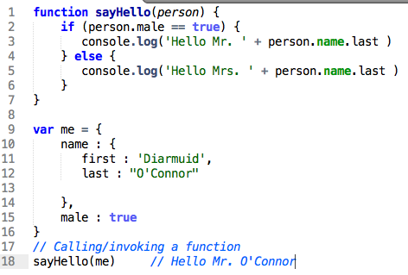
JavaScript functions.
Fundamental unit of composition for logic ( or BEHAVIOUR).
Basic syntax: function <func_name>( <parameters> ) { <body of code> }
  Some functions don’t need parameters.
A function’s body is executed by calling/invoking it with arguments - <func_name>( <argumentss>)

Slide 20
Functions - Variable scopes.
Every function creates a new variable scope.
  Variables declared inside the function are not accessible outside it.
  All variables defined within the function are “hoisted” to the start of the function, as if all the var statements were written first.
    You can use a variable inside a function before declaring it.
Global scope – default scope for everything declared outside a function’s scope.
  Variables in global scope are accessible inside functions.

Slide 21
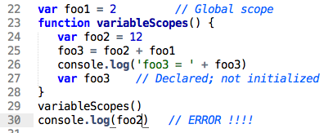
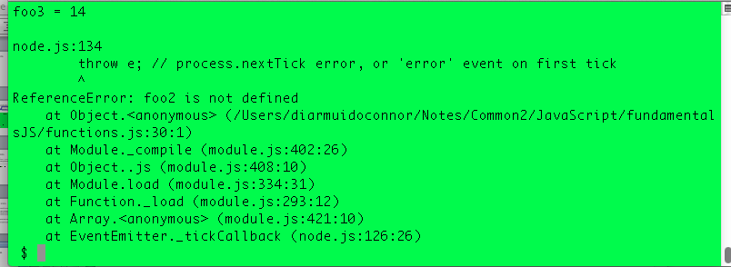
Functions - Variable scopes.
Stack trace

Slide 22
JavaScript functions.
Can be created using:
  A declaration (previous examples).
  An expression.
  A method (of a custom object).
  An anonymous unit.
Can be called/invoked as:
  A function (previous examples).
  A method.
  A constructor.

Slide 23
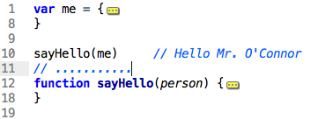
Function Declarations
Define a function using the syntax:
function name( ... ) { ... }
Function definitions are “hoisted” to the top of the current scope.
  You can use a function before it is defined – like function-scoped variables.
Can also define functions inside other functions – same scoping rules as variables.
Collapsed for convenience

Slide 24
Function Expressions
Defines a function using the syntax:
var name = function( ... ) { ... }
Unlike function declarations, there is no “hoisting”.
  You can’t use the function before it is defined, because the variable referencing the function has no value, yet.
Useful for dynamically created functions.
Called in the same way as function declarations:
name( argument1, argument2, ... )

Slide 25
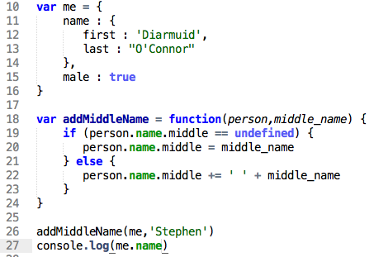

Function Expressions

Slide 26
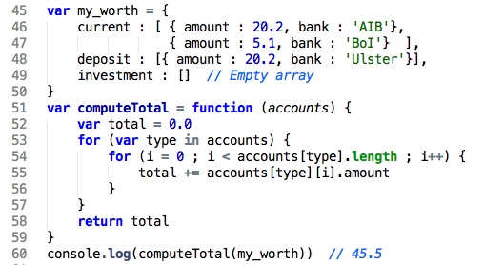
Function Returns
Typically, functions perform some logic AND return a result.
[A function without a return statement will return ‘undefined’]

Slide 27
Methods.
A property value of an object can be a function, termed a method.
The same form of function definition as function expressions.
Syntax: var obj = { …….
  methodX : function(….) { …. },
  …….. }
Calling method syntax: obj.methodX(….)
Methods of an object can be redefined or added at any time.
  JS is dynamic!!
Methods must be defined before use.
Application design – The dominant design methodology encourages encapsulating state (data) and behavior (methods) into units called classes. In JS, most custom objects are a mix of state and methods, where the latter manipulate the state.

Slide 28
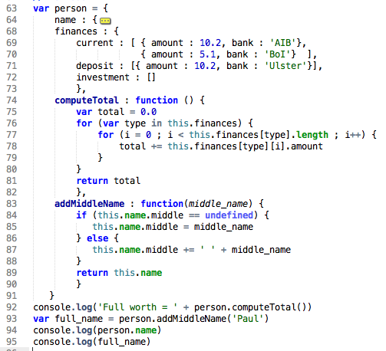

Methods
Use ‘this’ to reference the enclosing object

Slide 29
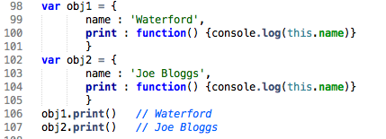
Methods.
Syntax comparison:
  Function:
    computeTotal(person) addMiddleName(person,’Paul')
  Method:
      person.computeTotal() person.addMiddleName(me,’Paul’)
The special ‘this’ variable.
  Always references the enclosing object.
  Used by methods to access properties of the enclosing object.

Slide 30

Anonymous functions.
You can define a function without giving it a name:
function( ... ) { …. }
Mainly used for “callbacks” - when a function/method needs another function as an argument, which it calls.
  EX. The setTimeout system function.
[Note: Any type of function (declaration, expression, method) can be used as a callback, not just anonymous functions.]

Slide 31
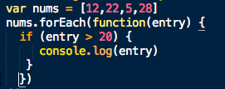
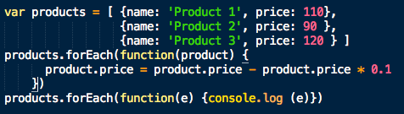
Anonymous functions.
A more elegant way of processing an array.
  Objective: Display every number > 20 from the array.
    The anonymous function is called by forEach(), once for each entry in the array. The function’s parameter (entry) will be set to the current array entry being processed.

Slide 32
Constructors.
The object literal syntax is not efficient for creating multiple objects of a common ‘type’.
  Efficiency = Amount of source code.
var customer1 = { name ’Joe Bloggs’,
address : ‘1 Main St’,
finances : {. . . . . },
computeTotal : function () { . . . . },
adjustFinance : function (change) { . . . }
}
var customer2 = { name ’Pat Smith’,
address : ‘2 High St’,
finances : {. . . . . },
computeTotal : function () { . . . . },
adjustFinance : function (change) { . . . }
}
var customer3 = . . . . .
Constructers solve this problem

Slide 33
Constructors.
Constructor - Function for creating (constructing) an object of a custom type.
  Custom type examples: Customer, Product, Order, Student, Module, Lecture.
  Idea borrowed from class-based languages, e.g. Java.
    No classes in Javascript.
Convention: Capitalize function name to distinguish it from ordinary functions.
    function Foo(. . . ) { ... }
Constructor call must be preceded by the new operator.
    var a_foo = new Foo( . . . )

Slide 34
Constructors.
What happens when a constructor is called?
  A new (empty) object is created, ie. { } .
  The this variable is set to the new object.
  The function is executed.
  The default return value is the object referenced by this.
function Customer (name_in,address_in,finances_in) {
  this.name = name_in
  this.address = address_in
  this.finances = finances_in
  this.computeTotal = function () { . . . . }
  this.changeFinannce = function (change) { . . . . }
}
var customer1 = new Customer ('Joe Bloggs','I Main St.', {. . . } )
var customer1 = new Customer (’Pat Smith',’2 High St.', {. . . } )
console.log(customer1.name) // Joe Bloggs
var total = customer1.computeTotal()

