Slide 1
REST and Express
1
Frank Walsh
(based on post by Stefan Tilkov)
http://www.infoq.com/articles/rest-introduction
And
http://www.ibm.com/developerworks/xml/library/wa-ajaxarch/

Slide 2
What is REST
2
Short for REpresentational State Transfer
A software architecture style for distributed hypermedia systems(WWW)
A set of principles that define how Web standards(HTTP and URIs) can be used.
One “incarnation” of the REST style is HTTP (and a set of related set of standards, such as URI).
The way the Web’s architecture “should” be used
Coined by Roy Fielding in his PhD thesis
The “right” way to implement heterogeneous application-to-application communication?...

Slide 3
REST Concept
3
Resource Orientated
Resources are identified by uniform resource identifiers (URIs)
Resources are manipulated through their representations
Messages are self-descriptive and stateless
Multiple representations are accepted or sent

Slide 4
Representation Concept
4
What do you get when you request a web page?
A representation of a resource
Resources are just “concepts”
i.e. list of Customers, Dept. of Computing Maths and Physics.
A client can request a specific representation of a resource from the representations available on a server
http://www.wit.ie/SchoolOfScience/DeptofComputingMathsandPhysics/

Slide 5
State Transfer Concept
5
State refers to an application/session state
Clients initiate requests to servers; servers process requests and return appropriate responses
A client can either be transitioning between application states or "at rest".
The client begins sending requests when it is ready to transition to a new state.
(i.e. request new URI)
While one or more requests are outstanding, the client is considered to be transitioning states.
The representation of each application state contains links that may be used next time the client chooses to initiate a new state transition.

Slide 6
State Transfer Concept
6
A Web-based application is a dynamically changing graph of
state representations (pages)
potential transitions (links) between states
If it doesn’t work like that, it may be accessible from the Web, but it’s not really part of the Web

Slide 7
Rest Key Principles
7
Every “thing” has an identity
Link things together
Use standard set of methods
Resources can have multiple representations
Communicate statelessly

Slide 8
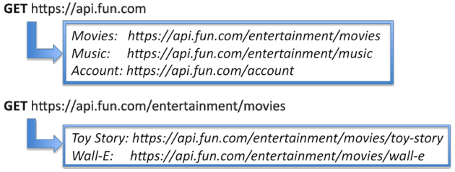
1-Identity
8
Everything identifiable in an application should get a unique global ID
URIs
URIs are consistent naming scheme for resources
Universally recognised standard
Example: companys assign unique product IDs. These can be URIs…
http://www.amazon.co.uk/gp/product/B002BWONF8/
http://example.com/customers/1234 http://example.com/orders/2007/10/776654 http://example.com/products/4554

Slide 9
2 – Linking Things
9
Hypermedia as the engine of application state.
This means the links that make the Web Work
Familiar with this from HTML but not restricted to this…
Any application retrieving the above XML document can “follow” the links to retrieve more information.
Links can be provided by a different application/server/company
naming scheme(URIs) are a global standard, all of the resources that make up the Web can be linked to each other.
Furthermore links allow the client (the service consumer) to move the application from one state to the next by following a link.

Slide 10
3 – Standard Methods
10
how does your browser know what to do with the URI?
every resource supports the same interface, the same set of methods
HTTP verbs: GET, POST, PUT, DELETE, HEAD, OPTIONS
From Object Orientated point of view, it’s like each RESTful Class must extend a Resource object that contains the above methods
Because Web resources use the same interface, you can be sure to get a representation of that resource by using the GET method.

Slide 11
3 – Standard Methods
11
HEAD, GET, OPTIONS are defined as ”safe”
intended only for information retrieval
POST, PUT and DELETE are intended for actions which may cause side effects either on the server
changing of persisted data
HEAD, GET, OPTIONS, PUT and DELETE are defined as Idempotent methods
multiple identical requests should have the same effect as a single request
Post is NOT defined as Idempotent
sending an identical POST request multiple times may further affect state(e.g. financial transactions, ticket purchase)
Ever see “only click once/wait for response/don’t click back” on a web application

Slide 12
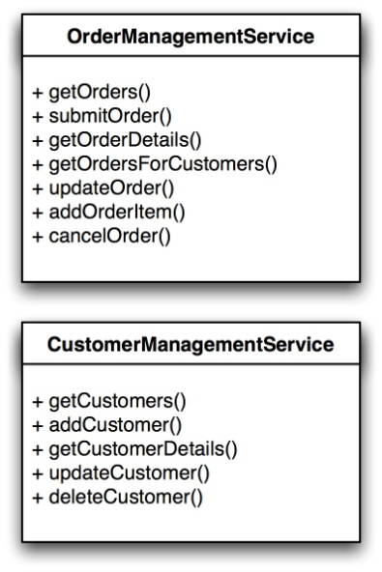
3 – Standard Methods Example
12
Order Management Class Models – standard design
Client needs to be coded against these particular interfaces
Cant use a client that was built before these interfaces were specified

Slide 13
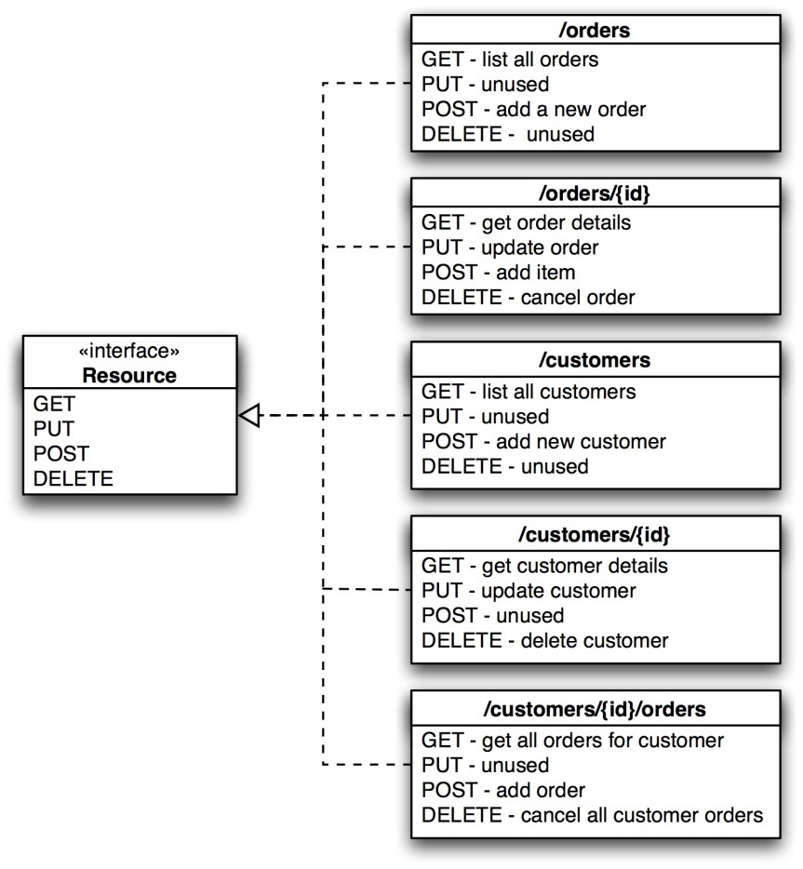
RESTful HTTP Approach
13
Define generic interface that makes up the HTTP application protocol.
Specific operations of the services have been mapped to the standard HTTP methods.
New set of resources created.

Slide 14
Comparison to SOAP-based Services
14
First approach has many operations and many kinds of data and a fixed number of Services
RESTful approach has fixed number of operations, many kinds of data and many objects/Resources to invoke those fixed methods upon.
If there’s 1 million orders in my database it means 1 million additional URIs on the web! So what?
Opting for RESTful approach makes your app inherently part of the Web.
Other approach usually involves one endpoint(URL) for each service, beyond which the methods can be accessed through some higher level protocol(e.g. SOAP)

Slide 15
4 - Multiple Representation
15
How does a client know how to request and deal with the data it retrieves?
Can look at HTTP headers: accept and content-type
HTTP allows separation of concerns between handling the data and invoking operations
Client can specify what data formats it can handle
a client can ask for a representation in a particular format.
GET /customers/1234 HTTP/1.1 Host: example.com Accept: application/json

Slide 16
5 - Stateless Communication
16
REST mandates communication is Stateless
Does not mean that application cannot have state
State must be:
A resource state
Kept on the client
A server should not have to retain the communication state beyond a single request

Slide 17
5 – Stateless Communication
17
Advantages of Stateless Comms:
Scalability. The server does not have to maintain state for each client
Isolation from changes on the server
not dependent on talking to the same server in two consecutive requests. Links from document returned by search engine will still work even if the search engine is shut down.

Slide 18
5 – What’s wrong with State on Servers
18
Remember, ideally software components are stateless.
Example: maintaining login credentials across a cluster of servers (an auto-scaled cluster in amazon).
If Restful, requests should not depend of the ones before
So what if your web server is shut down/drops HTTP connection, what happens to your laptop in your cart if your load balancer redirects next HTTP request to another server???
Could use shared cache that all servers share.
Spread cache across n servers to stop imprisoned session data

Slide 19
Web API Design

Slide 20
API Design
APIs expose functionality of an application or service
Designer must:
Understanding enough of the important details of the application for which an API is to be created,
Model the functionality in an API that addresses all use cases that come up in the real world, following the RESTful principles as closely as possible.

Slide 21
Nouns are good, verbs are bad
Keep your base URL simple and intuitive
2 base URLs per resource
The first URL is for a collection; the second is for a specific element in the collection.
Example
/contacts
/contacts/1234
Keep verbs out of your URLS

Slide 22
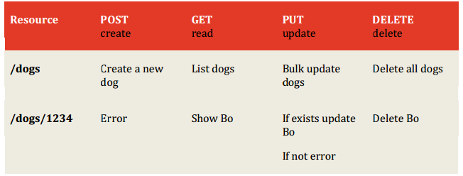
Use the HTTP verbs
We can use the HTTP verbs to manipulate the resources
GET, PUT, POST, DELETE is equivalent to READ, UPDATE, CREATE, DELETE
Rich set of intuitive capability

Slide 23
Rest In Express
Can easily implement REST APIS using express routing functionality
Functionality usually implemented in api routing script
app.get('/dogs', dogs.listAllDogs) app.post('/dogs', dogs.addADog)
app.put('/dogs/:id', dogs.updateDog) app.delete('/dogs/:id', dogs.deleteDog)

Slide 24
Creating Route Modules (Style 1)
server.js
var express = require('express')
var dogs = require('./api/dogs/index');
…
app.get('/dogs', dogs.listAllDogs);
index.js
// GET the homepage
exports.listAllDogs = function(req, res){
…);
};

Slide 25
Creating Route Modules (Style 2)
server.js
// Routes
require('./api/dogs/index')(app);
index.js
/*
* Module dependencies
*/
module.exports = function(app){
// GET home page
app.get('/dogs', function(req, res){
...
});
}

Slide 26
Express Request Object
The req object represents the HTTP request.
by convention, the object is always referred to as 'req', Response is 'res'
Can use it to access the request query string, parameters, body, HTTP headers.
Example:
app.get('/user/:id', function(req, res){
res.send('user ' + req.params.id);
});
Notes:
Req.Param is an abstraction layer for picking up information about a request – it automatically searches:
Query strings
Posted form values
Route values
And will let you pick from what’s available
26

Slide 27
req.body
Contains key-value pairs of data submitted in the request body.
Need body-parsing middleware such as body-parser.
This example shows how to use body-parsing middleware to populate req.body.
var app = require('express')();
var bodyParser = require('body-parser');
var multer = require('multer');
app.use(bodyParser.json()); // for parsing application/json
app.use(bodyParser.urlencoded({ extended: true })); // for parsing application/x-www-form-urlencoded
app.use(multer()); // for parsing multipart/form-data
app.post('/', function (req, res) {
console.log(req.body);
res.json(req.body);
})

Slide 28
Response Object
The res object represents the HTTP response that an Express app sends when it gets an HTTP request.
app.get('/user/:id', function(req, res){ res.send('user ' + req.params.id); });

Slide 29
Response Properties
res.json([body])
Sends a JSON response. This method is identical to res.send() with an object or array as the parameter. res.json({ user: 'tobi' }) res.status(500).json({ error: 'message' })

Slide 30
Response Properties
res.send([body])
Sends the HTTP response.
The body parameter can be a String, an object, or an Array.
For example:
res.send({ some: 'json' });
res.send('<p>some html</p>'); res.status(404).send('Sorry, we cannot find that!');
res.status(500).send({ error: 'something blew up' });

Slide 31
Response Properties
res.format(object)
Performs content-negotiation on the Accept HTTP header on the request object
res.format({
'text/plain': function(){
res.send('hey');
},
'text/html': function(){
res.send('<p>hey</p>');
},
'application/json': function(){
res.send({ message: 'hey' });
},
'default': function() {
// log the request and respond with 406
res.status(406).send('Not Acceptable');
}
});

Slide 32
Express Route Filters
//Catch-all
app.all('/app(/*)?', function(req, res, next) {
if(req.session && req.session.userName) {
next();
} else {
res.redirect('/login?redir=' + req.url);
}
});

Slide 33
Further Reference
ExpressJS.com - Official Express Homepage
Node and Express Tutorial

