Slide 1
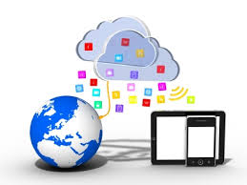
Web Services Development
1. Introduction
Frank Walsh

Slide 2
Agenda
Me
Module Outline
What is a Web Service?
Brief History of Web Services
Current trends in Web Services

Slide 3
Me
Frank Walsh
Room F21
fxwalsh@wit.ie
Contact/message me via Moodle

Slide 4
Module Outline(Tentative)
Introduction to Web Services
Javascript overview
Representational State Transfer
Web APIs
Microservices

Slide 5
Technical Content(Tentative)
Javascript
Node.js
  Express package
NoSQL data stores
  Mongo/Dynamo
Cloud Platforms
  Amazon/Azure/Bluemix

Slide 6
Module Assessment Structure
50% Continuous Assessment
  2 assignments
50% Exam
Content administered via Moodle
All assignment submission though Moodle
Late assignments will be deducted 20% per day.
  Please submit on time
  Extensions only with proper certification.

Slide 7
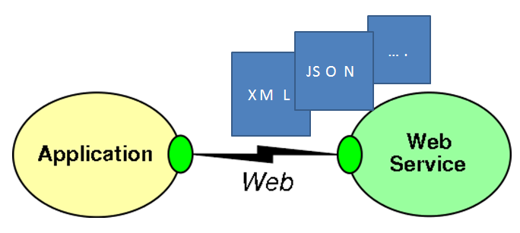
What's a Web Service
Apps that communicate over the World Wide Web(the www)
Characteristics:
  Based on open standards.
  Interoperation between apps running on a varaiety of platforms and devices.
  Web services can be combined to perform more complex processes.

Slide 8

WWW
World Wide Web resulted in simple,
straightforward technologies
Limiting web use to browsers
restricts potential applications
What about using web infrastructure for richer interoperability between clients and servers?
Allows provision of services that integrate several other services
  Even across different organisations

Slide 9
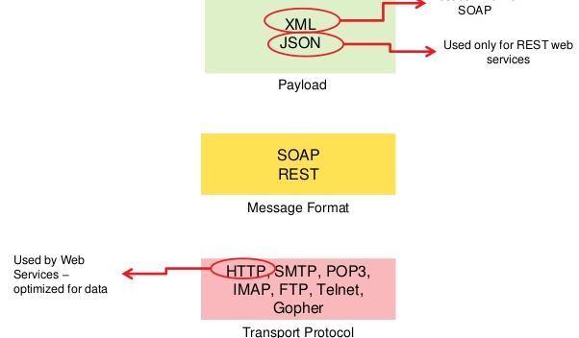
Open Standards
Web Services should “support inter-operable machine-to-machine interaction over a network“ using open protocols
Examples of typical open sandards used in Web Service Development are:
  HTTP
  XML, JSON
  SOAP

Slide 10
Web Service Interoperability
Different languages on different platforms can communicate with each other in a open standards-based way.
  Previously had several proprietry middleware solutions:
    Microsoft Distributed Common Object Model(DCOM)
    CORBA
    Java Remote Method Invocation(RMI)
Helps to address heterogeneity in DS systems.
Component nature of web services promotes flexibility, modularity.

Slide 11
Brief History
Web services evolved from older, legacy technologies used to develop Distributed Systems
  RPC, ORPC (DCOM, CORBA and JAVA RMI)
These old solutions had the following issues:
  Interoperability
  Firewalls
  Complexity

Slide 12
Brief History - Interoperability
Old Distributed systems had interoperability issues because vendor implemented its own proproetry technology for interprocess communciation.
  DCOM apps strictly bound to Windows Operating system.
  RMI bound to Java programming language.

Slide 13
Brief History - Firewalls
Collaboration across organisations was an issue because distributed system middleware such as CORBA and DCOM used non-standard ports.
  Firewalls usually don't like this and will block.
Web Services use HTTP as a transport protocol
  firewalls tend to allow access though port 80 (HTTP), leading to easier cross-organisation collaboration.

Slide 14
Brief History - Middleware
Old middleware technologies such as RMI, COM, and CORBA are all different.
New technologies and languages have to be learnt to implement these services.
  Usually requires specialised “integrators” to deign/implement.
Adds complexity and expense to

Slide 15
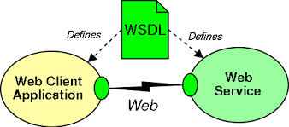
Brief History – XML/Big Web Services
Sometimes known as SOAP-based or XML or WSDL web services (or any combination of).
  Standards based
Typically accessed by software
Access is programmatic unlike access to web resource by browser(if it is in browser it’s via Javascript/AJAX client).
The reason it’s programmatic is that each client of a service must be “coded” to the interface.
Allows description of complex data structuress in request and response
Using XML Schema standard
http://www.w3.org/XML/Schema

Slide 16
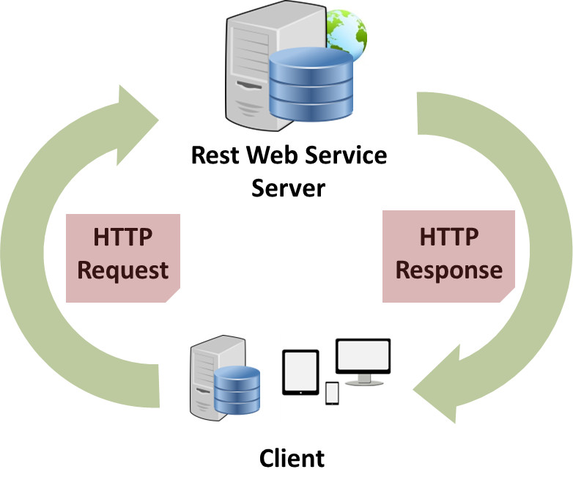
Brief History – RESTful Web Services
Short for REpresentational State Transfer
  A software architecture style for distributed hypermedia systems(WWW)
A set of principles that define how Web standards(HTTP and URIs) can be used.
One “incarnation” of the REST style is HTTP (and a set of related set of standards, such as URI).
  The way the Web’s architecture “should” be used
Coined by Roy Fielding in his PhD thesis
The “right” way to implement heterogeneous
application-to-application communication?...

Slide 17
Web APIs
Web API term used alot to refer to REST-like web services
  Communication done via HTTP
  Nothing much else defined
Trends Web API / REST in tech world.
  “Big Web” Services are seen as inferior to Web APIs for some.
  More complicated to develop and tend to use more resources(Memory/bandwidth.

Slide 18
Bibliography
Java EE tutorial: https://docs.oracle.com/javaee/6/tutorial/doc/gijvh.html
Data Structures - 1. Objects and Classes

