Slide 1
Agile Software Development
MSc in Computer Science
Eamonn de Leastar
edeleastar@wit.ie

Slide 2
Software Paradigms
Agile Software Development

Slide 3
Literate Programmer
Good design and programming is not learned by generalities, but by seeing how significant programs can be made clean, easy to read, easy to maintain and modify, human-engineered, efficient, and reliable, by the application of good design and programming practices. Careful study and imitation of good designs and programs significantly improves development skills.
Kernighan and Plauger

Slide 4
Software Paradigms
"Paradigm" (example in Greek) is commonly used to refer to a category of entities that share a common characteristic.
Taken to mean a conceptual way of describing something
The rate of change in the software discipline has seen numerous paradigms

Slide 5
Popular Paradigms
Procedural Programming
Artificial Intelligence
Knowledge Engineering
Model Driven Development
Domain Driven Development
Object Oriented Programming
Functional Programming
Design Patterns
Agile Methods

Slide 6

Paradigm Structure
Two aspects to a paradigm:
1: Principles and techniques:
Symbolic generalizations: Assertions that are later taken for granted and employed without question
Model beliefs: a commitment to a belief in a model to which the relevant domain conforms
Values
2: Exemplars: shared examples that illustrate the properties of the paradigm.
(Kuhn, “The Structure of Scientific Revolutions”)
http://en.wikipedia.org/wiki/The_Structure_of_Scientific_Revolutions

Slide 7
Paradigms for This Course
Object Oriented Programming
OO Principles (particular SOLID - http://en.wikipedia.org/wiki/SOLID_(object-oriented_design)
Java Programming Language
Xtend Programming Language
Agile Methods
Test Driven Development (TDD)
Automated Build / Configuration Management
Network Programming
HTTP/REST
Sockets

Slide 8
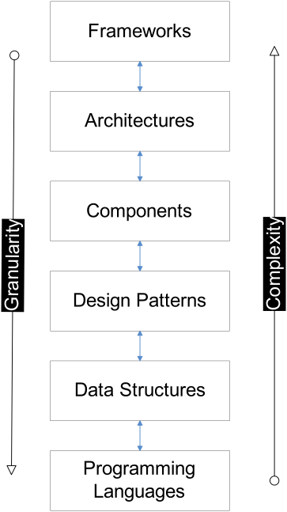
Context

Slide 9
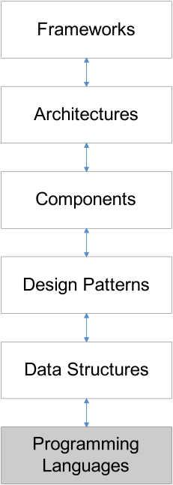
Programming Languages
A programming language is a system of signs used to communicate a task/algorithm to a computer, causing the task to be performed
The task to be performed is called a computation, which follows absolutely precise and unambiguous rules.
Three components:
The syntax of the language is a way of specifying what is legal in the phrase structure of the language; (analogous to knowing how to spell and form sentences English)
The second component is semantics, or meaning, of a program in that language.
Certain idioms that a programmer needs to know to use the language effectively - are usually acquired through practice and experience

Slide 10
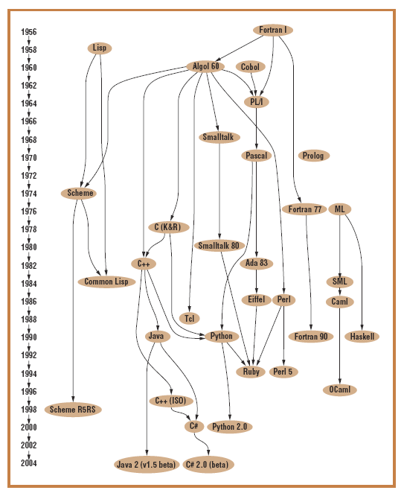
Family Tree
Imperative languages: (Fortran, C, and Ada) enable programmers to express algorithms for solving problems.
Declarative languages, (Lisp, Prolog, Haskell) allow the programmer to specify what has to be computed, but not how the computation is done.
Object Oriented: can be viewed as a hybrid – of declarative (class structures) & imperative (methods) features.

Slide 11
Characteristics of OO Languages
Object-based modular structure.
Data abstraction.
Automatic memory management.
Classes.
Inheritance.
Polymorphism and dynamic binding.
Multiple and repeated inheritance.
(Meyer)

Slide 12
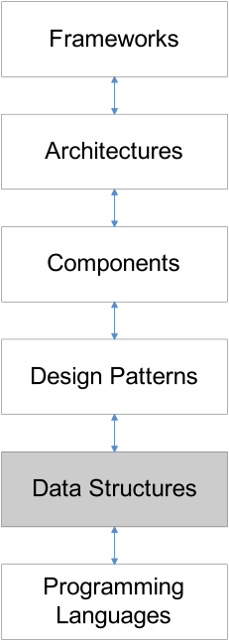
Data Structures & Problems
Typical Data Structures:
Lists, Stacks, Queues, Trees, Heaps
Static and Dynamic implementations
Typical Problem Categories:
Search
Decision
Classification
Generation & Enumeration
Aggregation & Clustering
Sorting
Traversal

Slide 13
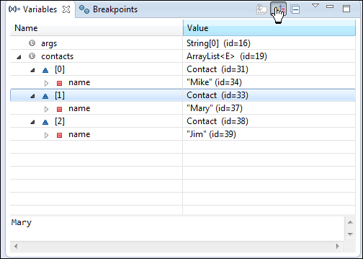
Exploring a Data Structure
public class Contact
{
private String name;
public Contact(String name)
{
this.name = name;
}
public String toString()
{
return name;
}
}
public class Main
{
public static void main(String[] args)
{
List<Contact> contacts = new ArrayList<Contact>();
contacts.add(new Contact("Mike"));
contacts.add(new Contact("Mary"));
contacts.add(new Contact("Jim"));
System.out.println(contacts);
}
}

Slide 14
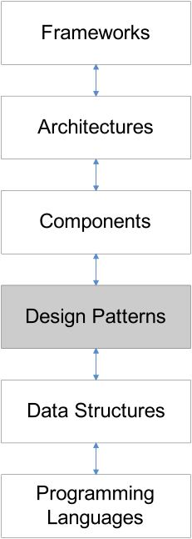
Design Patterns
A design pattern is a proven solution for a general design problem.
It consists of communicating ‘objects’ that are customized to solve the problem in a particular context.
Patterns have their origin in object-oriented programming where they began as collections of objects organized to solve a problem.
There isn't any fundamental relationship between patterns and objects; it just happens they began there.
Patterns may have arisen because objects seem so elemental, but the problems we were trying to solve with them were so complex.

Slide 15
Pattern Levels
Architectural Patterns:
Expresses a fundamental structural organization or schema for software systems. It provides a set of predefined subsystems, specifies their responsibilities, and includes rules and guidelines for organizing the relationships between them.
Design Patterns:
Provides a scheme for refining the subsystems or components of a software system, or the relationships between them. It describes commonly recurring structure of communicating components that solves a general design problem within a particular context.
Idioms:
A low-level pattern specific to a programming language. An idiom describes how to implement particular aspects of components or the relationships between them using the features of the given language.

Slide 16
Exploring a Pattern
public class FileLogger
{
private static FileLogger logger;
private FileLogger()
{
}
public static FileLogger getLogger()
{
if (logger == null)
{
logger = new FileLogger();
}
return logger;
}
public boolean log(String msg)
{
try
{
PrintWriter writer = new PrintWriter(new FileWriter("log.txt", true));
writer.println(msg);
writer.close();
}
catch (FileNotFoundException ex)
{
return (false);
}
catch (IOException ex)
{
return (false);
}
return (true);
}
}

Slide 17
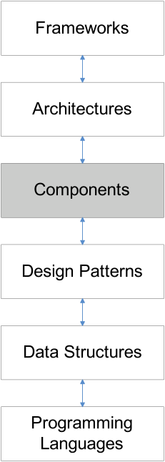
Components
Software components are binary units of:
independent production,
acquisition,
deployment
that interact to form a functioning program. (Szyperski)
Emphasis has on reusable units
A component must be compatible and interoperate with a whole range of other components.
Two main issues arise with respect to interoperability information:
How to express interoperability information
How to publish this information

Slide 18
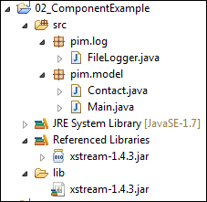
Exploring a Component )
public class Main
{
public static void main(String[] args) throws IOException
{
FileLogger logger = FileLogger.getLogger();
logger.log("Creating contact list");
List<Contact> contacts = new ArrayList<Contact>();
logger.log("Adding contacts");
contacts.add(new Contact("Mike"));
contacts.add(new Contact("Mary"));
contacts.add(new Contact("Jim"));
System.out.println(contacts);
logger.log("Serializing contacts to XML");
XStream xstream = new XStream(new DomDriver());
ObjectOutputStream out = xstream.createObjectOutputStream
(new FileWriter("contacts.xml"));
out.writeObject(contacts);
out.close();
logger.log("Finished - shutting down");
}
}
<object-stream>
<list>
<pim.model.Contact>
<name>Mike</name>
</pim.model.Contact>
<pim.model.Contact>
<name>Mary</name>
</pim.model.Contact>
<pim.model.Contact>
<name>Jim</name>
</pim.model.Contact>
</list>
</object-stream>

Slide 19
More Component Definitions
"A component is a nontrivial, nearly independent, and replaceable part of a system that fulfills a clear function in the context of a well-defined architecture. A component conforms to and provides the physical realization of a set of interfaces." (Philippe Krutchen, Rational Software)
"A runtime software component is a dynamically bindable package of one or more programs managed as a unit and accessed through documented interfaces that can be discovered at runtime." (Gartner Group)
"A component is a physical and replaceable part of a system that conforms to and provides the realization of a set of interfaces...typically represents the physical packaging of otherwise logical elements, such as classes, interfaces, and collaborations." (Grady Booch, Jim Rumbaugh, Ivar Jacobson, The UML User Guide, p. 343)

Slide 20
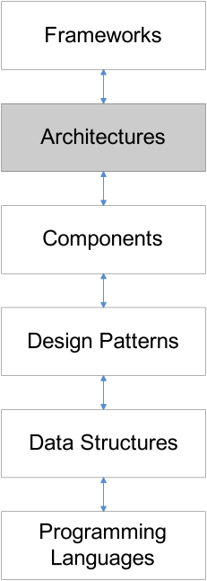
Architecture
The software architecture of a program or computing system is:
the structure or structures of the system, which comprise software components,
the externally visible properties of those components, and
the a set of rules that govern relationships among them.
An architectural style is a family of software architectures, defining types of components and types of connections, and rules describing how to combine them.
A software architecture is an instantiation of an architectural style for a certain system. The components and connections may be decomposed into architectures themselves.

Slide 21
Architectural Styles
Batch
Pipe & Filter
Client/Server
Blackboard
Event Driven
Plug-in
Space Based (Tuples)
Three-Tier
Network
Data Flow
Replication
Hierarchal
Mobile Code
Peer to Peer

Slide 22
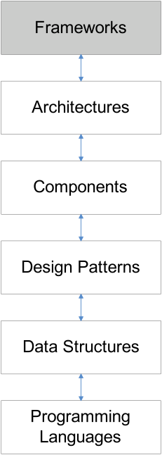
Frameworks
A framework is a set of related components which you specialize, integrate and/or instantiate to implement an application or subsystem
Usually, a semi complete application containing dynamic and static components that can be customized to produce applications
Frameworks are targeted for a particular application domain & consists of a set of classes (abstract & concrete), whose instances:
collaborate
are intended to be extended, i.e. reused (abstract design)
do not have to address a complete application domain (allowing for composition of frameworks)
Emphasize stable parts of the domain and their relationships and interactions

Slide 23
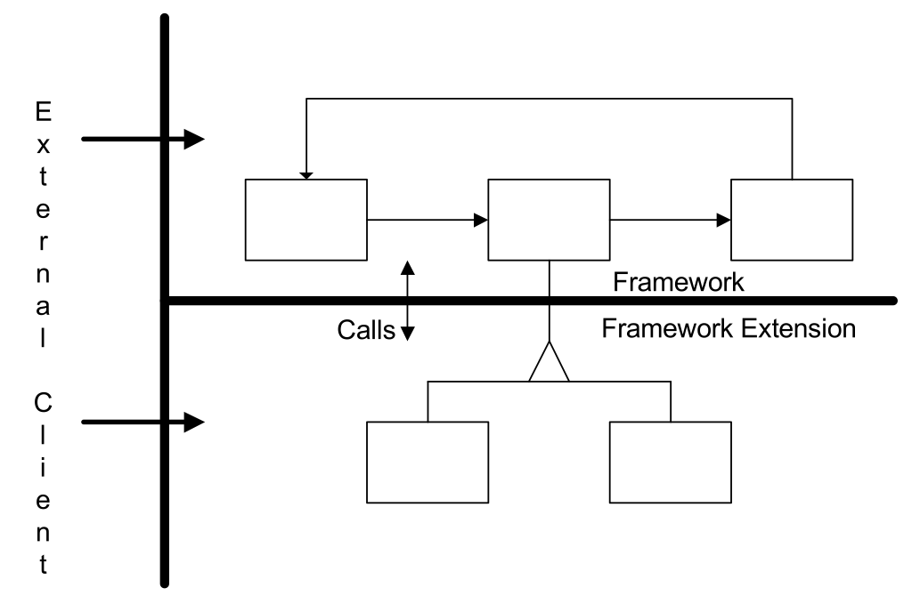
Framework Structure

Slide 24
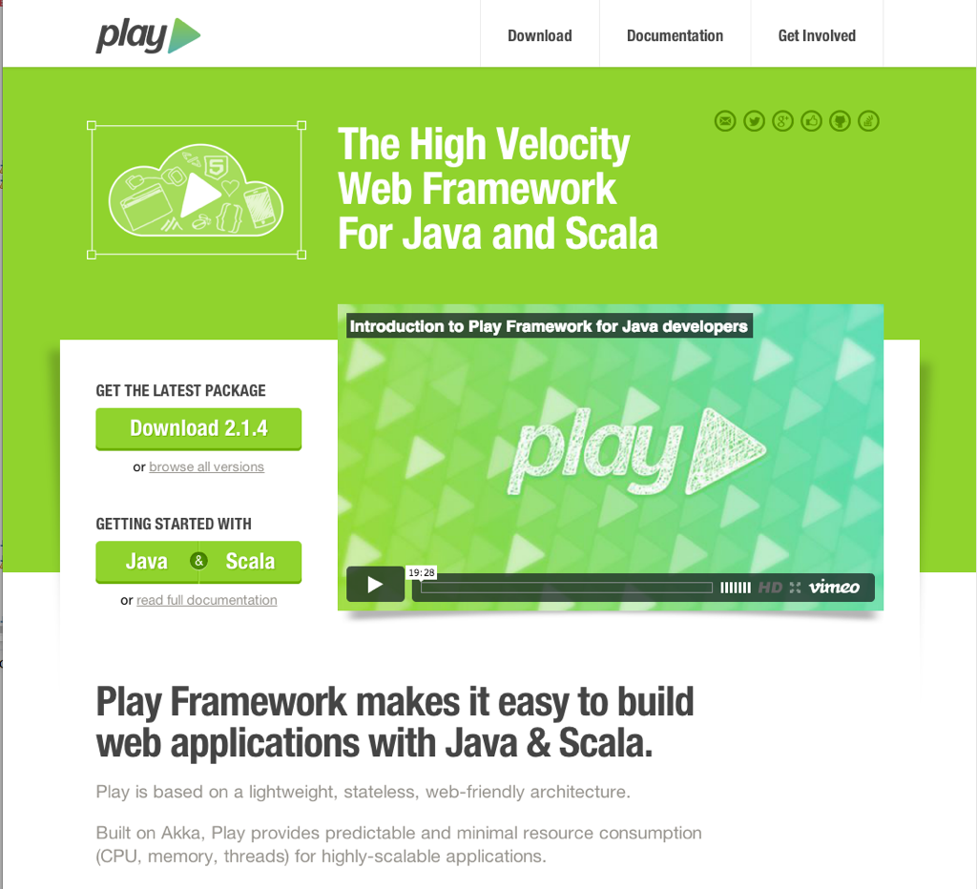
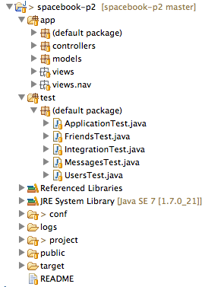
Framework Example

Slide 25
Agile Software Development Module
Assumptions:
General Programming Ability (not necessarily java)
Focus for this course:
SOLID Principles within OO Programming
Test Driven Software Development in Java
Effective Build Processes
Network Programming
Future and Beyond Java

