Slide 1
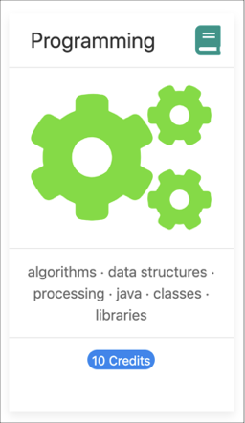

Programming Fundamentals
An Introduction to the module
Produced by:
Mr. Colm Dunphy
Dr. Siobhán Drohan
Department of Computing and Mathematics
http://www.wit.ie/

Slide 2
Agenda
Lecturers / Tutors
Module Structure & Delivery
Technologies
Module Assessment (Assignments)
Troubleshooting Labs
Ethos

Slide 3


Introducing your lecturers / tutors
Colm Dunphy
Profile:https://www.wit.ie/about_wit/contact_us/staff_directory/colm_dunphy
Email:cdunphy@wit.ie
Patrick Felicia
Profile:https://www.wit.ie/about_wit/contact_us/staff_directory/patrick_felicia
Email: pfelicia@wit.ie
Jonathan Brazil
Profile:https://www.wit.ie/about_wit/contact_us/staff_directory/colm_dunphy
Email: jbrazil@wit.ie

Slide 4
Module Structure
12 weeks of delivery
2 *Lectures / Talks (webinar/video)
2 * Labs
Mon Tues
Wed Thurs
Mon 12:15 – 2:00
Wed 12:15 – 2:00
Lab Support on Slack
within 24 hours M-F
* Double Module (10 credits)

Slide 5



Learning Technologies
Notes:
These technologies are used to deliver the course

Slide 6



Programming Technologies
Notes:
These technologies are the software development technologies/approaches that we will teach in the course.

Slide 7
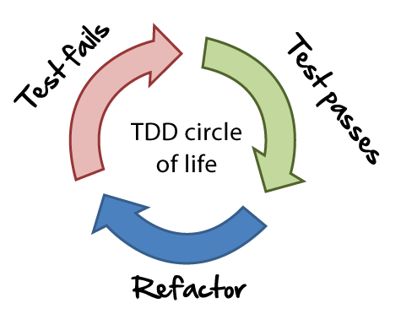


Programming Technologies
Notes:
These technologies are the software development technologies/approaches that we will teach in the course.

Slide 8
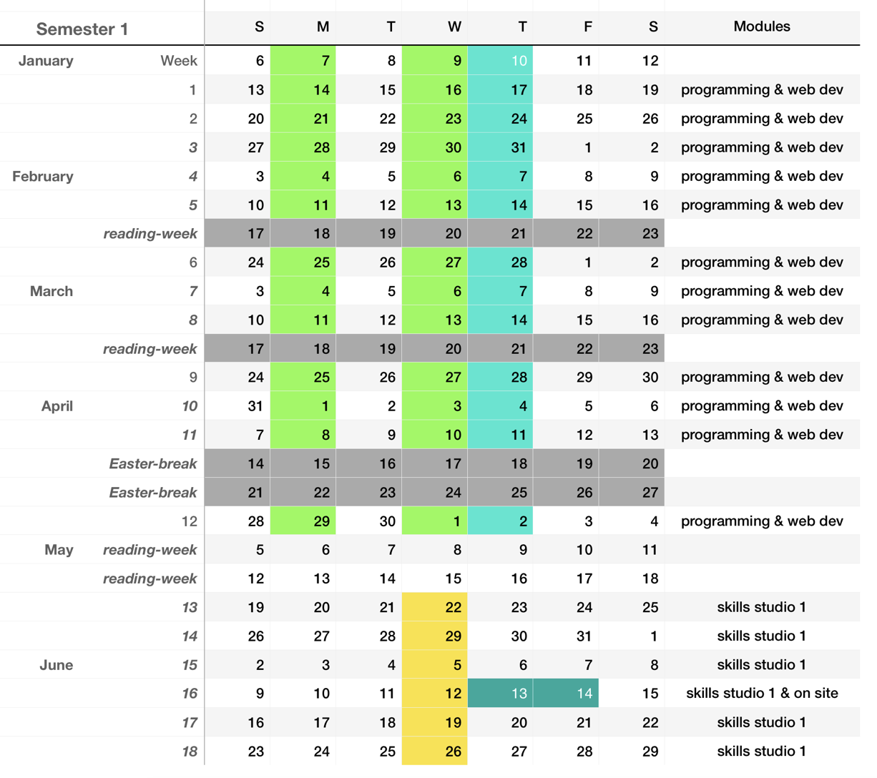

Slide 9
Week | Lecture
1 | Intro to Processing
 | Animate your Drawings
2 | If statement and Events
 | Iteration (for and while)
3 | Methods
 | More on Methods
4 | Strings and Intro to Classes
 | Classes and Encapsulation
5 | Swing (JOptionPane) and Arrays
 | Arrays and Classes
6 | Pong Intro
 | Pong Solutions
Week | Lecture
7 | IntelliJ, JVM and I/O
8 | Grouping Objects (ArrayLists)
9 | Menu and CRUD
10 | Persistence (XML) and Exceptions
11 | Inheritance and Polymorphism
12 | Collections (Map and Set)
Notes:
IDE – Integrated Development Environment

Slide 10
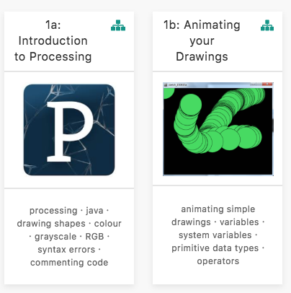
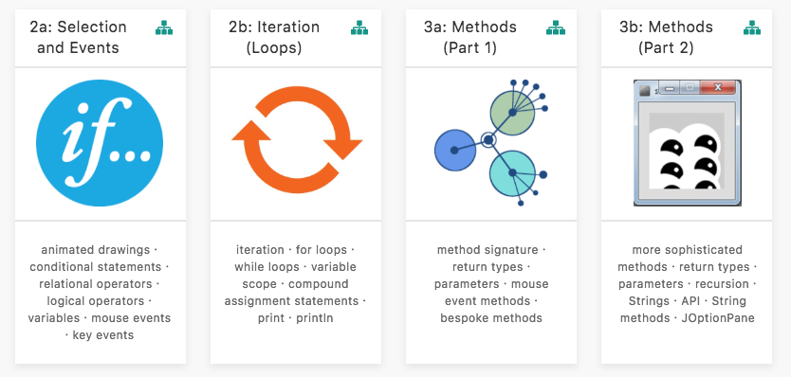
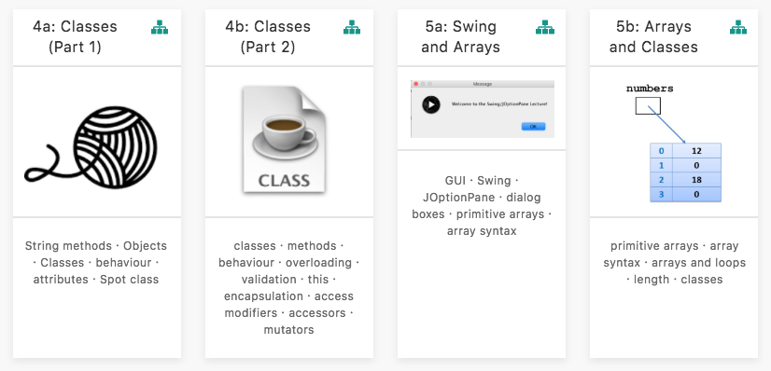
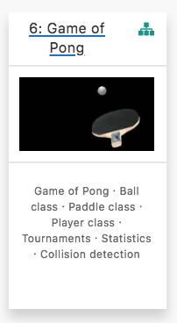
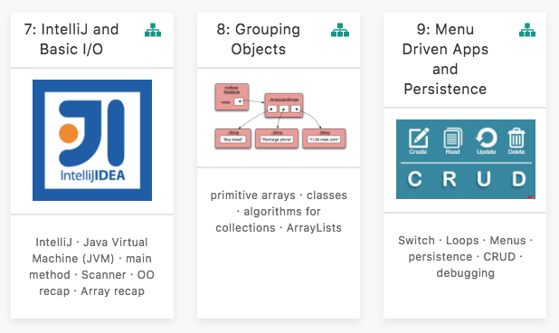
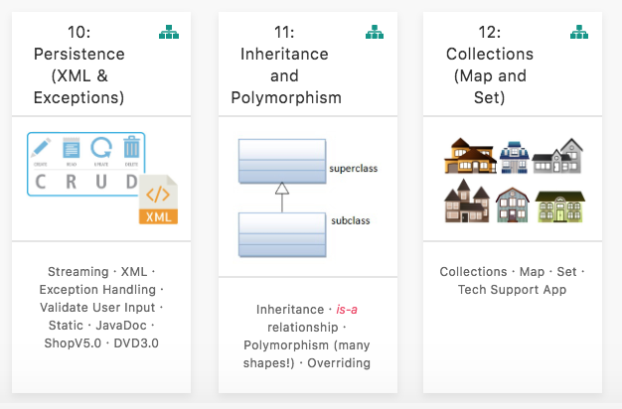
Assignment 1
(P1)
Assignment 2
(P2)
Assignment 3
(P3)

Slide 11
ASSESSMENT
P1 – 15%
P2 - 30%
% reflects difficulty and time required
P3 – 55%

Slide 12
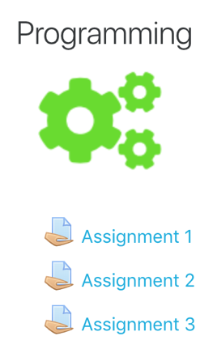
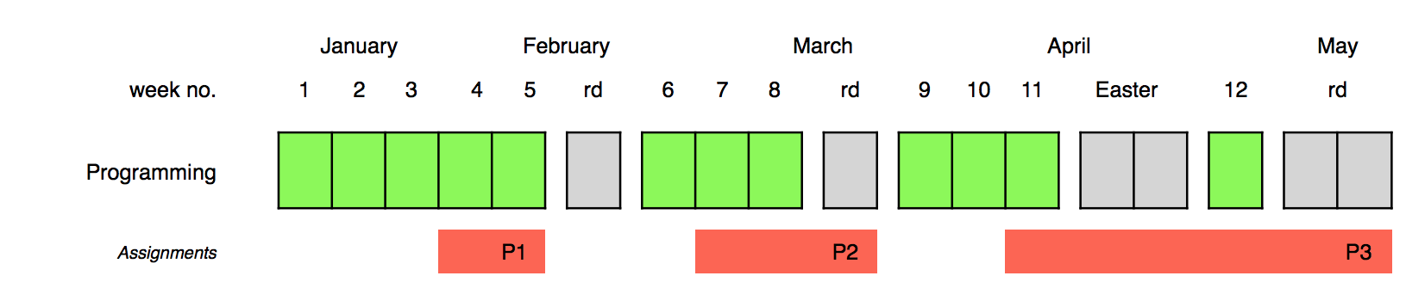

Assignments
Online Interviews / Demos

Slide 13
Assignments
100% Continuous Assessment (CA).
All Individual assignments
(no team-based ones).
Submit via Moodle assignment dropboxes.
Hard deadlines; extensions only permitted if mitigating circumstances apply.
Interviews
Notes:
As programming is a brand new topic to most students, we weight the majority of marks towards the end of the module. This gives students a chance to learn this new field, without compromising their grade.

Slide 14
Troubleshooting labs ...during the lab sessions
Post the issue in Slack; think of it as asking a question in a traditional classroom. Include any screen shots, screen recordings, etc. you think might help with solving the problem.
We encourage classmates to help each other (peer learning), if you know the answer to another student’s issue, please do respond.
All our responses will be via Slack so that all students can see the resolution. for private issues, use DM in Slack

Slide 15
Troubleshooting labs …outside of the lab sessions
Search #Slack Chatroom
Check Google / StackOverflow (or equivalent) for possible solution
Post the issue on #Slack programming channel

Slide 16
Ethos
Self-directed learning outside of lectures / labs.
Inquisitive and motivated.
Help your peers (use #Slack!).
Engagement and staying current with the module.
All work submitted must be your own work.
all code/approaches given in the module by us can be re-used / re-purposed in your assignments.

Slide 17
Introduction to Processing

Slide 18
What is Processing?
“Processing is a programming language,
development environment,
and online community.”
Source: https://processing.org/
Examples:
http://www.openprocessing.org/browse/

Slide 19
Processing…
…can be used to develop static or interactive online material
and data visualisations.
…is often used by visual artists.
…produces visual and interactive representations of programming code.

Slide 20
What is Processing?
Different programming languages can be used with Processing e.g. :
Java: we will use this language.
JavaScript
Python
CoffeeScript
Etc.

Slide 21
Why are we using Processing?
Processing is increasingly used
to teach computer
programming fundamentals (https://processing.org/overview/)
Notes:
Can visually the result of your programming code.
Visual confirmation that your code is correct.
Little “ceremony” around getting a piece of code to work…simple IDE and you can have a program with only one line of code if you wish.
Helps with understanding flow of control e.g. sequence, selection (if), iteration (loops)

Slide 22
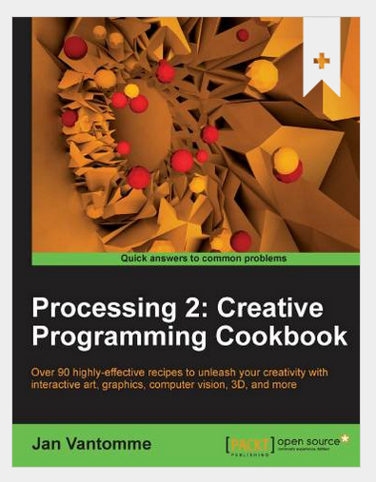
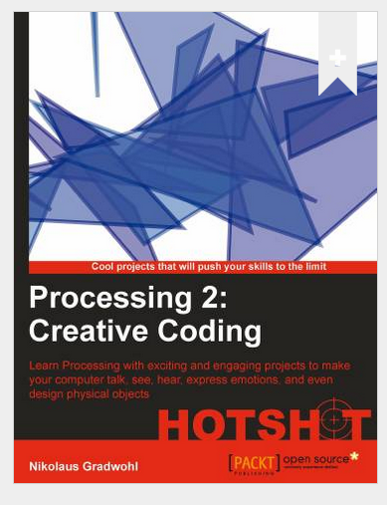
Some eBooks in WIT library

Slide 23
We will start coding in Processing in the afternoon session
Notes:
We are using version 3

Slide 24

Questions?

