Slide 1

Programming Fundamentals
An Introduction to the module
Produced by:
Dr. Siobhán Drohan
Mr. Colm Dunphy
Mr. Diarmuid O’ Connor
Department of Computing and Mathematics
http://www.wit.ie/

Slide 2
Agenda
Module Structure / Approach:
Introducing your lecturers
Structure of the module
Troubleshooting labs
Module assessment
Ethos

Slide 3
Introducing your lecturers
Colm Dunphy
Profile:https://www.wit.ie/about_wit/contact_us/staff_directory/colm_dunphy
Email:cdunphy@wit.ie
Diarmuid O’Connor
Profile:https://www.wit.ie/about_wit/contact_us/staff_directory/diarmuid-oconnor
Email: doconnor@wit.ie

Slide 4
Structure of the module
12 weeks of delivery
Lectures
Labs
Tues (A) 12:15 - 1:45
Thurs(A) 10:45 - 12:15
Mon 12:15 – 2:00
Wed 12:15 – 2:00
Tues (B) 1:45 -3:15
Fri (B) 10:45 - 12:15

Slide 5




Structure of the module
Notes:
These technologies are used to deliver the course

Slide 6



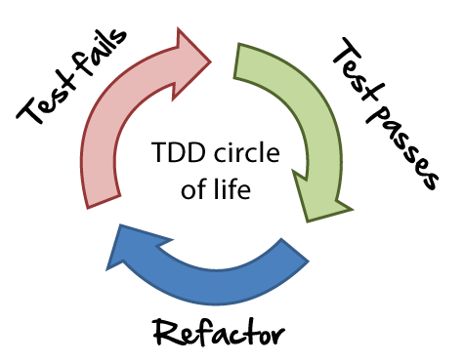


Structure of the module
Notes:
These technologies are the software development technologies/approaches that we will teach in the course.

Slide 7
Week Starting… | Topic | IDE | Assessment (100% CA)
Week 1 (22nd Jan) | Static and Animated Drawings, Sequence, Data Types | Processing
Week 2 (29th Jan) | Selection (if), Iteration (loops), Events | Processing
Week 3 (5th Feb) | Using and Writing Methods | Processing
Week 4 (12th Feb) | Strings, Classes, Objects | Processing | Assign 1 (20%) released
MIDTERM (19th Feb) | MIDTERM | MIDTERM
Week 5 (26th Feb) | Primitive Arrays | Processing
Week 6 (5th March) | Primitive Arrays and More on Classes | Processing | Assignment 1 due Sunday
Week 7 (12th March) | Building the Game of Pong | Processing | Assign 2 (40%) released
Week 8 (19th March) | IntelliJ, Basic I/O, Array Recap, | IntelliJ
EASTER (26th March) | EASTER HOLIDAYS | EASTER
EASTER (2nd April) | EASTER HOLIDAYS | EASTER
Week 9 (9th April) | Collections (ArrayList) | IntelliJ | Assign 2 due Sunday
Week 10 (16th April) | Collections (ArrayList continued), Menu Driven Apps, | IntelliJ | Assign 3 (40%) released
Week 11 (23rd April) | Persistence | IntelliJ
Week 12 (30th April) | XML, Exceptions, Collections (Maps, Sets) | IntelliJ | Assign 3 due Sun 20th May
Notes:
IDE – Integrated Development Environment

Slide 8
Assignment structure
100% Continuous Assessment (CA).
3 assignments:
Assignment 1 (30%) – due Sunday 18th March, 5PM
Assignment 2 (20%) – due Sunday 15th April, 5PM
Assignment 3 (50%) – due Sunday 20th May, 5PM
Hard deadlines; extensions only permitted if mitigating circumstances apply.
Individual assignments (no team-based ones).
Submit via Moodle assignment dropboxes.
Notes:
As programming is a brand new topic to most students, we weight the majority of marks towards the end of the module. This gives students a chance to learn this new field, without compromising their grade.

Slide 9
Troubleshooting labs ...during the lab sessions
Post the issue in Slack; think of it as asking a question in a traditional classroom. Include any screen shots, screen recordings, etc you think might help solve the problem.
We encourage classmates to help each other, so if you know the answer to another student’s issue, please do respond.
All our responses will be via Slack so that all students can see the resolution.
Note: for private issues, chat is also possible with us privately in Slack (or email).

Slide 10
Troubleshooting labs …outside of the lab sessions
Search Slack Chatroom
Check Google / StackOverflow (or equivalent) for possible solution
Post the issue in Slack Chatroom

Slide 11
Ethos
Self-directed learning outside of lectures / labs.
Inquisitive and motivated.
Helpful to peers.
Engagement and staying current with the module.
All work submitted must be your own work.
Note: all code/approaches given in the module by us can be re-used / re-purposed in your assignments.

Slide 12
Introduction to Processing

Slide 13
What is Processing?
“Processing is a programming language,
development environment,
and online community.”
Source: https://processing.org/
Some online examples developed using Processing:
http://www.thesheepmarket.com/
http://balldroppings.com/js/
http://www.openprocessing.org/browse/

Slide 14
What is Processing?
Processing…
…can be used to develop static or interactive online material and data visualisations.
…is often used by visual artists.
…produces visual and interactive representations of programming code.

Slide 15
What is Processing?
Different programming languages can be used with Processing e.g. :
Java: we will use this language.
JavaScript
Python
CoffeeScript
Etc.

Slide 16
Why are we using Processing?
Processing is increasingly used
to teach computer
programming fundamentals (https://processing.org/overview/)
Notes:
Can visually the result of your programming code.
Visual confirmation that your code is correct.
Little “ceremony” around getting a piece of code to work…simple IDE and you can have a program with only one line of code if you wish.
Helps with understanding flow of control e.g. sequence, selection (if), iteration (loops)

Slide 17
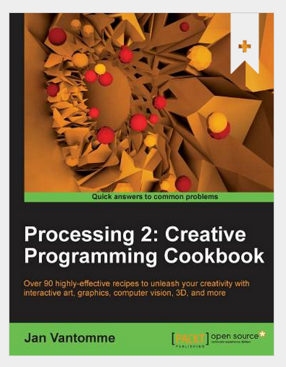
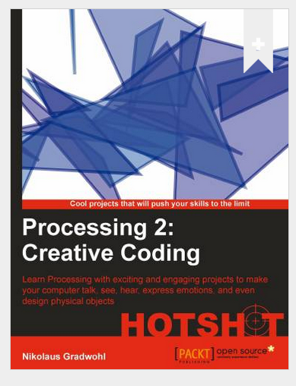
Some eBooks in WIT library

Slide 18
We will start coding in Processing in the afternoon session
Notes:
We are using version 3

Slide 19

Questions?

