Slide 1
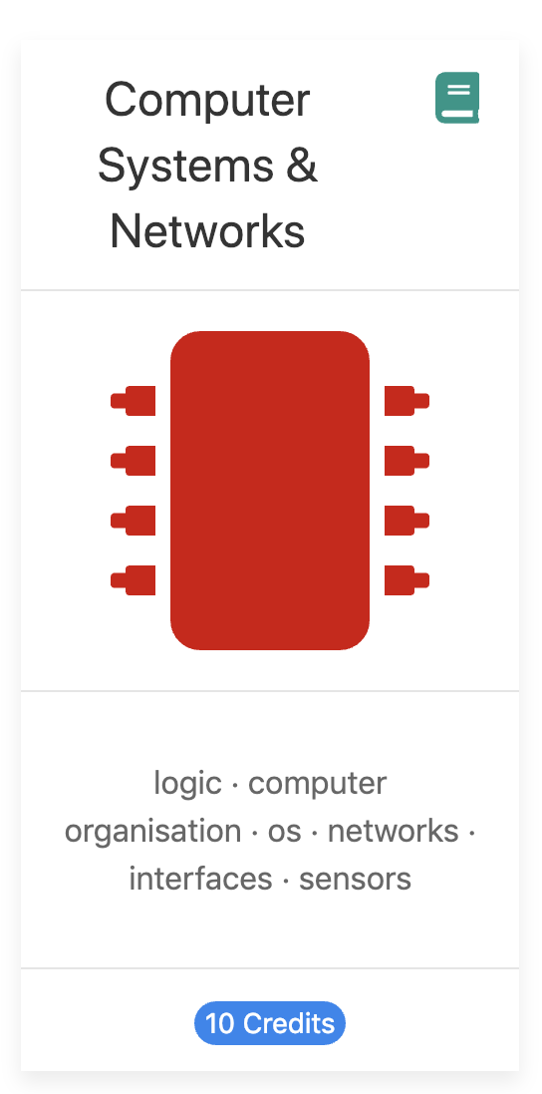
Computer Systems & Networks An overview
Frank Walsh

Slide 2
Agenda
Main Topics
Computer Systems & Architecture
Operating Systems
Communication Networks
Cloud Platforms
Tools and technologies
Ethos

Slide 3
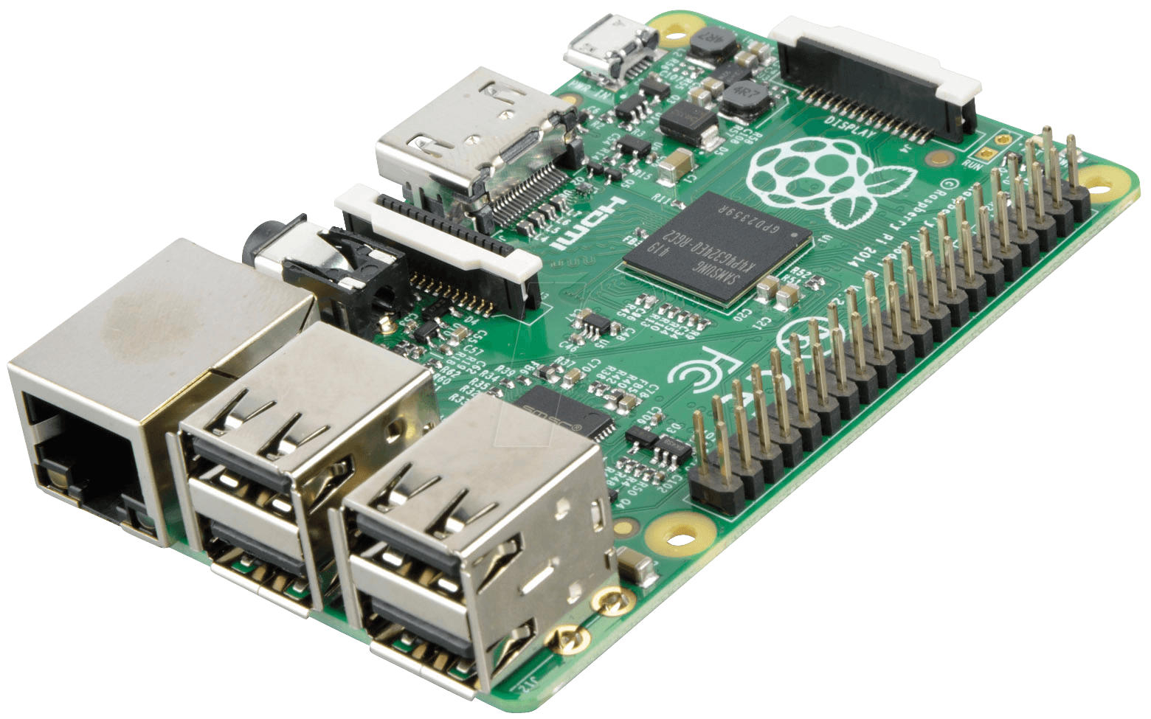



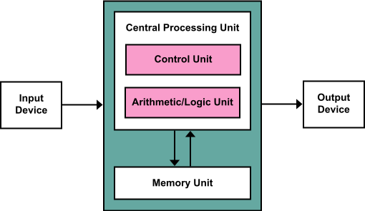
Main Topics

Slide 4


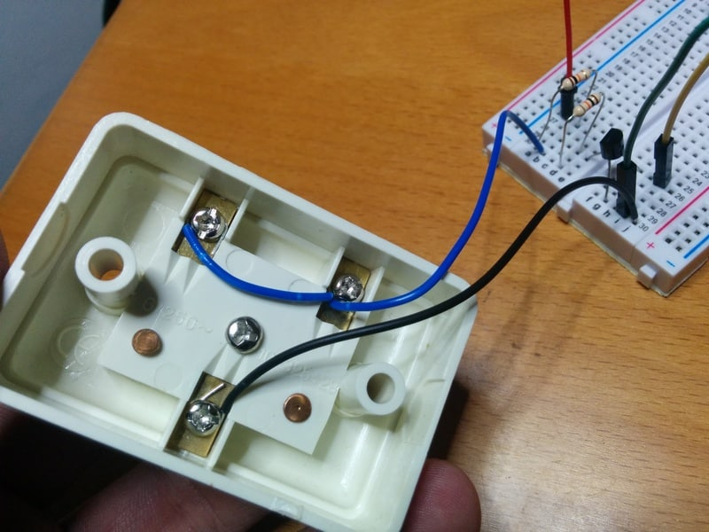
Tools and Technologies (tentative)

Slide 5

Ethos
Module will encourage “permissionless innovation”
Encourage the inclusion and experimentation of various devices and technologies
Lab programme will focus on particular devices/platforms
However feel free to connect and incorporate your own personal devices in assignments

