Slide 1

Unit Test Examples
Eamonn de Leastar (edeleastar@wit.ie)
Produced
by:
Department of Computing and Mathematics
http://www.wit.ie/

Slide 2
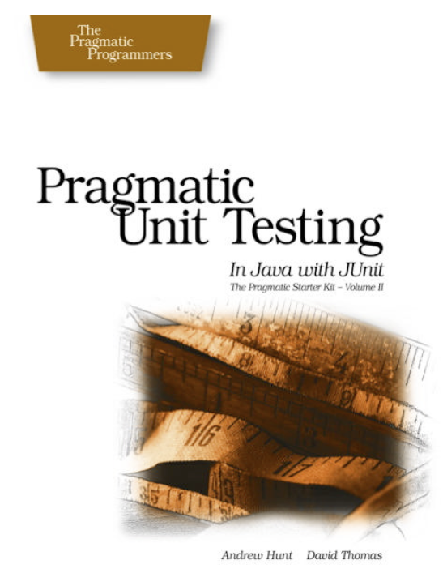
Some Unit Test Examples
VideoPlayer

Slide 3
VideoPlayer Specification
Implementations will provide methods to control a VCR or tape deck.
There's the notion of a current position that lies somewhere between the beginning of tape (considered to be zero) and the end of tape - considered to be the tape duration in seconds.
public interface VideoPlayer
{
public void fastForward (int seconds);
public void rewind (int seconds);
public int currentTimePosition ();
public void markTimePosition (String name);
public void gotoMark (String name);
}
You can ask for the current position and move from there to another given position. Fast-forward moves from current position toward end by some amount. Rewind moves from current position toward the beginning by some amount. When tapes are first loaded, they are positioned at beginning automatically.
A "Mark" can be established at any location - and this is remembered by the player. Going to a mark should make the location of the mark the current position.

Slide 4
VideoPlayer
public class VideoPlayerImpl implements VideoPlayer
{
private int duration;
private int currentPosition;
private Map<String, Integer> marks;
public VideoPlayerImpl(int length)
{
this.duration = length;
marks = new HashMap<String, Integer>();
}
public int currentTimePosition ()
{
return currentPosition;
}
public void gotoMark (String name)
{ }
public void markTimePosition (String name)
{ }
public void rewind (int seconds)
{ }
public void fastForward (int seconds)
{ }
}
Initial implementation....
the System Under Test (SUT)

Slide 5
Test Case Specifications
Verify that the initial position is 0.
Fast forward by some allowed amount (not past end of tape), then rewind by same amount. Should be at initial location.
Rewind by some allowed amount amount (not past beginning of tape), then fast forward by same amount. Should be at initial location.
Fast forward past end of tape, then rewind by same amount. Should be before the initial location by an appropriate amount to reflect the fact that you can't advance the location past the end of tape.
Try the same thing in the other direction (rewind past beginning of tape).
Mark various positions and return to them after moving the current position around.
Mark a position and return to it without moving in between

Slide 6
Test Fixture
public class VideoPlayerTest
{
private VideoPlayer editor;
@Before
public void setUp() throws Exception
{
editor = new VideoPlayerImpl(100);
}
@After
public void tearDown() throws Exception
{
editor = null;
}
...

Slide 7
1.
(Test)
@Test
public void testBOT()
{
assertEquals(0, editor.currentTimePosition());
}
Verify that the initial position is 0
public class VideoPlayerImpl implements VideoPlayer
{
private int duration;
private int currentPosition;
private Map<String, Integer> marks;
public VideoPlayerImpl(int length)
{
this.duration = length;
marks = new HashMap<String, Integer>();
}
public int currentTimePosition ()
{
return currentPosition;
}
(SUT)

Slide 8
2.
(Test)
@Before
public void setUp() throws Exception
{
editor = new VideoPlayerImpl(100);
}
@Test
public void testFF()
{
editor.fastForward(30);
editor.rewind(30);
assertEquals(0, editor.currentTimePosition());
}
Fast forward by some allowed amount (not past end of tape), then rewind by same amount. Should be at initial location.
public void rewind (int seconds)
{
currentPosition -= seconds;
}
public void fastForward (int seconds)
{
currentPosition += seconds;
}
(SUT)

Slide 9
3.
(Test)
@Before
public void setUp() throws Exception
{
editor = new VideoPlayerImpl(100);
}
@Test
public void testRewind()
{
editor.fastForward(30);
editor.rewind(20);
editor.fastForward(20);
assertEquals(30, editor.currentTimePosition());
}
Rewind by some allowed amount (not past beginning of tape), then fast forward by same amount. Should be at initial location.
public void rewind (int seconds)
{
currentPosition -= seconds;
}
public void fastForward (int seconds)
{
currentPosition += seconds;
}
(SUT)

Slide 10
4.
(Test)
@Before
public void setUp() throws Exception
{
editor = new VideoPlayerImpl(100);
}
@Test
public void testFFBeyondEnd()
{
editor.fastForward(50);
editor.fastForward(60);
editor.rewind(60);
assertEquals(40, editor.currentTimePosition());
}
Fast forward past end of tape, then rewind by same amount.
Should be before the initial location by an appropriate amount to reflect the fact that you can't advance the location past the end of tape.
public void fastForward (int seconds)
{
if ((currentPosition + seconds) < duration)
{
currentPosition += seconds;
}
else
{
currentPosition = 100;
}
}
public void fastForward (int seconds)
{
currentPosition += seconds;
}
(SUT)

Slide 11
5
(Test)
@Before
public void setUp() throws Exception
{
editor = new VideoPlayerImpl(100);
}
@Test
public void testRewindBeyondStart()
{
editor.fastForward(50);
editor.rewind(60);
editor.fastForward(60);
assertEquals(60, editor.currentTimePosition());
}
Try the same thing in the other direction (rewind past beginning of tape).
public void rewind (int seconds)
{
if ((currentPosition - seconds) >= 0)
{
currentPosition -= seconds;
}
else
{
currentPosition = 0;
}
}
public void rewind (int seconds)
{
currentPosition -= seconds;
}
(SUT)

Slide 12
6,7
(Test)
@Test
public void testMark()
{
editor.fastForward(30);
editor.markTimePosition("one");
editor.fastForward(30);
editor.markTimePosition("two");
editor.gotoMark("one");
assertEquals(30, editor.currentTimePosition());
editor.gotoMark("two");
assertEquals(60, editor.currentTimePosition());
}
Mark various positions and return to them after moving the current position around.
Mark a position and return to it without moving in between.
public void gotoMark (String name)
{
if (marks.containsKey(name))
{
currentPosition = marks.get(name);
}
}
public void markTimePosition (String name)
{
marks.put(name, currentPosition);
}
(SUT)

