Slide 1

ReactJS.
The Component model (Contd)

Slide 2
Topics
Hooks and Component Lifecycle.
Data Flow patterns – Data Down, Action Up pattern. 
The Virtual DOM

Slide 3
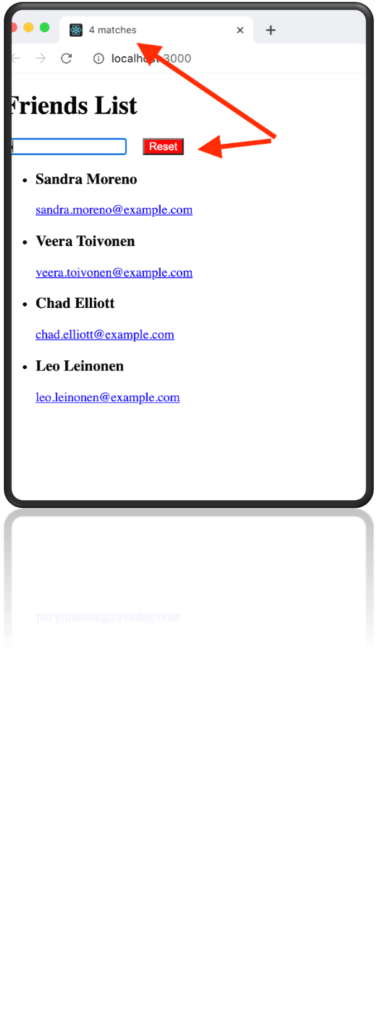
Sample App 1 – Version 2
App UI changes:
  A ‘Reset’ button – loads a new list of friends (overwriting the current list).
  Browser tab title - shows # of matching friends (side effect).
Ref. lecture archive for source code

Slide 4
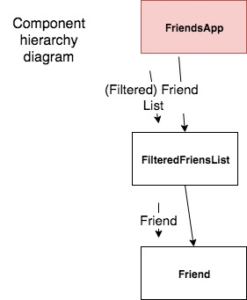
Sample App 1 (v2) - Design
3 state variables:
  List of friends from API.
  Text box content.
  Reset button toggle.
2 side effects, both with dependency arrays:
  ‘Fetch API data’ - reset button toggle dependency.
  ‘Set browser tab title’ - matching list length dependency.

Slide 5
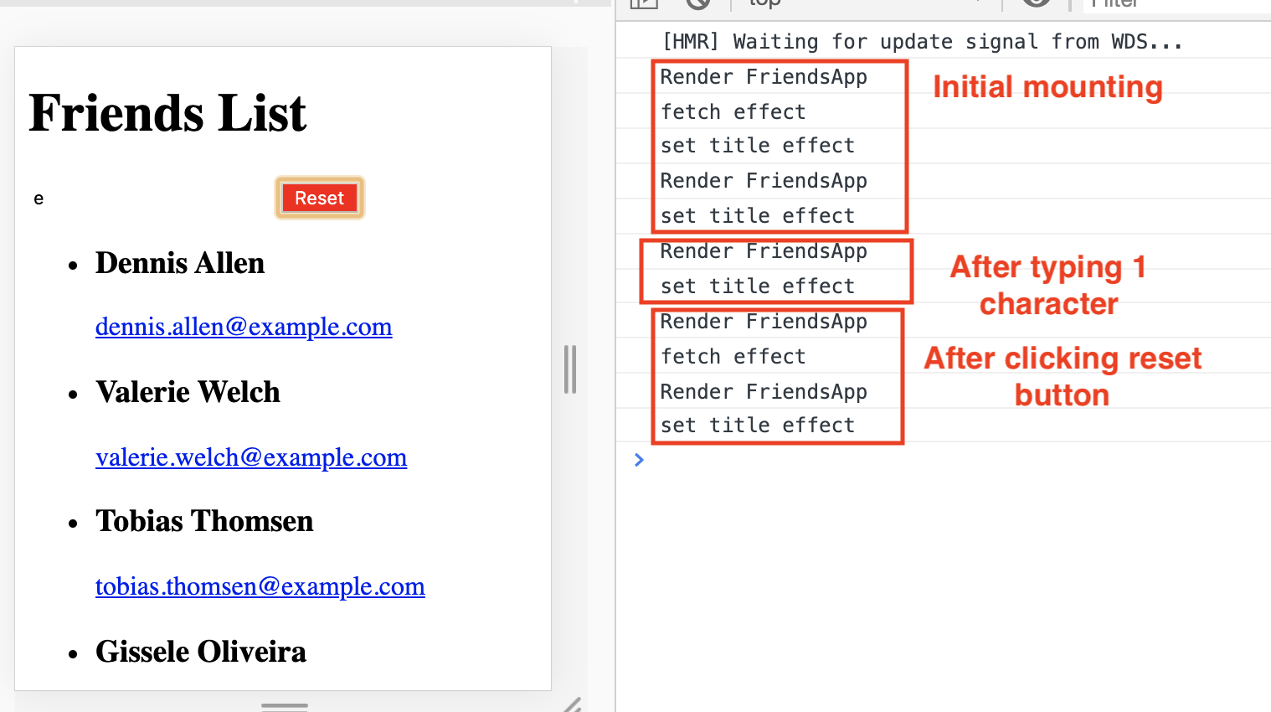
Sample App 1 (v2) - Events

Slide 6
Sample App 1 (v2) - Events.
On mounting of FriensApp component:
    Both effects execute (Set browser tab to ’0 matches’).
    ‘Fetch data’ effect initializes ‘friends list’ state.
    Component re-renders → ‘Set browser tab’ effect executes.
On typing a character in the text box:
    ‘Text box’ state changes.
    FriendsApp rerenders + recomputes matching friends list
    ‘Set browser title’ effect executes.
On clicking Reset button:
    ‘Reset toggle’ state changes.
    FriendsApp re-renders.
    ‘Fetch data’ effect executes.
    ‘Friends list’ state changes.
    FriendsApp re-renders + recomputes matching list
    ‘Set browser title’ effect executes.

Slide 7
Topics
Hooks and Component Lifecycle.
Data Flow patterns – Data Down, Action Up pattern. 
The Virtual DOM

Slide 8
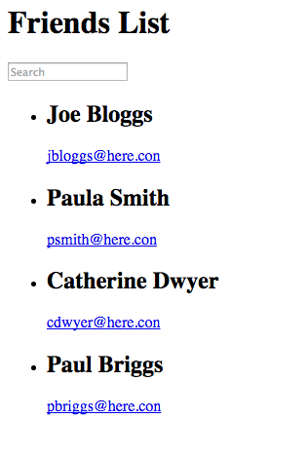
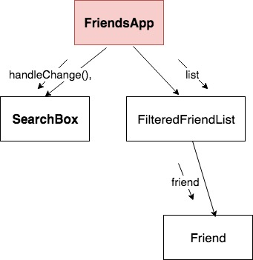
Sample App 2
(Data down, actions up pattern or Inverse data flow pattern )
Often a component’s state change is caused by an event in a subordinate component.
Solution: Use the data down, action up pattern.

Slide 9
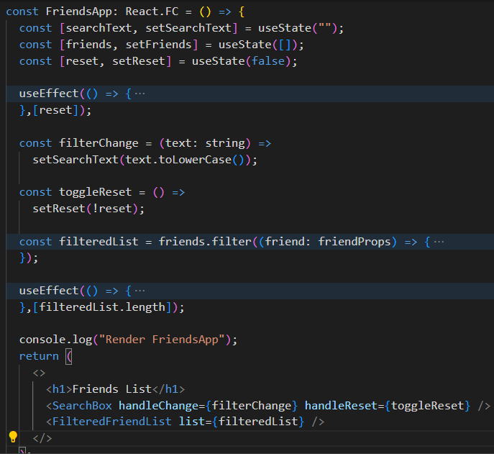
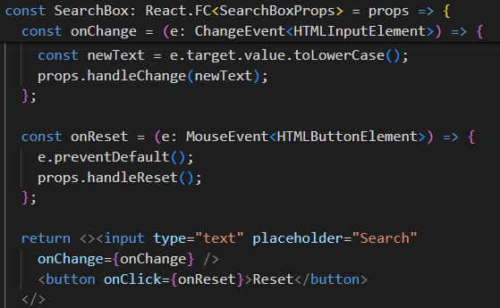
Data down, Action up.
Pattern:
Stateful component provides a callback to the subordinate.
Subordinate invokes callback when the event occurs.

Slide 10
Topics
Hooks and Component Lifecycle.
Data Flow patterns – Data Down, Action Up pattern. 
The Virtual DOM
       

Slide 11
Modifying the DOM
DOM – an internal data structure representing the browser’s current ‘display area’ ; DOM always in sync with the display.
Traditional performance best practice:
  Minimize direct accessing of the DOM.
  Avoid ‘expensive’ DOM operations.
  Update elements offline, then replace in the DOM.
  Avoid changing layouts in Javascript.
  . . . etc.
Should the developer be responsible for low-level DOM optimization? Probably not.
  React provides a Virtual DOM to shield developers from these concerns.

Slide 12
The Virtual DOM
How React works:
  At app startup it create a lightweight, efficient form of the DOM, termed the Virtual DOM.
  The app changes the V. DOM whenever a component re-renders.
  When the re-rendering cycle is complete, the React engine:
    Performs a diff operation between the current and previous V. DOM instance.
    Computes the set of changes to apply to real DOM.
    Batch update the real DOM.
Benefits:
  Cleaner, more descriptive programming model.
  Optimized DOM updates and reflows.

Slide 13
Automatic Re-rendering (detail)
EX.: The Counter component.
  User clicks button
  → onClick event handler executed
    → component state is changed
  → component re-executed (re-renders)
  → The Virtual DOM has changed
  → React diffs the changes between the current and previous Virtual DOM
  → React batch updates the Real DOM

Slide 14

Re-rendering & the real DOM
What happens when the user types in the text box?
  User types a character in text box
  → onChange event handler executes
  Handler changes a state variable
  React re-renders FriendsApp component
  React re-renders children (FilteredFriendList) with new prop values.
  React re-renders children of FilteredFriendList.
  (Re-rendering completed)
  (Pre-commit phase) React computes the updates required to the browser’s DOM
  (Commit phase) React batch updates the DOM.
  Browser repaints screen

Slide 15
Summary
A state variable change always causes a component to re-render.
  State change logic is usually part of an event handler function.
  Event hadler may be in a subordinate component.
Side effects:
  Always execute at mount time.
  The dependency array will either reference a state variable, a value computed from a state variable, or a prop.
    Can be multiple entries
  Callback performs the side-effect, and may also cause a state change.
Data flows downward, actions flow upward.

Slide 16


