Slide 1

ReactJS.
The Component model

Slide 2
Topics
Component State.
  Basis for dynamic, interactive UI.
Data Flow patterns.
Hooks.

Slide 3
Component DATA
A component has two sources of data:
  Props - Passed in to a component; Immutable; the props object.
  State - Internal to the component; Causes the component to re-render when changed / mutated.
  Both can be any data type - primitive, object, array.
Props-related features:
  Default values.
  Type-checking.
State-related features:
  Initialization.
  Mutation – using a setter method.
    Automatically causes component to re-render. ***
    Performs an overwrite operation, not a merge.

Slide 4
Stateful Component Example
The Counter component.
Ref. basicReactLab samples – sample 06.
The useState() function:
  Declares a state variable.
  Returns a Setter / Mutator method.
  Termed a React hook.
jump (Int)
Counter
count (int) = 0
Increment
Notes:
Searching for relevant definitions...The code you've shared is defining a functional component in React using TypeScript. Here's a breakdown of what's happening:- `interface CounterProps`: This is a TypeScript interface named [`CounterProps`](command:_github.copilot.openSymbolInFile?%5B%22src%2Fcomponents%2Fsamples%2F06-state.tsx%22%2C%22CounterProps%22%5D "src/components/samples/06-state.tsx"). Interfaces in TypeScript are a way of defining a contract for a certain structure of an object. In this case, [`CounterProps`](command:_github.copilot.openSymbolInFile?%5B%22src%2Fcomponents%2Fsamples%2F06-state.tsx%22%2C%22CounterProps%22%5D "src/components/samples/06-state.tsx") is defining the shape of the props that the [`Counter`](command:_github.copilot.openSymbolInFile?%5B%22src%2Fcomponents%2Fsamples%2F06-state.tsx%22%2C%22Counter%22%5D "src/components/samples/06-state.tsx") component expects to receive. It specifies that there should be a [`jump`](command:_github.copilot.openSymbolInFile?%5B%22src%2Fcomponents%2Fsamples%2F06-state.tsx%22%2C%22jump%22%5D "src/components/samples/06-state.tsx") property, and that the value of [`jump`](command:_github.copilot.openSymbolInFile?%5B%22src%2Fcomponents%2Fsamples%2F06-state.tsx%22%2C%22jump%22%5D "src/components/samples/06-state.tsx") should be a number.- `const Counter: React.FC<CounterProps>`: This is declaring a constant named [`Counter`](command:_github.copilot.openSymbolInFile?%5B%22src%2Fcomponents%2Fsamples%2F06-state.tsx%22%2C%22Counter%22%5D "src/components/samples/06-state.tsx") and specifying its type as `React.FC<CounterProps>`. `React.FC` stands for "React Function Component", and it's a type provided by the `@types/react` package, which provides TypeScript definitions for React. By using `React.FC<CounterProps>`, you're telling TypeScript that [`Counter`](command:_github.copilot.openSymbolInFile?%5B%22src%2Fcomponents%2Fsamples%2F06-state.tsx%22%2C%22Counter%22%5D "src/components/samples/06-state.tsx") is a functional component that expects to receive props of the shape defined by [`CounterProps`](command:_github.copilot.openSymbolInFile?%5B%22src%2Fcomponents%2Fsamples%2F06-state.tsx%22%2C%22CounterProps%22%5D "src/components/samples/06-state.tsx").- `= (props) => {`: This is the start of an arrow function that defines the component. The `props` parameter represents the props that are passed to the component. In this case, `props` is expected to be an object with a [`jump`](command:_github.copilot.openSymbolInFile?%5B%22src%2Fcomponents%2Fsamples%2F06-state.tsx%22%2C%22jump%22%5D "src/components/samples/06-state.tsx") property, as defined by [`CounterProps`](command:_github.copilot.openSymbolInFile?%5B%22src%2Fcomponents%2Fsamples%2F06-state.tsx%22%2C%22CounterProps%22%5D "src/components/samples/06-state.tsx").So, in summary, this code is defining a new functional component named [`Counter`](command:_github.copilot.openSymbolInFile?%5B%22src%2Fcomponents%2Fsamples%2F06-state.tsx%22%2C%22Counter%22%5D "src/components/samples/06-state.tsx") that expects to receive a single prop named [`jump`](command:_github.copilot.openSymbolInFile?%5B%22src%2Fcomponents%2Fsamples%2F06-state.tsx%22%2C%22jump%22%5D "src/components/samples/06-state.tsx") of type number. The actual implementation of the component (i.e., what it renders) would come after the `=>`.

Slide 5
React’s event system.
Cross-browser support.
Event handlers receive a React Event Object – a cross-browser wrapper for the browser's native event.
React event naming convention slightly different to native:
See https://react.dev/learn/responding-to-events and
https://react.dev/reference/react-dom/components/common#react-event-object
for full details,
React | Native
onClick | onclick
onChange | onchange
onSubmit | onsubmit

Slide 6
Automatic Re-rendering.
EX.: The Counter component.
  User clicks button
  → onClick event handler executes (incrementCounter)
    → handler changes component’s state (setCount())
  → component function re- executed (re-rendering)

Slide 7
Topics
Component State. ✔
Data Flow patterns.
Hooks.

Slide 8
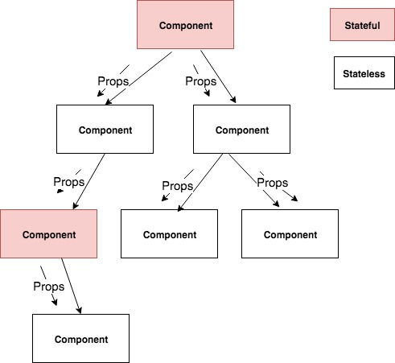
Unidirectional data flow

Slide 9
Unidirectional data flow
In React, data flow is unidirectional ONLY.
  Other SPA frameworks use two-way data binding.
Typical React app pattern: A small subset of the components are stateful; the majority are stateless.
Stateful component execution flow:
  User interaction causes a component state change.
  Component re-renders (re-executes).
  Component recomputes the props for its subordinate components.
  Subordinate components re-render, and recomputes props for its subordinates.
  etc.

Slide 10
Topics
Component State. ✔
Data Flow patterns.        ✔
Hooks

Slide 11
React Hooks
Introduced in version 16.8.0 (February 2019)
React Hooks are:
  Functions (some are HOFs).
  That performs component state manipulation and lifecycle management.
Examples: useState, useEffect, useContext, useRef, etc
  ‘use’ prefix is necessary for linting tools.
Usage Rule:
  Can only call hooks at the ‘top level’ in a component.
    i.e. Don’t call hooks inside loops or condition statements.

Slide 12
useEffect Hook
Used when a component needs to perform side effects.
Side Effect example:
  fetching data from a web API.
  Subscribe to a browser events, e.g. window resize.
Signature: useEffect(callback, dependency array)
  The callback contains the side effect code.
  Dependencies determine when a hook is executed.
useEffect is executed:
  On component mounting.
  On every rendering that coincides with a dependency entry update.
  An empty dependency array restricts execution to mount-time only.

Slide 13
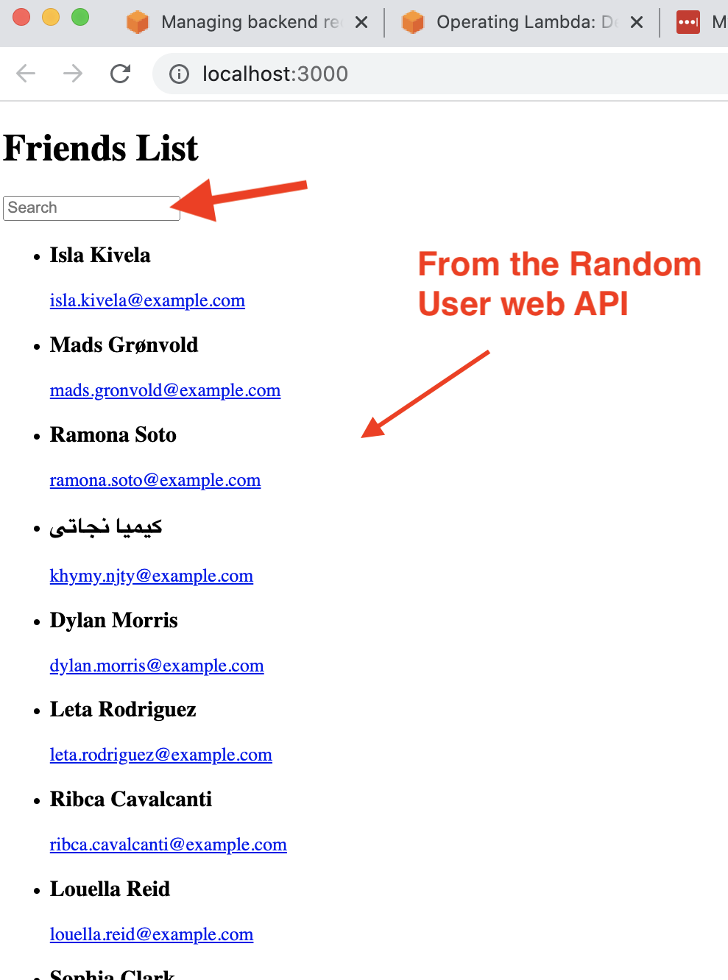
Sample App

Slide 14
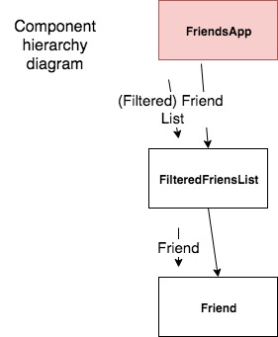
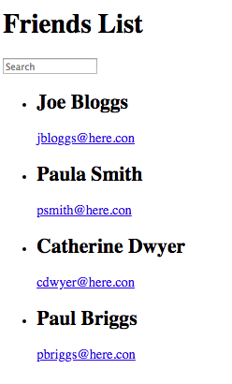
Sample App 1
(see lecture archive)
FriendsApp component:
Manages state (i.e. text box, full list of friends).
Fetches data from a web API – side effect.
Computes matching friends.
Controls list rendering.

Slide 15
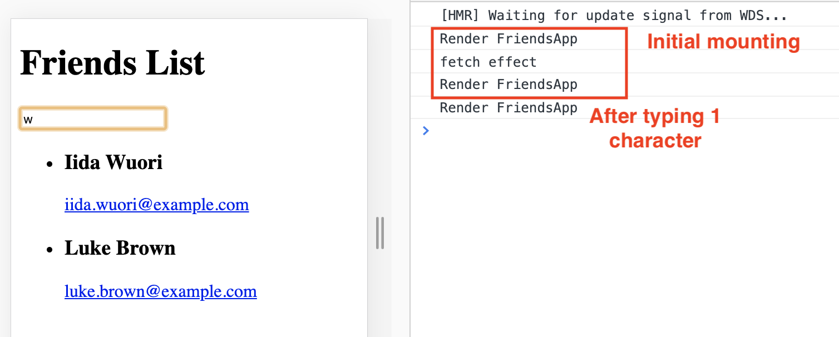
Sample App - useEffect Hook
useEffect runs AT THE END of a component’s mount process.
  i.e. First rendering occurs BEFORE the API data is available.
  We must accommodate this in the implementation.

Slide 16
Sample App - useEffect Hook
You must allow for asynchronous nature of API calls:
  UI must remain interactive while waiting for API data.
  Components should render without errors before API data is available.
Correct approach:
    const [friends, setFriends] = useState( [ ] ) ; // Store API data
Incorrect approach:
    const [friends, setFriends] = useState(null);
  Resulting error
    TypeError: Cannot read property 'filter' of null

Slide 17

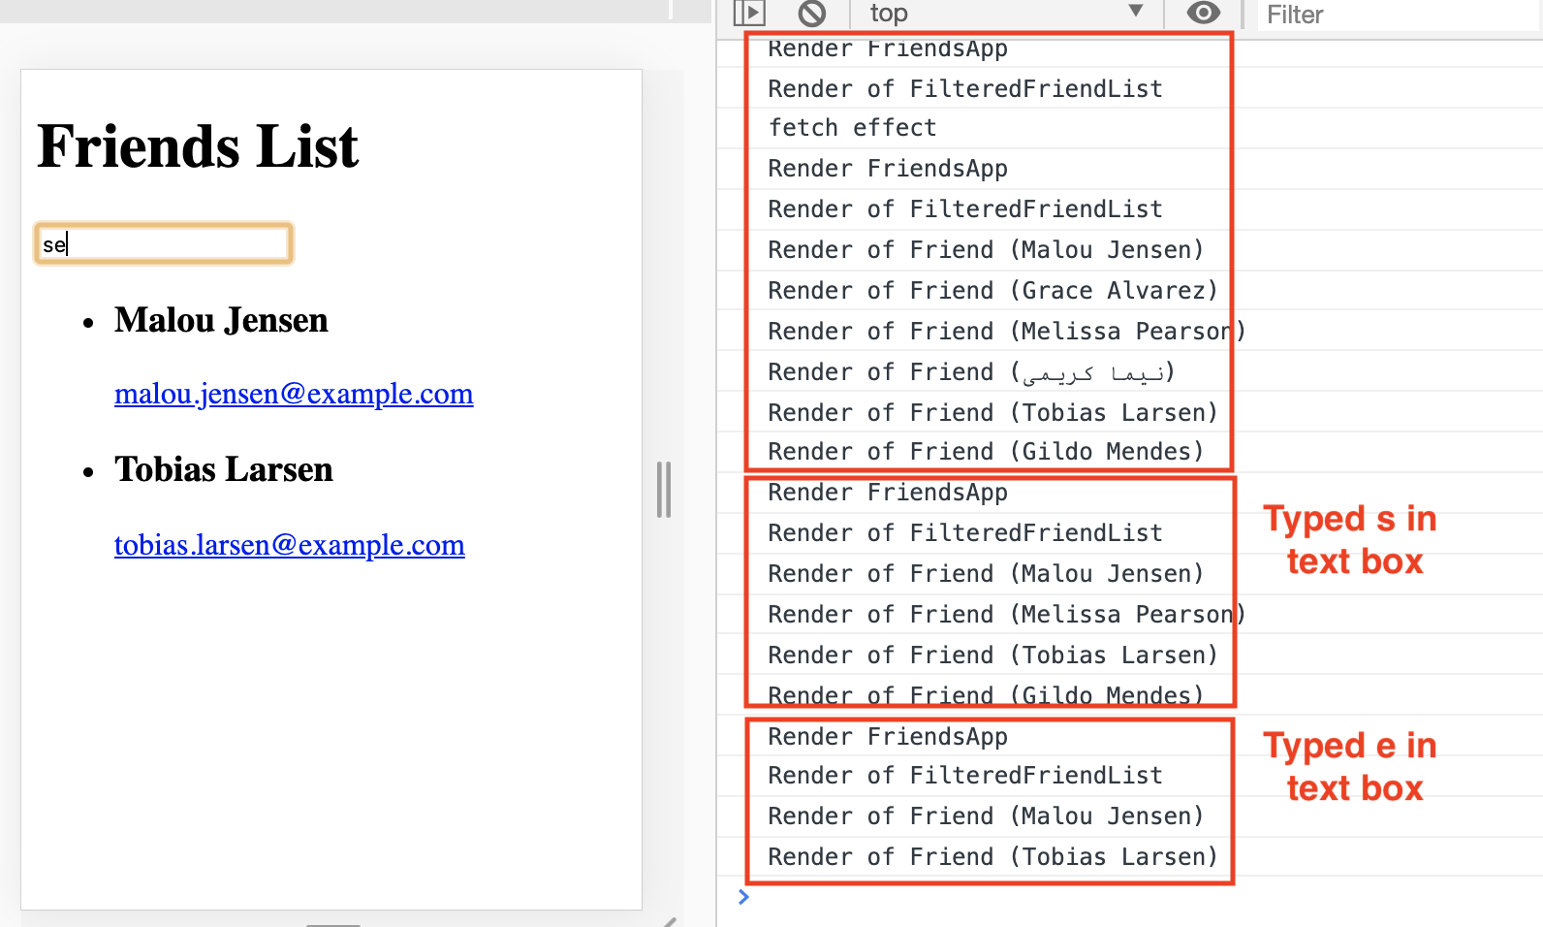
Unidirectional data flow & Re-rendering
(Assume we request 6 friends from web API)

Slide 18
More to come ….

