Slide 1
Authentication and Protected/Private Routes
(See Routing samples Archive)

Slide 2
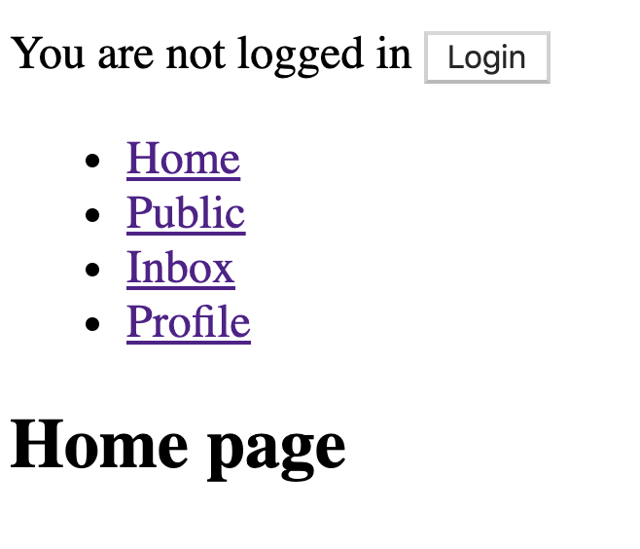
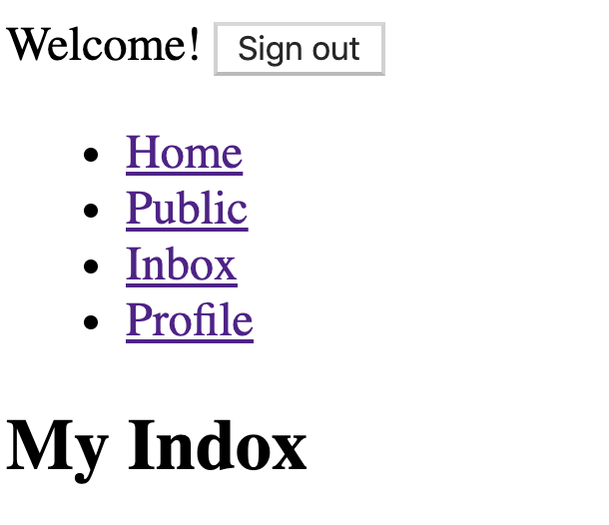

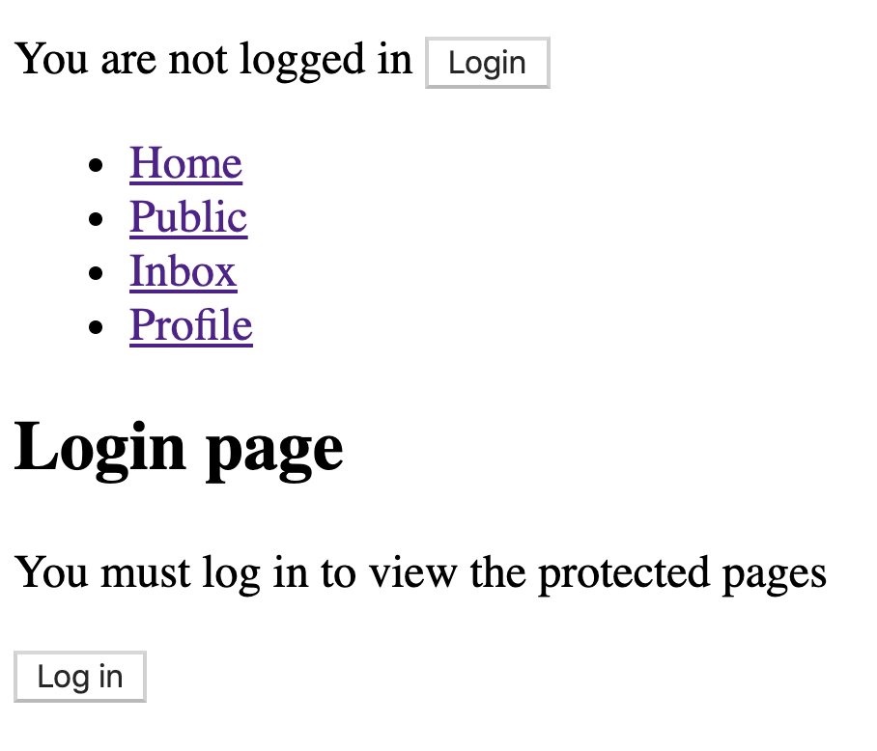

Objective

Slide 3
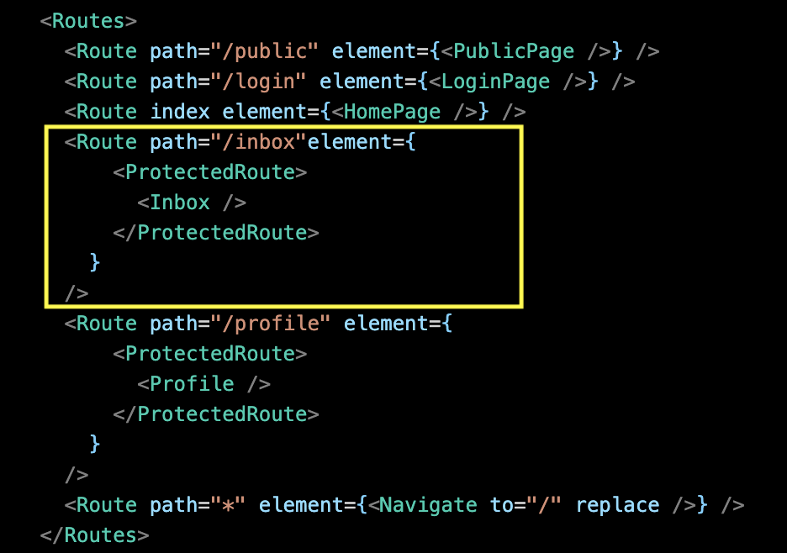
Protected Routes - Solution outline.
Not native to React Router.
We need a custom solution.
Solution outline: A clear, declarative style for declare the views/pages that require authentication.

Slide 4
Solution elements.
Solution features:
  A React Context to store the current authenticated user’s token.
  Programmatic navigation - to redirect unauthenticated user to login page.
  Remember user’s intent prior to the forced authentication step.

Slide 5
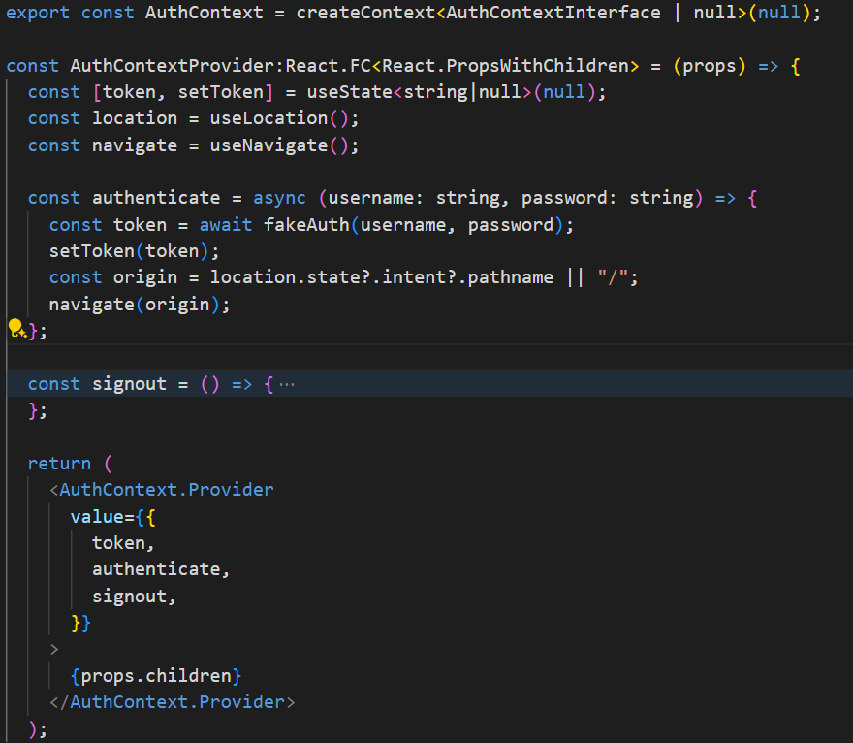
Implementation
Solution elements: The AuthContext.
Notes:
`useLocation` hook from the `react-router-dom` library returns the current location object, which contains information about the current URL.
useNavigate: imperative method for changing the location. Used by <Link>s, but may also be used by other elements to change the location.
optional chaining (?.) operator and the logical OR (||) operator to assign a value to the origin constant.
It's a way to provide a default value. If the value on the left side of the || operator is undefined, null, NaN, 0, an empty string (""), or false, JavaScript will use the value on the right side of the || operator.
Intent: string representing the intended path of the resource to be accessed.

Slide 6
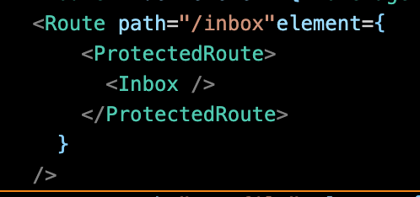
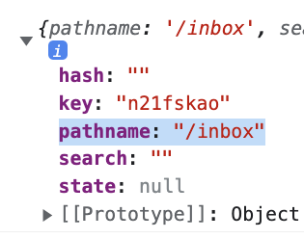
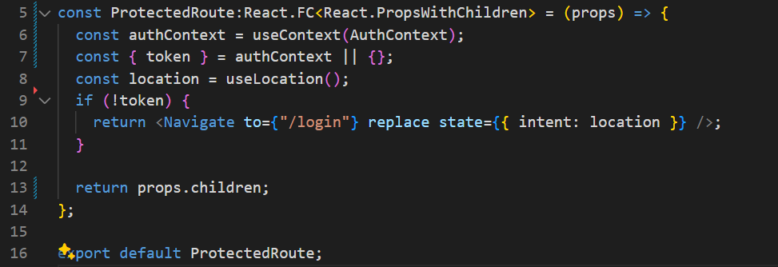
Implementation
Solution elements (Contd.): <ProtectedRoute />
Notes:
Replace : replaces the current entry in the history stack with the new location. This means that the user won't be able to use the browser’s back button to navigate back to the original page
The state prop allows you to pass state to the route you're navigating to. This can be any JavaScript object

Slide 7
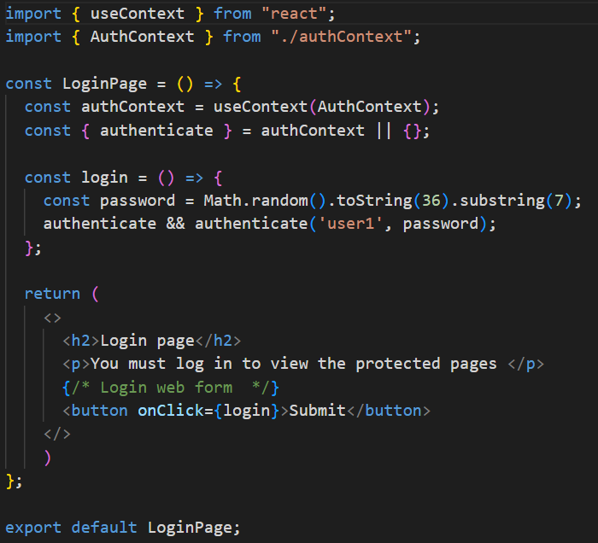
Implementation
Solution elements (Contd.): The Login Page.

Slide 8
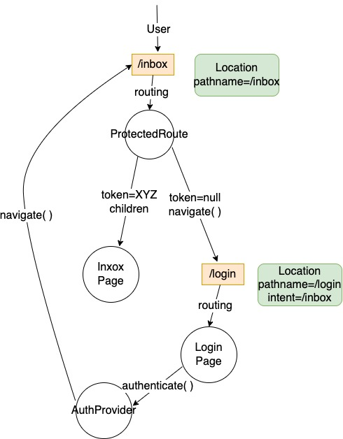
Implementation - Flow of control.
When an unauthenticated user tries to access /inbox

Slide 9
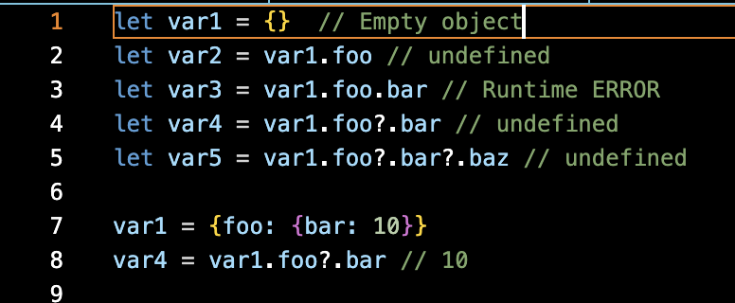
The optional chaining operator (?.)
The optional chaining operator (?.) accesses an object's property. If the property is undefined or null, the expression short circuts and evaluates to undefined instead.

Slide 10
The code archive.
Two implementations:
Version 1 - AuthContext and login page only; No ProtectedRoute or Remember intent.
Version 2 – Full implementation.
The fakeAuth() function and the async/await model for asynchronous programming.

Slide 11


