Slide 1
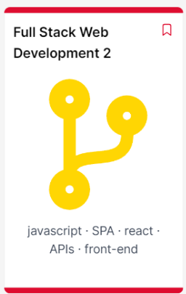
Full Stack Web Development 2
Overview
Frank Walsh, Diarmuid O’Connor
Jan 2024

Slide 2
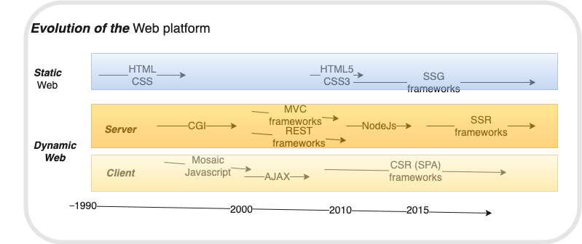
Context
SSG (Static site generation)
SSR (Server-side rendering)
CSR (Client-side rendering)
Web
Dev 1
Full Stack
1
Web
Dev 2
Full Stack 2

Slide 3
Full Stack Development 2
“Design and implement (performant) client-side rendering web apps using industry-standard frameworks and tools.”
2.5 Credit Module
5 weeks in June
100% Continuous Assessment

Slide 4
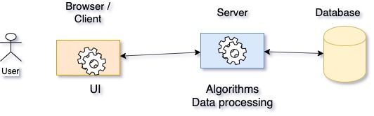


Full Stack Dev 2
Web API

Slide 5






Industry Standard Frameworks

Slide 6
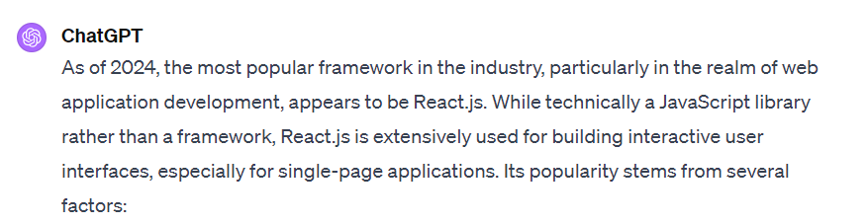
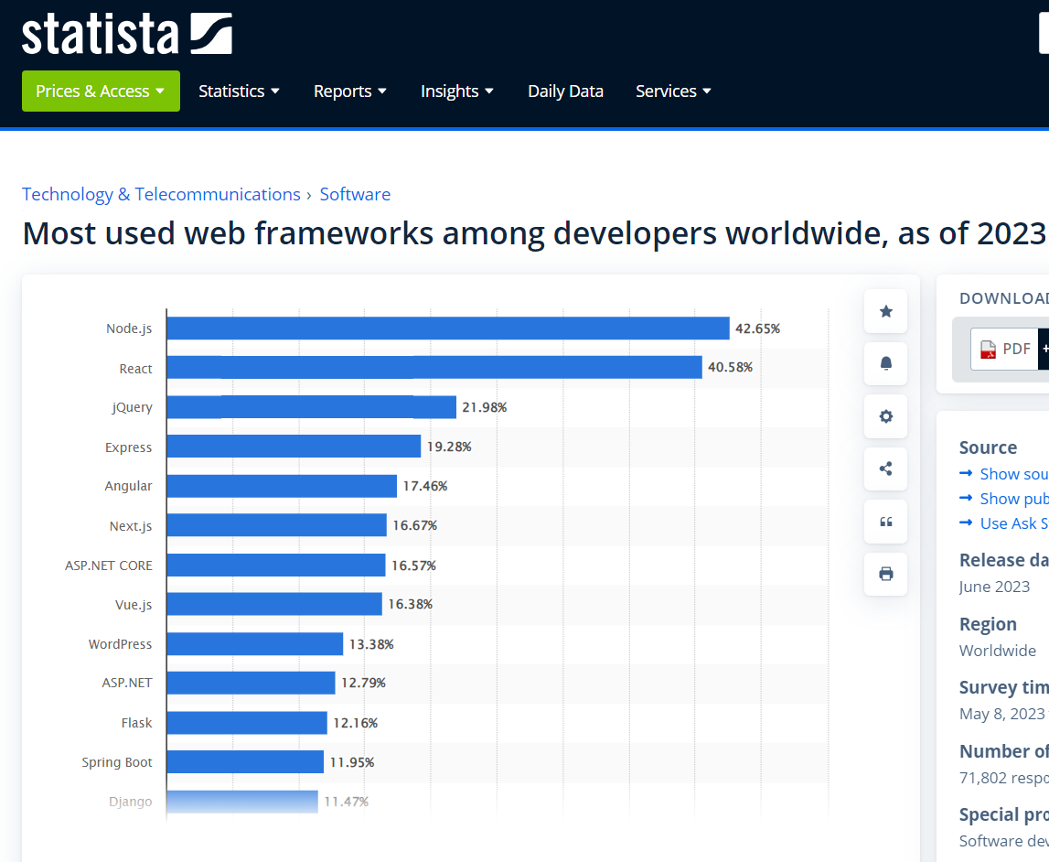
Why React?

Slide 7
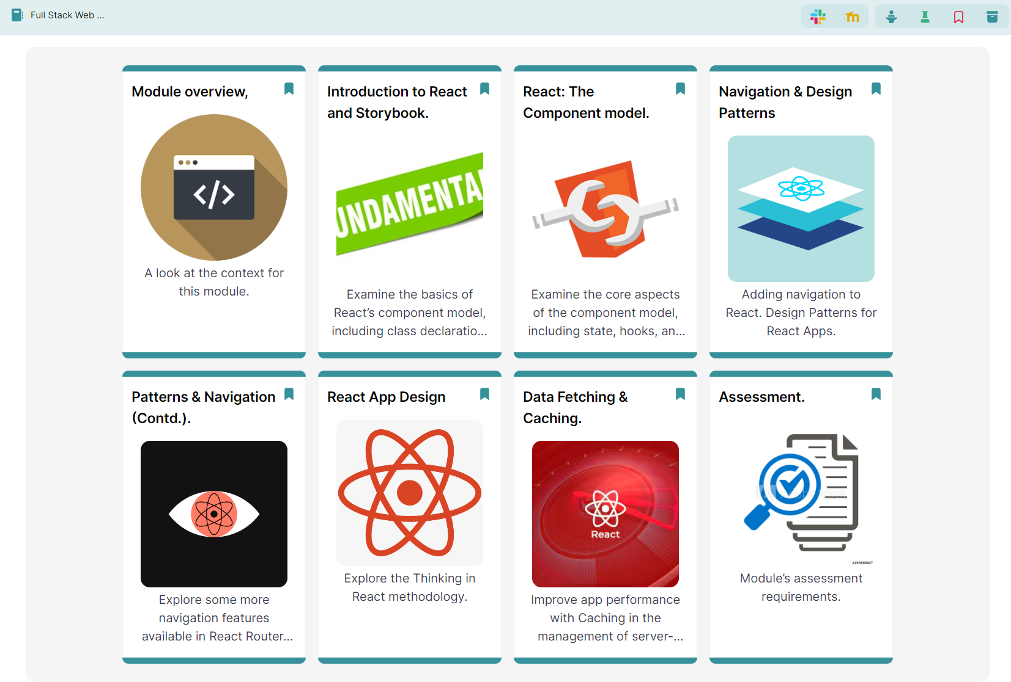
Indicative Content…

Slide 8
Assessment
Labs 40%
Submit at end of term
Assignment/Project 60%
Submit August.

Slide 9

Questions???

