Slide 1
Agenda
Data Fetching and Caching
  The react-query library
Assignment 1 specification

Slide 2
Data Fetching &
Caching.

Slide 3
SPA State (Data) - Client
Client state (aka App State).
  e.g. Menu selection, UI theme, Text input, logged-in user id.
Characteristics:
    Client-owned; Not shared; Not persisted (across sessions); Always up-to-date.
    Accessed synchronously.
    useState() hook
    Management - Private to a component or Global state (Context).

Slide 4
SPA State (Data) - Server
Server state (The M in MVC).
  e.g. list of ‘discover’ movies, movie details, friends.
Characteristics:
    Persisted remotely. Shared ownership.
    Accessed asynchronously → Impacts user experience.
    Can change without client’s knowledge → Client can be ‘out of date’.
    useState + useEffect hooks.

Slide 5
SPA Server State.
Server state characteristics (contd.).
  Management options:
    Spread across many component.
      Good separation of concerns. (+)
      Unnecessary re-fetching. (-)
    Global state (Context).
      No unnecessary re-fetching. (+)
      Fetching data before its required. (-)
      Poor separation of concerns. (-)_
    3rd party library – e.g. Redux
      Same as 2 above.
We want the best of 1 and 2, if possible.

Slide 6
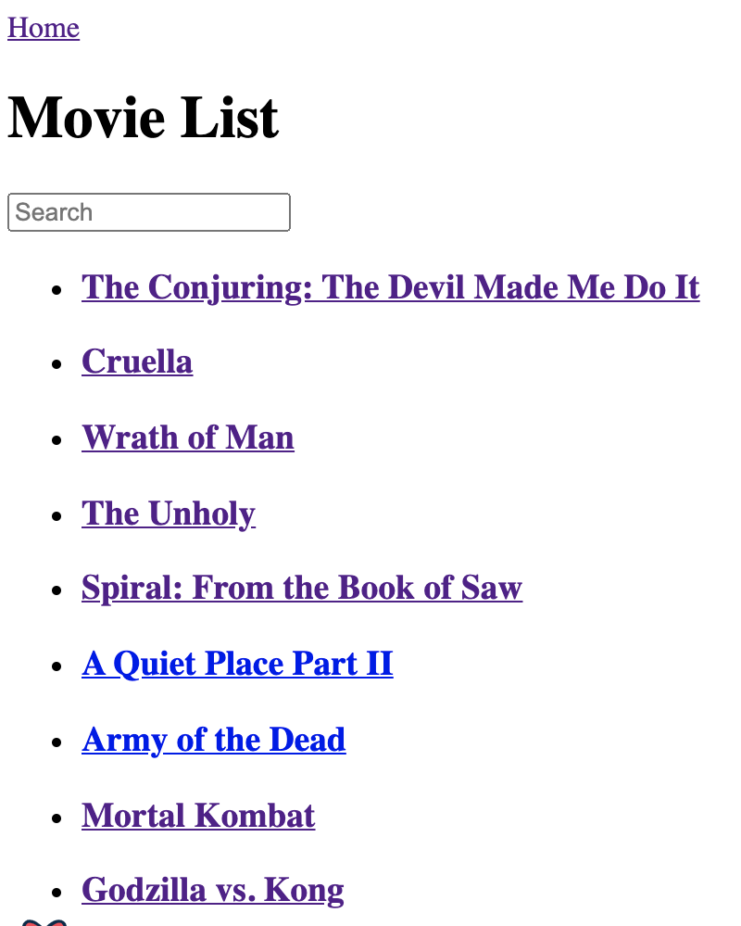
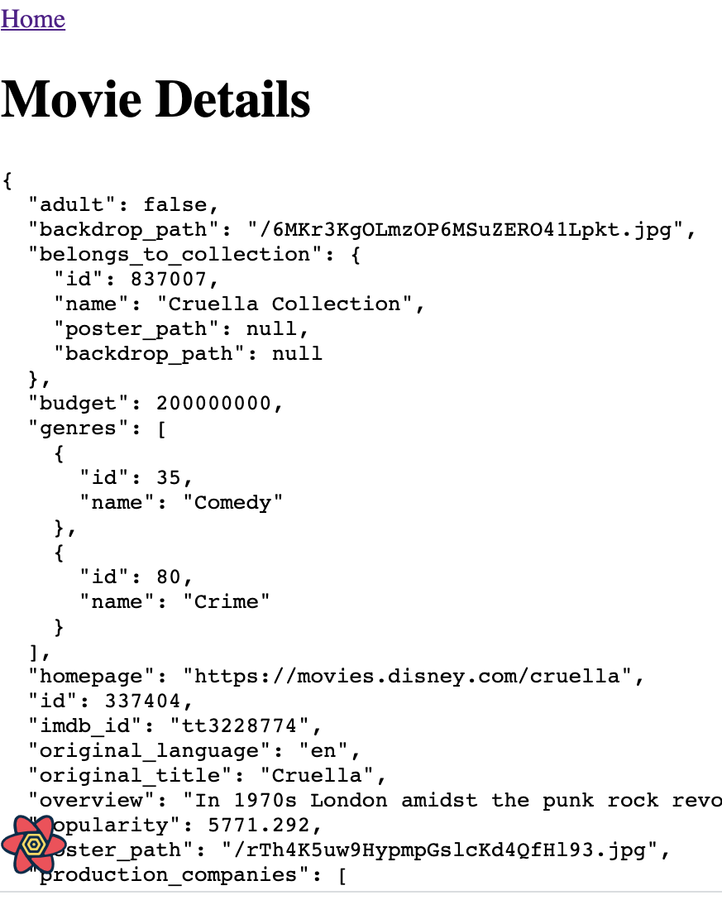
Sample App.
Both pages make a HTTP Request to a web API (TMDB)

Slide 7
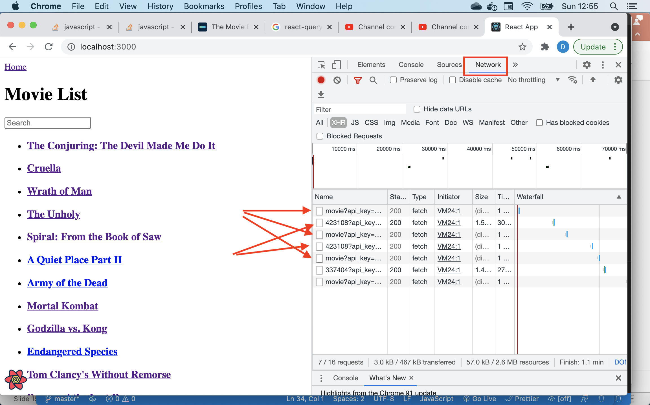
Sample App – The Problem.
Every navigation to the Home page triggers an HTTP request to TMDB.
Similarly for the Detail page.
Both pages use useEffect and useState hooks.

Slide 8
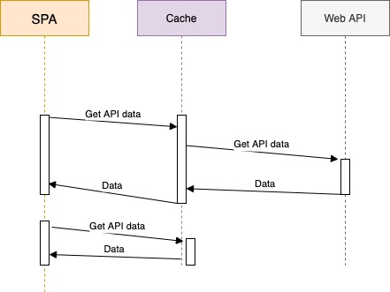
Sample App – The Solution. .
Cache (store temporarily) the API data locally in the browser.
Reduces the workload on the backend for read intensive apps.
Speeds up the rendering time for revisited pages.

Slide 9
Caching (General).
Caches are in-memory datastores with high performance and low latency.
Simple key-value datastores structure.
  Keys must be unique.
  Value can be any serialisable data type – Object, Array, Primitive.
Cache hit – The requested data is in the cache.
Cache miss - The requested data is not in the cache.
Caches have a simple interface:
  serializedValue = cache.get(key)
  cache.delete(key)
  cache.purge()
Cache entries have a time-to-live (TTL).

Slide 10

The react-query library
3rd party JavaScript (React) caching library.
  Provides a set of hooks.
  e.g. const { data, error, isLoading, isError } = useQuery(key, queryFunction);
  data – from the cache (hit) or returned by the API (miss).
  error – error response from API.
  isLoading(boolean) – true while waiting for API response.
  isError (boolean) – true when API response is an error status.
Causes a component to re-render on query completion.
Replaces your useState and useEffect hooks.

Slide 11
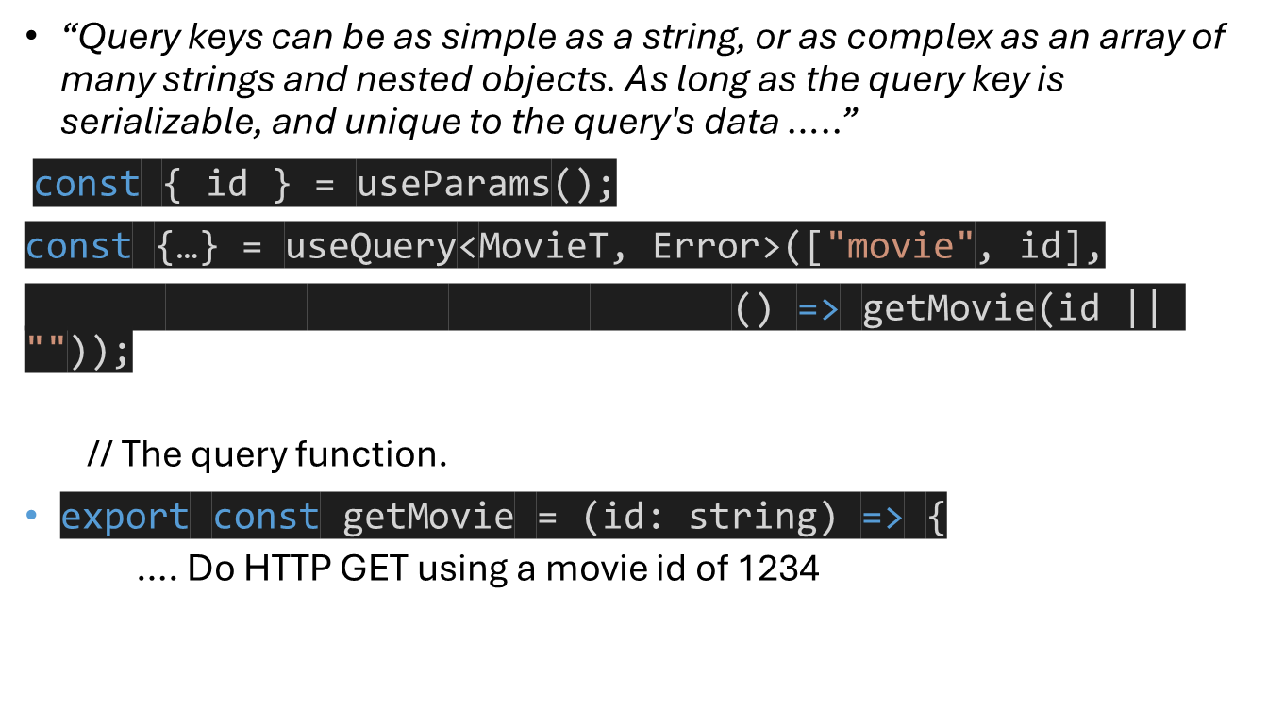
The query key.

Slide 12
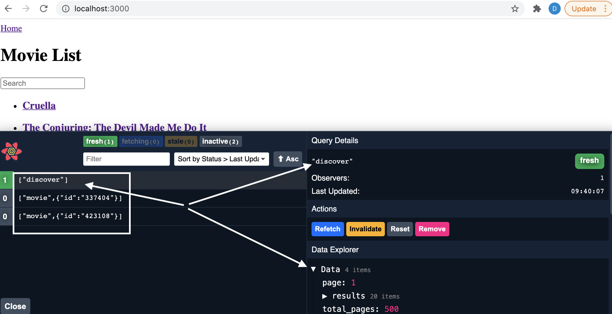
react-query DevTools.
Allows us to observe the current state of the cache datastore – great for debugging.

Slide 13
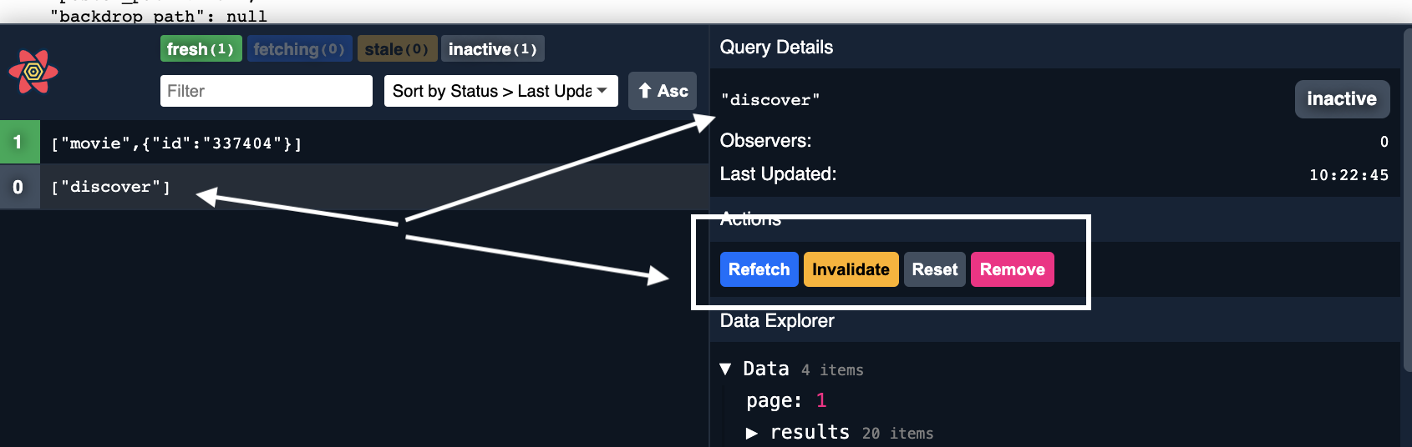
react-query DevTools.
Allows us to manipulate cache entries.
  Refresh – force an immediate re-request of data from theAPI.
  Invalidate – set entry as ‘stale’. Cache will request update from web API when next required by the SPA.
  Reset – only applies when app can mutate the API’s data.
  Remove – remove entry from cache immediately.

Slide 14
Summary
State Management - The M in MVC
State:
  Client/App state.
  Server state.
Cache server state locally in the browser.
  Avoid unnecessary HTTP traffic → Reduce page load time
  Be aware of cache entry staleness → Use TTL to minimize staleness.
The react-query library
  A set of hooks for cache interaction.

