Slide 1
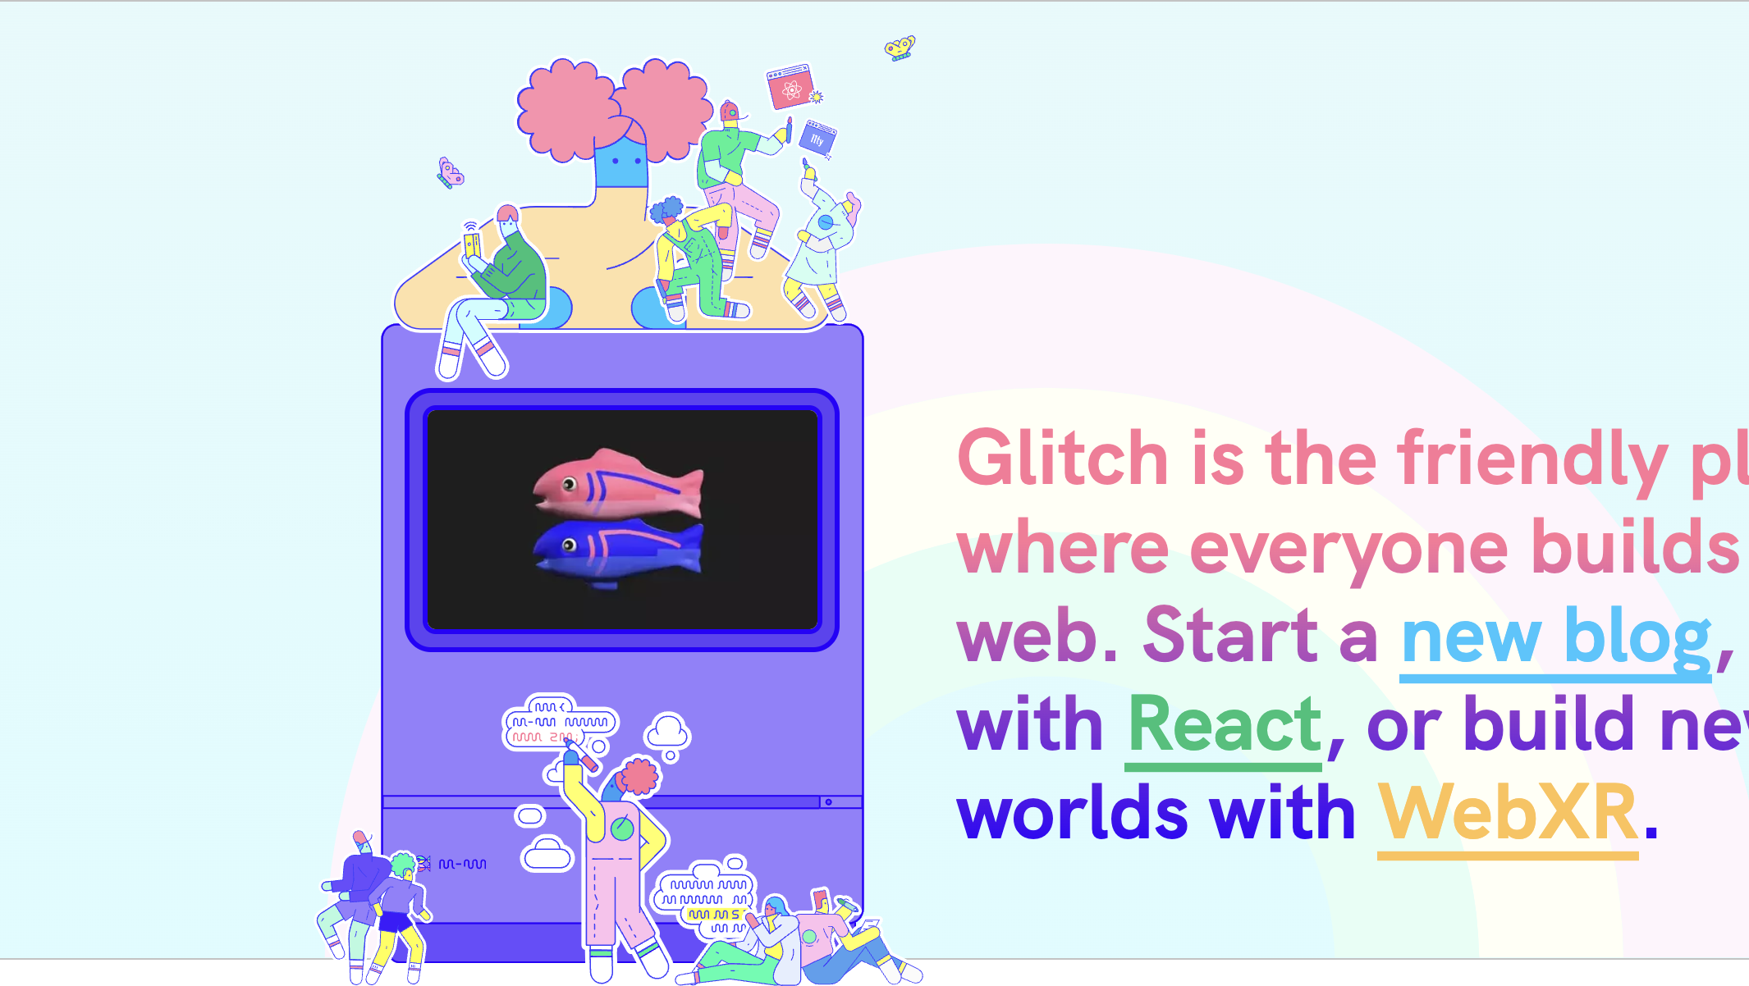

Web Dev II Module Introduction
HDip in Computer Science
john.rellis@setu.ie

Slide 2
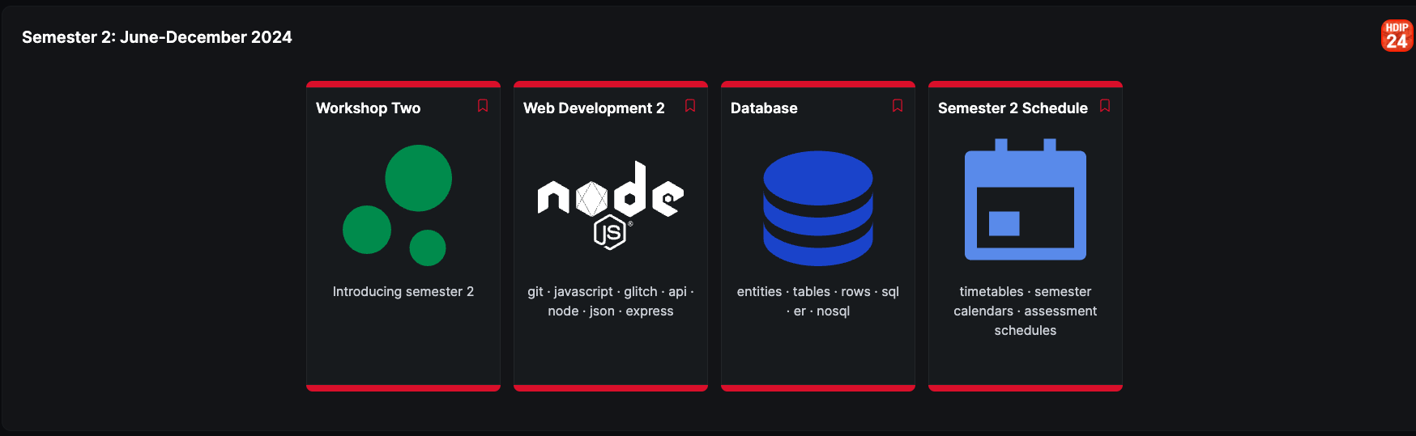

Slide 3
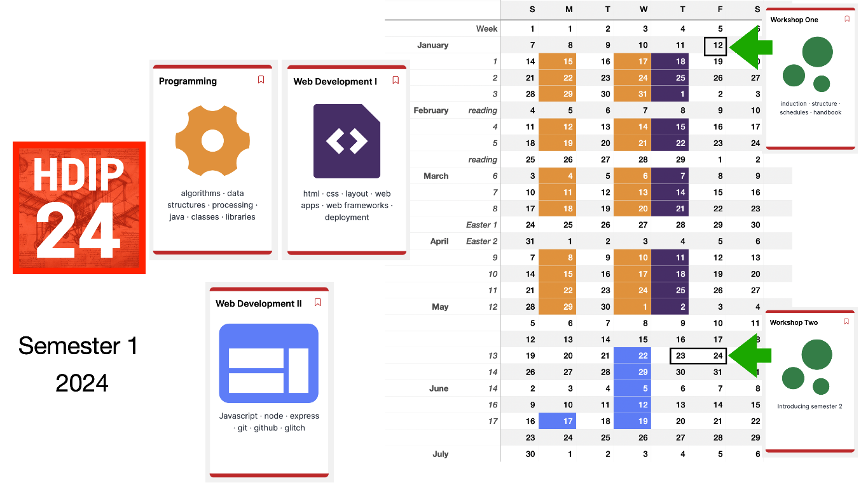

Slide 4

Going Server-Side!

Slide 5



Browser - Client
Glitch - Server
We will run JavaScript code in the cloud, using Glitch

Slide 6
?
https://glitch.com

Slide 7





Technologies

Slide 8
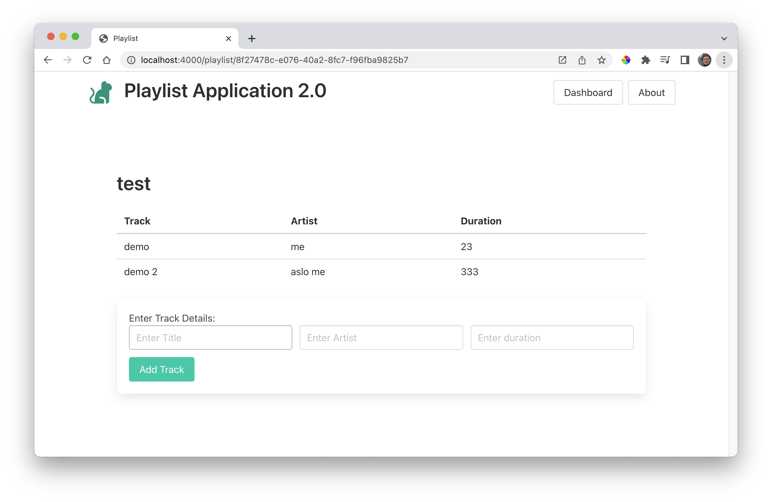
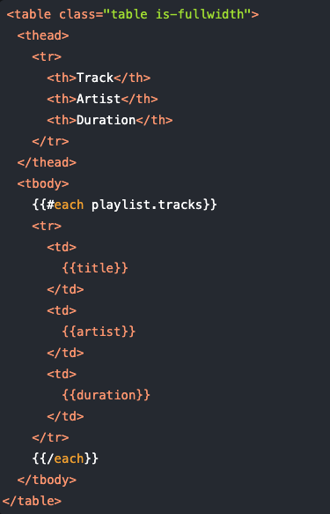
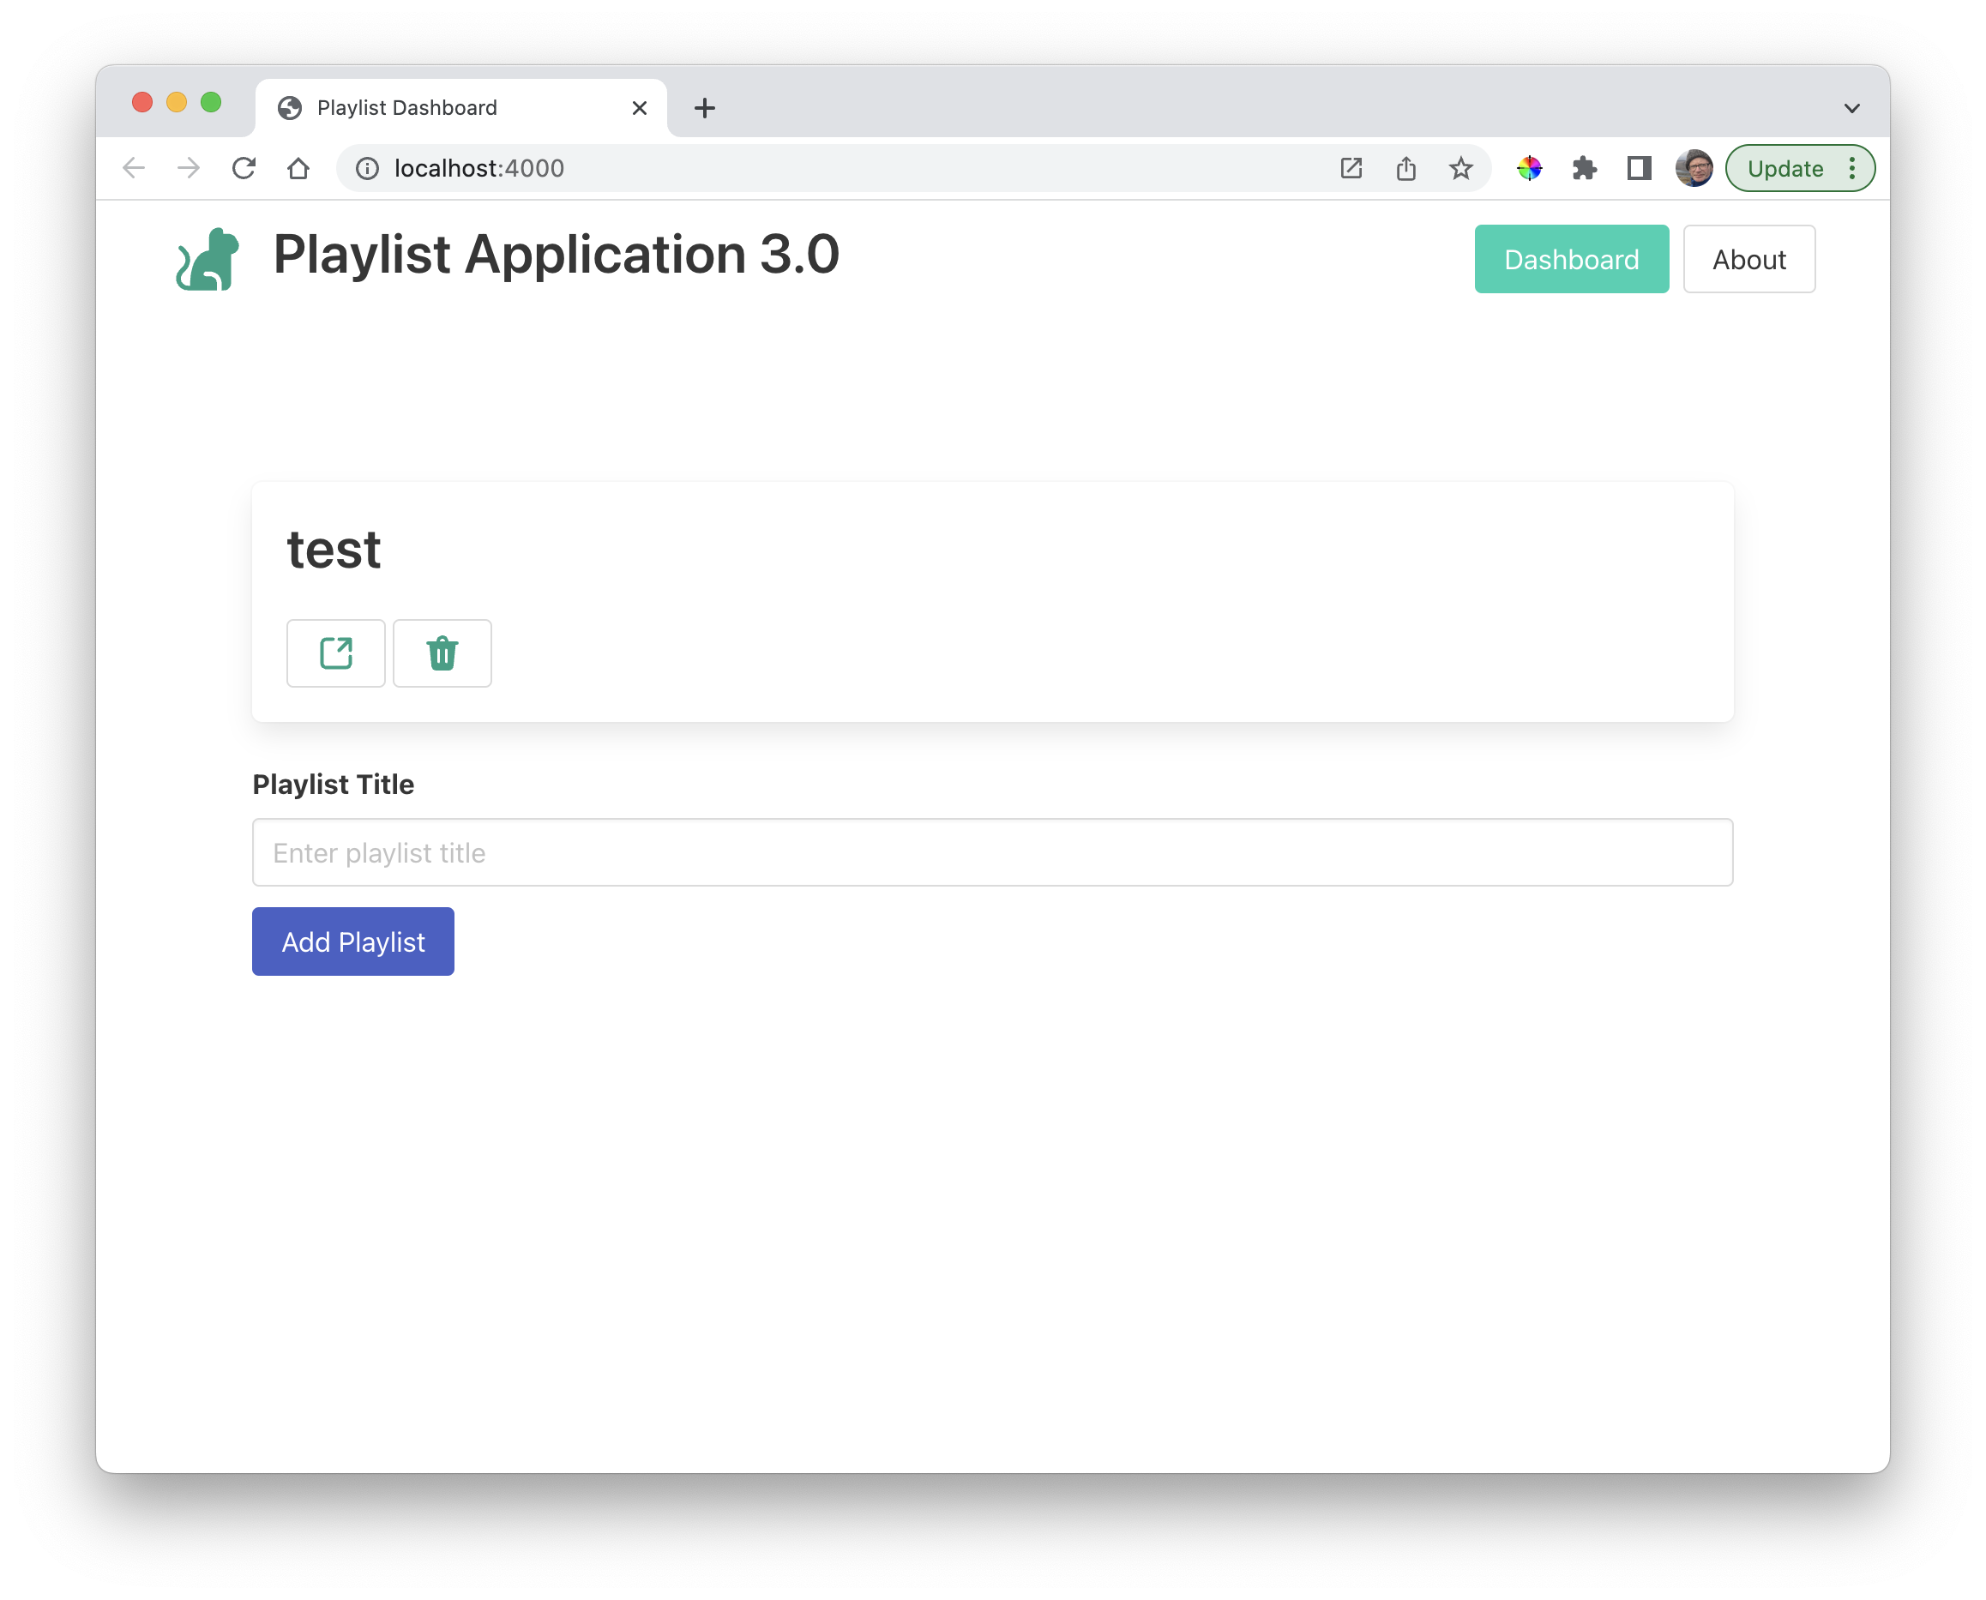
Labs – Simplified Clientside

Slide 9

Assignment
Simplified version of (Whether) Weather on Glitch, with a focus on server-side code Will be delivered ~ Week 3 Deadline will be ~ End of August Interviews ~ September, October 2024 Official Results will be January 2025
More details when spec is delivered

