Slide 1

git
An Introduction
John Rellis
Web Development 2

Slide 2
What is git?
Imagine you're working on a big group project for your class. Everyone needs to contribute their part, but it's hard to keep track of who did what and when.
Git is like an ultra-organized, digital notebook that helps you and your classmates work together on your project without stepping on each other's toes.

Slide 3
What is git?
Git helps you keep track of every change you make to your project.
It's like taking snapshots of your work at different points in time.
So if something goes wrong, you can go back to a previous snapshot and fix it.
This makes git a “version control” system.

Slide 4
What is git?
Git allows multiple people to work on the same project at the same time.
It helps you merge everyone's changes together seamlessly.
It's like having a magic wand that combines all your classmates' contributions into one neat document.

Slide 5
What is git?
Git also acts as a backup for your project.
If your computer crashes or you accidentally delete something important, you can always get your work back from Git, especially if you have pushed it to a remote repository

Slide 6
What is git?
Think of Git as your trusty assistant that keeps your project organized, helps you work with others, and ensures you never lose your hard work.

Slide 7
So, to recap.
git is a version control system that enables collaboration and backup of (typically) code based projects.

Slide 8
What is a version control system?
Imagine you're writing a story on your computer.
Every time you make a change, like adding a new paragraph or deleting a sentence, you hit the "save" button.
But what if you want to go back to how your story looked a few days ago?
That's where version control comes in.

Slide 9
What is a version control system?
Version control is like a smart save button for your files.
It keeps track of every change you make, along with who changed it and when, creating a history of your work.
So, if you ever want to go back to a previous version of your story, you can!

Slide 10
What is a version control system?
But version control isn't just about saving different versions of your work.
It also helps you collaborate with others.
Let's say you're writing your story with a friend.
Version control allows both of you to work on the same document at the same time, without stepping on each other's toes.
It keeps track of who made which changes and helps you merge your work together.

Slide 11
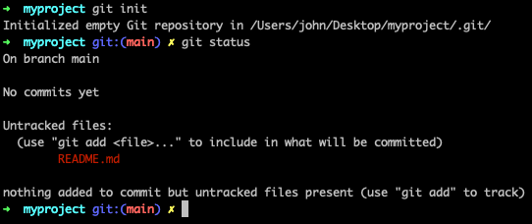
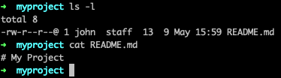
Repository (or repo)
A repository is where git stores all the files and their complete history.
It's like a folder on your computer that git is watching closely.
When you initialize a repository in a folder (using git init), git starts tracking all the changes made to the files in that folder.

Slide 12
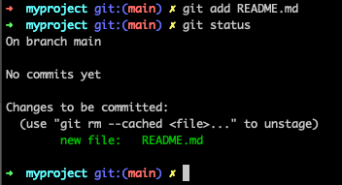
Add README.md to the staging area

Slide 13


Commit our file to the repo

Slide 14

Staging area? Commit?

Slide 15
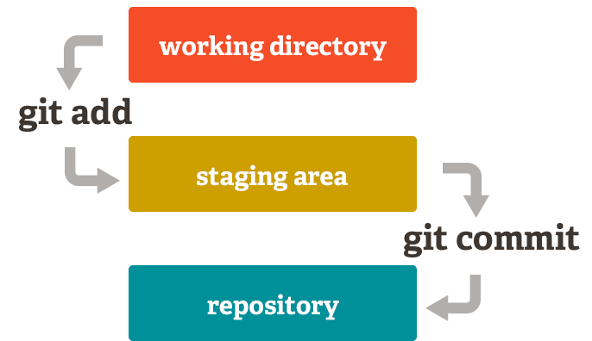
Staging area?
git has something called the "staging area" or "index".
This is an intermediate area where commits can be formatted and reviewed before completing the commit.
One thing that sets Git apart from other tools is that it's possible to quickly stage some of your files and commit them without committing all of the other modified files in your working directory or having to list them on the command line during the commit.

Slide 16
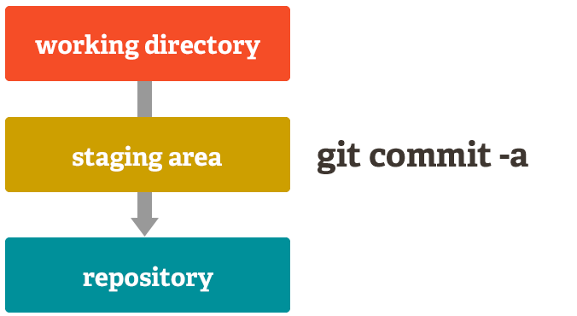
Staging area?
git also makes it easy to ignore this feature if you don't want that kind of control — just add a '-a' to your commit command in order to add all changes to all files to the staging area. https://git-scm.com/about/staging-area

Slide 17
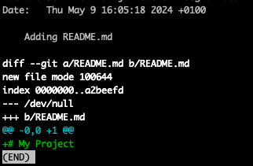
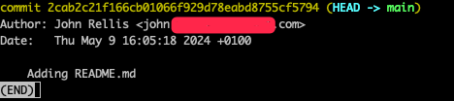
Commit?
We commit changes to our repository, these changes can include new files, updated files, deleted files, renamed files
Once a change (or a number of changes) are committed as part of a commit, these changes become part of the history of the repository, we can view the changes using `git log` and then `git show 2cab2c21f166cb01066f929d78eabd8755cf5794`

Slide 18
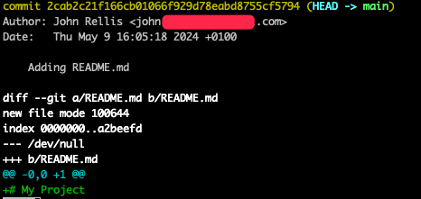
Commit?
Therefore, a commit is a record of one or more changes committed to the repository
A commit is ID’ed via a hash within git itself, 2cab2c21f166cb01066f929d78eabd8755cf5794, in the last example.
These hashes can be shortened to the first 7 characters, the following are equivalent:
git show 2cab2c21f166cb01066f929d78eabd8755cf5794
git show 2cab2c2

Slide 19
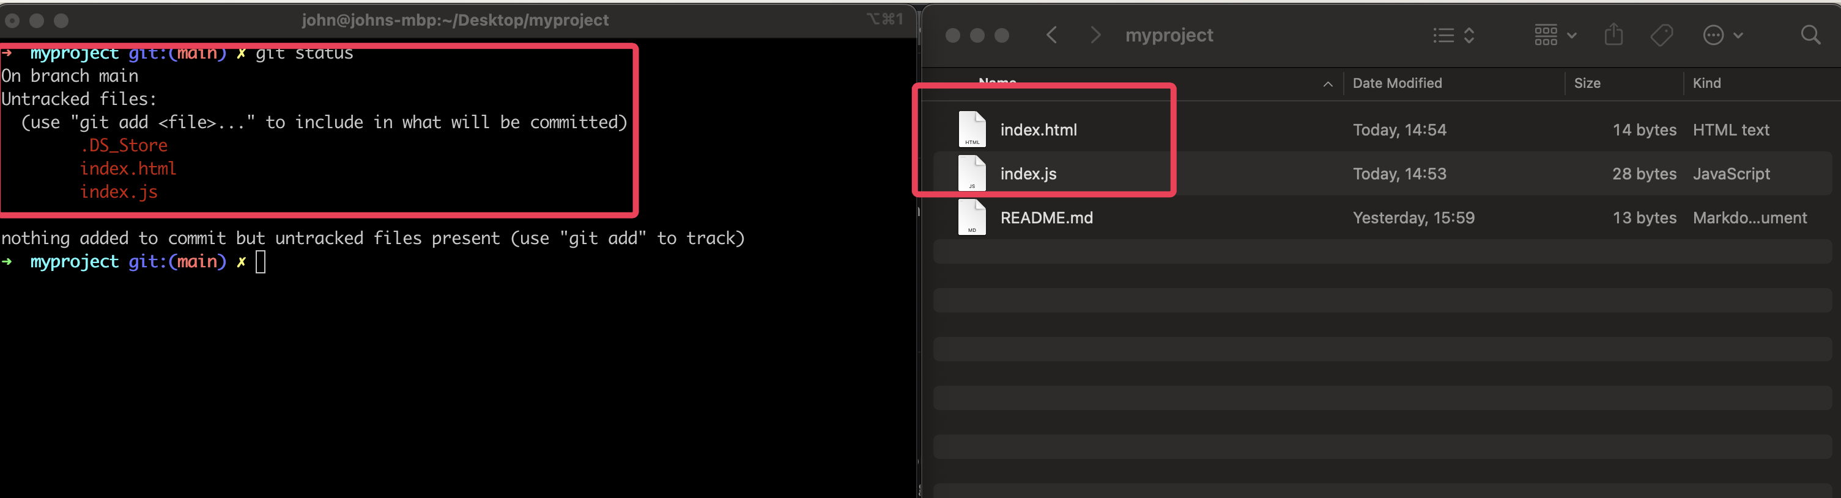
2 new files…… Oh wait, what’s .DS_Store? It’s a directory OSX uses to manage it’s file system. We do not want this in our repository

Slide 20
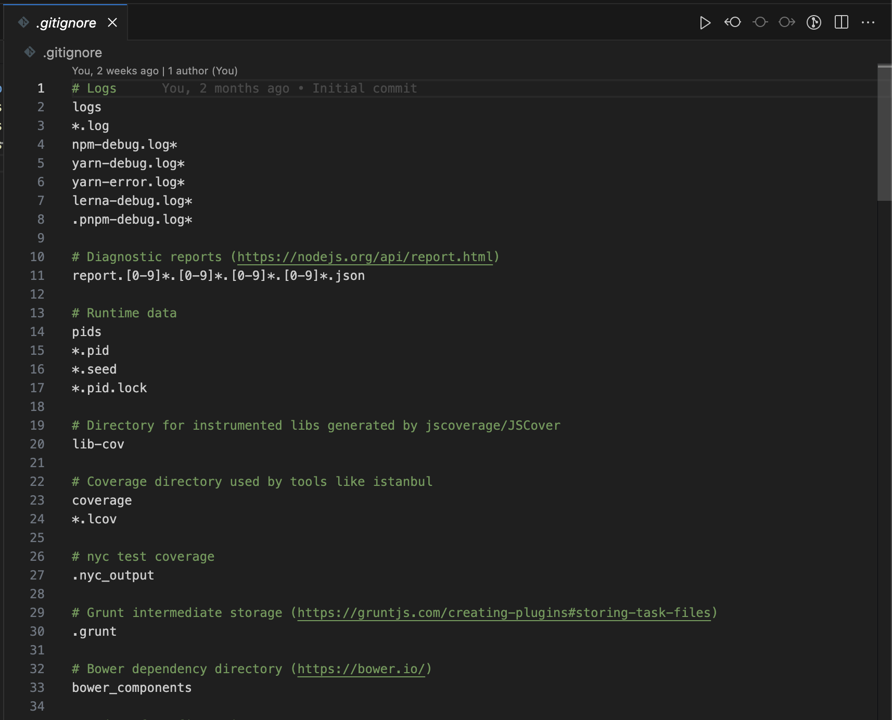
.gitignore
.gitignore (or git ignore) is a file that contains a list of files or directories to not track in our repository

Slide 21
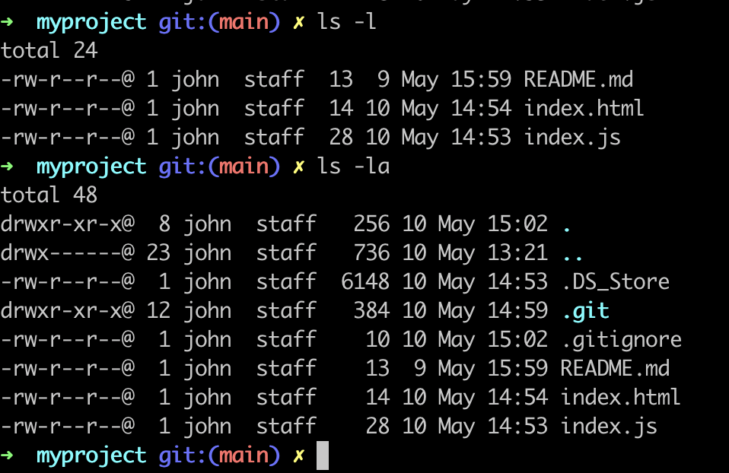
.gitignore
Note that it is a “hidden file” in most operating systems, that is, it is named with a`.` at the beginning

Slide 22
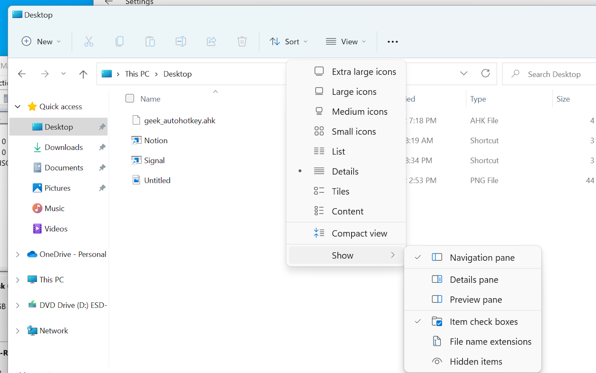
.gitignore

Slide 23
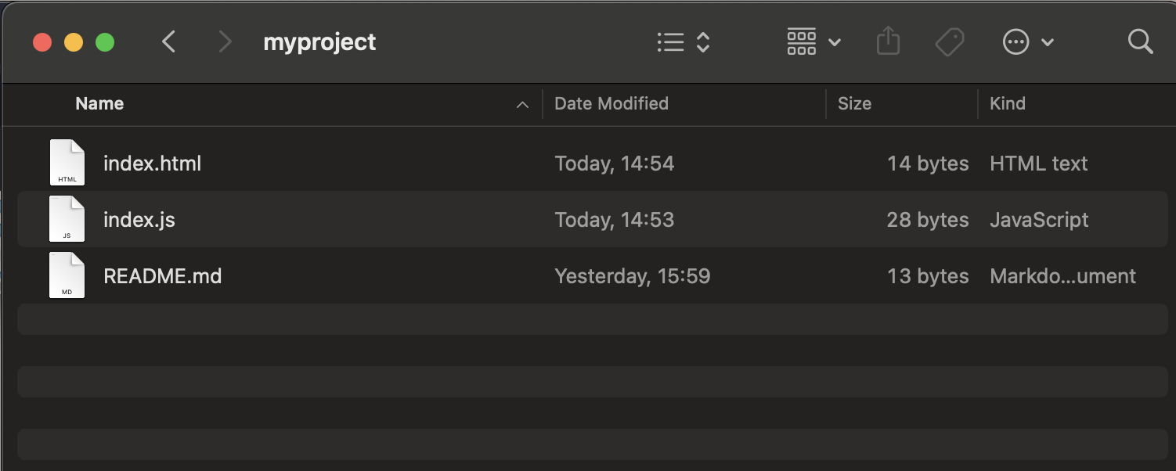
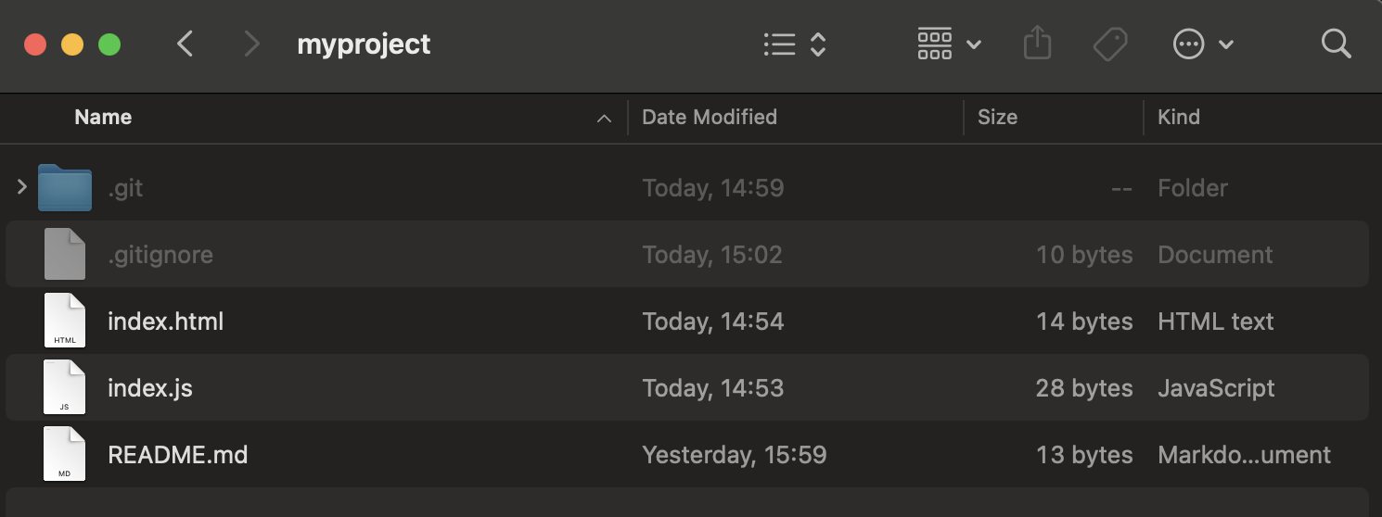
.gitignore
Cmd + shift + .

Slide 24
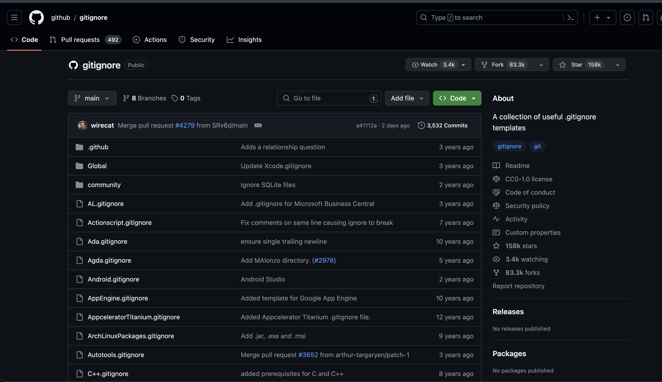
.gitignore
Useful .gitignores: https://github.com/github/gitignore

Slide 25
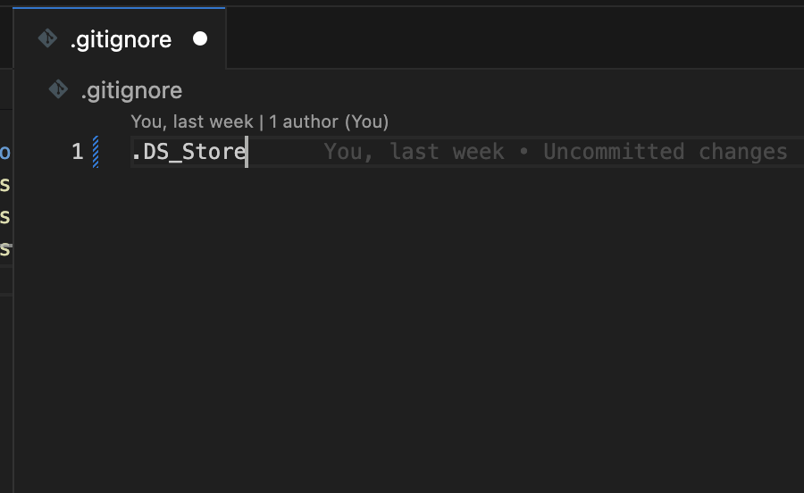
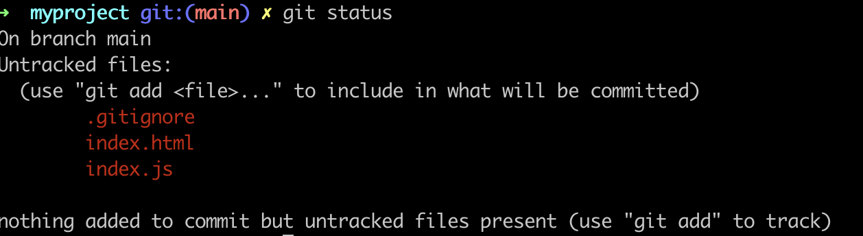
So, we add a .gitignore

Slide 26
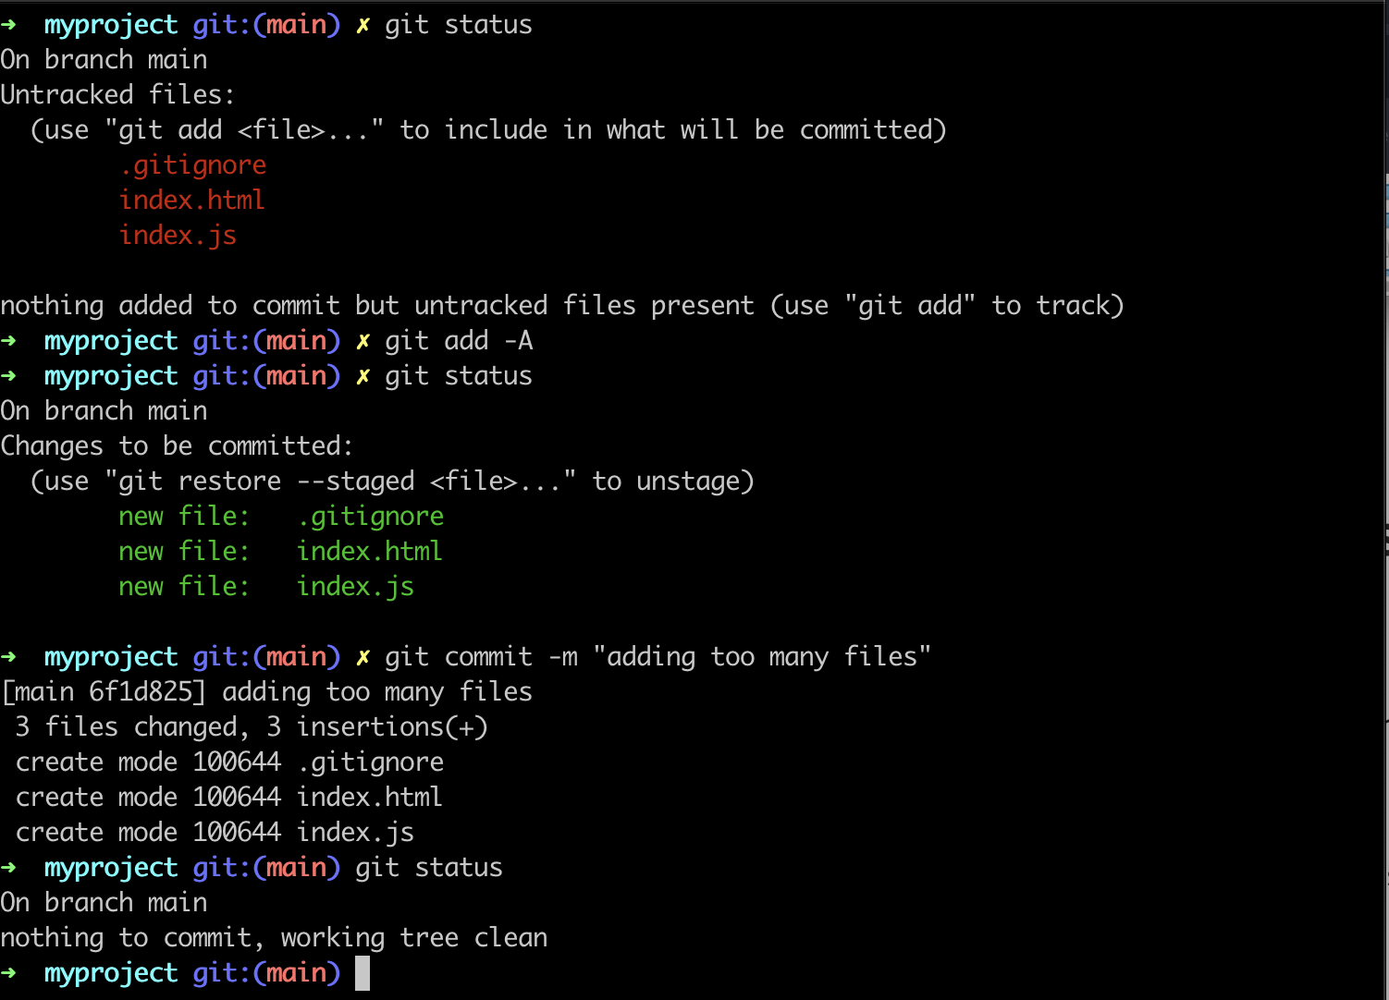
Now we add and commit our new files

Slide 27
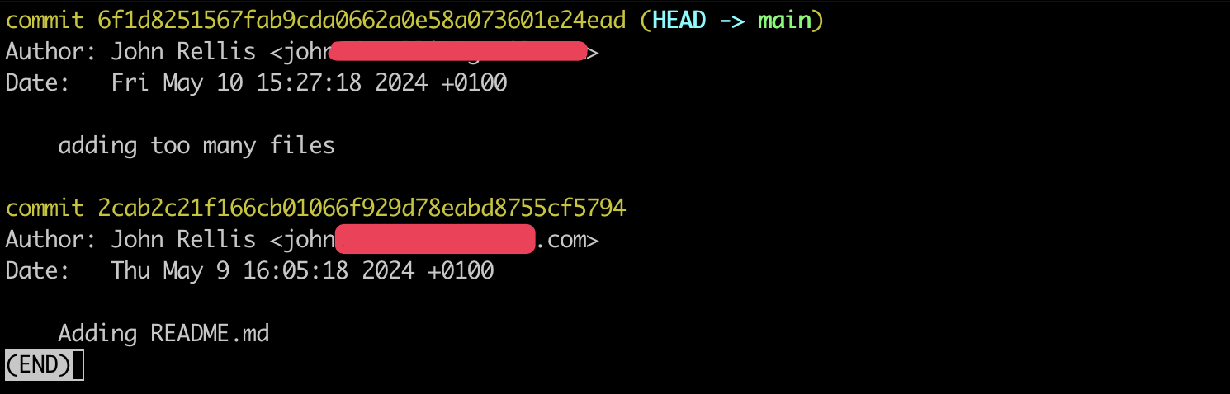
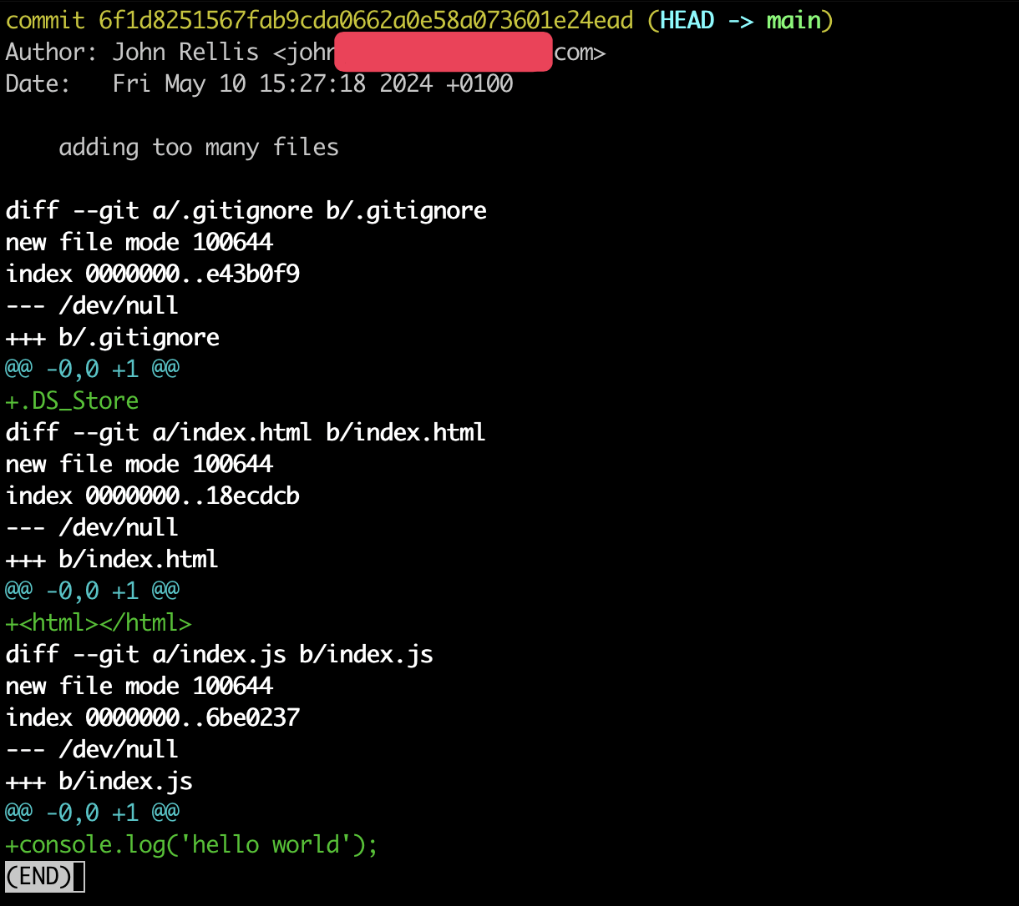
git log
git show 6f1d825

Slide 28
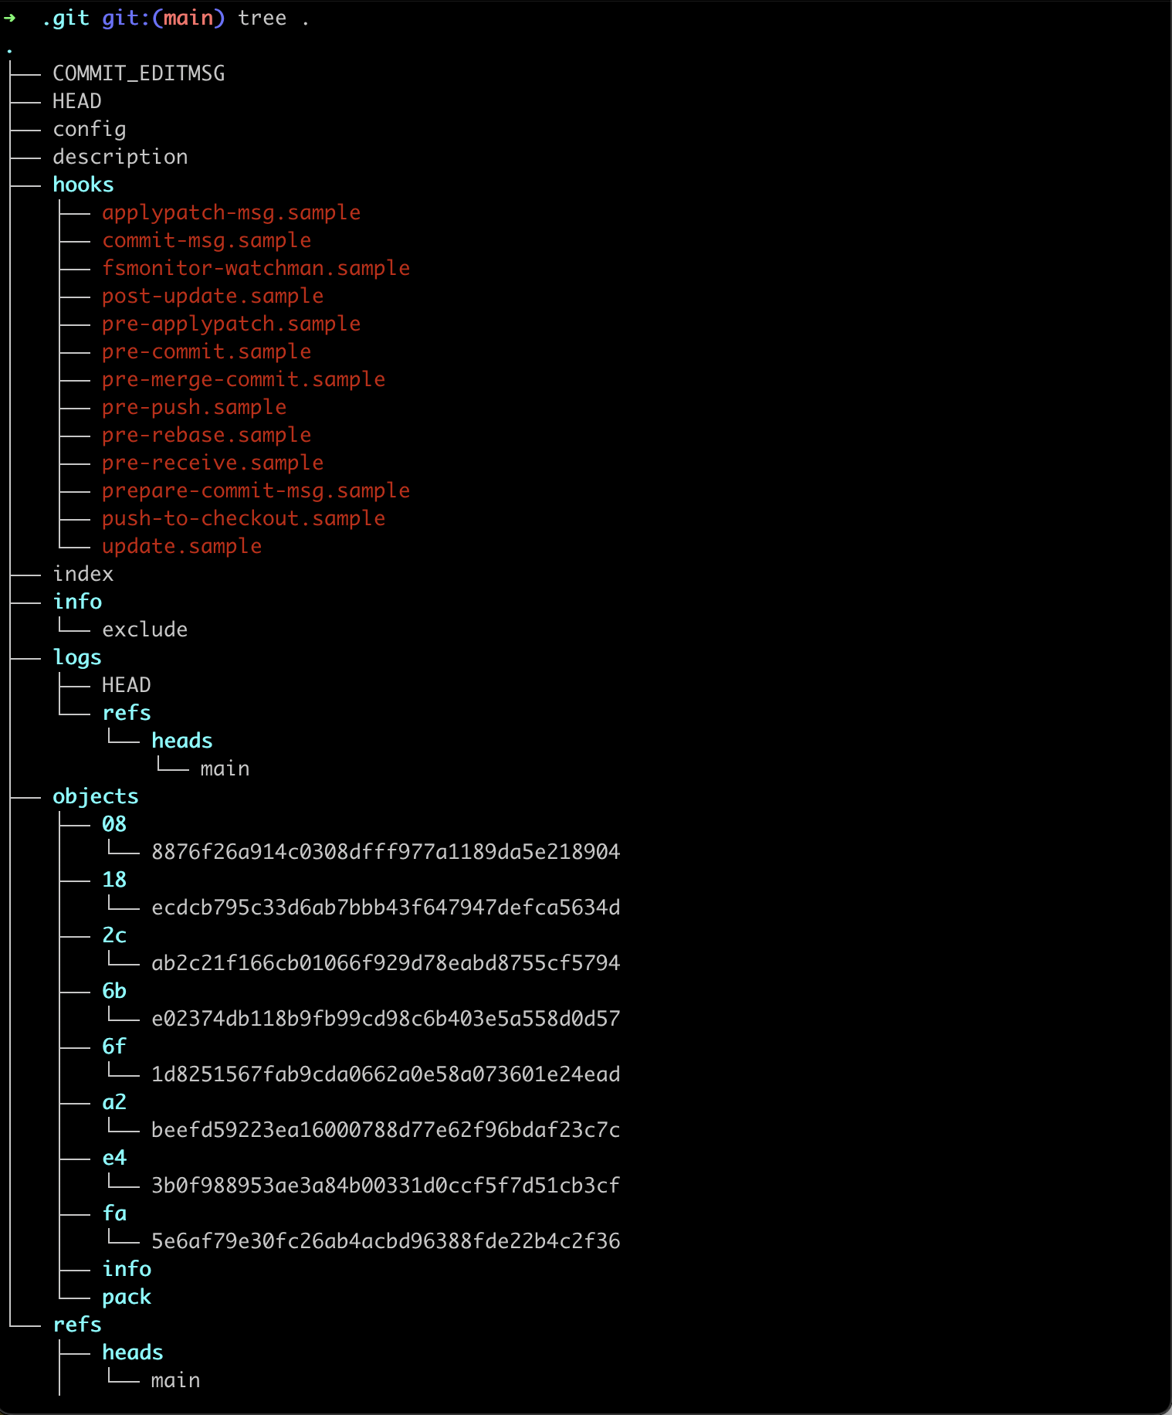
.git folder
This is the history of your repository, you probably shouldn’t be in here if you are new to git but it’s good to know it exists
git init creates this folder
Use git log to see the commit history
Use git status to see the current status of the repository

Slide 29
Recap
We used git init to turn our directory into a repository
We learned about the staging area that we can add files to to stage a commit
We can then commit these files to the repository
git log will show us the log of commits
Each commit has a hash that can be shortened to the first 7 characters
git show <commit hash> will show us information about the commit
We used .gitignore to ignore files/folders within our project directory
So far, this is all done locally on your machine

