Slide 1

github
An introduction
John Rellis
Web Development 2

Slide 2

What is github?
github is a web based service that allows the hosting of remote git repositories
It has become synonymous with collaboration on open source projects
github has features that integrate your git repositories with your entire development and release lifecycle e.g. CICD pipelines, github actions
github can also act as an identity provider
It is accessible via https://github.com/

Slide 3
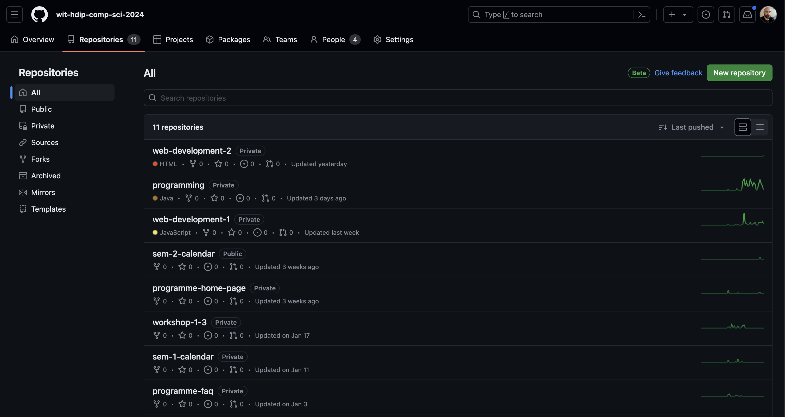

Slide 4
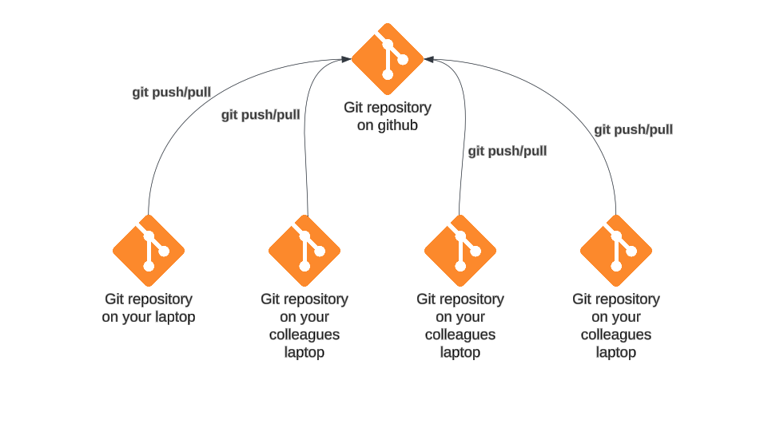
Remote.
The key here is, github hosts REMOTE git repositories
git allows multiple repositories to “connect” to a remote repository
This allows you to use github as a backup and source of truth on personal projects
Work on the same project on your home and work laptop
While also allowing for collaboration on group projects, such as in the workplace
Allows for conflicts

Slide 5




Are there other git hosting services?

Slide 6
Why have I heard so much about github?
Early Adoption and Popularity
GitHub was one of the earliest platforms to offer Git repository hosting services. It gained popularity quickly due to its user-friendly interface, robust features, and strong community support.
Feature-Rich Platform
GitHub provides a wide range of features beyond basic Git repository hosting, such as issue tracking, project management tools, code review capabilities, and wikis. These additional features have made GitHub a comprehensive platform for software development collaboration.
Social Coding
Allows developers to easily share their code, contribute to open-source projects, and collaborate with others.
Integration Ecosystem
Integrates seamlessly with a vast array of third-party tools and services, including continuous integration and deployment (CI/CD) pipelines, code analysis tools, project management platforms, and more. This integration capability has made GitHub an integral part of many developers' workflows.
Opensource Culture
GitHub has played a significant role in fostering the growth of the open-source movement. Many major open-source projects host their repositories on GitHub, making it a central hub for accessing and contributing to open-source software.
Acquisition by Microsoft:
GitHub's acquisition by Microsoft in 2018 further solidified its position as a dominant platform for software development. Microsoft's resources and support have allowed GitHub to continue growing and improving its services.

Slide 7
https://github.com/features

Slide 8





Also, octocats…… https://octodex.github.com/

