Slide 1


git and github
Web Development 1 john.rellis@setu.ie

Slide 2

git guide – useful for self learning
https://github.com/git-guides

Slide 3

Install git
We are going to use the command line and visual studio code – this means, if you are on windows, you will use a program called git bash.
On other systems, you can use the native terminal.
If you choose to use github-cli, you are on your own.
Do not install a GUI program yet.

Slide 4
Install git
https://github.com/git-guides/install-git

Slide 5
Configure your laptop
Set your git username as per:
https://docs.github.com/en/get-started/getting-started-with-git/setting-your-username-in-git
Set your git email address as per:
https://docs.github.com/en/account-and-profile/setting-up-and-managing-your-personal-account-on-github/managing-email-preferences/setting-your-commit-email-address
If starting out, don’t worry too much about config per repository, set everything global, e.g.
git config --global user.email "YOUR_EMAIL"
git config --global user.name "Mona Lisa"
Confirm with
git config --global user.name
git config --global user.email

Slide 6

Install vs code
https://code.visualstudio.com/download

Slide 7
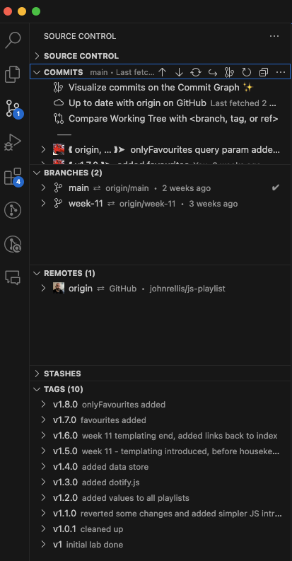
Install vs code
VS code supports a host of git features out of the box so we’ll work with those first

Slide 8
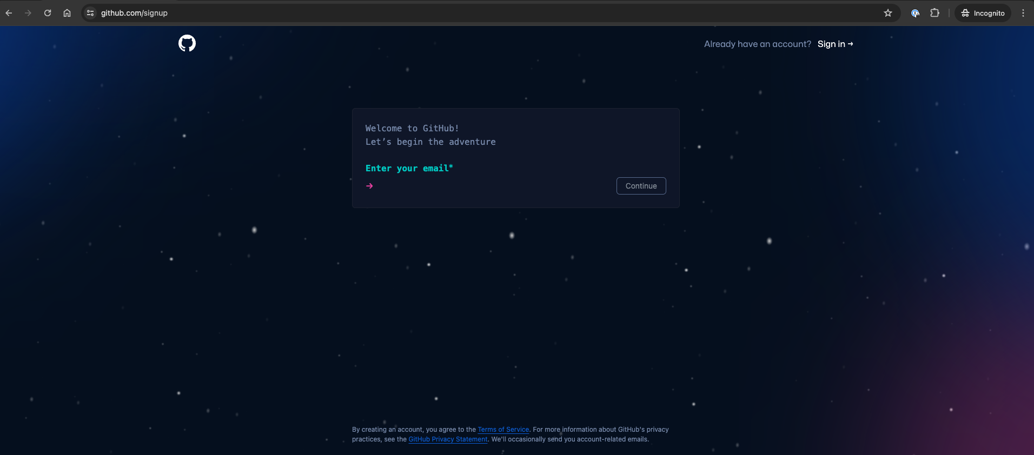
Sign up for a github account – github.com/signup

Slide 9

Public and Private repositories
You can restrict who has access to a repository by choosing a repository's visibility: public or private.
When you create a repository, you can choose to make the repository public or private.
I recommend you start all your repositories private until you have learned enough about software licencing OR you are asked to create public repositories by a teacher/lecturer

Slide 10
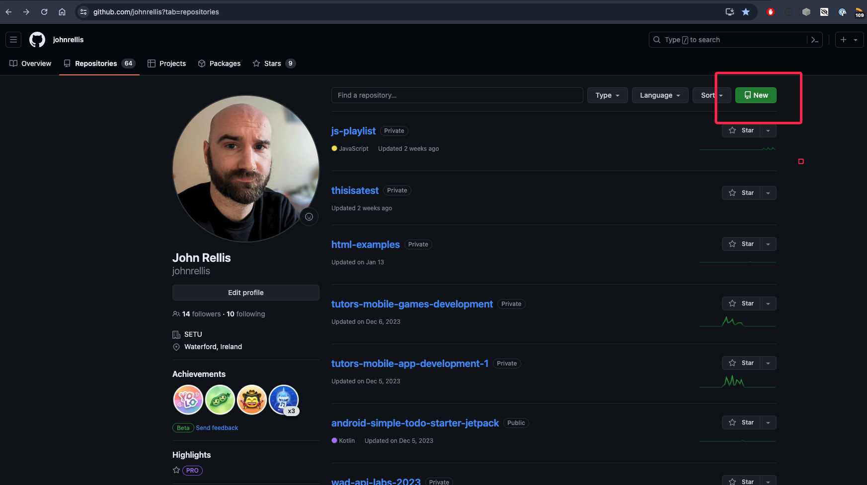

Create a Repository / Create a Repo

Slide 11
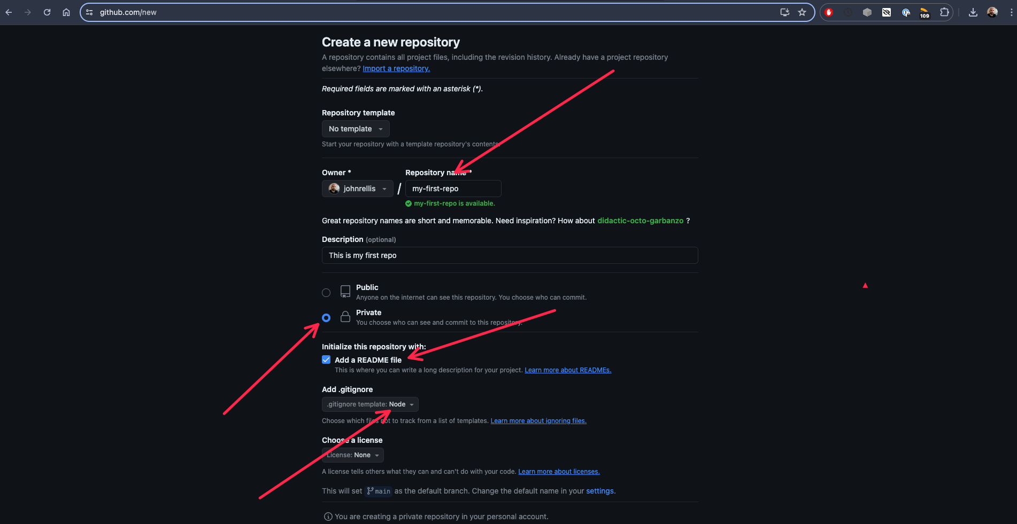

Slide 12
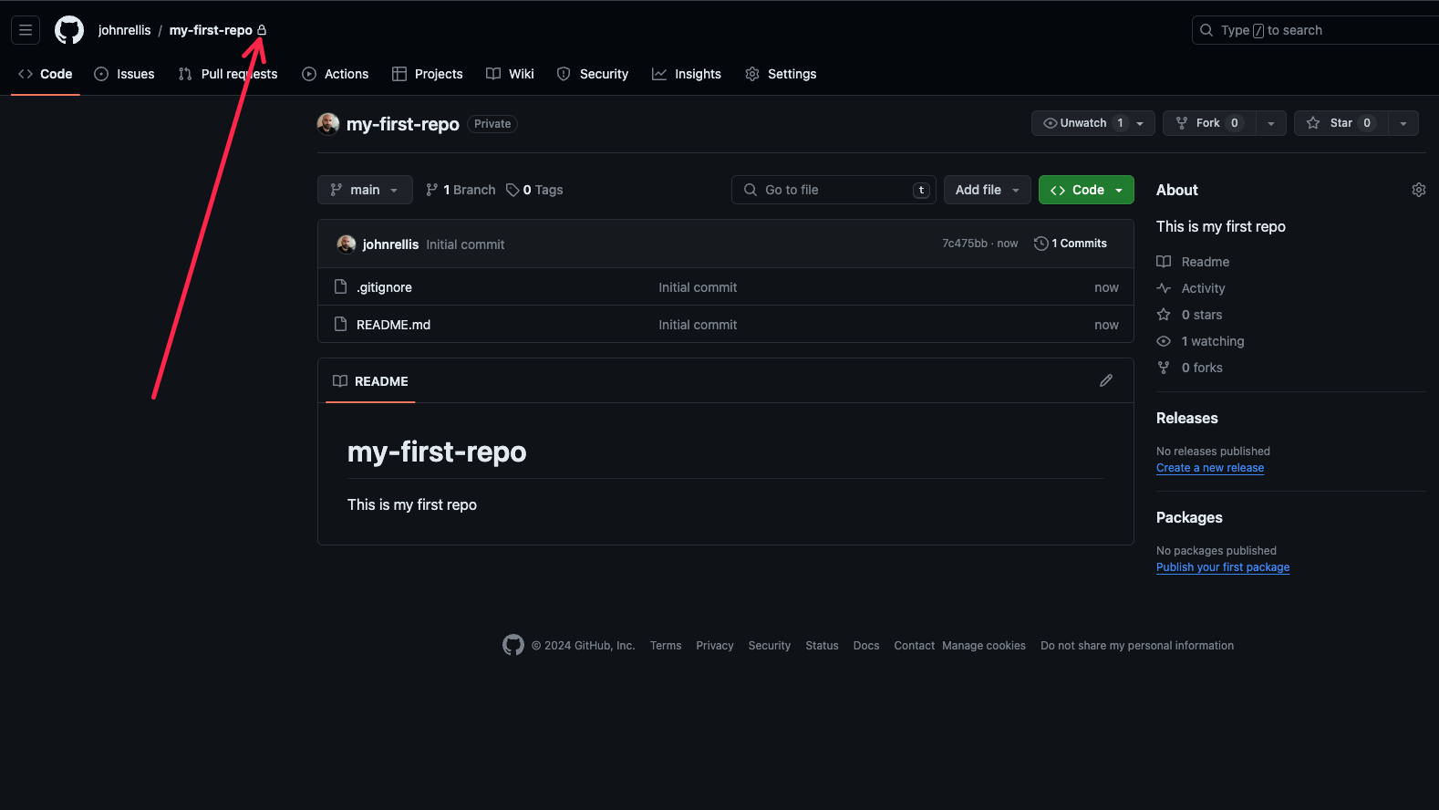

Slide 13

Now for the messy bit….. Authentication
We are going to use SSH keys to authenticate
https://docs.github.com/en/authentication/connecting-to-github-with-ssh/about-ssh
Read the above and you can jump to the the following steps, note that there are tabs for mac, windows and linux:
https://docs.github.com/en/authentication/connecting-to-github-with-ssh/checking-for-existing-ssh-keys
https://docs.github.com/en/authentication/connecting-to-github-with-ssh/generating-a-new-ssh-key-and-adding-it-to-the-ssh-agent
https://docs.github.com/en/authentication/connecting-to-github-with-ssh/adding-a-new-ssh-key-to-your-github-account
https://docs.github.com/en/authentication/connecting-to-github-with-ssh/testing-your-ssh-connection
https://docs.github.com/en/authentication/connecting-to-github-with-ssh/working-with-ssh-key-passphrases

Slide 14
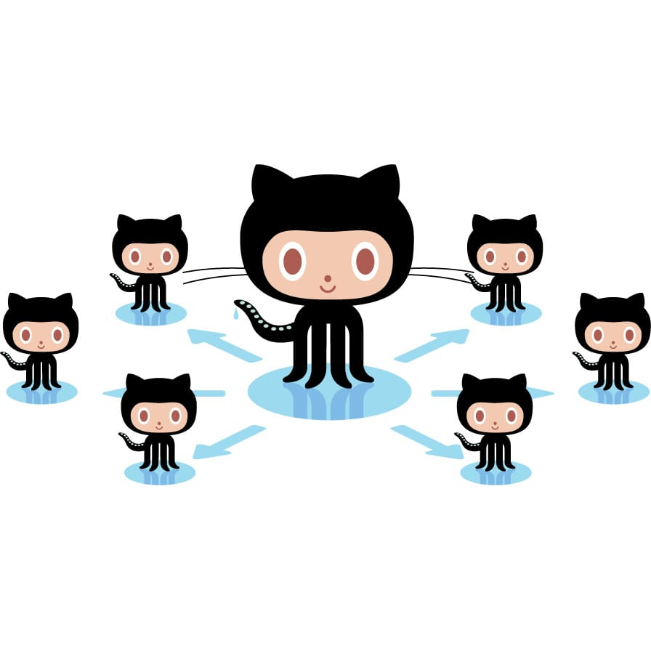
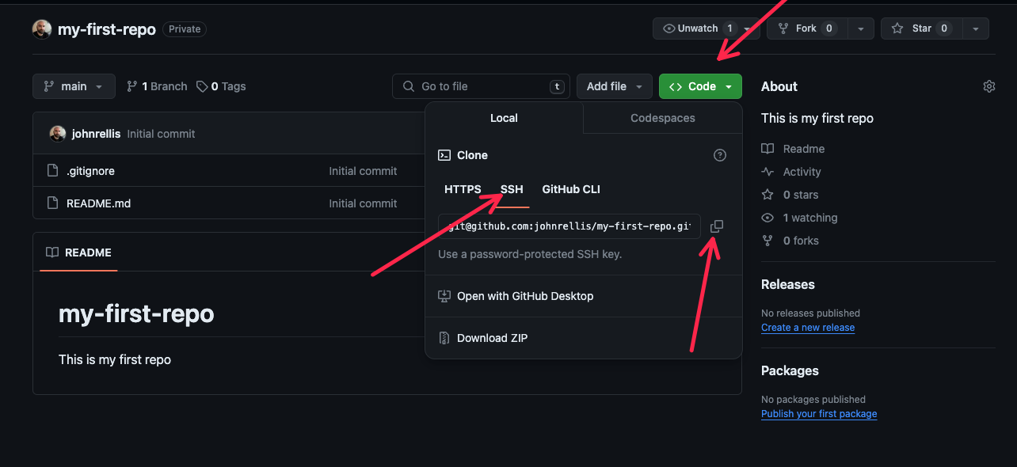
If you’ve made it this far, time to clone…

Slide 15
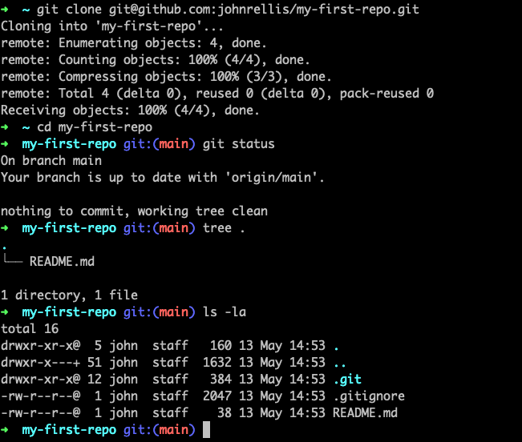
We clone the repo using the copied git URL
We cd into my-first-repo
git status confirms we have our repo and we are on the main branch (huh, what’s a branch?)
I have a fancy terminal configuration that shows me git repo information in the command line, you may not.
I use tree to inspect the repo, you may not have tree installed, don’t worry.
ls –la lists all our files, including our hidden files
.git directory, contains all our repo information
.gitignore, our ignore file that was created on repo creation
Our README.md

Slide 16
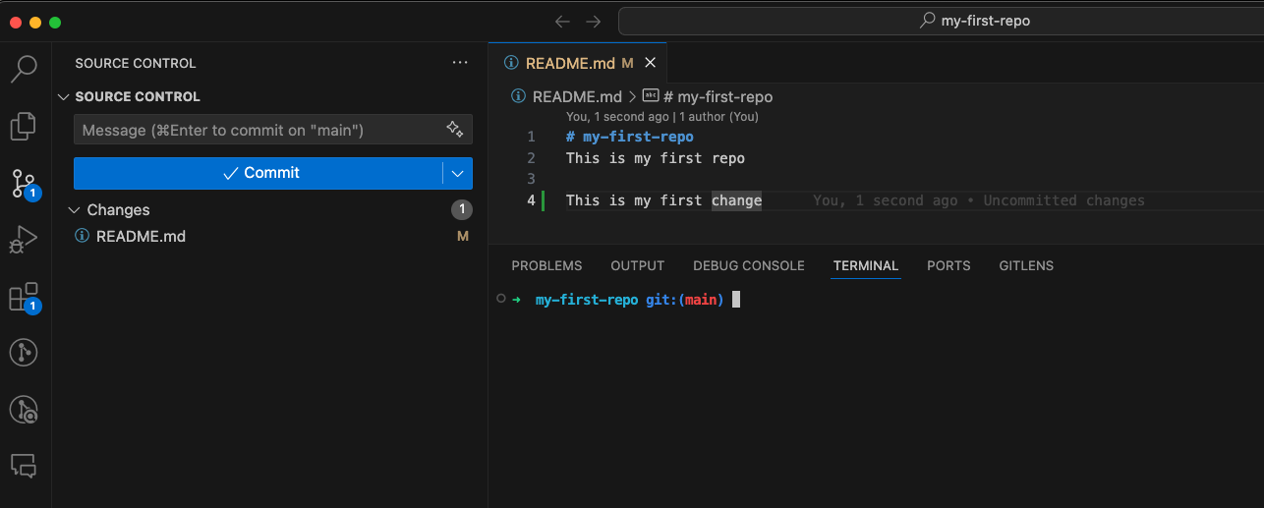
Open the directory/repo in VS Code
2. Open the git section
1. Make this change to README.md and save.

Slide 17
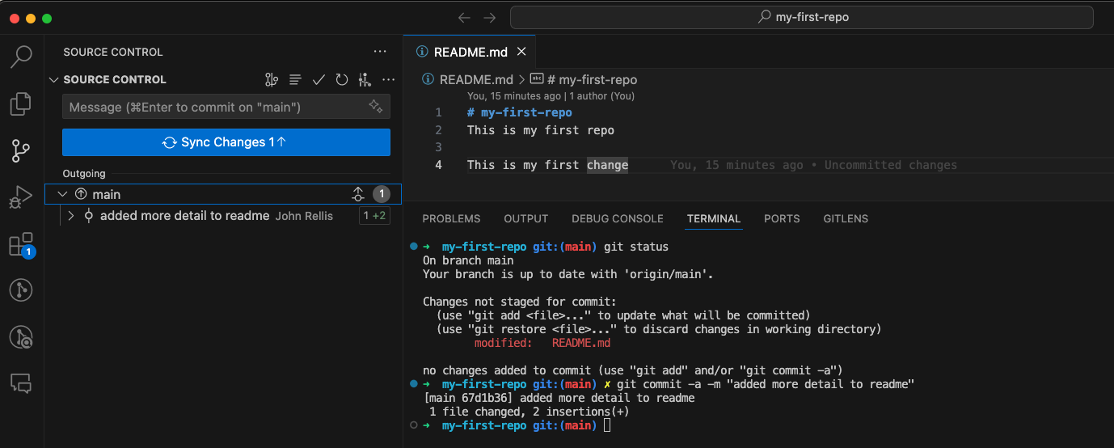
Open the directory/repo in VS Code
4. Our changes waiting to be pushed
3. Notice we have changes to “sync” – I don’t like this term in git but vs code does
2. Commit all changes with a message
1. git status to see the current status of the repo

Slide 18
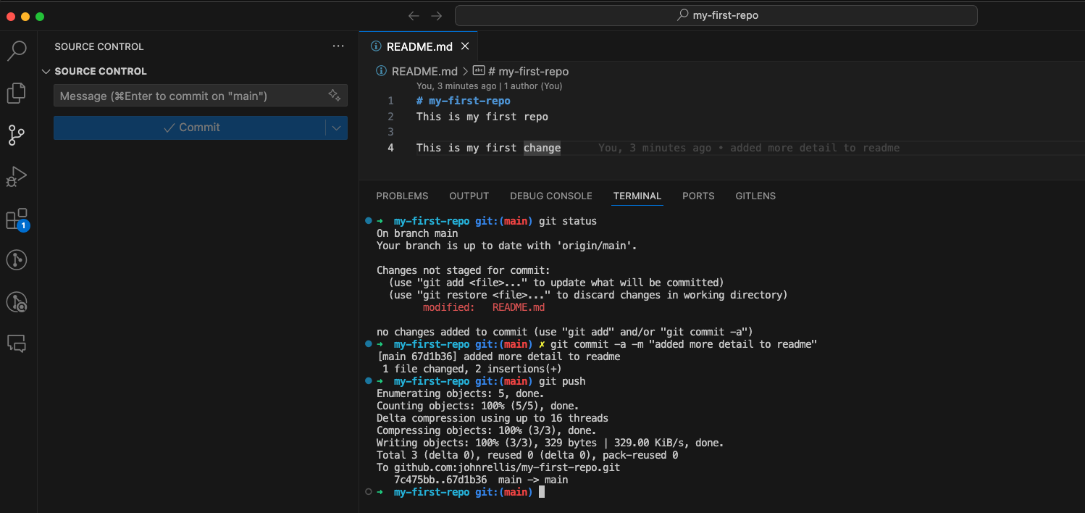
Open the directory/repo in VS Code
1. We perform a git push to push our changes to our remote

Slide 19
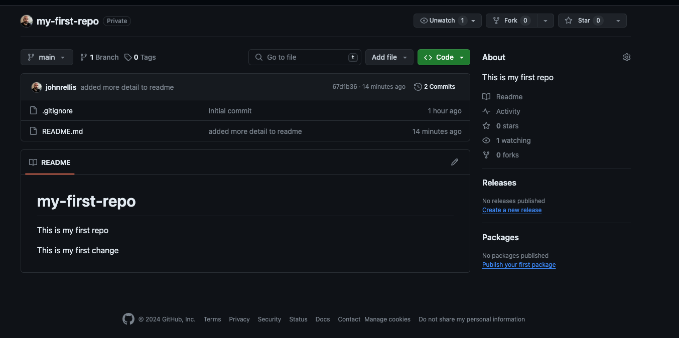
Verify your changes on github

Slide 20

Celebrate!

Slide 21
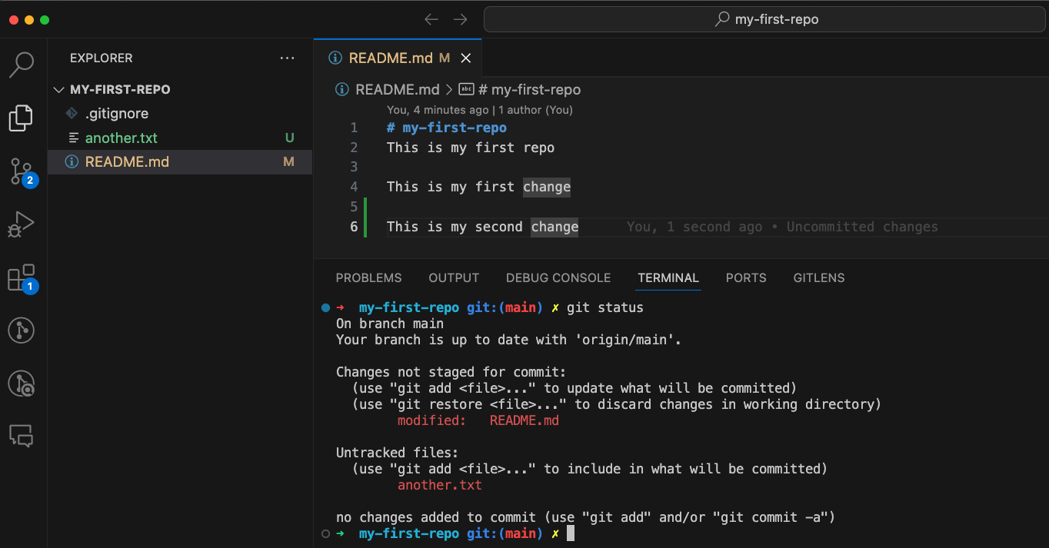
A note on VS Code
New file in green
There’s a plethora of useful git extensions but when starting out, they can be confusing.
Personally, I use very little, I work from the explorer and the command line
Explorer button
Modified is highlighted in yellow

Slide 22

Mini cheatsheet
git clone <git url> - to clone a repository from git
git status – check the status of the repo – this is forever in my muscle memory, I do it a lot
git add –A or git add README.md to stage a file(s)
git commit –a –m “this adds all new staged files and unstaged mods of existing files”
git push – will push up to the repo you have cloned

Slide 23
The simple life
My general workflow is
git pull – pull down changes from repo
Make a group of related changes
git status
git add -A (if new files have been added, will do no harm anyway)
git commit –a –m “bug-fix: code no longer explodes”
git push
Rinse and repeat
There’s nuance you can mix in there, but that can get you going in a kind of unidirectional workflow when working solo.
It is useful to commit more often than not, as if you make a mistake you can always revert
Also useful but careful now!
git checkout <filename> - undo all changes since last commit on a file
git reset --hard – undo all changes since last commit (careful)

Slide 24
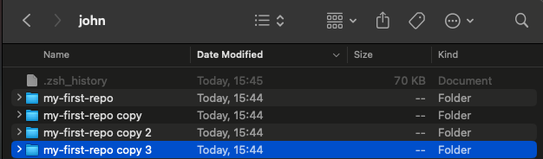
Something has gone wrong
A multitude of things can go wrong when working with projects that have multiple collaborators.
Take your time, in industry, all changes are peer reviewed so silly mistakes are usually caught
My secret, if you feel like there’s a lot that could go wrong with a git action, make a copy of your repo locally, that way, if you do something you are unsure of in your original, you can just throw it away
Just be sure to clean up after yourself or you will be confused

Slide 25
Resources
https://education.github.com/git-cheat-sheet-education.pdf
https://www.atlassian.com/git/tutorials/atlassian-git-cheatsheet

