Slide 1

git features 1
Web Development 2
john.rellis@setu.ie

Slide 2
Git Features
Branching and Merging
Remote Branches and Pull Requests (in brief)

Slide 3
Branching and Merging
In git, all work is done on a branch
When you create a repository, you create the “main” branch
This “main” branch was once called ”master” but it is now less common
Up to now you have seen staging and then committing all on the main branch
Typically, a branch is created from a commit on main to, for example, create a new feature or fix a bug. This is often referred to as “feature branching”
Once the feature is complete/bug fixed, we then merge back to main, between such time, others may have augmented main. It is at this time merge conflicts are managed, if they exist

Slide 4
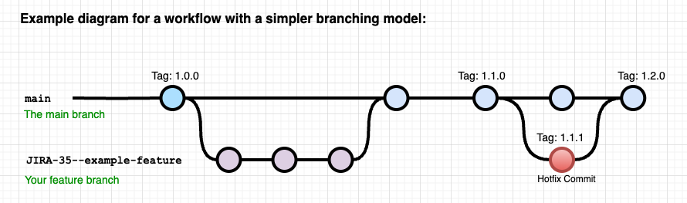
Simple Branching Model
Below we can see a typical way of visualising git branches
The dots are commits
A release is tagged on the main branch and the next feature is started via a feature branch, when done, we merge back and delete our branch

Slide 5
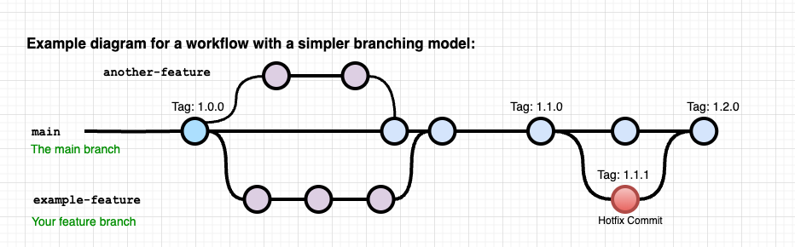
Extended example with 2 features

Slide 6
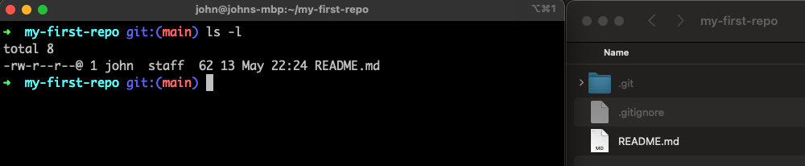
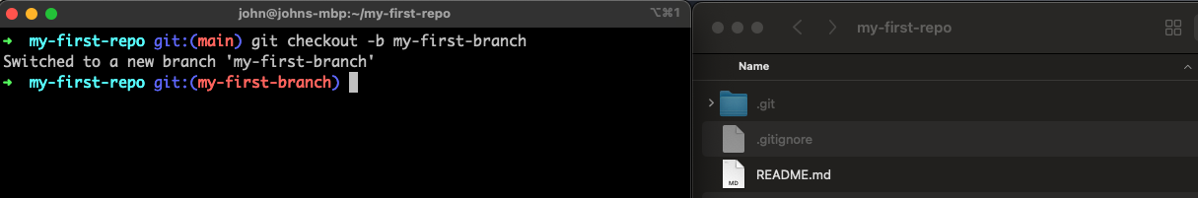
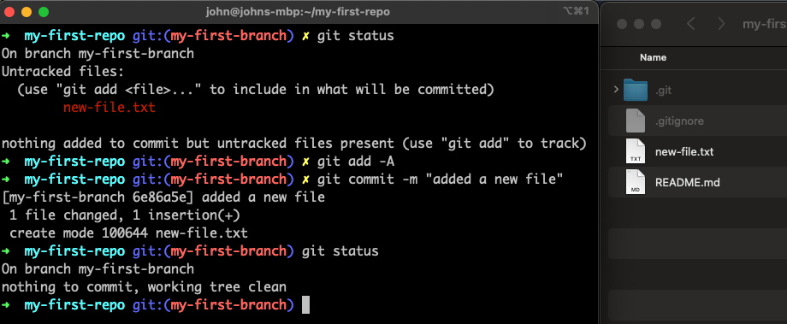

Slide 7
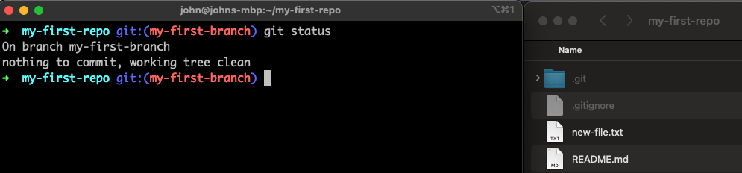
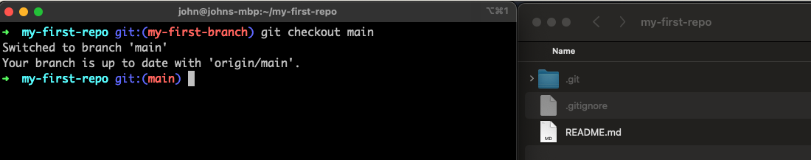
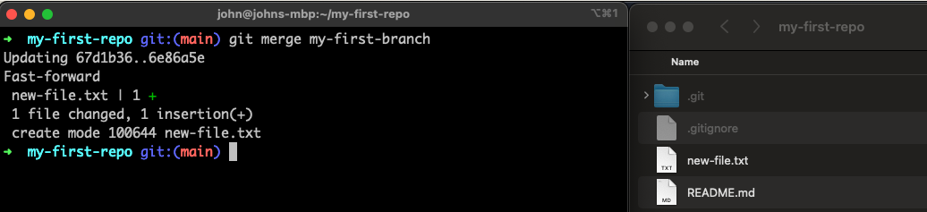
Notice, new-file.text is gone on the file system as we changed branch. When we merge below, it reappears.

Slide 8
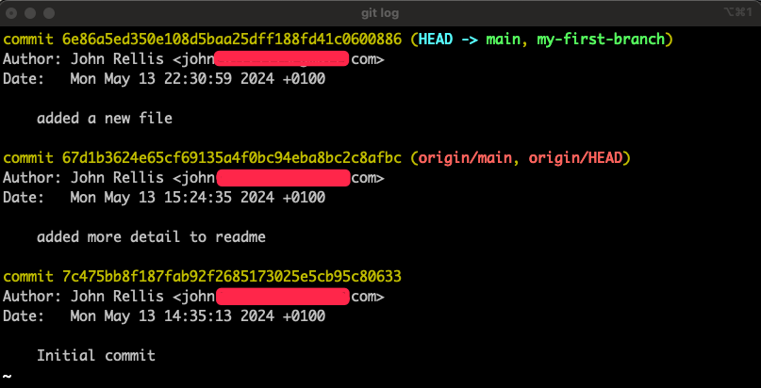
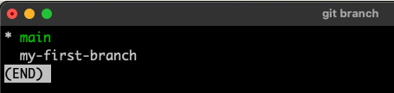
git log
git branch

Slide 9
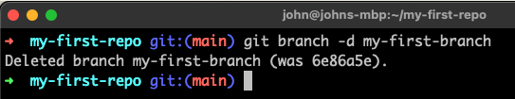

git branch

Slide 10
Recap
We created a new branch called my-first-branch - git checkout –b my-first-branch
-b creates the new branch and switches you to it
git status will tell you what branch you are on
We created a new file, added it and committed it to my-first-branch
Create file
git add new-file.txt
git commit –m “added a new file”
We switched back to main
git checkout main (or in newer versions of git, git switch main)
We noted the file system changed when switching branches, not something hidden in the depths of git
Personally, this was a big understanding moment for me with branches, nothing is hidden, you can see the file system change as you switch between branches.
We then merged our branch into main - git merge my-first-branch
Delete the branch - git branch –d my-first-branch
To view available branches – git branch
To view the git log – git log
Use q to quit from the log and the branch view

Slide 11
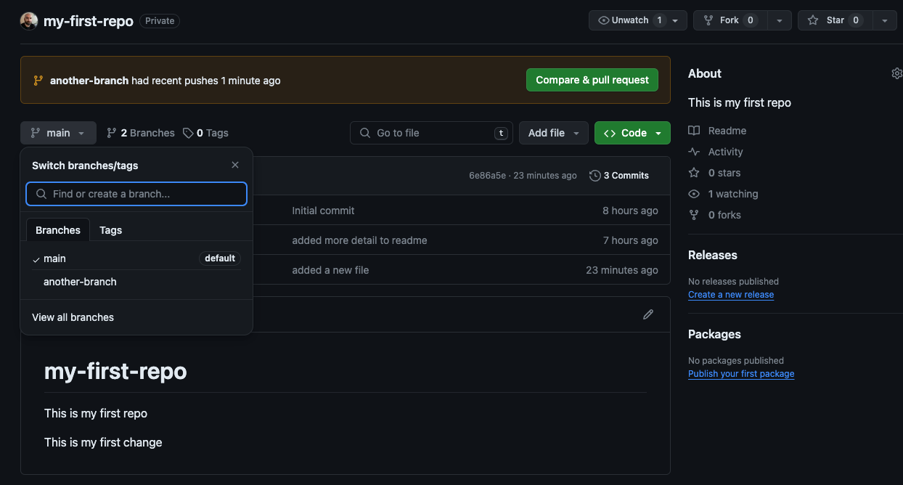
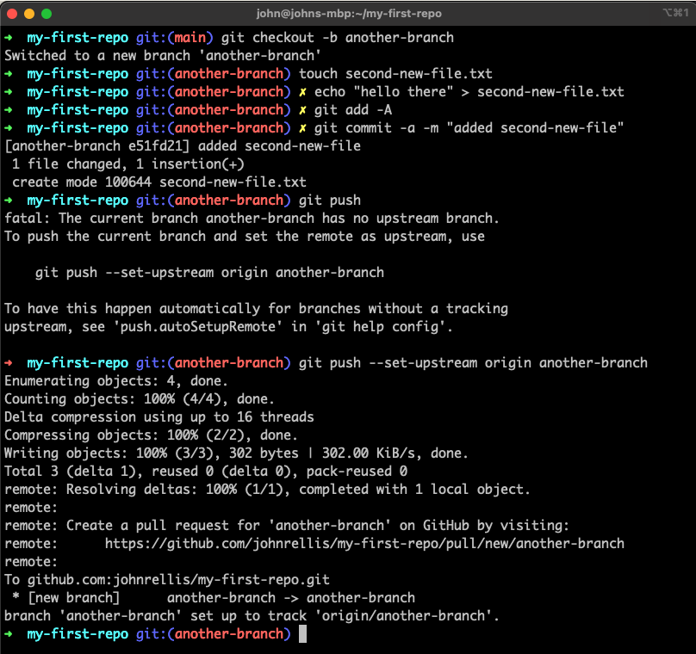
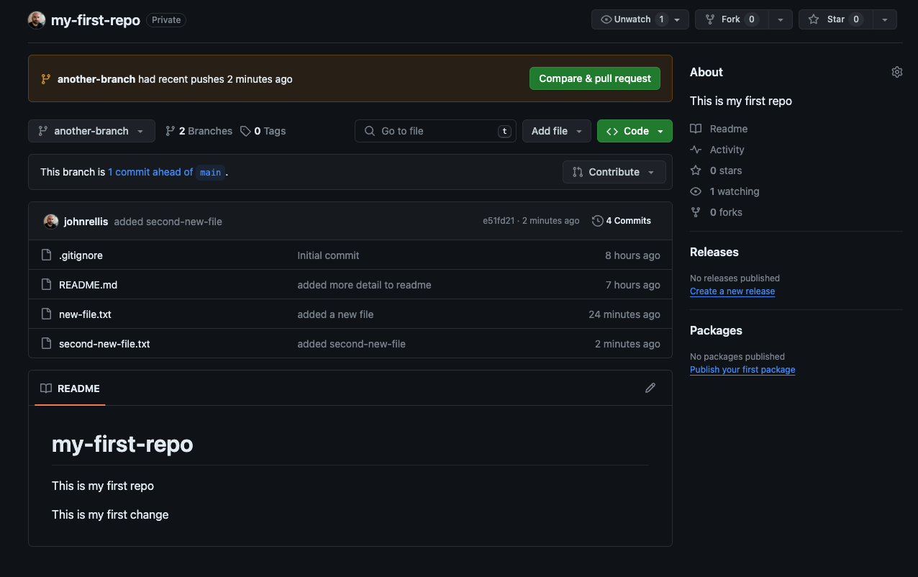
Git and Remote Branches

Slide 13
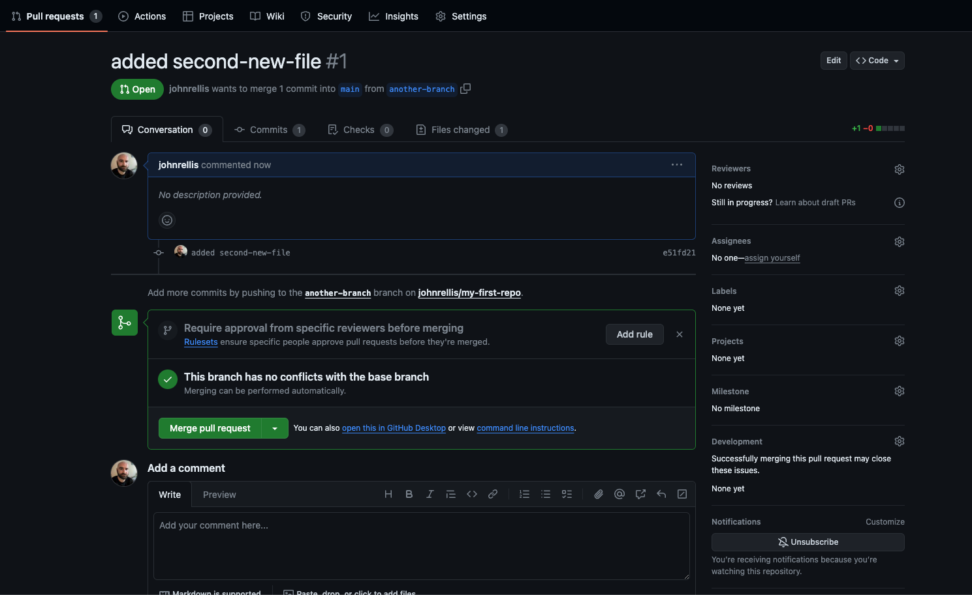
Compare and Pull Request

Slide 14
Where to next?
Check out - https://git-scm.com/about
Free ebook - https://git-scm.com/book/en/v2
Discover what is a git tag?
https://code.visualstudio.com/docs/sourcecontrol/overview
Videos worth watching
https://gist.github.com/bryanbraun/8c93e154a93a08794291df1fcdce6918
https://github.com/nicoespeon/gitgraph.js/tree/master/packages/gitgraph-js

