Slide 1
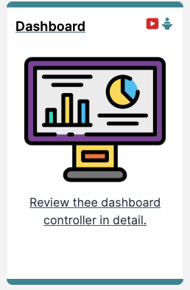
Dashboard Controller

Slide 2
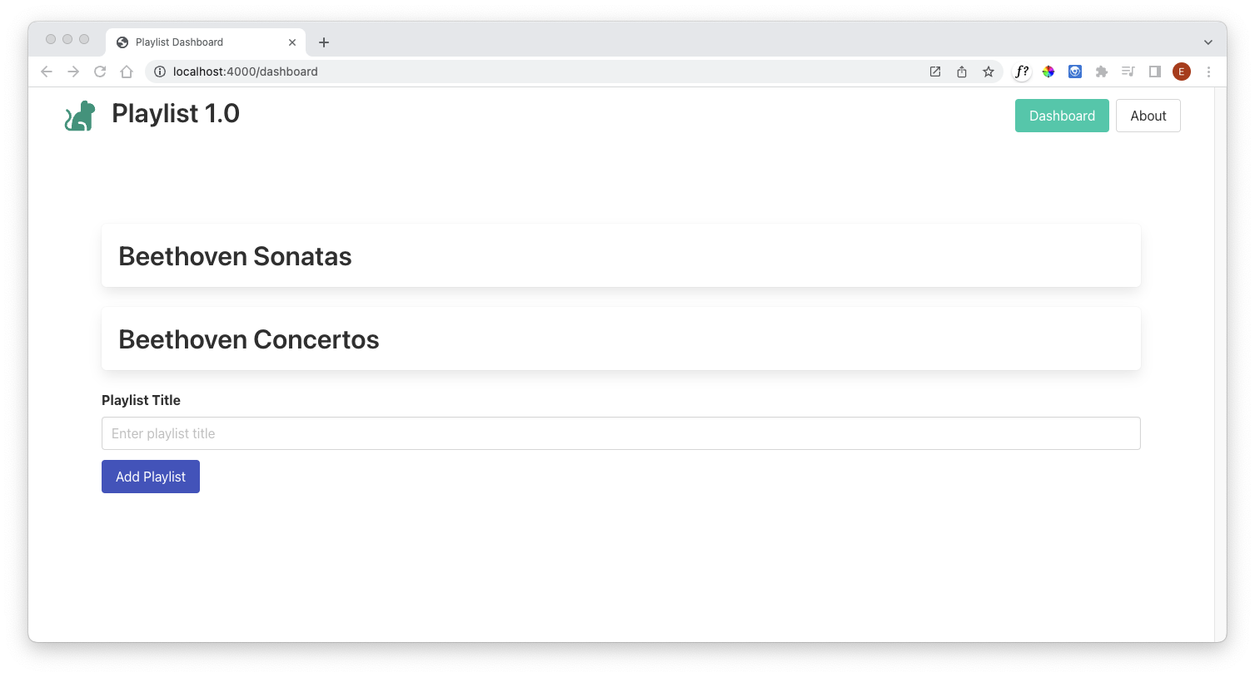
Dashboard Controller
import { playlistStore } from "../models/playlist-store.js";
export const dashboardController = {
async index(request, response) {
const viewData = {
title: "Playlist Dashboard",
playlists: await playlistStore.getAllPlaylists(),
};
console.log("dashboard rendering");
response.render("dashboard-view", viewData);
},
async addPlaylist(request, response) {
const newPlaylist = {
title: request.body.title,
};
console.log(`adding playlist ${newPlaylist.title}`);
await playlistStore.addPlaylist(newPlaylist);
response.redirect("/dashboard");
},
};

Slide 3
Dashboard Controller
Import playlistStore to access model
Define & export dashboardController object
index Action
addPlaylist Action
import { playlistStore } from "../models/playlist-store.js";
export const dashboardController = {
async index(request, response) {
...
},
async addPlaylist(request, response) {
...
},
};

Slide 4
Index Action
async index(request, response) {
const viewData = {
title: "Playlist Dashboard",
playlists: await playlistStore.getAllPlaylists(),
};
console.log("dashboard rendering”);
response.render("dashboard-view", viewData);
},
Invoked when “/dashboard“ route triggered
Create object to be sent to view
Retrieve all playlists from store
Log to console for debug purposes
Render “dashboard-view.hbs”
passing viewData

Slide 5
Index Action
Invoked when
“/dashoard/addplayist“ triggered
async addPlaylist(request, response) {
const newPlaylist = {
title: request.body.title,
};
console.log(`adding playlist ${newPlaylist.title}`);
await playlistStore.addPlaylist(newPlaylist);
response.redirect(“/dashboard");
},
Create a playlist object, using the title passed in the request
Log to console for debug purposes
Add new playlist object to the datastore
Redirect to “/dashboard” route

Slide 6
Dashboard Controller
import { playlistStore } from "../models/playlist-store.js";
export const dashboardController = {
async index(request, response) {
const viewData = {
title: "Playlist Dashboard",
playlists: await playlistStore.getAllPlaylists(),
};
console.log("dashboard rendering");
response.render("dashboard-view", viewData);
},
async addPlaylist(request, response) {
const newPlaylist = {
title: request.body.title,
};
console.log(`adding playlist ${newPlaylist.title}`);
await playlistStore.addPlaylist(newPlaylist);
response.redirect("/dashboard");
},
};

Slide 7
Dashboard Controller

