Slide 1
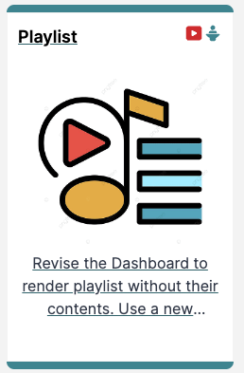
Playlist Controller

Slide 2
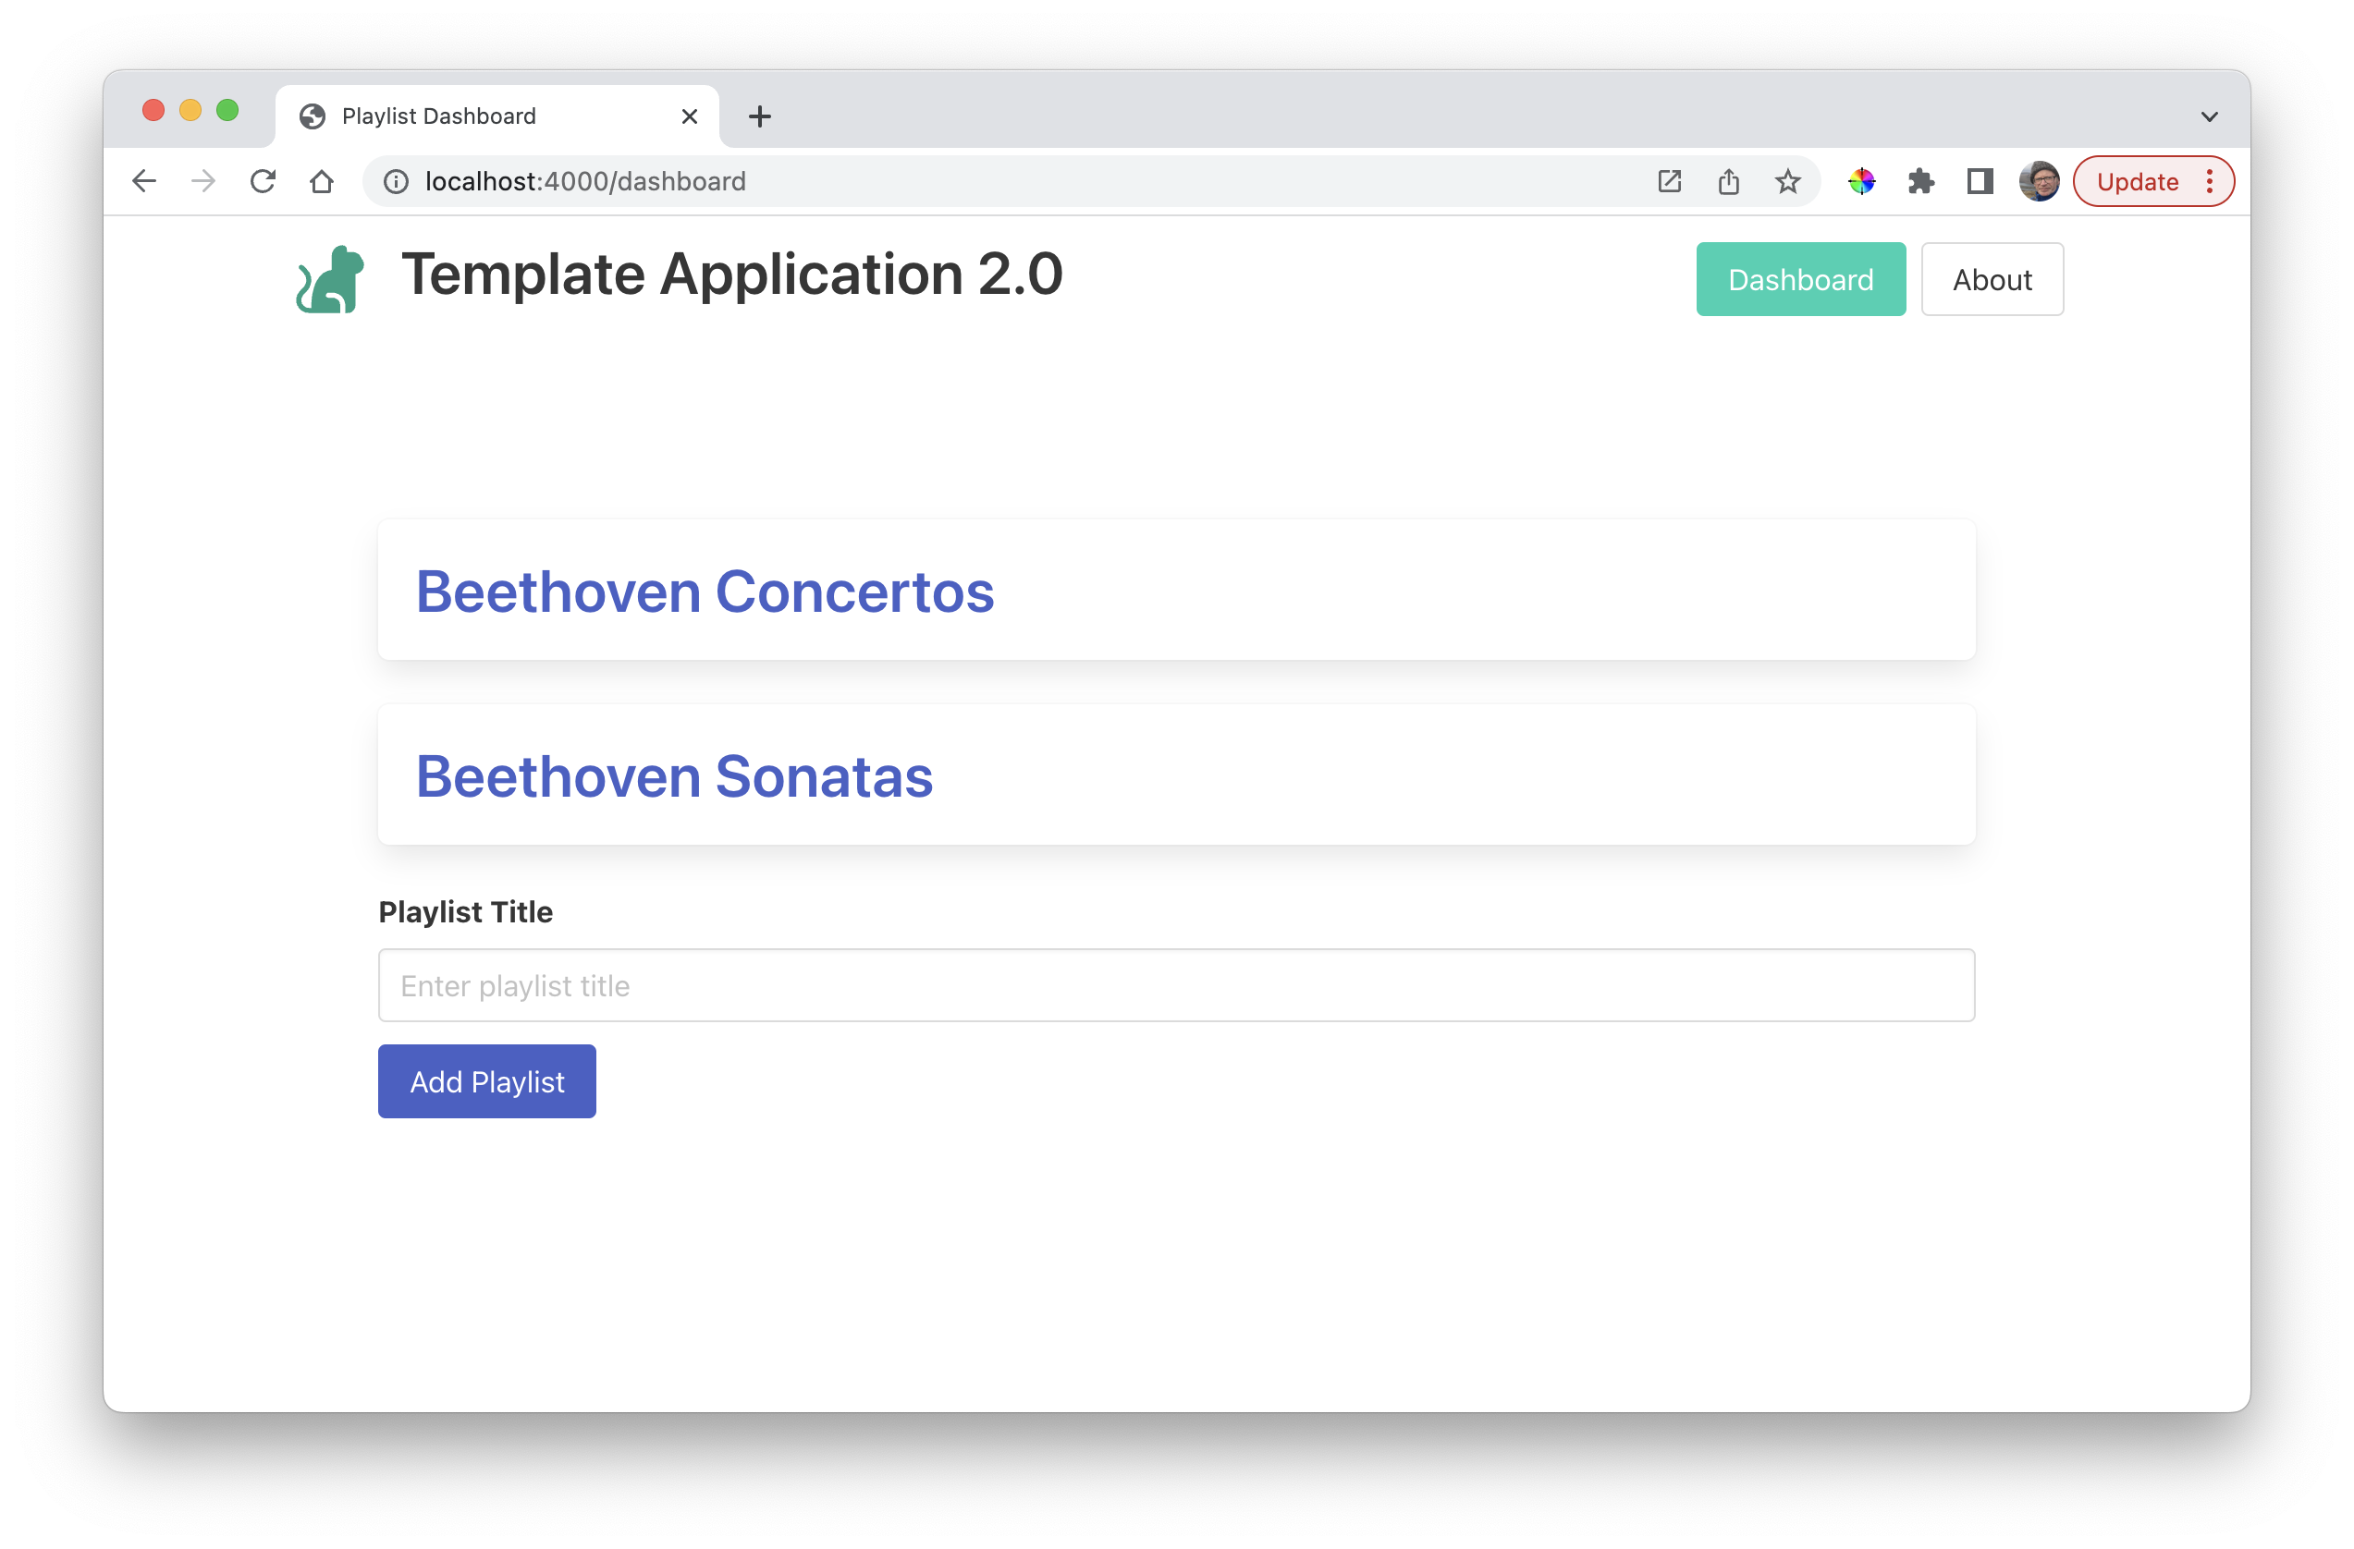
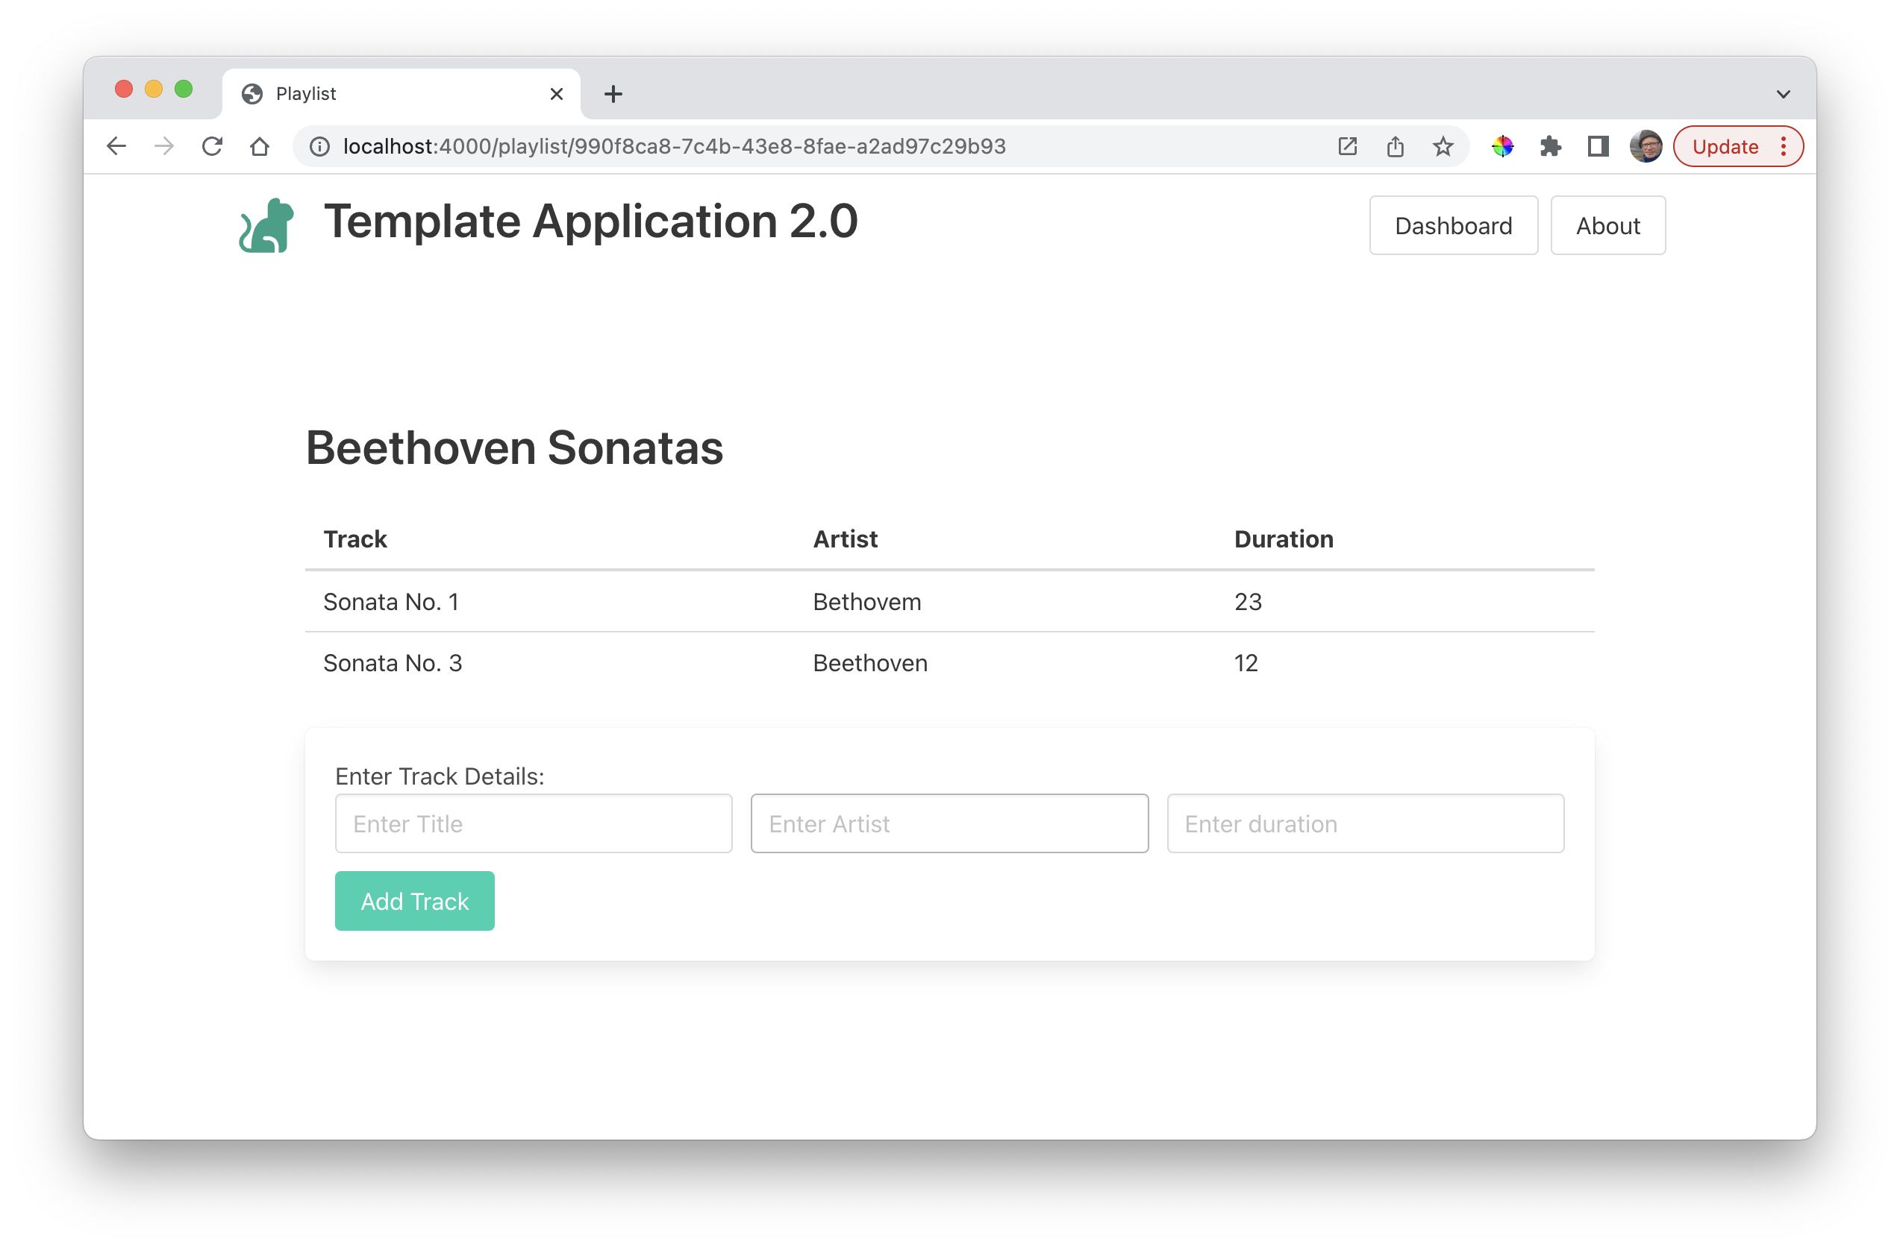
Dashboard -> Playlist

Slide 3
import { playlistStore } from "../models/playlist-store.js";
export const dashboardController = {
async index(request, response) {
const viewData = {
title: "Playlist Dashboard",
playlists: await playlistStore.getAllPlaylists(),
};
console.log("dashboard rendering");
response.render("dashboard-view", viewData);
},
…
};
dashboard-controller.js
{{#each playlists}}
<div class="box box-link-hover-shadow">
<h2 class="title">
<a href="/playlist/{{_id}}">
{{title}}
</a>
</h2>
</div>
{{/each}}
{{> menu active="dashboard"}}
<section class="section">
{{> list-playlists}}
{{> add-playlist}}
</section>
dashboard-view.hbs
list-playlists.hbs

Slide 4
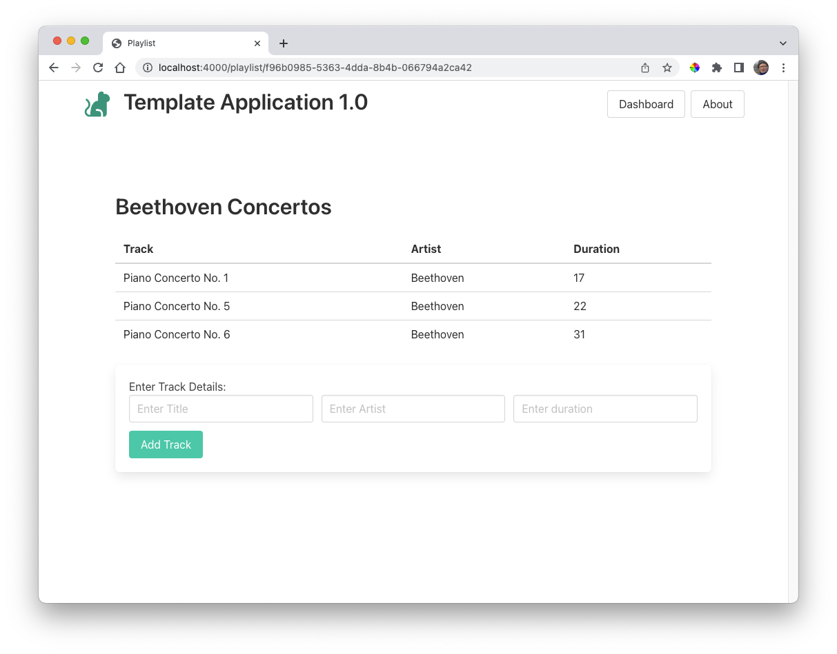
Full playlist to be displayed when Playlist title selected

Slide 5
Introducing a new view
Typically need
Route
Controller
View
Model

Slide 6
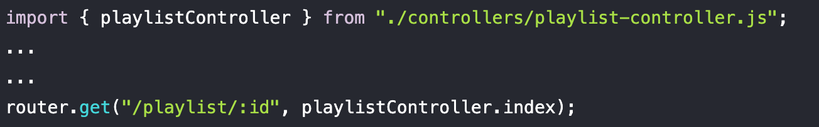
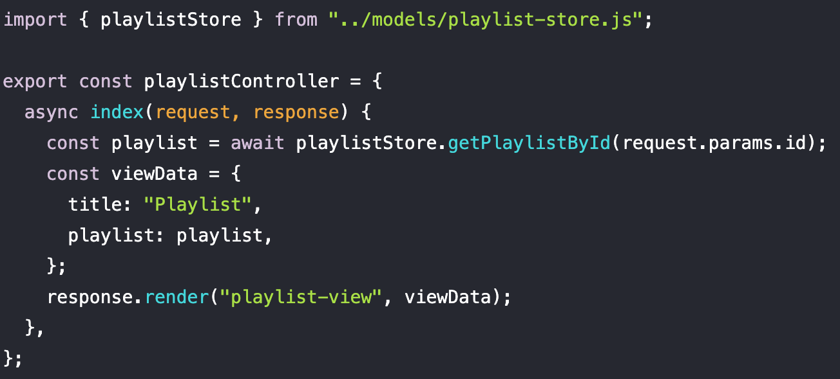
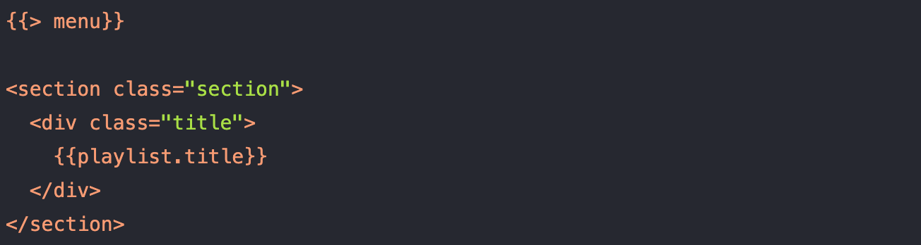
Introducing a new view
routes.js
playlist-controller.js
Typically need
Route
Controller
View
Model
playlist-view.hbs

Slide 7
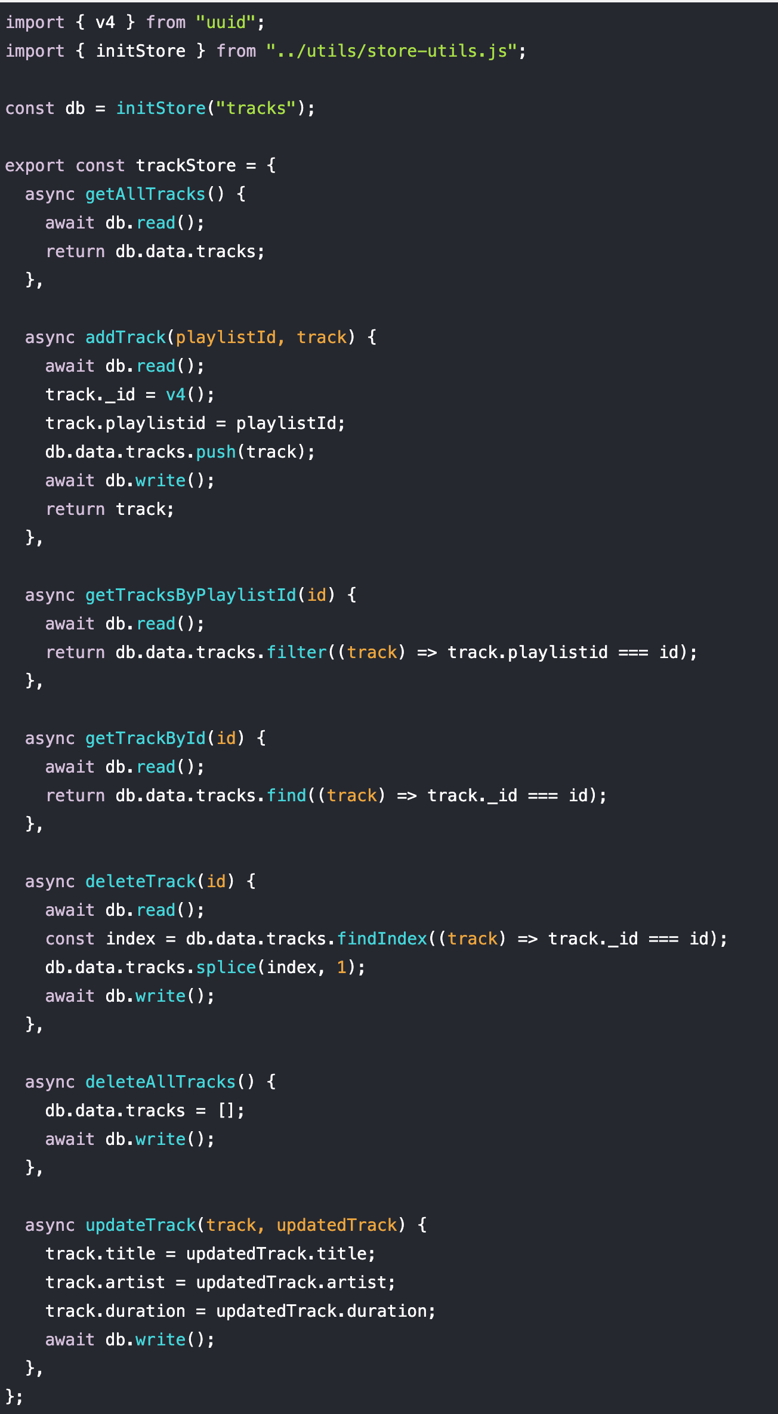
Introducing a new view
Typically need
Route
Controller
View
Model
We do not need to go into the details of how this works for the moment.
It provides a service whereby we add, remove or update tracks via the methods listed above.
Ultimately these tracks are maintained in a Json file called "tracks.json".

Slide 8
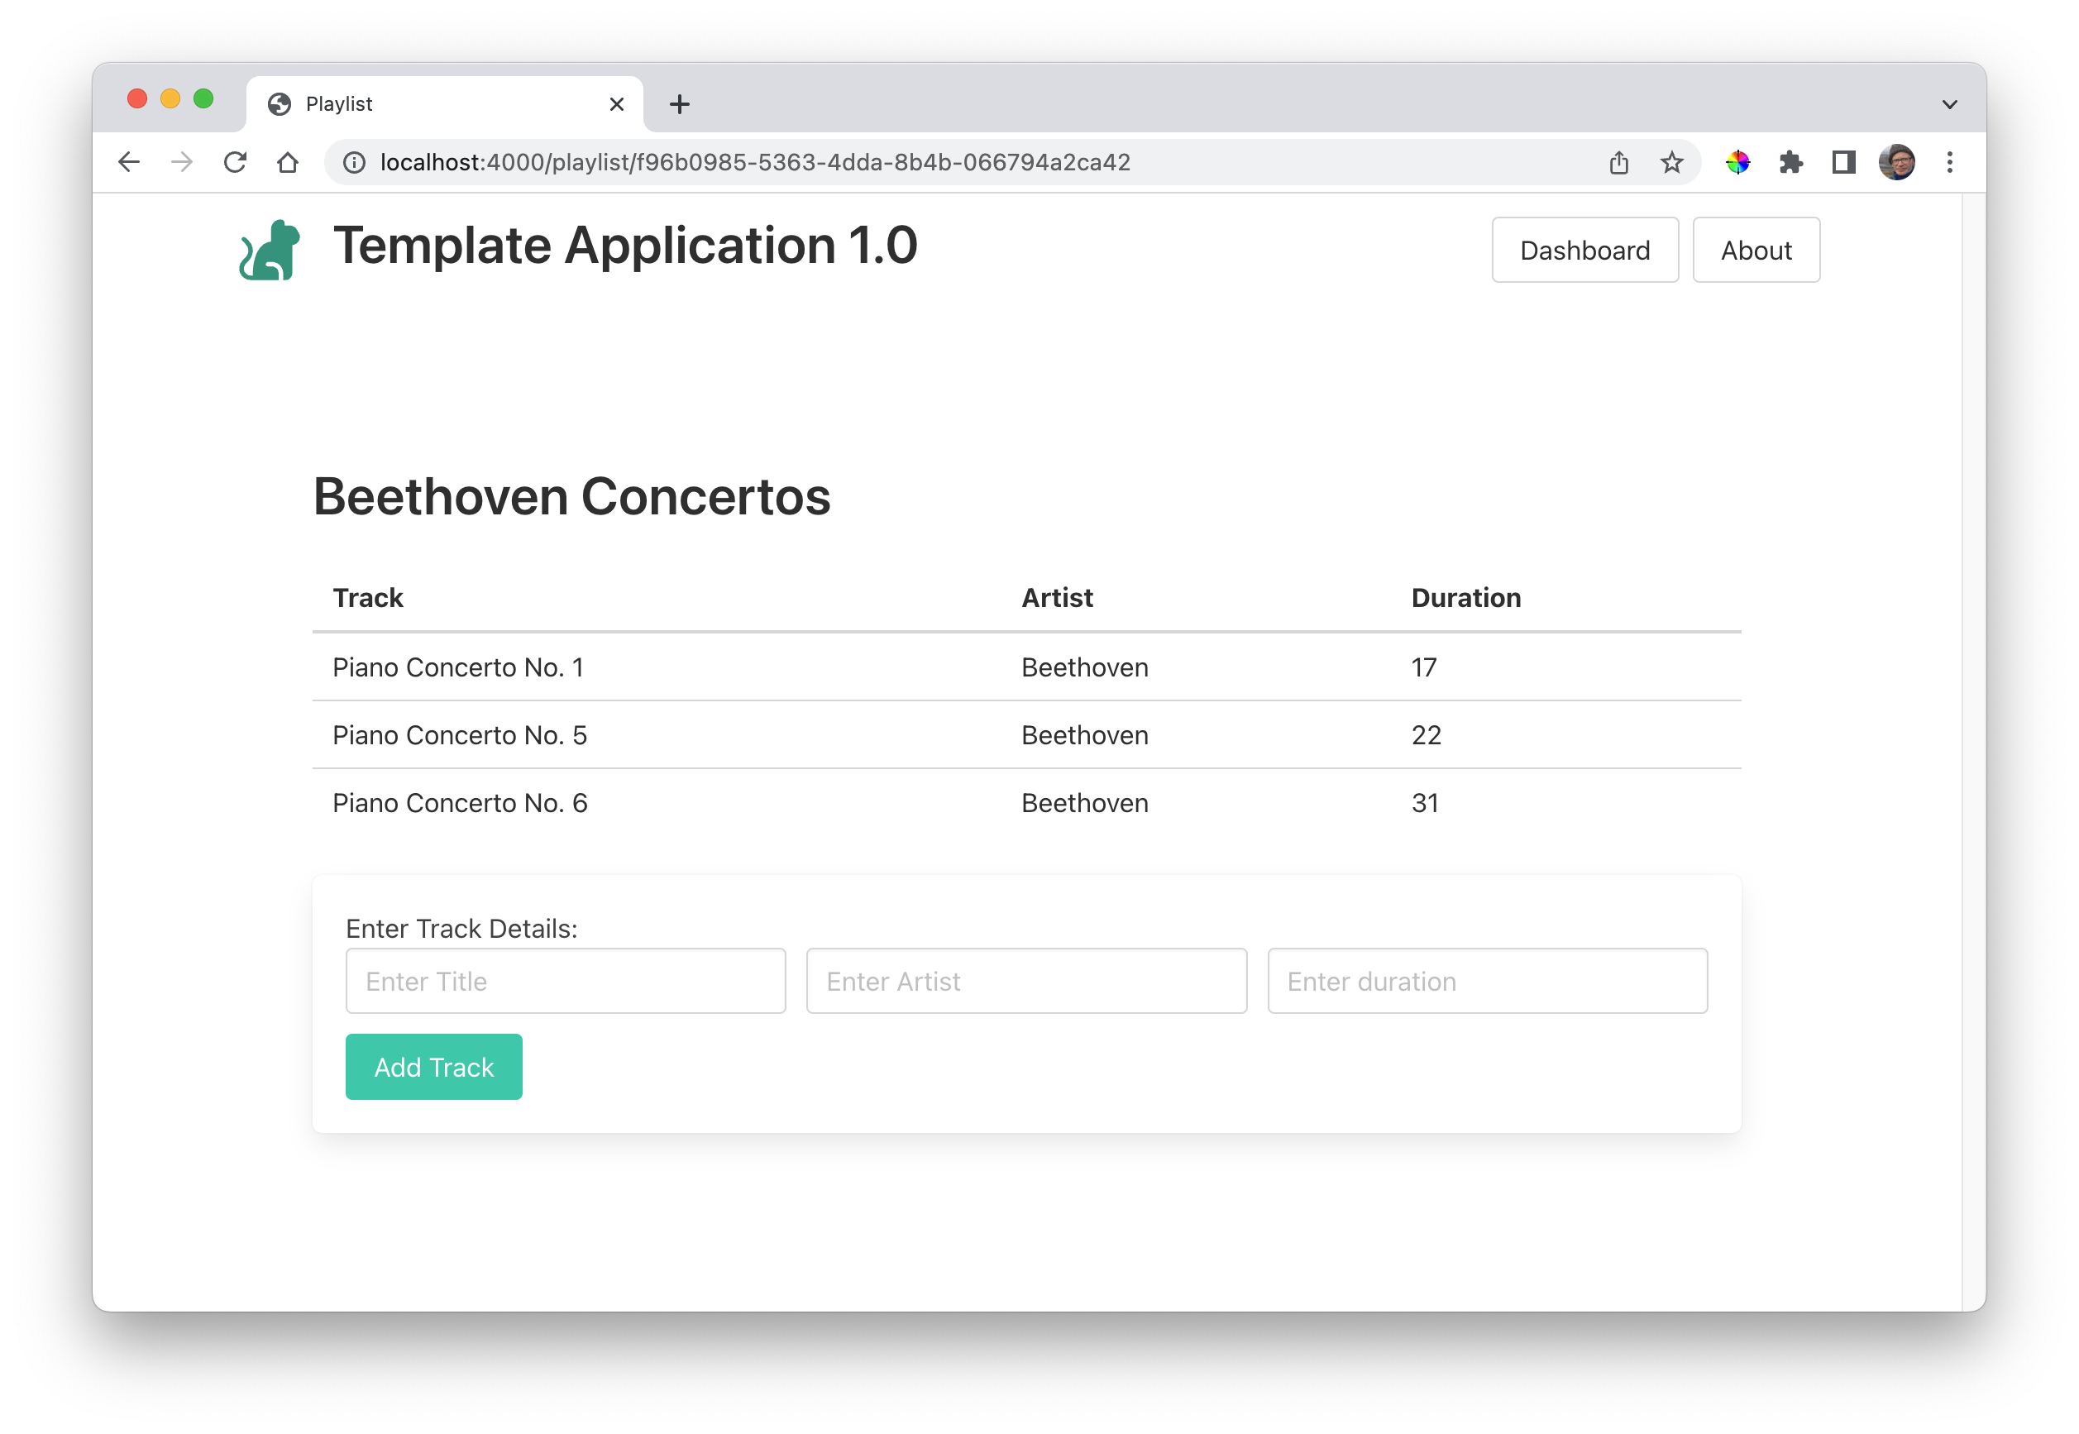
List / Add Tracks
List Tracks
Add Track

Slide 9
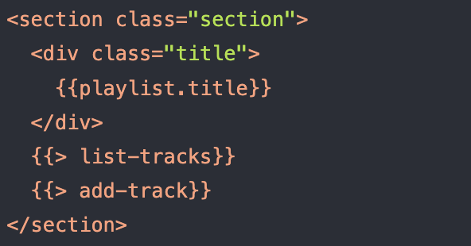
List / Add Tracks
List Tracks
Add Track

Slide 10
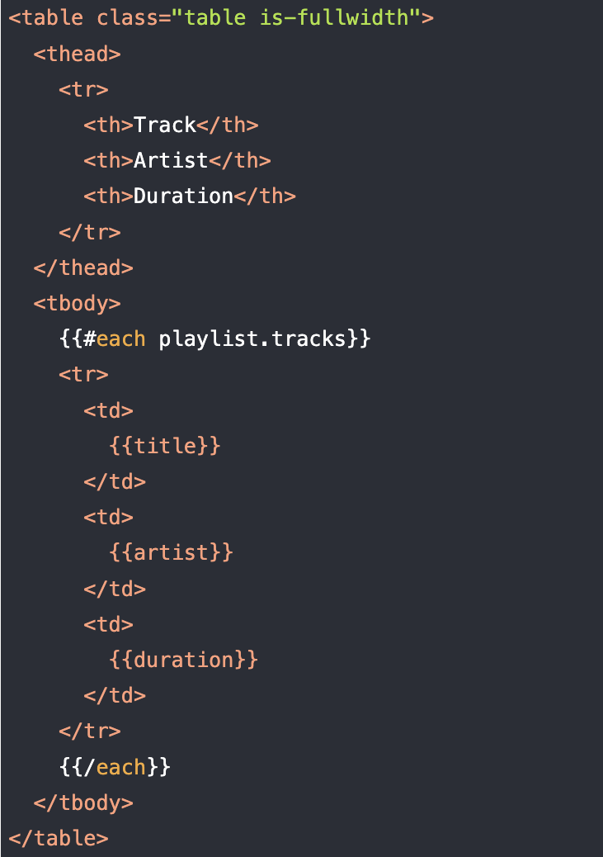
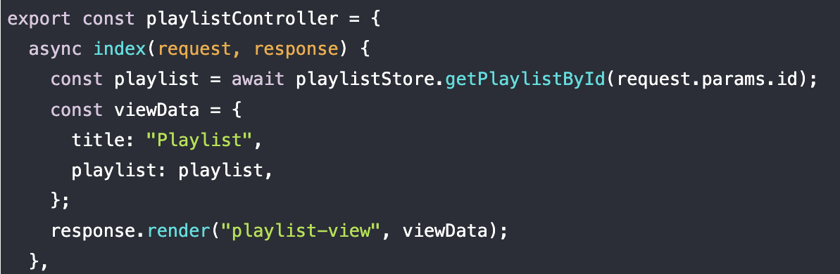
List Tracks
Retrieve playlist tracks from store
Send to the view to be displayed
list-tracks.hbs

Slide 11
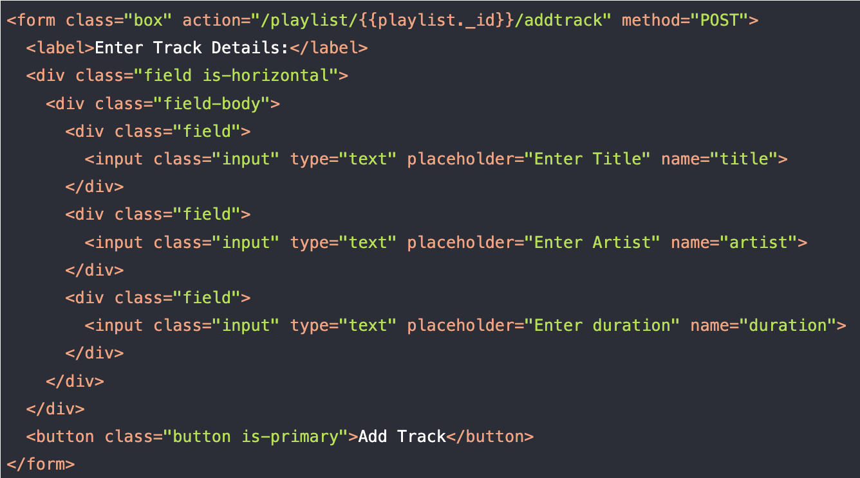
Add Tracks
routes.js
add-track.hbs

Slide 12
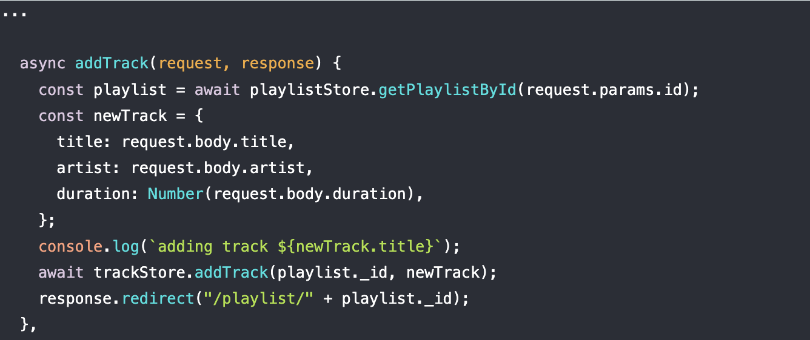
Add Tracks
routes.js
addTrack controller / action

Slide 13
Playlist Controller

