Slide 1
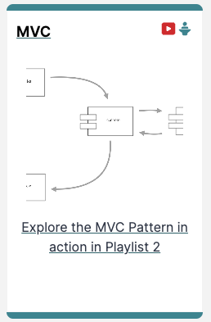
MVC

Slide 2
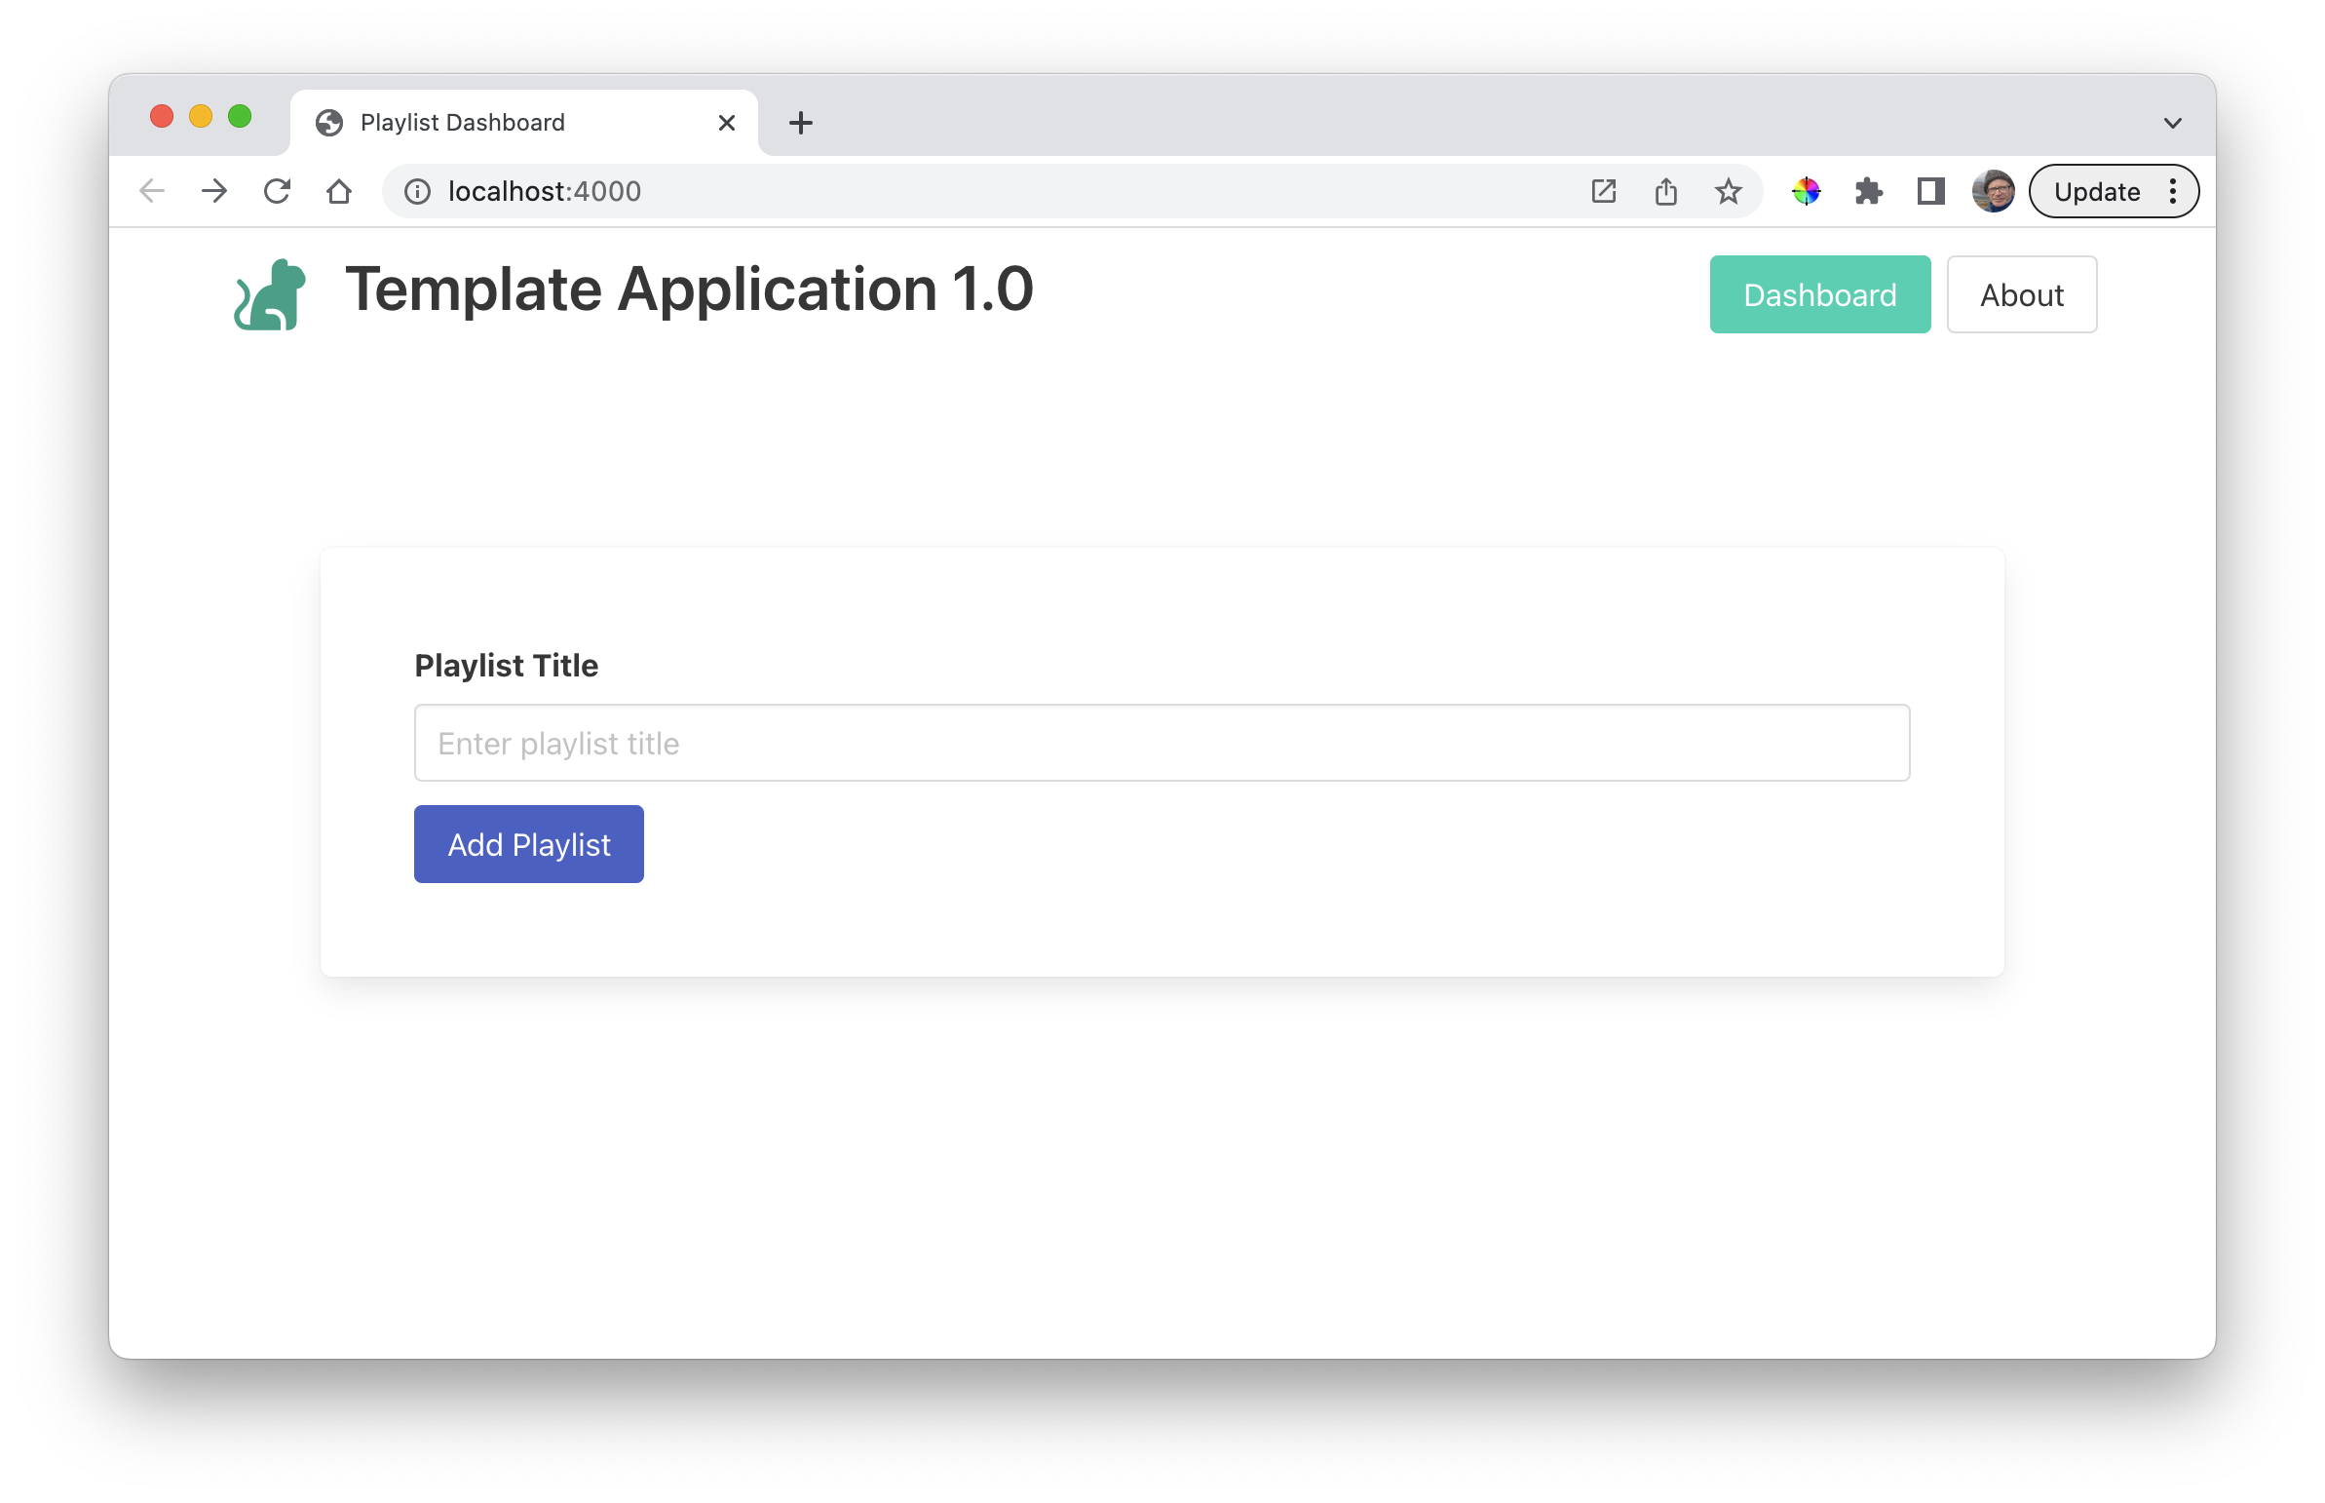
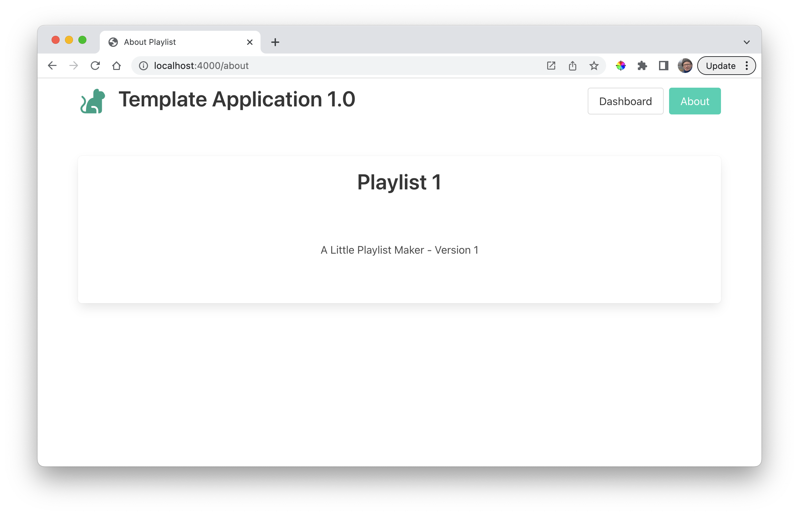
Router / Controller / View

Slide 3

router
controller
view

Slide 4
https://myapp.glitch.com/
<!DOCTYPE html> <html> <head> <meta charset="utf-8"> <title> Welcome to Playlist 1 </title> <meta charset="UTF-8"> <script type="text/javascript" src=“...jquery.min.js”></script> <link rel="stylesheet" href=“...semantic.min.css” type="text/css"> <script type="text/javascript" src=“h...semantic.min.js”></script> </head> <body> <section class="ui container"> <nav class="ui menu"> <header class="ui header item">
<a href="/"> Playlist 1 </a>
</header> <div class="right menu"> <a id="dashboard" class="item" href=“/dashboard">
Dashboard
</a> <a id="about" class="item" href="/about">
About
</a> </div> </nav> <section class="ui center aligned middle aligned segment"> <h1 class="ui header"> Welcome to Playlist 1 </h1> <p> A small app to let you compose playlists. </p> </section> </section> </body> </html>
‘/about’
REQUEST
router

Slide 5
https://myapp.glitch.com/
<!DOCTYPE html> <html> <head> <meta charset="utf-8"> <title> Welcome to Playlist 1 </title> <meta charset="UTF-8"> <script type="text/javascript" src=“...jquery.min.js”></script> <link rel="stylesheet" href=“...semantic.min.css” type="text/css"> <script type="text/javascript" src=“h...semantic.min.js”></script> </head> <body> <section class="ui container"> <nav class="ui menu"> <header class="ui header item">
<a href="/"> Playlist 1 </a>
</header> <div class="right menu"> <a id="dashboard" class="item" href=“/dashboard">
Dashboard
</a> <a id="about" class="item" href="/about">
About
</a> </div> </nav> <section class="ui center aligned middle aligned segment"> <h1 class="ui header"> Welcome to Playlist 1 </h1> <p> A small app to let you compose playlists. </p> </section> </section> </body> </html>
routes.js
router.get("/about", aboutController.index);
controller
‘/about’
about.js
REQUEST
router
export const aboutController = {
index(request, response) {
const viewData = {
title: "About Playlist",
};
console.log("about rendering");
response.render("about-view", viewData);
},
about.index(request, response)

Slide 6
https://myapp.glitch.com/
<!DOCTYPE html> <html> <head> <meta charset="utf-8"> <title> Welcome to Playlist 1 </title> <meta charset="UTF-8"> <script type="text/javascript" src=“...jquery.min.js”></script> <link rel="stylesheet" href=“...semantic.min.css” type="text/css"> <script type="text/javascript" src=“h...semantic.min.js”></script> </head> <body> <section class="ui container"> <nav class="ui menu"> <header class="ui header item">
<a href="/"> Playlist 1 </a>
</header> <div class="right menu"> <a id="dashboard" class="item" href=“/dashboard">
Dashboard
</a> <a id="about" class="item" href="/about">
About
</a> </div> </nav> <section class="ui center aligned middle aligned segment"> <h1 class="ui header"> Welcome to Playlist 1 </h1> <p> A small app to let you compose playlists. </p> </section> </section> </body> </html>
routes.js
router.get("/about", aboutController.index);
controller
‘/about’
about.js
REQUEST
router
export const aboutController = {
index(request, response) {
const viewData = {
title: "About Playlist",
};
console.log("about rendering");
response.render("about-view", viewData);
},
about.index(request, response)
response.render('about', viewData);
viewData = {
title: 'About Playlist 1', };
about-view.hbs
view
{{> menu active="about"}}
<section class="box is-3 has-text-centered">
<h3 class="title">
Playlist 1
</h3>
<div class="section">
<p>
A Little Playlist Maker - Version 1
</p>
</div>
</section>
menu.hbs
<nav class="navbar mb-6">
<div class="navbar-brand">
{{> brand}}
</div>
<div class="navbar-menu" id="navMenu">
<div class="navbar-end">
<div class="navbar-item">
<div class="buttons">
<a id="dashboard" class="button" href="/dashboard"> Dashboard </a>
<a id="about" class="button" href="/about"> About </a>
</div>
</div>
</div>
</div>
</nav>
<script>
document.getElementById("{{active}}").classList.add("is-primary");
</script>

Slide 7
https://myapp.glitch.com/
<!DOCTYPE html> <html> <head> <meta charset="utf-8"> <title> Welcome to Playlist 1 </title> <meta charset="UTF-8"> <script type="text/javascript" src=“...jquery.min.js”></script> <link rel="stylesheet" href=“...semantic.min.css” type="text/css"> <script type="text/javascript" src=“h...semantic.min.js”></script> </head> <body> <section class="ui container"> <nav class="ui menu"> <header class="ui header item">
<a href="/"> Playlist 1 </a>
</header> <div class="right menu"> <a id="dashboard" class="item" href=“/dashboard">
Dashboard
</a> <a id="about" class="item" href="/about">
About
</a> </div> </nav> <section class="ui center aligned middle aligned segment"> <h1 class="ui header"> Welcome to Playlist 1 </h1> <p> A small app to let you compose playlists. </p> </section> </section> </body> </html>
routes.js
router.get("/about", aboutController.index);
controller
‘/about’
about.js
REQUEST
router
export const aboutController = {
index(request, response) {
const viewData = {
title: "About Playlist",
};
console.log("about rendering");
response.render("about-view", viewData);
},
about.index(request, response)
response.render('about', viewData);
viewData = {
title: 'About Playlist 1', };
about-view.hbs
view
{{> menu active="about"}}
<section class="box is-3 has-text-centered">
<h3 class="title">
Playlist 1
</h3>
<div class="section">
<p>
A Little Playlist Maker - Version 1
</p>
</div>
</section>
main.hbs
menu.hbs
<!DOCTYPE html> <html> <head> <meta charset="utf-8"> <title> {{title}} </title> <meta charset="UTF-8"> <script type="text/javascript" src=“...jquery.min.js”></script> <link rel="stylesheet" href=“...semantic.min.css” type="text/css"> <script type="text/javascript" src=“h...semantic.min.js”></script> </head> <body> <section class="ui container"> {{{body}}} </section> </body> </html>
<nav class="navbar mb-6">
<div class="navbar-brand">
{{> brand}}
</div>
<div class="navbar-menu" id="navMenu">
<div class="navbar-end">
<div class="navbar-item">
<div class="buttons">
<a id="dashboard" class="button" href="/dashboard"> Dashboard </a>
<a id="about" class="button" href="/about"> About </a>
</div>
</div>
</div>
</div>
</nav>
<script>
document.getElementById("{{active}}").classList.add("is-primary");
</script>

Slide 8
https://myapp.glitch.com/
<!DOCTYPE html> <html> <head> <meta charset="utf-8"> <title> Welcome to Playlist 1 </title> <meta charset="UTF-8"> <script type="text/javascript" src=“...jquery.min.js”></script> <link rel="stylesheet" href=“...semantic.min.css” type="text/css"> <script type="text/javascript" src=“h...semantic.min.js”></script> </head> <body> <section class="ui container"> <nav class="ui menu"> <header class="ui header item">
<a href="/"> Playlist 1 </a>
</header> <div class="right menu"> <a id="dashboard" class="item" href=“/dashboard">
Dashboard
</a> <a id="about" class="item" href="/about">
About
</a> </div> </nav> <section class="ui center aligned middle aligned segment"> <h1 class="ui header"> Welcome to Playlist 1 </h1> <p> A small app to let you compose playlists. </p> </section> </section> </body> </html>
routes.js
router.get("/about", aboutController.index);
controller
‘/about’
about.js
REQUEST
router
export const aboutController = {
index(request, response) {
const viewData = {
title: "About Playlist",
};
console.log("about rendering");
response.render("about-view", viewData);
},
about.index(request, response)
response.render('about', viewData);
viewData = {
title: 'About Playlist 1', };
about-view.hbs
view
<!DOCTYPE html> <html> <head> <meta charset="utf-8"> <title> Welcome to Playlist 1 </title> <meta charset="UTF-8"> <script type="text/javascript" src=“...jquery.min.js”></script> <link rel="stylesheet" href=“...semantic.min.css” type="text/css"> <script type="text/javascript" src=“h...semantic.min.js”></script> </head> <body> <section class="ui container"> <nav class="ui menu"> <header class="ui header item">
<a href="/"> Playlist 1 </a>
</header> <div class="right menu"> <a id="dashboard" class="item" href=“/dashboard">
Dashboard
</a> <a id="about" class="item" href="/about">
About
</a> </div> </nav> <section class="ui center aligned middle aligned segment"> <p> A Little Playlist Maker - Version 1 </p> </section>
</section> </body> </html>
{{> menu active="about"}}
<section class="box is-3 has-text-centered">
<h3 class="title">
Playlist 1
</h3>
<div class="section">
<p>
A Little Playlist Maker - Version 1
</p>
</div>
</section>
main.hbs
menu.hbs
<!DOCTYPE html> <html> <head> <meta charset="utf-8"> <title> {{title}} </title> <meta charset="UTF-8"> <script type="text/javascript" src=“...jquery.min.js”></script> <link rel="stylesheet" href=“...semantic.min.css” type="text/css"> <script type="text/javascript" src=“h...semantic.min.js”></script> </head> <body> <section class="ui container"> {{{body}}} </section> </body> </html>
<nav class="navbar mb-6">
<div class="navbar-brand">
{{> brand}}
</div>
<div class="navbar-menu" id="navMenu">
<div class="navbar-end">
<div class="navbar-item">
<div class="buttons">
<a id="dashboard" class="button" href="/dashboard"> Dashboard </a>
<a id="about" class="button" href="/about"> About </a>
</div>
</div>
</div>
</div>
</nav>
<script>
document.getElementById("{{active}}").classList.add("is-primary");
</script>
RESPONSE
https://myapp.glitch.com/about

Slide 9
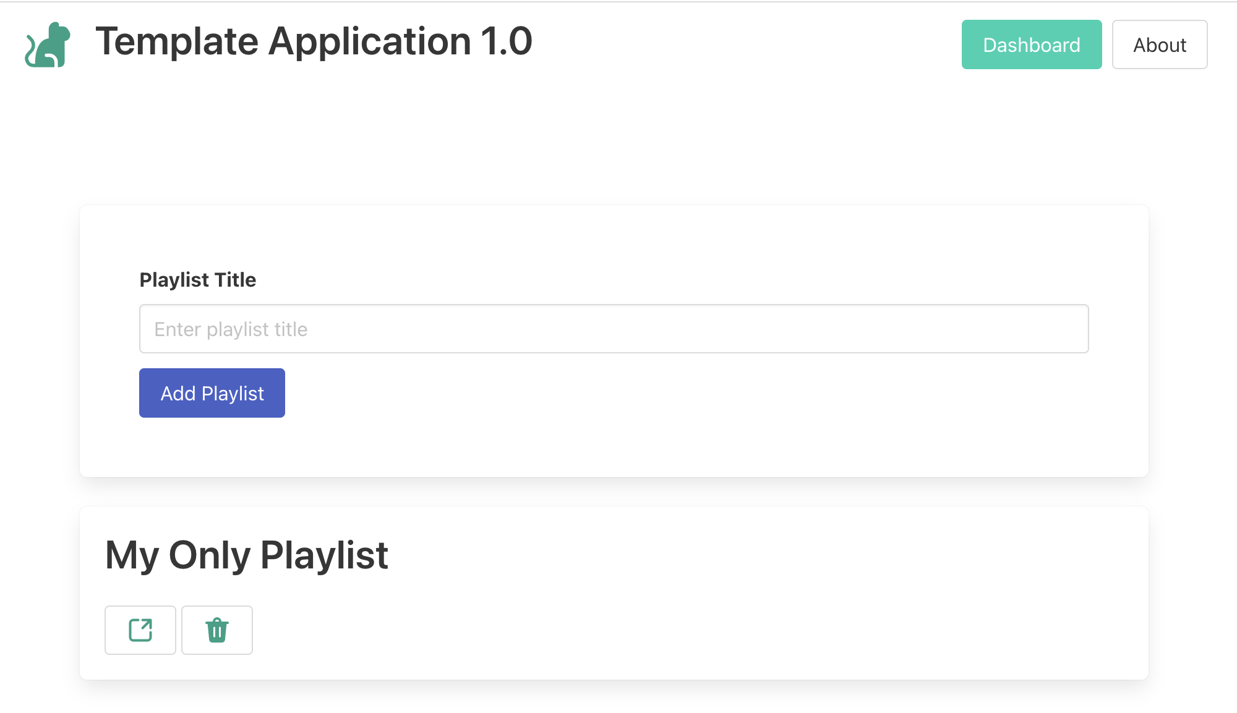
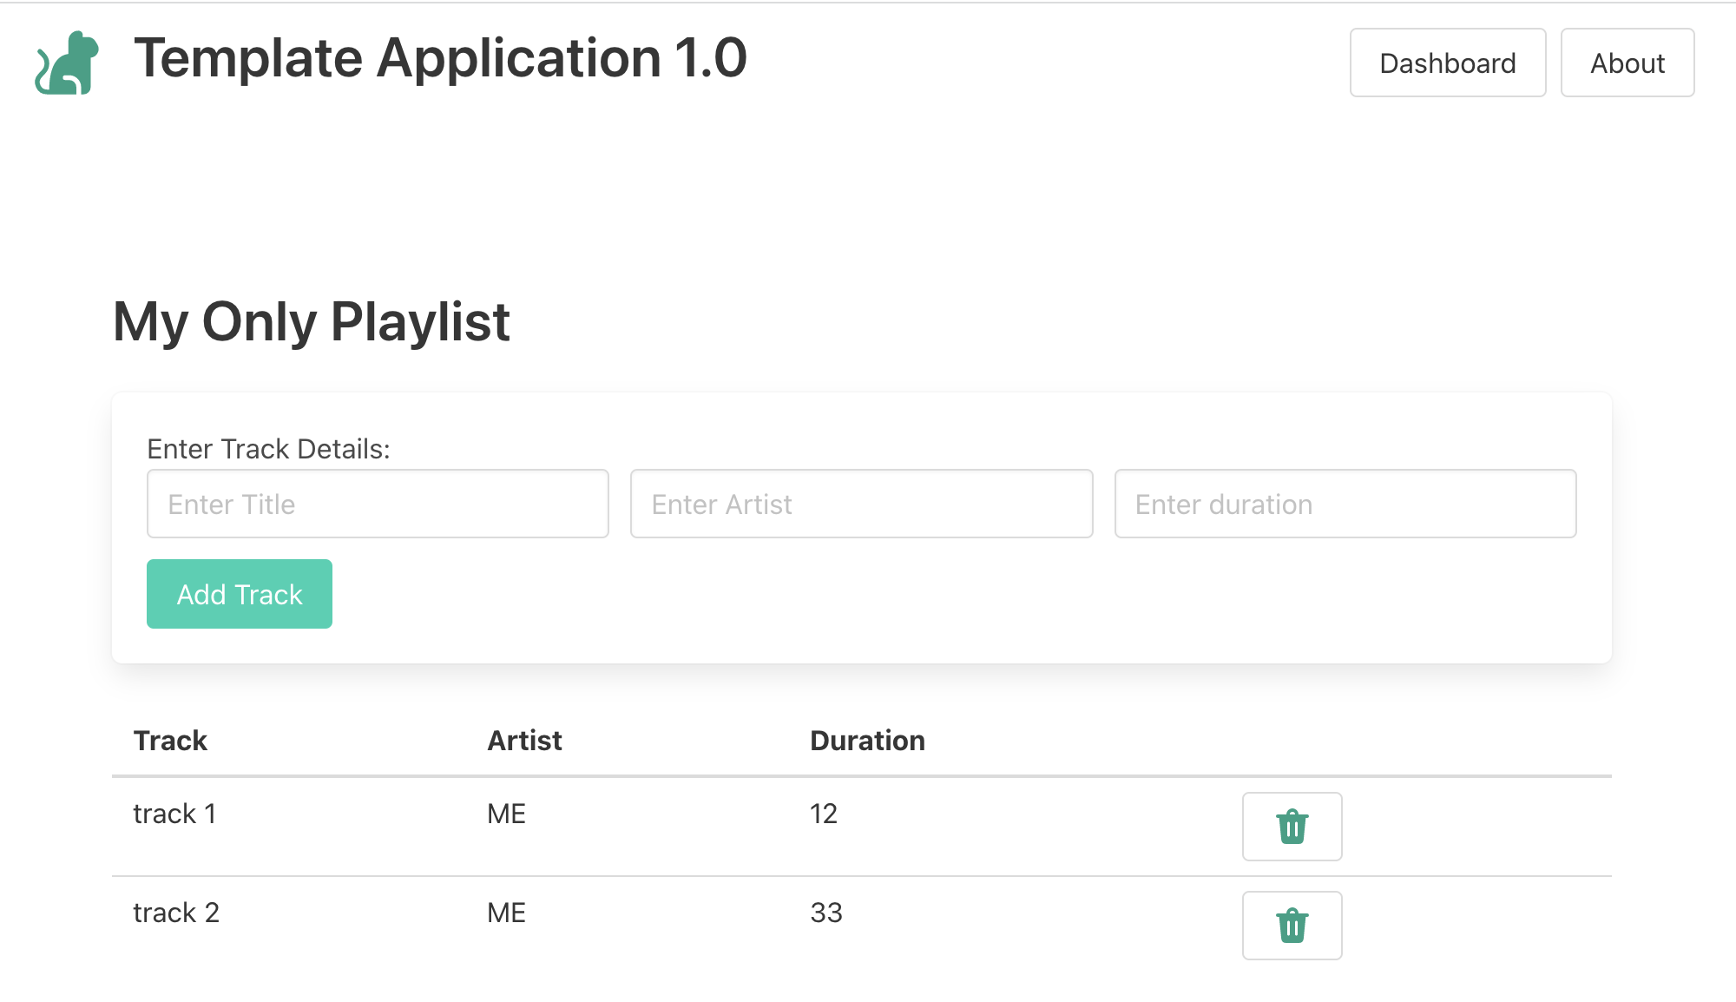
Router / Controller / Model / View

Slide 10
router
controller
model
view

Slide 11
https://myapp.glitch.com/dashboard
...
<h2 class="title">
My Only Playlist
</h2>
<a href="/playlist/677455fd-50fb-4ff1-903c-14f487f6f394" class=“button"></a>
...
router
REQUEST

Slide 12
https://myapp.glitch.com/dashboard
routes.js
router.get("/playlist/:id", playlistController.index);
playlist-controller.js
...
<h2 class="title">
My Only Playlist
</h2>
<a href="/playlist/677455fd-50fb-4ff1-903c-14f487f6f394" class=“button"></a>
...
export const playlistController = {
async index(request, response) {
const playlist = await playlistStore.getPlaylistById(request.params.id);
const viewData = {
title: "Playlist",
playlist: playlist,
};
response.render("playlist-view", viewData);
},
};
router
playlist.index(req, res)
controller
REQUEST

Slide 13
https://myapp.glitch.com/dashboard
model
{
"file": "./models/playlists.json",
"playlists": [
{
"title": "My Only Playlist",
"_id": "677455fd-50fb-4ff1-903c-14f487f6f394"
}
]
}
routes.js
const playlistStore = { ... async getPlaylistById(id) { ... }, ... };
router.get("/playlist/:id", playlistController.index);
playlist-controller.js
{
"file": "./models/tracks.json",
"tracks": [
{
"title": "track 1",
"artist": "ME",
"duration": 12,
"_id": "a572147e-a592-4e9e-baa5-aad435be819d",
"playlistid": "677455fd-50fb-4ff1-903c-14f487f6f394"
},
{
"title": "track 2",
"artist": "ME",
"duration": 32,
"_id": "65229f82-9bc0-4292-8fef-932b6c441b39",
"playlistid": "677455fd-50fb-4ff1-903c-14f487f6f394"
}
]
}
...
<h2 class="title">
My Only Playlist
</h2>
<a href="/playlist/677455fd-50fb-4ff1-903c-14f487f6f394" class=“button"></a>
...
export const playlistController = {
async index(request, response) {
const playlist = await playlistStore.getPlaylistById(request.params.id);
const viewData = {
title: "Playlist",
playlist: playlist,
};
response.render("playlist-view", viewData);
},
};
router
playlist.index(req, res)
controller
REQUEST

Slide 14
https://myapp.glitch.com/dashboard
model
{
"file": "./models/playlists.json",
"playlists": [
{
"title": "My Only Playlist",
"_id": "677455fd-50fb-4ff1-903c-14f487f6f394"
}
]
}
routes.js
const playlistStore = { ... async getPlaylistById(id) { ... }, ... };
router.get("/playlist/:id", playlistController.index);
playlist-controller.js
{
"file": "./models/tracks.json",
"tracks": [
{
"title": "track 1",
"artist": "ME",
"duration": 12,
"_id": "a572147e-a592-4e9e-baa5-aad435be819d",
"playlistid": "677455fd-50fb-4ff1-903c-14f487f6f394"
},
{
"title": "track 2",
"artist": "ME",
"duration": 32,
"_id": "65229f82-9bc0-4292-8fef-932b6c441b39",
"playlistid": "677455fd-50fb-4ff1-903c-14f487f6f394"
}
]
}
...
<h2 class="title">
My Only Playlist
</h2>
<a href="/playlist/677455fd-50fb-4ff1-903c-14f487f6f394" class=“button"></a>
...
export const playlistController = {
async index(request, response) {
const playlist = await playlistStore.getPlaylistById(request.params.id);
const viewData = {
title: "Playlist",
playlist: playlist,
};
response.render("playlist-view", viewData);
},
};
router
playlist.index(req, res)
controller
REQUEST
list-tracks.hbs
playlist-view.hbs
<table class="table is-fullwidth">
<thead>
<tr>
<th>Track</th>
<th>Artist</th>
<th>Duration</th>
</tr>
</thead>
<tbody>
{{#each playlist.tracks}}
<tr>
<td>
{{title}}
</td>
<td>
{{artist}}
</td>
<td>
{{duration}}
</td>
</tr>
{{/each}}
</tbody>
</table> </table>
viewData = {
title: ‘Playlist’,
playlist: {
"_id": "677455fd-50fb-4ff1-903 "title": “My Only Playlist", "tracks": [
{
"title": "track 1",
"artist": "ME",
"duration": 12,
"_id": "a572147e-a592-4e9e-baa5-aad435be819d",
"playlistid": "677455fd-50fb-4ff1-903c-14f487f6f394"
},
{
"title": "track 2",
"artist": "ME",
"duration": 32,
"_id": "65229f82-9bc0-4292-8fef-932b6c441b39",
"playlistid": "677455fd-50fb-4ff1-903c-14f487f6f394"
}
} };
{{> menu}}
<section class="section">
<div class="title">
{{playlist.title}}
</div>
{{> add-track}}
{{> list-tracks}}
</section>
view

Slide 15
https://myapp.glitch.com/dashboard
model
{
"file": "./models/playlists.json",
"playlists": [
{
"title": "My Only Playlist",
"_id": "677455fd-50fb-4ff1-903c-14f487f6f394"
}
]
}
routes.js
const playlistStore = { ... async getPlaylistById(id) { ... }, ... };
router.get("/playlist/:id", playlistController.index);
playlist-controller.js
{
"file": "./models/tracks.json",
"tracks": [
{
"title": "track 1",
"artist": "ME",
"duration": 12,
"_id": "a572147e-a592-4e9e-baa5-aad435be819d",
"playlistid": "677455fd-50fb-4ff1-903c-14f487f6f394"
},
{
"title": "track 2",
"artist": "ME",
"duration": 32,
"_id": "65229f82-9bc0-4292-8fef-932b6c441b39",
"playlistid": "677455fd-50fb-4ff1-903c-14f487f6f394"
}
]
}
...
<h2 class="title">
My Only Playlist
</h2>
<a href="/playlist/677455fd-50fb-4ff1-903c-14f487f6f394" class=“button"></a>
...
export const playlistController = {
async index(request, response) {
const playlist = await playlistStore.getPlaylistById(request.params.id);
const viewData = {
title: "Playlist",
playlist: playlist,
};
response.render("playlist-view", viewData);
},
};
router
playlist.index(req, res)
controller
REQUEST
list-tracks.hbs
<table class="table is-fullwidth">
<thead>
<tr>
<th>Track</th>
<th>Artist</th>
<th>Duration</th>
</tr>
</thead>
<tbody>
{{#each playlist.tracks}}
<tr>
<td>
{{title}}
</td>
<td>
{{artist}}
</td>
<td>
{{duration}}
</td>
</tr>
{{/each}}
</tbody>
</table> </table>
playlist-view.hbs
viewData = {
title: ‘Playlist’,
playlist: {
"_id": "677455fd-50fb-4ff1-903 "title": “My Only Playlist", "tracks": [
{
"title": "track 1",
"artist": "ME",
"duration": 12,
"_id": "a572147e-a592-4e9e-baa5-aad435be819d",
"playlistid": "677455fd-50fb-4ff1-903c-14f487f6f394"
},
{
"title": "track 2",
"artist": "ME",
"duration": 32,
"_id": "65229f82-9bc0-4292-8fef-932b6c441b39",
"playlistid": "677455fd-50fb-4ff1-903c-14f487f6f394"
}
} };
{{> menu}}
<section class="section">
<div class="title">
{{playlist.title}}
</div>
{{> add-track}}
{{> list-tracks}}
</section>
view
main.hbs
<!DOCTYPE html> <html> <head> ...
</head> <body> <section class="container"> {{{body}}} </section> </body> </html>

Slide 16
https://myapp.glitch.com/dashboard
model
{
"file": "./models/playlists.json",
"playlists": [
{
"title": "My Only Playlist",
"_id": "677455fd-50fb-4ff1-903c-14f487f6f394"
}
]
}
routes.js
const playlistStore = { ... async getPlaylistById(id) { ... }, ... };
router.get("/playlist/:id", playlistController.index);
playlist-controller.js
{
"file": "./models/tracks.json",
"tracks": [
{
"title": "track 1",
"artist": "ME",
"duration": 12,
"_id": "a572147e-a592-4e9e-baa5-aad435be819d",
"playlistid": "677455fd-50fb-4ff1-903c-14f487f6f394"
},
{
"title": "track 2",
"artist": "ME",
"duration": 32,
"_id": "65229f82-9bc0-4292-8fef-932b6c441b39",
"playlistid": "677455fd-50fb-4ff1-903c-14f487f6f394"
}
]
}
...
<h2 class="title">
My Only Playlist
</h2>
<a href="/playlist/677455fd-50fb-4ff1-903c-14f487f6f394" class=“button"></a>
...
export const playlistController = {
async index(request, response) {
const playlist = await playlistStore.getPlaylistById(request.params.id);
const viewData = {
title: "Playlist",
playlist: playlist,
};
response.render("playlist-view", viewData);
},
};
router
playlist.index(req, res)
controller
REQUEST
list-tracks.hbs
playlist-view.hbs
<table class="table is-fullwidth">
<thead>
<tr>
<th>Track</th>
<th>Artist</th>
<th>Duration</th>
</tr>
</thead>
<tbody>
{{#each playlist.tracks}}
<tr>
<td>
{{title}}
</td>
<td>
{{artist}}
</td>
<td>
{{duration}}
</td>
</tr>
{{/each}}
</tbody>
</table> </table>
viewData = {
title: ‘Playlist’,
playlist: {
"_id": "677455fd-50fb-4ff1-903 "title": “My Only Playlist", "tracks": [
{
"title": "track 1",
"artist": "ME",
"duration": 12,
"_id": "a572147e-a592-4e9e-baa5-aad435be819d",
"playlistid": "677455fd-50fb-4ff1-903c-14f487f6f394"
},
{
"title": "track 2",
"artist": "ME",
"duration": 32,
"_id": "65229f82-9bc0-4292-8fef-932b6c441b39",
"playlistid": "677455fd-50fb-4ff1-903c-14f487f6f394"
}
} };
<section class=“…t”> <h2 class="ui header"> My Only Playlist </h2> <table class="ui table"> <thead> <tr> <th>Track</th> <th>Artist</th> <th>Duration</th> </tr> </thead> <tbody> <tr> <td> Track 1 </td> <td> ME </td> </tr> <tr> <td> Track 2
</td> <td> ME </td> </tr> </tbody> </table> </section>
{{> menu}}
<section class="section">
<div class="title">
{{playlist.title}}
</div>
{{> add-track}}
{{> list-tracks}}
</section>
view
main.hbs
<!DOCTYPE html> <html> <head> ...
</head> <body> <section class="container"> {{{body}}} </section> </body> </html>
RESPONSE

Slide 17
MVC

