Slide 1

Assignment 2
HDip in Computer Science
Web Development 1

Slide 2
Introduction
This is the spec for Assignment 2 that is worth 60%

Slide 3
Introduction
Whether Weather have launched a new API that provides weather data for cities all over the world using the latest satellite technology
Whether Weather has hired YOU to create their first web app to display the weather and forecast for the next 7 days for cities all over the world

Slide 4
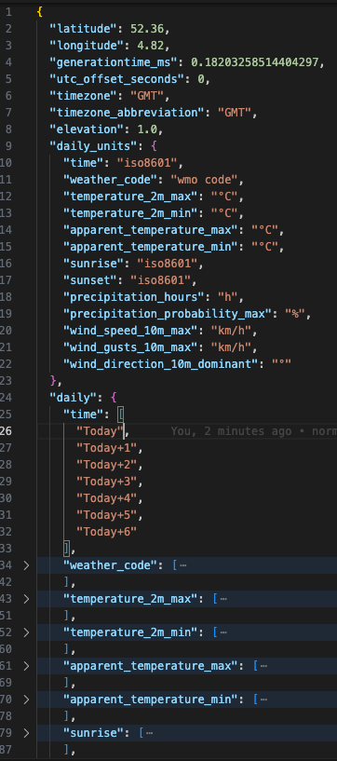
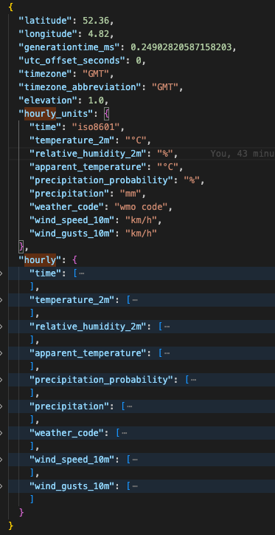
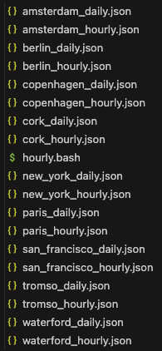
Data
You will be provided with weather data for today and 6 following days that you must build use in your website
There will be a number of cities with various data points
The data spec is available in the data download – data-definition.pdf
Note that the times have been changed on the daily to be relative to today

Slide 5
Expected Release Schedule
Following are some designs for each stage of the Proof of Concept (POC) to Release
The designs are illustrative only, you can use them for inspiration, or you can choose your own designs
Whether Weather has also kindly offered to allow you redesign the logo if you wish, or use the one provided.

Slide 6
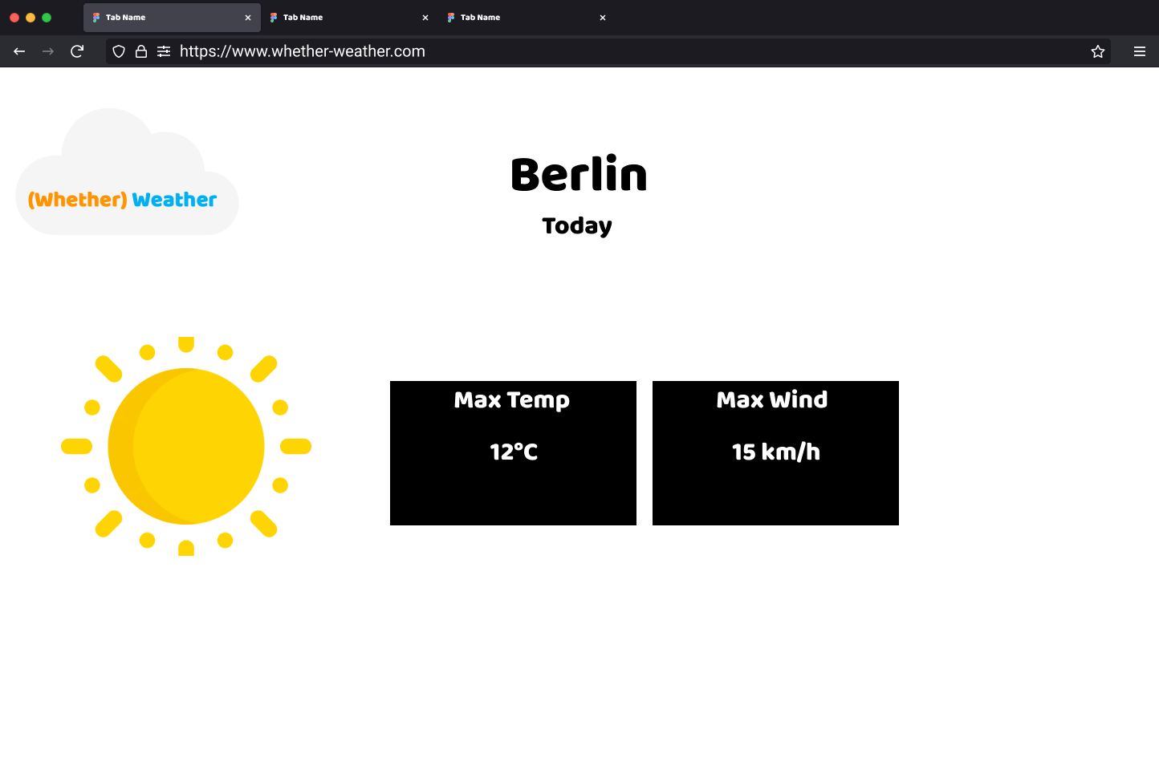
Proof of Concept (POC) City Focus 1 - Berlin
City Focus is where we focus on one city and display:
Today’s weather (using weather code) – overcast, sunny, rain
Today’s max temperature in Celsius
Today’s max wind strength (not gust) in km/h
This is the initial POC, it can be hardcoded to select Berlin (or any other city)

Slide 7
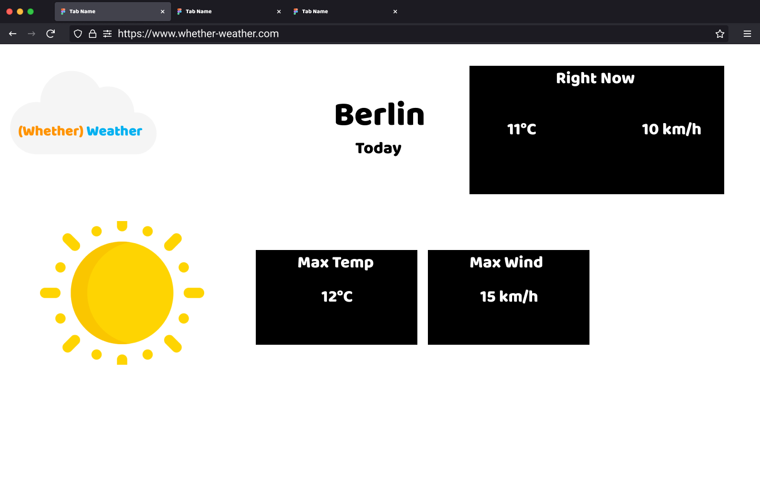
Proof of Concept (POC) City Focus 2 - Berlin
Add the current hour’s weather forecast to Berlin
This should be the hour that the page is loaded
Wind and Temp

Slide 8
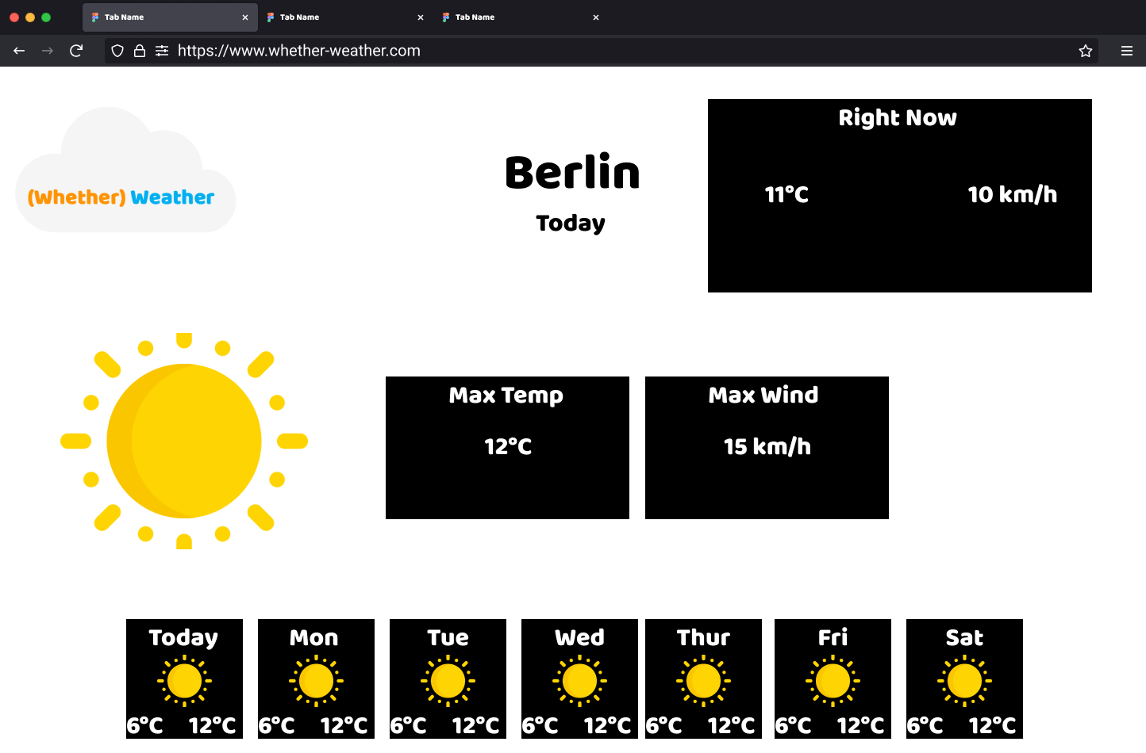
Proof of Concept (POC) City Focus 3 - Berlin
Add a summary for each day for the next 7 days

Slide 9
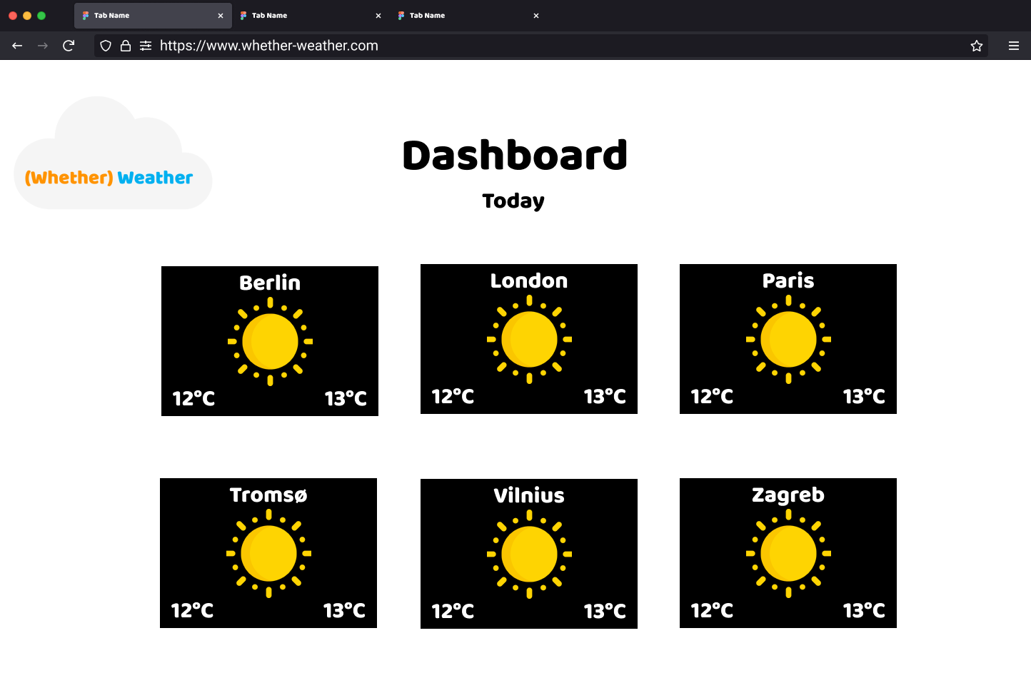
Release 1 The Dashboard
Create a dashboard that shows a list of cities and the weather using the weather codes
Interacting with a city will bring you the City Focus page for that city
It should be possible to get back to the dashboard from City Focus

Slide 10

Click
URL Path & Parameters

Slide 11
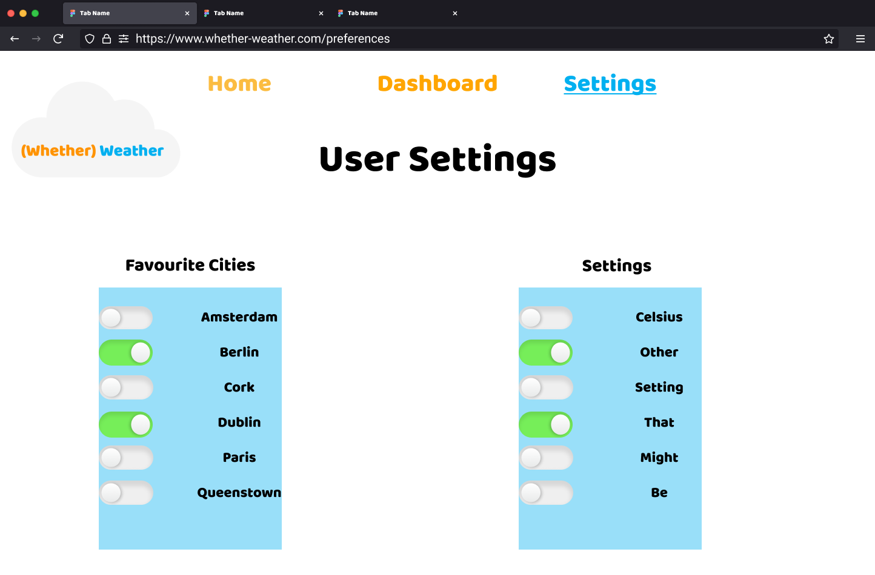
Release 2 User Preferences
A user should be able to select their favourite cities via a user preferences page
These cities are highlighted (or separated) in some way in the dashboard
Preferences are stored locally in the browser local storage so they are available on every visit
Clearing the browser cache will clear the preference and that is what we want
Note: Favourite Cities is only expected in this release

Slide 12
Release 3 Impress Us
Use the data as you wish, show us what you can do
Suggestions
Add hourly summaries to City Focus
Add preferences for wind speed and temp units
Clicking on a day other than today in City Focus will open City Focus on that day
Introduce “Feels Like” using (apparent temperature metric)
Introduce wind gusts and other metrics that may be useful
Selectable city on City Focus
Default city on City Focus
Default to “last seen city” on City Focus
Navigation bar
Up to you!

Slide 13
Assignment
Using JavaScript, HTML and CSS step through each release or iteration as shown previous and develop a weather forecasting website
The website must use the data provided, you cannot add or remove data
The website must be multiple pages of HTML, no single page webapps allowed
The technologies you are allowed to use to develop your website itself are:
HTML, CSS, Bulma, JavaScript, JQuery, Eleventy, Netlify
There is no server-side component, everything is client side apart from deployment on Netlify
You cannot use libraries like React, Angular etc
This assignment is worth 60% of your final grade

Slide 14
Submission
All files included in your website as a single zipped archive, submitted via moodle
The project will be observed in Chrome with standard desktop orientation
The main site entry point is to be ‘index.html’.
The submission is to be accompanied by a completed reflection document (word template provided but please submit PDF)
This template is to include a url of the deployed site (if you deployed it)

Slide 15
Please Note:
The grading scheme may be subject to changes and is provided as a guideline
Marks will be available for independent learning and other areas as the lecturing team sees fit
It may be safest to target your independent learning towards taking what we’ve learned to another level, rather than something completely new
Please highlight any areas of independent learning in the notes section of your reflection form
The number of marks for independent learning will be limited, for example, if there’s 5 marks for independent learning and 20 marks for the rest of the column, you cannot get more than 5 marks for independent learning.
TLDR; if you spend 2 weeks on a feature that you consider independent learning and it is substantial, you will still only get 5 marks for it
This means that a submission that strays from the brief may lose marks relative to the amount of time you spend on it
It is recommended you build to spec, get that working, and then branch out if you have time
The grading scheme will be the same for each student/submission
Grades may be visible on moodle, however, all grades are not final and are subject to change until reviewed by the University
A breakdown of how the submission scored will also be available but it is subject to the same change
Marks may be deducted for incomplete submissions (e.g. an unclear reflection form may result in features being missed)

Slide 16
Plagiarism
All work must be your own and created specifically for this module
We reserve the right to interview any candidate regarding their submission
Plagiarism will result in a mark of zero (there may be additional consequences)
The use of Generative AI is not permitted for this assignment
Includes but not limited to chatgpt, copilot (or similar applications), local code generation models or prompt driven code generation of any kind
Any code copied from another source must be cited with a comment linking to the source if it is on the web, if it is from a book, please include a comment with the title, author, chapter. If you cannot explain how this code works, it may lead to marks lost.
Your submission may be submitted to third party tools to verify it is not plagiarised

Slide 17
Grading Rubric
Grade Band | JavaScript | Dev Experience | Submission and Deployment | Release | Release Features
starter | Understanding of best practices: let and const Usage of arrays Usage of object | Clearly laid out project structure – HTML, CSS and JavaScript | Zip file to moodle | POC – 1 - City Focus 1 1 City with today’s weather | Weather Code Mapped to Correct Weather Display City Name Clear it is today’s weather Max Temp and Wind
baseline | Add and Remove elements from the DOM without the need for a screen refresh | DRY - Very little Repetition of HTML, JS and Styles | + github repository link + github commit history OR bulma breadcrumb component | POC – 2 – City Focus 2 + current hour’s weather | Added current hours forecast Correctly mapped hourly weather code Correct hour taken from browser
good | Understanding of application name spacing and scopes | Layered JavaScript Architecture - MVC | + github tags OR bulma dropdown component to select something (city?) | POC – 3 – City Focus 3 + 7 days summary | Clear and concise summary for the 7 days Weather code correctly mapped Additional weather information
excellent | Well maintained utility file(s) Clear and concise loading of javascript Functions utilized correctly | Excellent README | + Manual upload to netlify | Release -1 + Dashboard | Focus on user experience Ability to navigate to city view Ability to navigate back to dashboard Usage of URL paths and parameters
outstanding |  |  | + github push deploys to netlify OR use the bulma modal to show weather info in a popup | Release – 2 + Configure and Persist User Preferences | User preferences user interface User preferences saved in localStorage Clear navigation User preferences affect how the dashboard render Reset preferences
amazing |  |  | - | Release – 3 + Build out your own features | Start small and build from there Do not start this without a lot of the previous releases done, don’t feel pressure to get here

Slide 18
Allowed Resources
Icons:
https://www.flaticon.com/
https://thenounproject.com/
https://fontawesome.com/
All Bulma icon sets
Any images used must be attributed or known to be royalty free and free to use

Slide 19
Deadline
Sunday May 12th 11:50pm.

Slide 20
Easter – Get Started on the UI
Do not worry about the JavaScript, in fact, don’t use it because we will be covering specific implementation patterns
Bulma is a requirement so get started with Bulma in Week 7 and Week 8 lectures and labs
The Week 8 Bulma lab starts an application completely from scratch, it should provide guidance for getting going here. Feel free to use it as a starting point (just change the style).
Recommended path for easter – stick to bulma
Use the project structure from the week 8 lab to get a project with eleventy spun up
Use a column layout in bulma to create the City Focus Proof of Concept
Just hardcode any values for now, keep it simple
Ignore JavaScript and the data provided, we will do deep dive sessions on the data and how to work with it in JavaScript after easter
Take the path of POC 1, 2, 3 in order. It will ensure that you will have a great starting point for integrating JavaScript after easter
Feel free to use njk files for the header and footer but this can also wait until after easter, we will split the Dotify app from Week 8 into templates later
You can follow the designs in this document exactly if you wish, that can typically be the hardest part to getting started
Even getting the POC v1 done is an achievement as the rest should fall into place.
April will vanish very quickly, so be weary of that.
IT WILL TAKE YOU LONGER THAN YOU EXPECT TO GET STARTED WITH BULMA…. ahem

Slide 21
Passing Pathway
To pass
You must have a well implemented City Focus
You must have a Dashboard that shows more than city (see below)
You must be able to link from the Dashboard to the City Focus using the City in the URL params
You must use Bulma and JavaScript
You must deploy to Netlify
I have highlighted areas that will ensure you pass on the next slide
Note that everything in green implemented well would be more than a passing grade so there is a little bit of flexibility to do a little less – particularly in the Dashboard, that is why it is highlighted yellow
Just be sure to have at least 2 pages implemented in Bulma that populate their data from the JavaScript data set provided and that link to each other
Extra points will be awarded for the use of templates and partials

Slide 22
Passing Pathway
Grade Band | JavaScript | Dev Experience | Submission and Deployment | Release | Release Features
starter | Understanding of best practices: let and const Usage of arrays Usage of object | Clearly laid out project structure – HTML, CSS and JavaScript | Zip file to moodle | POC – 1 - City Focus 1 1 City with today’s weather | Weather Code Mapped to Correct Weather Display City Name Clear it is today’s weather Max Temp and Wind
baseline | Add and Remove elements from the DOM without the need for a screen refresh | DRY - Very little Repetition of HTML, JS and Styles | + github repository link + github commit history OR bulma breadcrumb component | POC – 2 – City Focus 2 + current hour’s weather | Added current hours forecast Correctly mapped hourly weather code Correct hour taken from browser
good | Understanding of application name spacing and scopes | Layered JavaScript Architecture - MVC | + github tags OR bulma dropdown component to select something (city?) | POC – 3 – City Focus 3 + 7 days summary | Clear and concise summary for the 7 days Weather code correctly mapped Additional weather information
excellent | Well maintained utility file(s) Clear and concise loading of javascript Functions utilized correctly | Excellent README | + Manual upload to netlify | Release -1 + Dashboard | Focus on user experience Ability to navigate to city view Ability to navigate back to dashboard Usage of URL paths and parameters
outstanding |  |  | + github push deploys to netlify OR use the bulma modal to show weather info in a popup | Release – 2 + Configure and Persist User Preferences | User preferences user interface User preferences saved in localStorage Clear navigation User preferences affect how the dashboard render Reset preferences
amazing |  |  | - | Release – 3 + Build out your own features | Start small and build from there Do not start this without a lot of the previous releases done, don’t feel pressure to get here

Slide 23
Assignment Data
Please review the Assignment Data talk in tutors in the same section
https://www.youtube.com/watch?v=eU0APT5Xgfg

