Slide 1


Assignment 2
Working with the Data

Slide 2
There is a video to accompany this!
https://www.youtube.com/watch?v=eU0APT5Xgfg

Slide 3
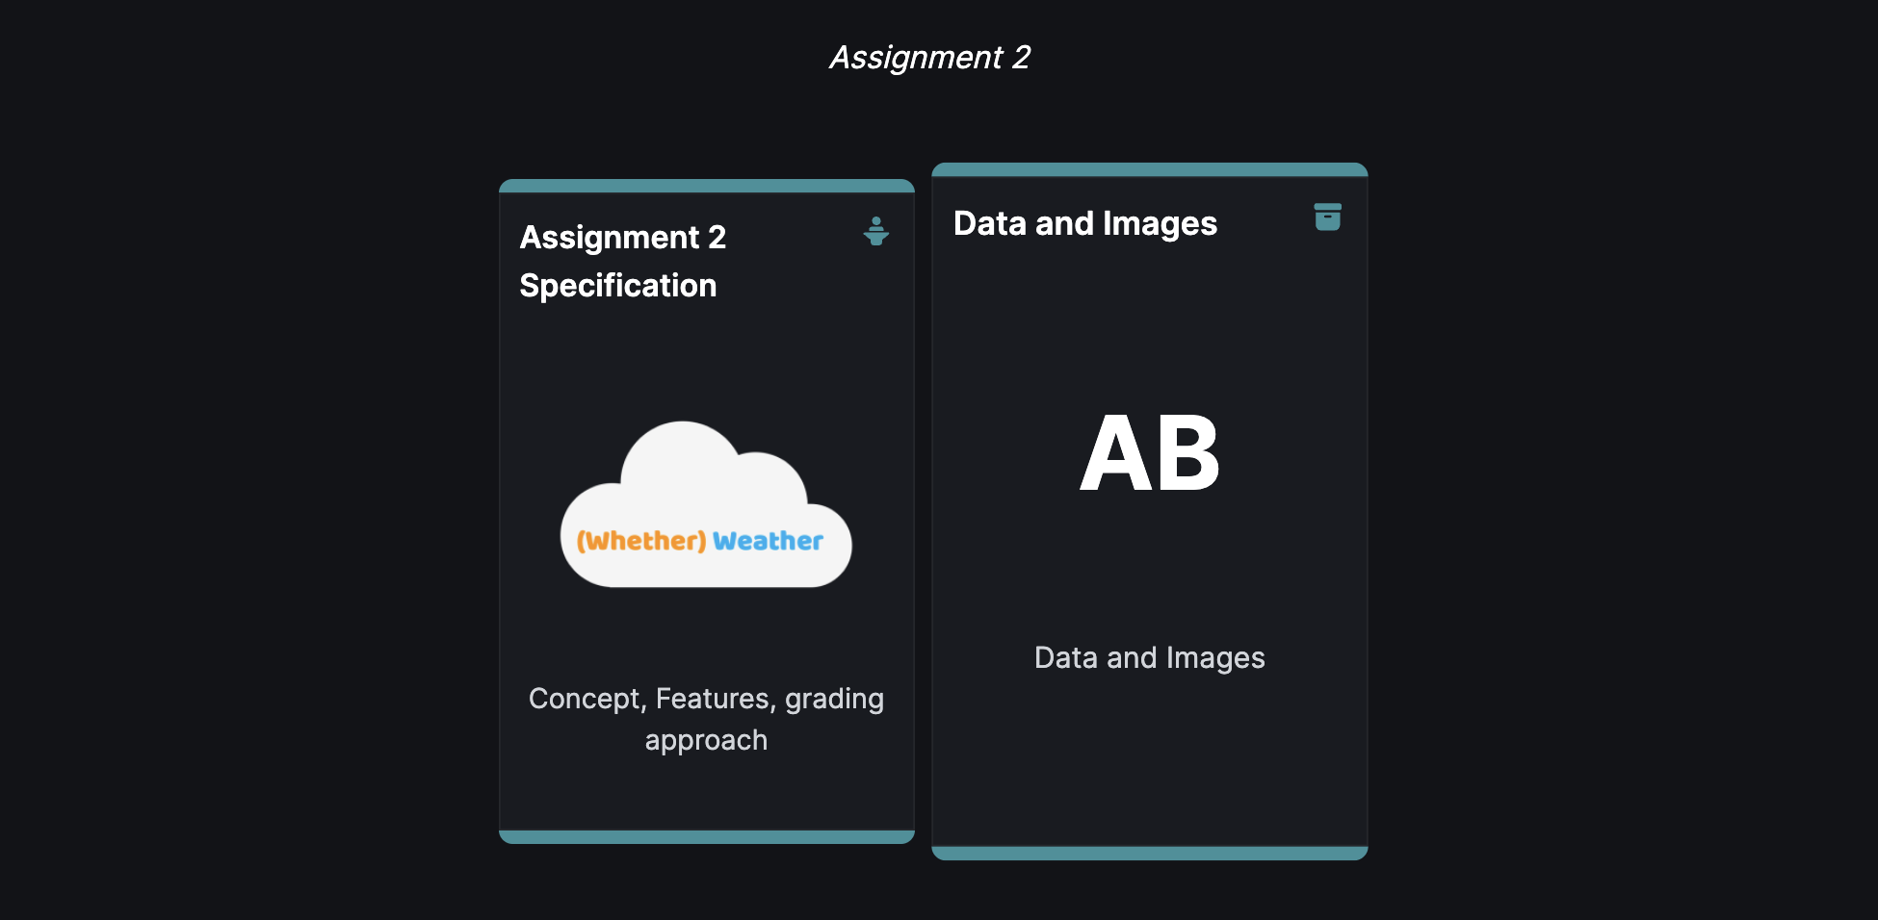
Where is the data?
https://wit-hdip-comp-sci-2024-web-dev-1.netlify.app/topic---assignments/unit-b-assign-2/archive/data.zip

Slide 4
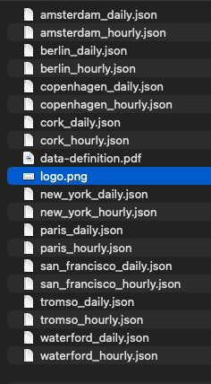
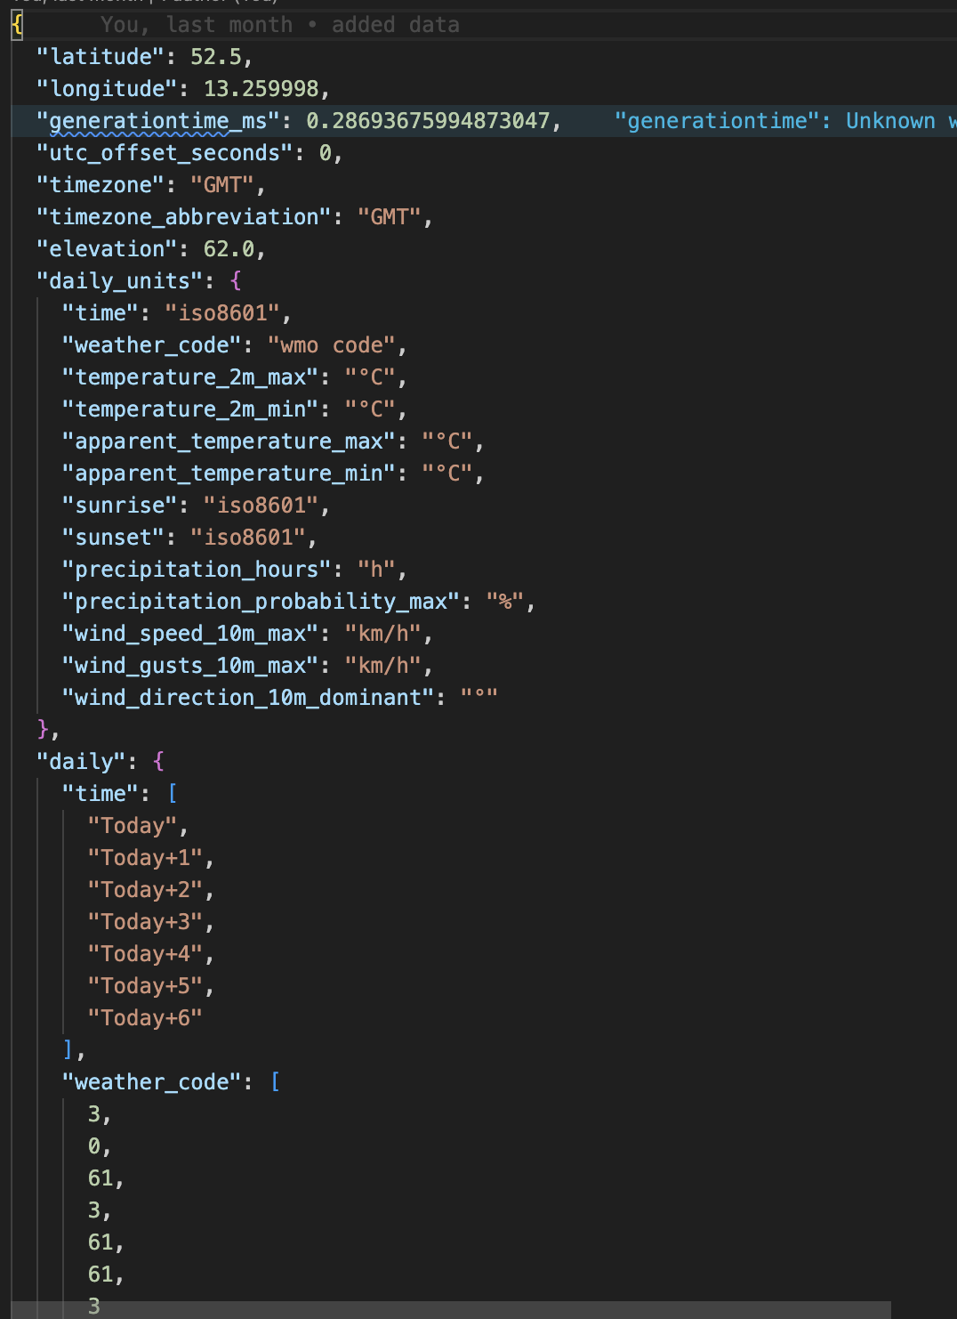
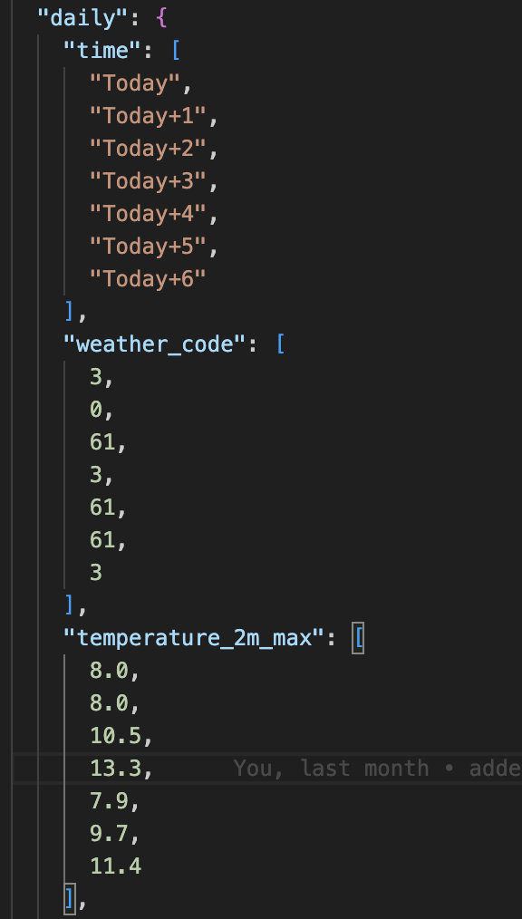
The Data

Slide 5
What is the weather code for today?
The weather code for today is 3
The weather code for tomorrow is 0
The weather code for the day after tomorrow is 61

Slide 6
What is the max temperature for today?
The max temp for today is 8.0
The max temp for tomorrow is 8.0
The max temp for the day after tomorrow is 10.5

Slide 7
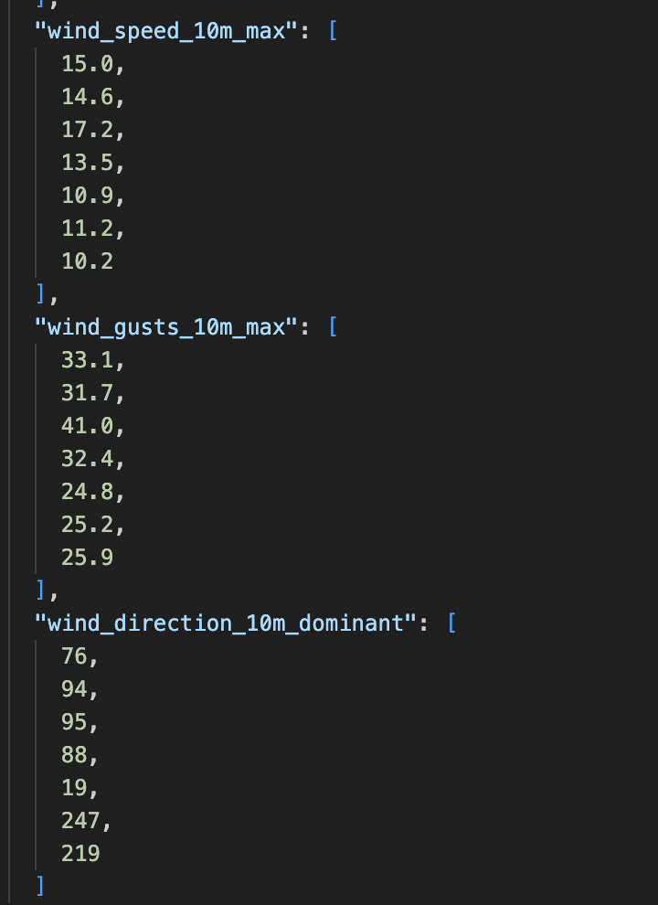
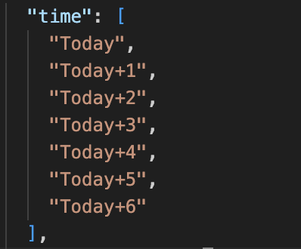
Time index and properties
The index of the “date” is the same index of the data
For Today+5
The wind speed is 11.2
The wind gusts are 25.2
The dominant wind direction is 247 degrees (you should convert to compass)

Slide 8
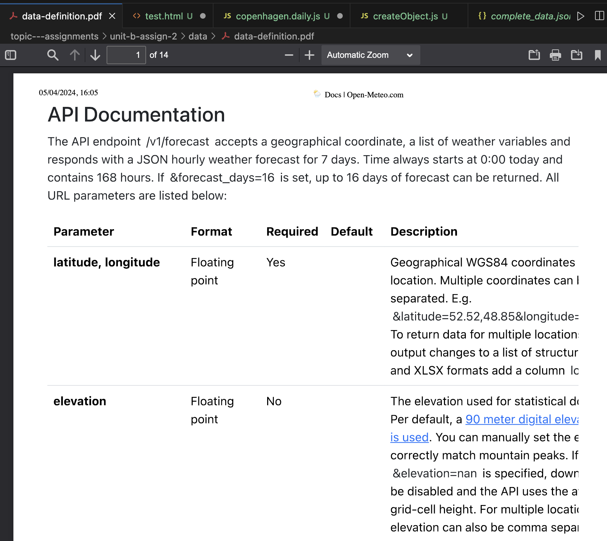
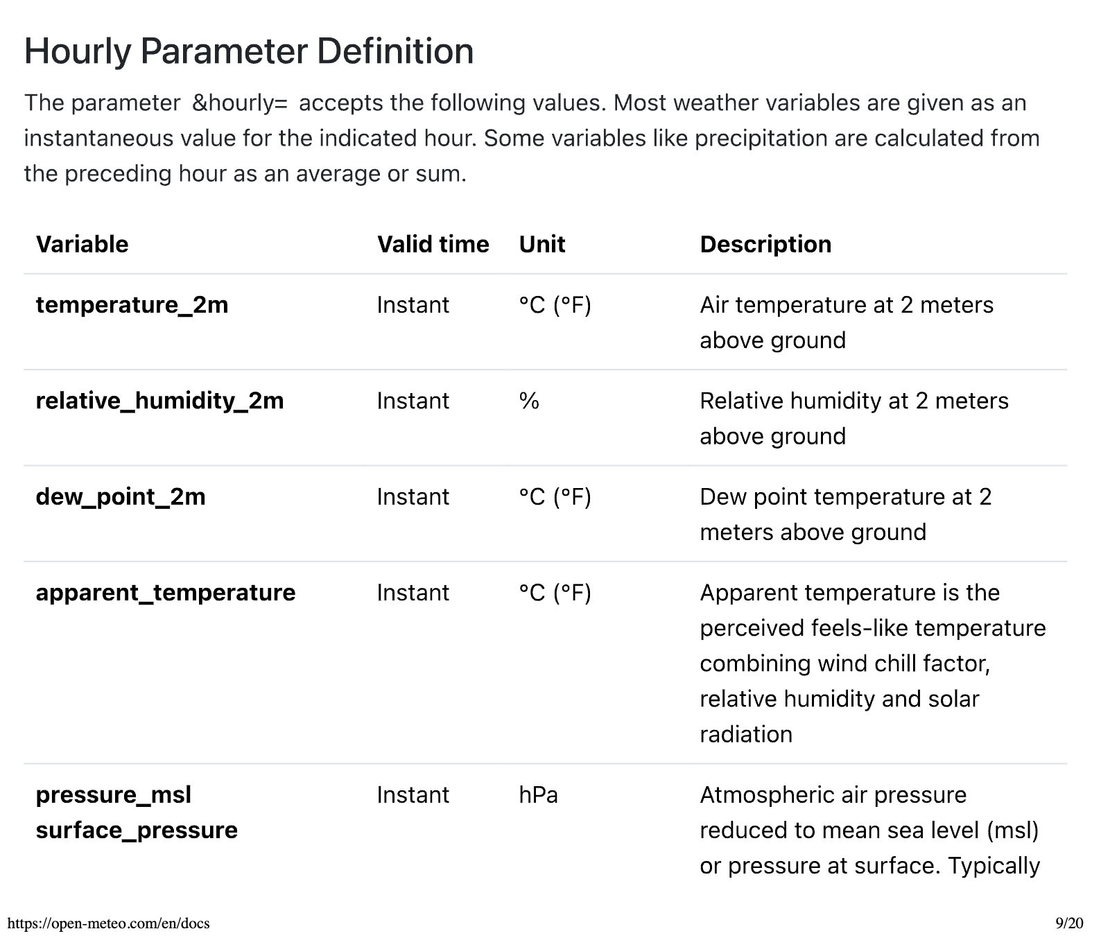
What else is in there? – Data Definition

Slide 9
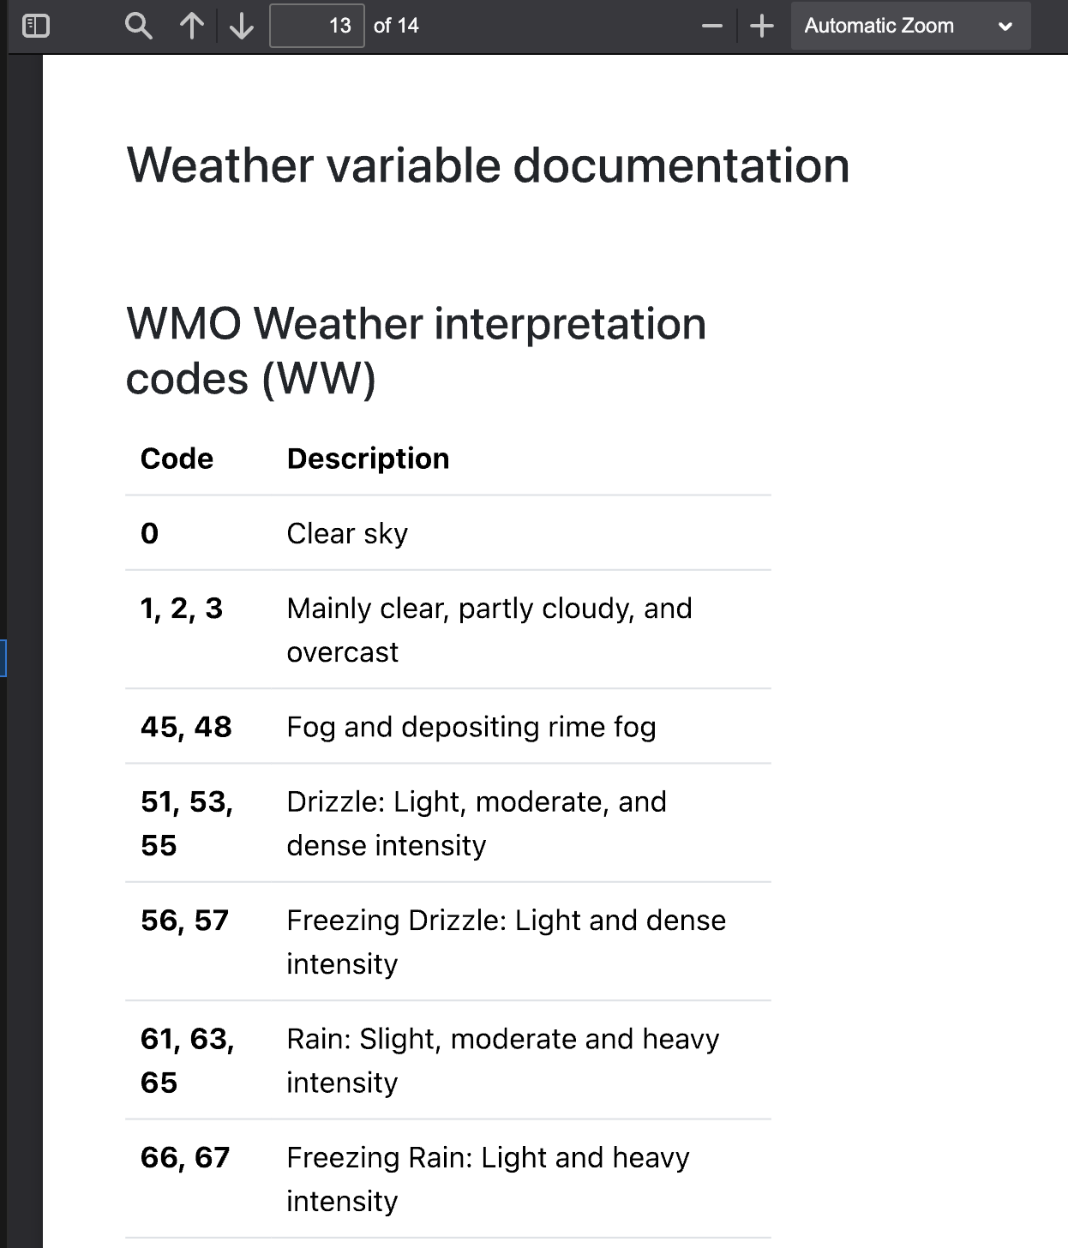
What is a weather code?
Check the data definition documentation

Slide 10
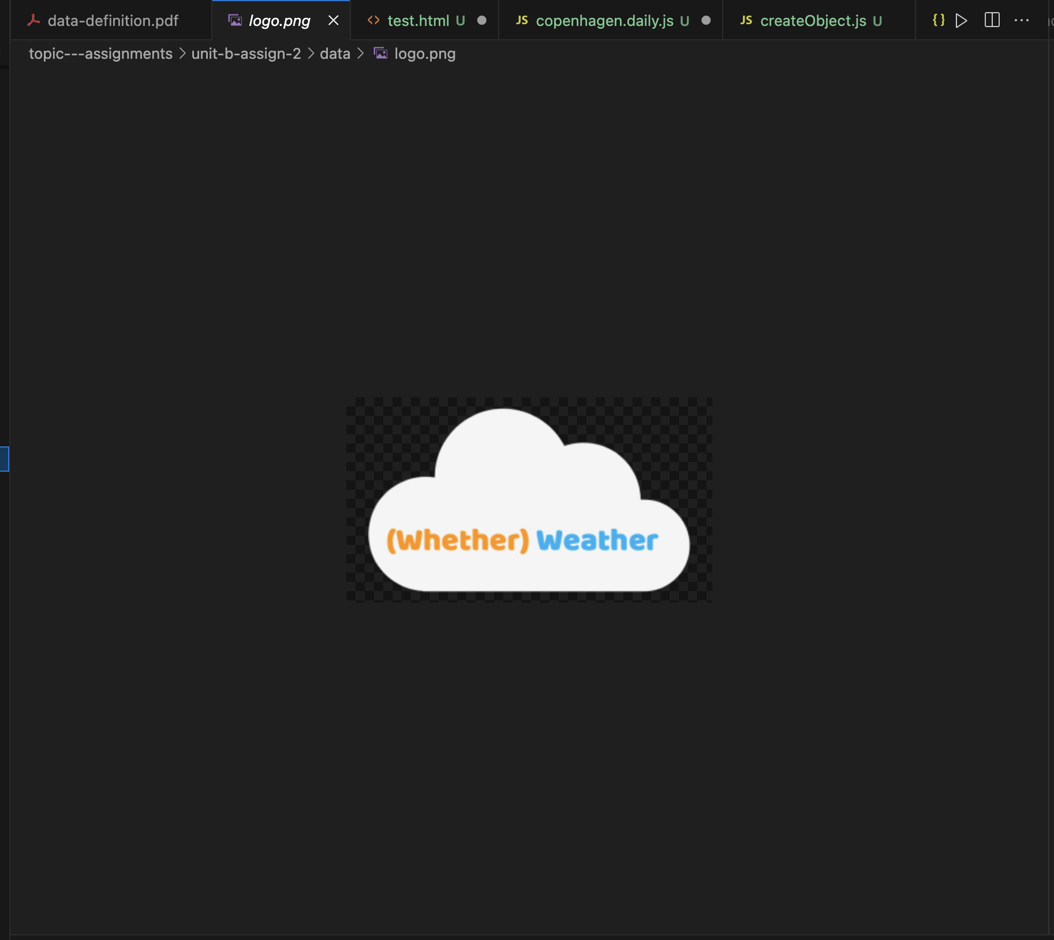
What else is in there? – Logo

Slide 11
How do we use the data?
The data is in JSON format
https://developer.mozilla.org/en-US/docs/Web/JavaScript/Reference/Global_Objects/JSON
This stands for JavaScript Object Notation
JSON is a standard across APIs for delivering data over the network
You can think of it as JavaScript arrays and Objects

Slide 12
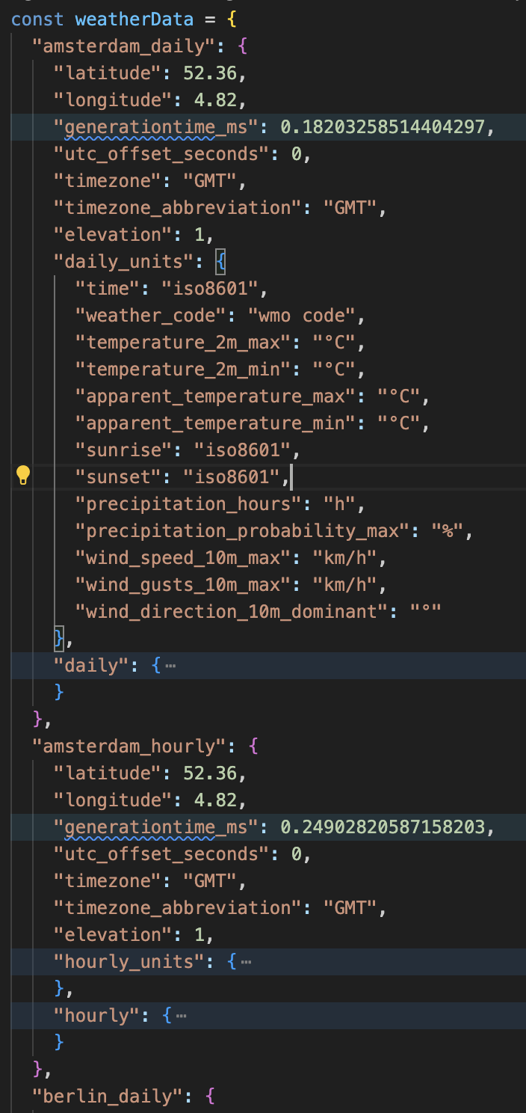
How can we use JSON in our Assignment?
I have provided a complete_data.json file, this is for reference
This is duplicated by weather_data.js and is a JavaScript file that we can use to import into our HTML pages
This creates an object called weatherData that has
The keys of the object are file name e.g. amsterdam_hourly, amsterdam_daily
The value is the weather data

Slide 13
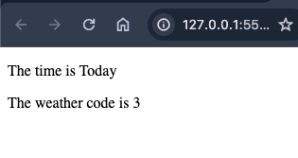
<!DOCTYPE html>
<html lang="en">
<head>
<meta charset="UTF-8">
<meta name="viewport" content="width=device-width, initial-scale=1.0">
<title>Test Data</title>
<script src="weather_data.js"></script>
<script>
document.addEventListener("DOMContentLoaded", () => {
const currentCity = "amsterdam";
const currentCityData = weatherData[currentCity + "_daily"]
const time = document.getElementById("time");
const weatherCode = document.getElementById("weatherCode");
time.innerHTML = currentCityData.daily.time[0];
weatherCode.innerHTML = currentCityData.daily.weather_code[0];
});
</script>
</head>
<body>
<p>The time is <span id="time"></span></p>
<p>The weather code is <span id="weatherCode"></span></p>
</body>
</html>
This page has been added to the data.zip

Slide 14
Basic
This would be seen as a basic way of loading data
To get to the next level we would want to namespace the weatherData object
We would also like to hide it behind a datastore via a pattern similar to Model View Controller
This will be shown in the lectures later, however, for a passing mark, accessing the data as above is acceptable

Slide 15
Useful Techniques for Working with Data
You may not have covered all these yet but we will

Slide 16
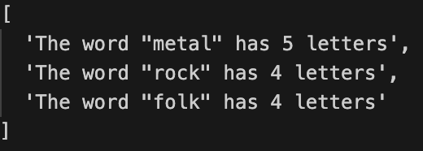
The Array map function
Array.map applies a function to each item in an array
It then maps the return value of the function to the same index of in completely new array
const words = ['metal', 'rock', 'folk']
const wordToDescription = (word) => {
return `The word "${word}" has ${word.length} letters`
}
const descriptions = words.map(wordToDescription)
https://developer.mozilla.org/en-US/docs/Web/JavaScript/Reference/Global_Objects/Map

Slide 17
The Array map function
const words = ['metal', 'rock', 'folk']
const wordToDescription = (word) => {
return `The word "${word}" has ${word.length} letters`
}
const descriptions = words.map(wordToDescription)
The function is typically declared within the parentheses
const descriptions = words.map((word) => {
return `The word "${word}" has ${word.length} letters`
})
https://developer.mozilla.org/en-US/docs/Web/JavaScript/Reference/Global_Objects/Map

Slide 18
The Array map function
const words = ['metal', 'rock', 'folk']
const wordToDescription = (word) => {
return `The word "${word}" has ${word.length} letters`
}
const descriptions = words.map(wordToDescription)
This can be shortened further from:
const descriptions = words.map((word) => {
return `The word "${word}" has ${word.length} letters`
})
To a one-line assignment:
const descriptions = words.map(word => `The word "${word}" has ${word.length} letters`)
https://developer.mozilla.org/en-US/docs/Web/JavaScript/Reference/Global_Objects/Map

Slide 19
The Array forEach function
Array.forEach runs a function for each item in an array
Unlike “map” it has no return value
const words = ['metal', 'rock', 'folk']
const descriptions = [] // we use forEach to populate one by one
words.forEach(word => descriptions.push(`The word "${word}" has ${word.length} letters`))
console.log(descriptions)
https://developer.mozilla.org/en-US/docs/Web/JavaScript/Reference/Global_Objects/Array/forEach

Slide 20
To map or forEach
Use map when you want to transform each item in an array into a new array, e.g. square every number in an array.
Use forEach when you want to use each item in an array to act upon another piece of data e.g. add every item of fruit into a shopping basket
const words = ['metal', 'rock', 'folk']
const uppercaseWords = words.map(word => word.toUpperCase());
// new array with ["METAL", "ROCK", "FOLK"]
https://developer.mozilla.org/en-US/docs/Web/JavaScript/Reference/Global_Objects/Array/forEach

Slide 21
find and filter
Use Array.find to find the FIRST ELEMENT that matches a condition
Use Array.filter to find ALL THE ELEMENTS as an array that match a condition
const numbers = [5, 12, 8, 130, 44];
const foundNumber = numbers.find((element) => element > 10); // 12
const foundNumbers = numbers.filter((element) => element > 10); // [12, 130, 44]
https://developer.mozilla.org/en-US/docs/Web/JavaScript/Reference/Global_Objects/Array/find https://developer.mozilla.org/en-US/docs/Web/JavaScript/Reference/Global_Objects/Array/filter

