Slide 1
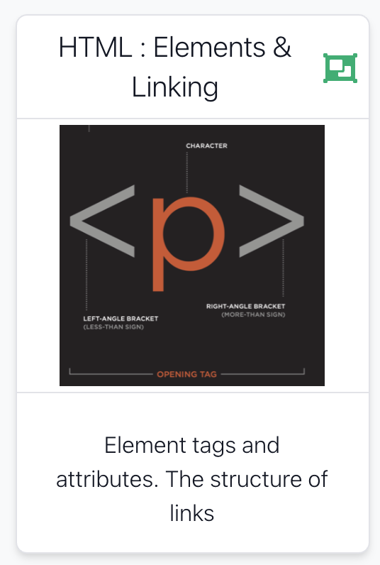

Slide 2

Some Key Concepts
The structure of an HTML Element its variants.
Nature of a relative path, the differences from an absolute path.

Slide 3
Agenda
Elements, Attributes, & Documents
Linking
Nesting
Line break, Block & Inline Elements

Slide 4
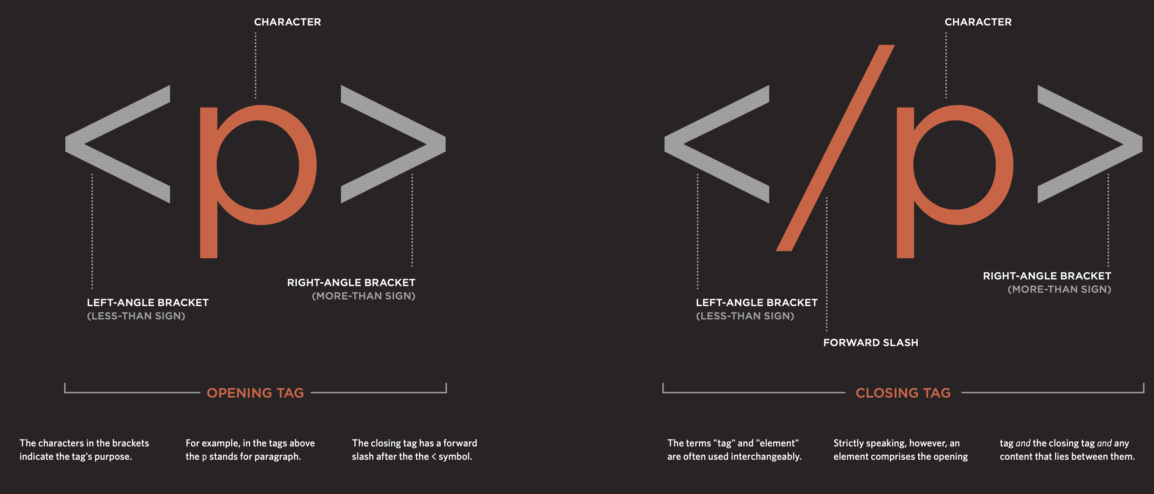

Slide 5
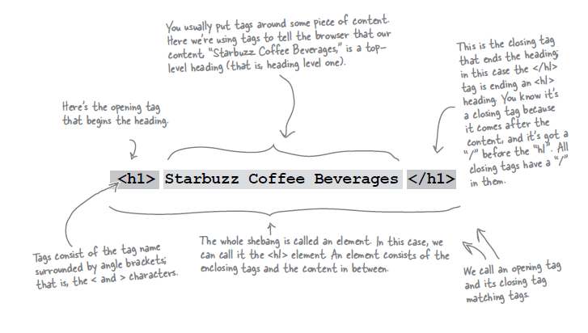
Components of an HTML Element

Slide 6
Components of an HTML Element
<ElementName >
Content
</ElementName>
Start Tag
End Tag

Slide 7
<title>
<title> My App Store </title>
ElementName: <title>
Content: My App Store
ElementName: </title>

Slide 8

<p>
<p>
This store brings you great app bundles
week after week. We select the best power
user apps from a broad range of suppliers
and combine them into great deals. These
are the highest quality apps
from the best publishers, at great
prices.
</p>
ElementName: <p>
Content:
ElementName: </p>

Slide 9
<a>
<a href=“apps.html”> App Store </a>
ElementName: <a>
AttributeName: href
AttributeValue: “apps.html”
Content: App Store
ElementName: </a>

Slide 10
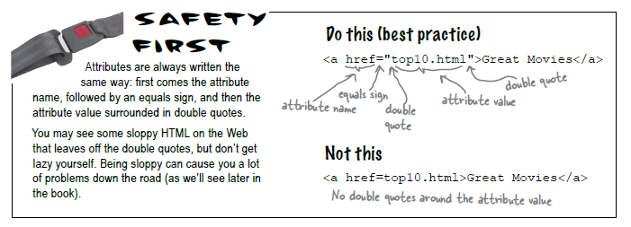
Attributes
Attributes give you a way to specify additional information about an element.

Slide 11
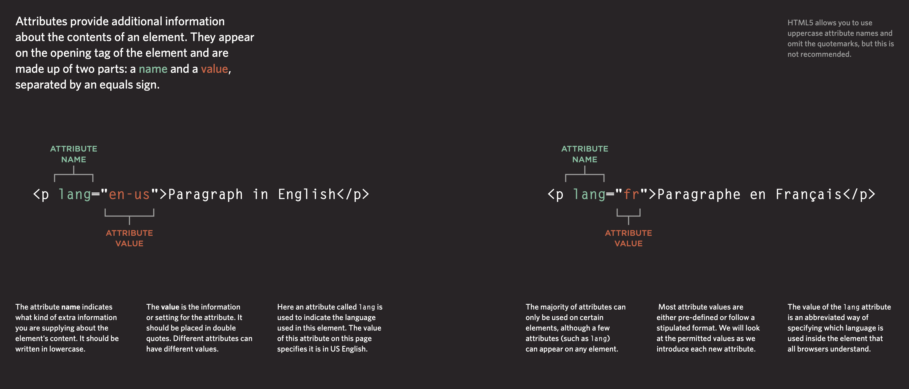

Slide 12
<img>
<img src=“../images/delete.jpg”/>
ElementName: <img>
AttributeName: src
AttributeValue: "../images/delete.jpg"
Content: empty
ElementName: none
<img src=“../images/delete.jpg”>

Slide 13
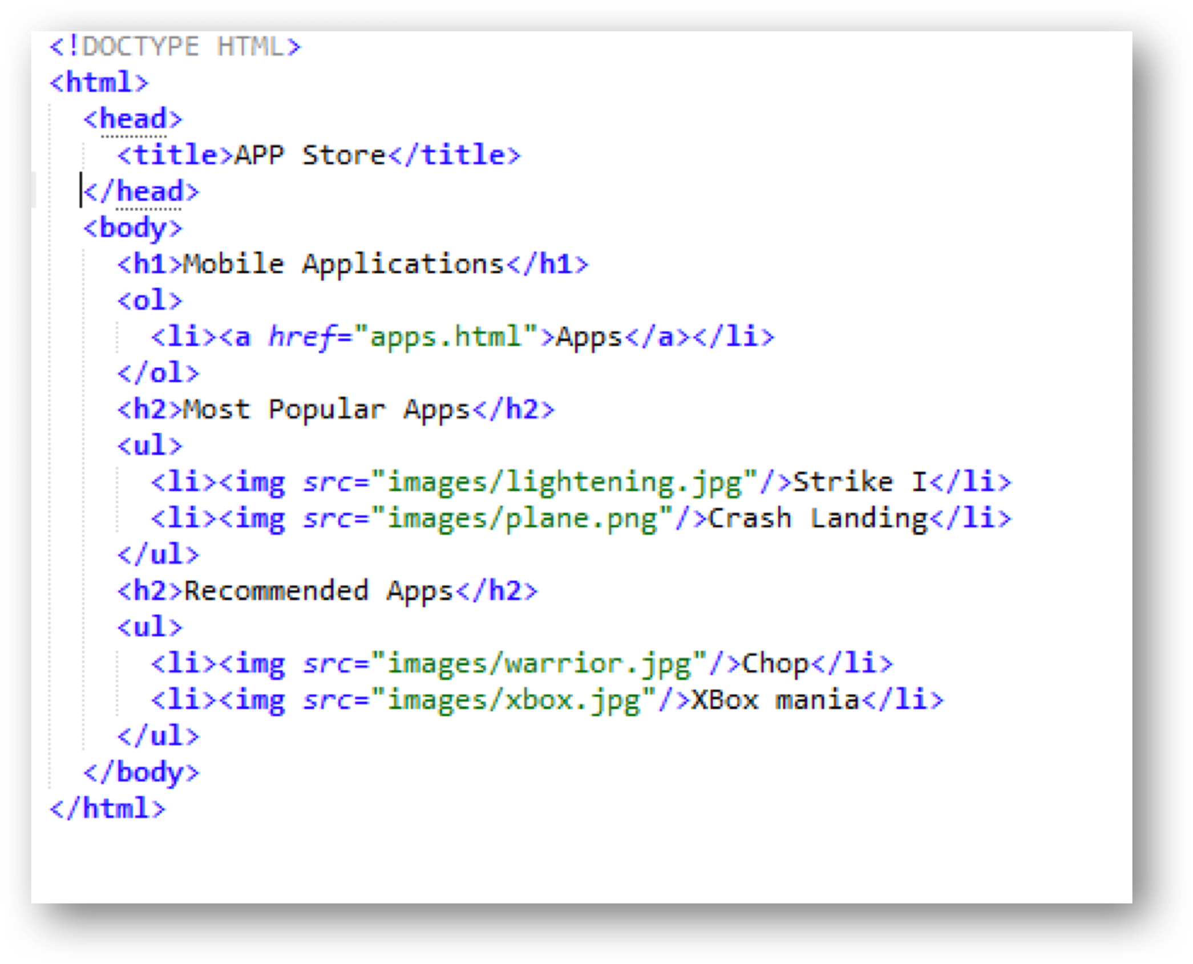
HTML Document Structure
html
head
title
body
h1
ol
etc...

Slide 14
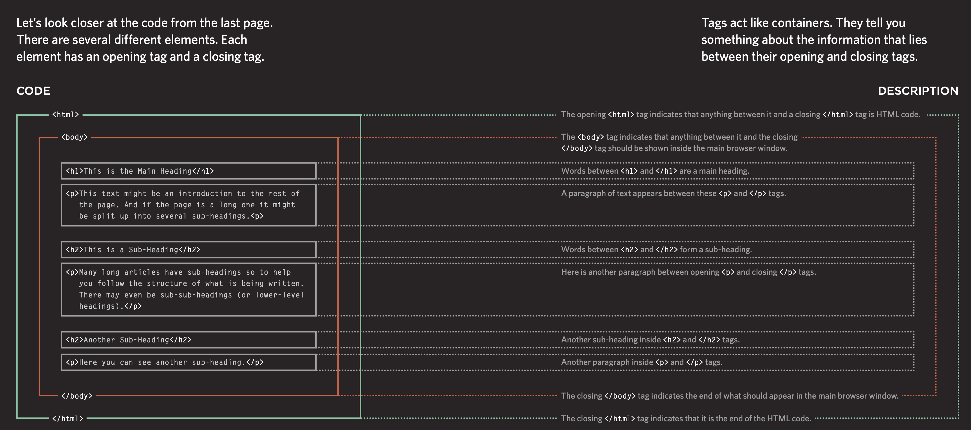

Slide 15
Agenda
Elements, Attributes, & Documents
Linking
Nesting
Line break, Block & Inline Elements

Slide 16
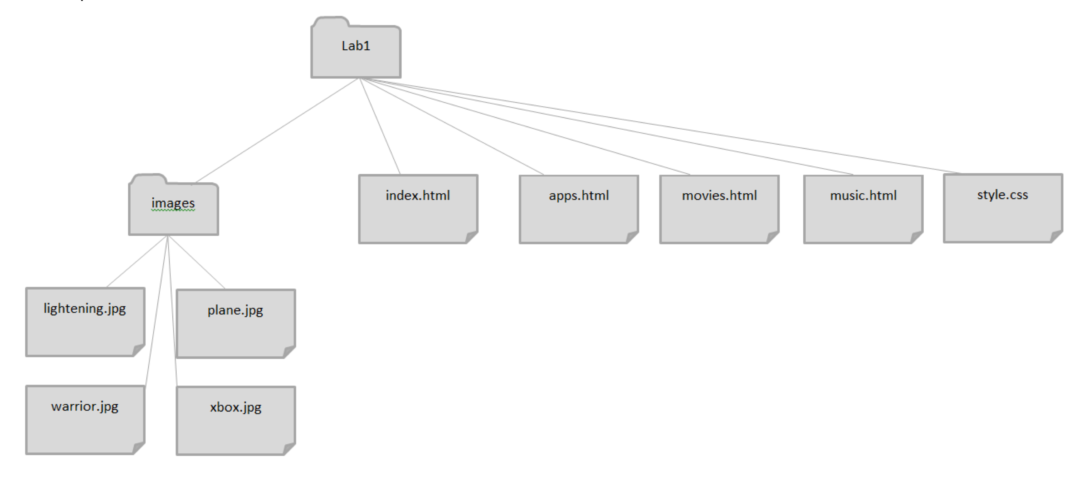
Linking
lab-01

Slide 17
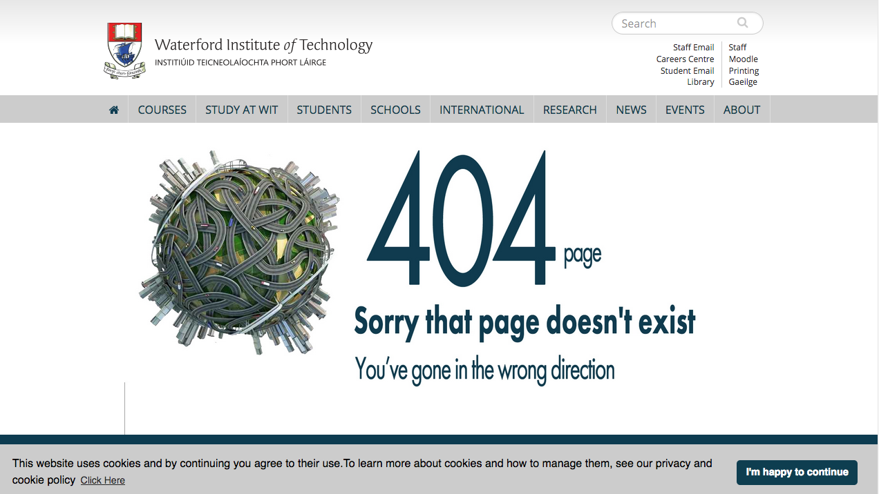
Linking to other pages or images
Creating links to other web pages and to image files can get confusing! If your link to a file or page is incorrect you get:
Whoops we can’t seem to find that page! (404 error )
Or
No image shows and you have a broken link to an image

Slide 18
Links: Absolute vs Relative
Absolute
Complete path to a file on the hard disk: e.g:
c:/web-development/lab-01/images/xbox.jpg
c:/web-development/lab-01/index.html
Relative:
./images/xbox.jpg
../apps.html
index.html
You can trace route from “current position” to the destination
“..” means go up one level
Directory name may prefix filename

Slide 19
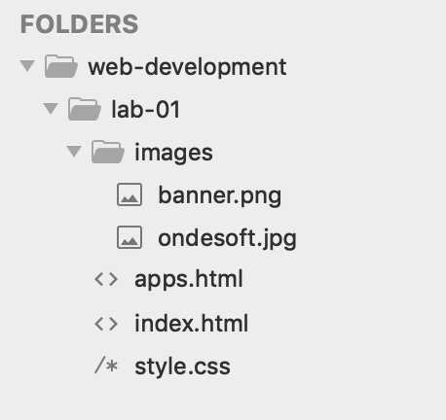


Relative Link Examples
If we are in “lab-01” then “images/banner.png” is a relative link from the current folder (lab-01) to the images folder, and to the file “banner.png” in that folder
Avoid absolute links!
<a href=“apps.html”>Movies</a>
<img src=“./images/banner.jpg”>
<img src=“c:/web-development/lab-01/images/banner.jpg”>

Slide 20
Absolute & Relative paths again
Relative
No drive name
../ one level up,
../../ two levels up, etc
somefolder one level down into folder named someFolder
somefolder/otherfolder two levels down
../../baffin/data two levels up and two levels down
Absolute
Drive + {folder(s)} + {file}
e.g. C:\projects\baffin\data

