Slide 1
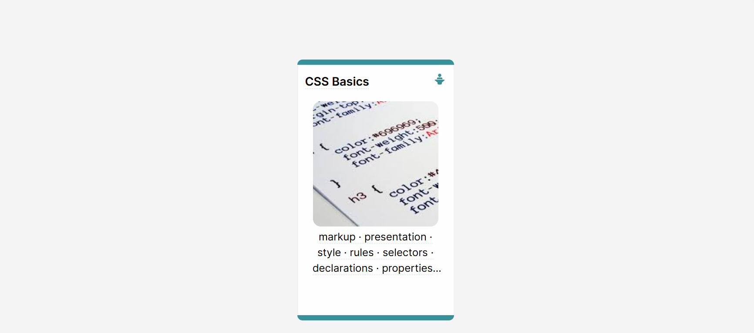

Slide 2
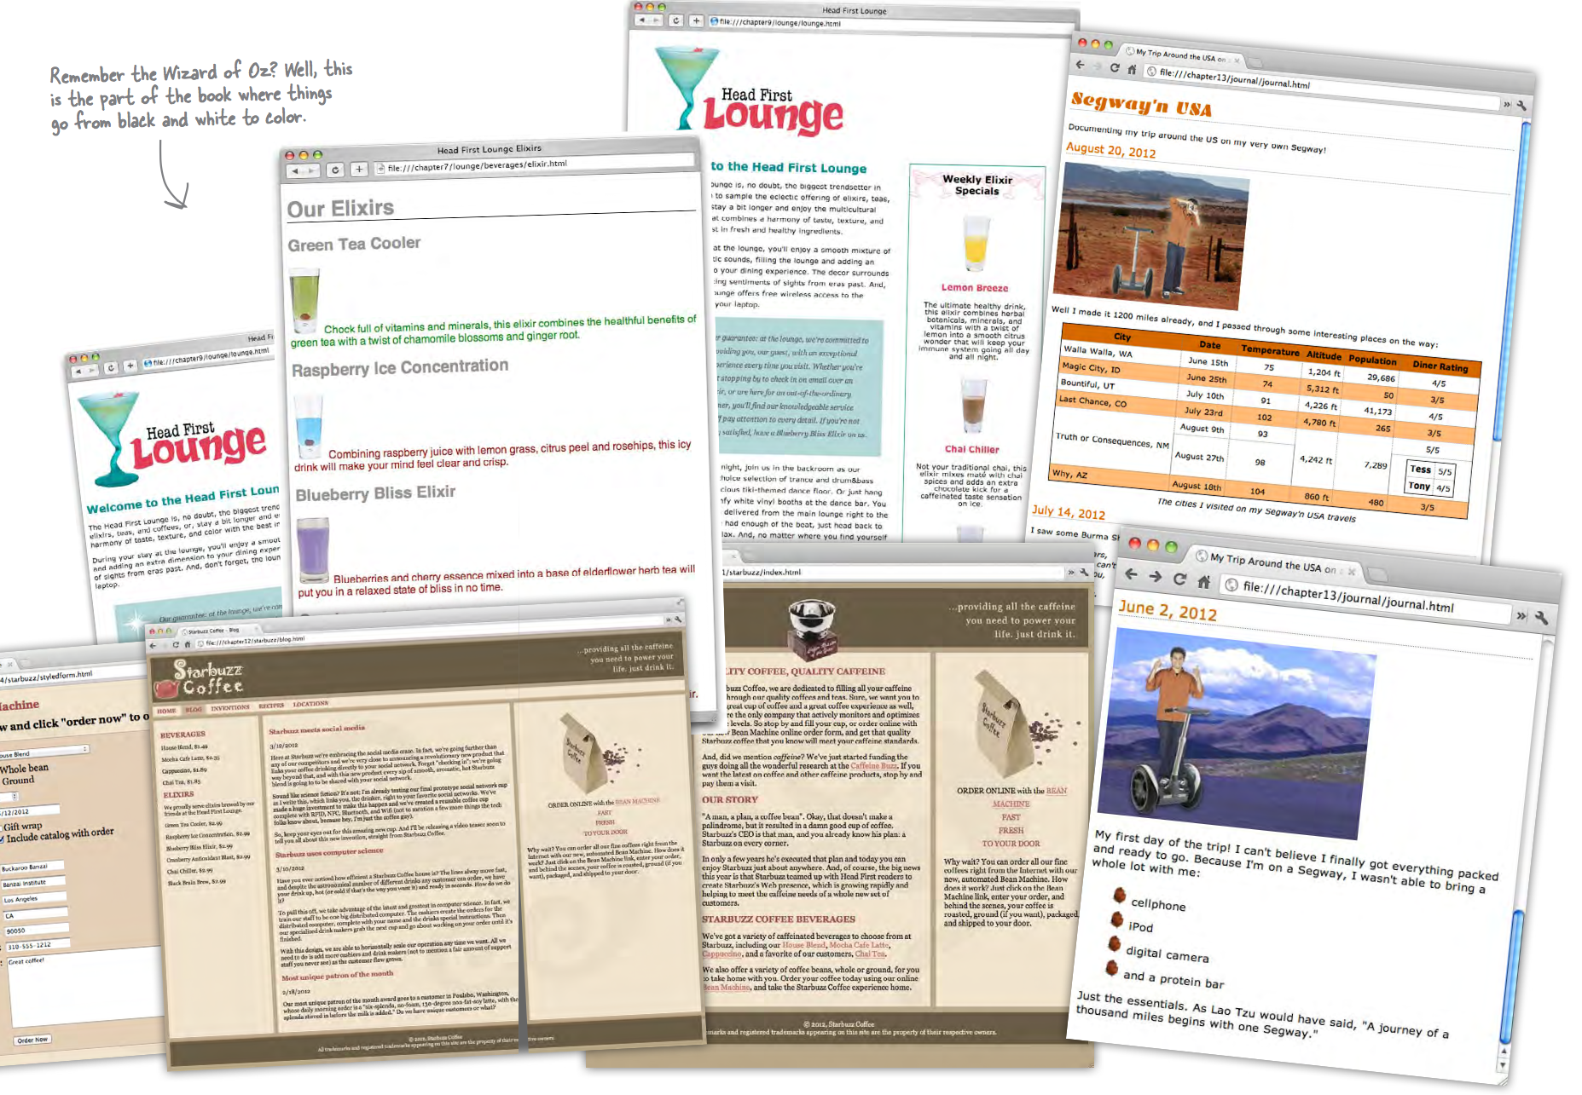

Slide 3
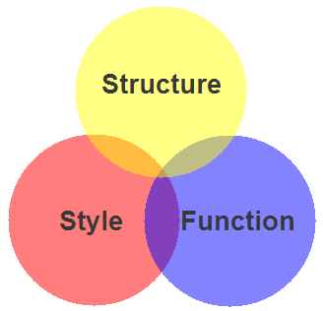
Markup, Style, Function
Markup (XHTML, HTML)
Structure
Content
Style (CSS)
Style
Presentation
Appearance
Function (Javascript)
Actions
Manipulations

Slide 4
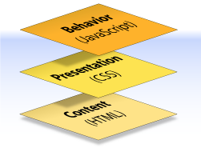
Content, Presentation, Behavior
Content comprises the information the author wishes to convey to his or her audience, and is embedded within HTML or XHTML markup that defines its structure and semantics.
Most of the content on the Web today is text, but content can also be provided through images, animations, sound, video, and whatever else an author wants to publish

Slide 5
Content, Presentation, Behavior
Presentation defines how the content will appear to a human being who accesses the document in one way or another
The conventional way to view a web page is with a regular web browser, of course, but that’s only one of many possible access methods. For example, content can also be converted to synthetic speech for users who have impaired vision or reading difficulties

Slide 6
Content, Presentation, Behaviour
Behaviour layer involves real-time user interaction with the document.
This task is normally handled by JavaScript.
The interaction can be anything from a trivial validation that ensures a required field is filled in before an order form can be submitted, to sophisticated web applications that work much like ordinary desktop programs.

Slide 7

Separation of Concerns
It’s possible to embed all three layers within the same document
<em> and <b> can be used to control the presentation of text, and <hr> will insert a visible rule element
Sometimes called Presentational Markup, these types of elements embed presentation-layer information within the content layer, they negate any advantage we may have gained by keeping the layers separate.
We can modify or replace any of the layers without having to change the others.
Keeping them separate gives us one valuable advantage:

Slide 8

What is CSS?
Cascading Style Sheets is the recommended way to control the presentation layer in a web document.
The main advantage of CSS over presentational HTML markup is that the styling can be kept entirely separate from the content.
CSS also provides far better control over presentation than do presentational element types in HTML.
CSS is a language for specifying how documents are presented to users — how they are styled & laid out
Notes:
Cascading Style Sheets (CSS) is a simple mechanism for adding style (e.g., fonts, colors, spacing) to Web documents.

Slide 9
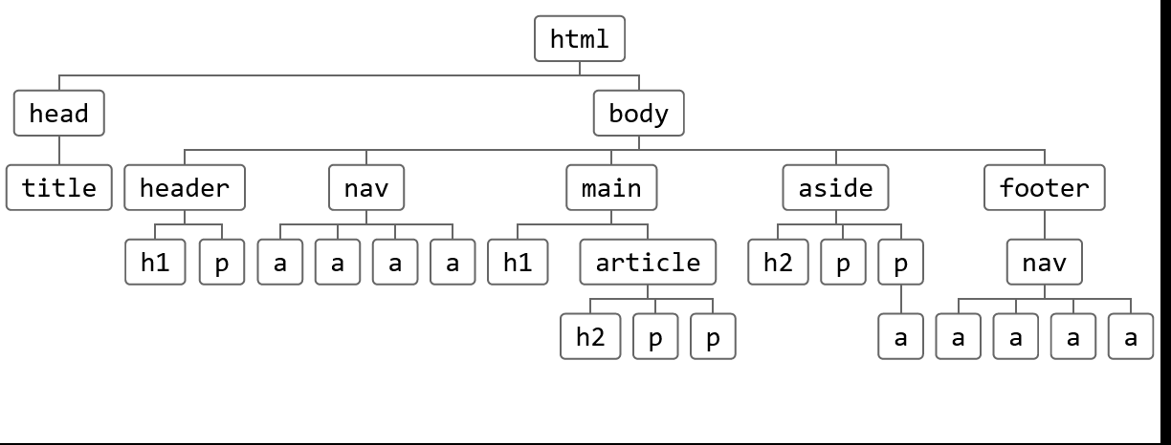
What is Cascading?
The “cascading” in CSS refers to the fact that styling rules “cascade” down from several sources. This means that CSS has an inherent hierarchy and styles of a higher precedence will overwrite rules of a lower precedence.

Slide 10
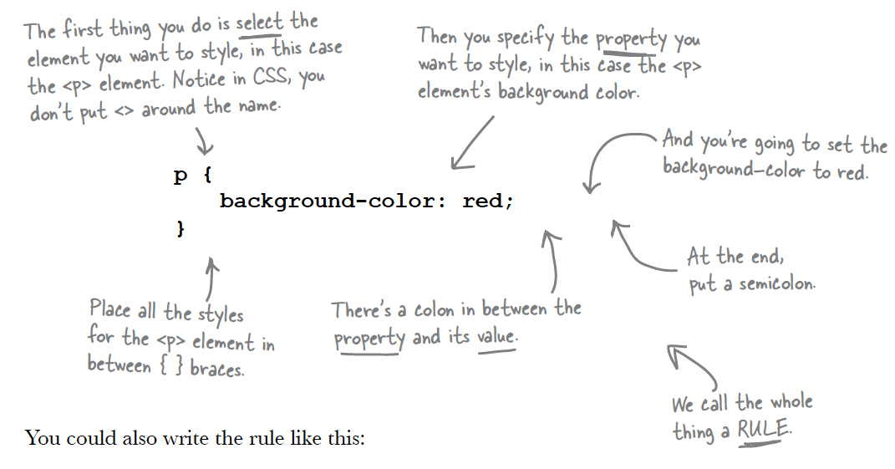
A CSS Rule

Slide 11
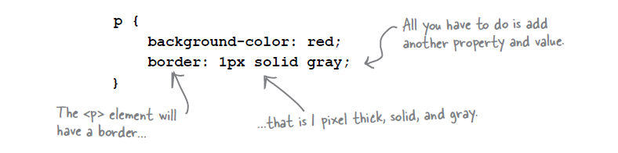
More Properties...
You can add as many properties and values as you like in each CSS rule.
To put a border around your paragraphs:

Slide 12
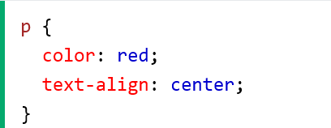
p is a selector in CSS (it points to the HTML element you want to style: <p>).
color is a property, and red is the property value
text-align is a property, and center is the property value

Slide 13
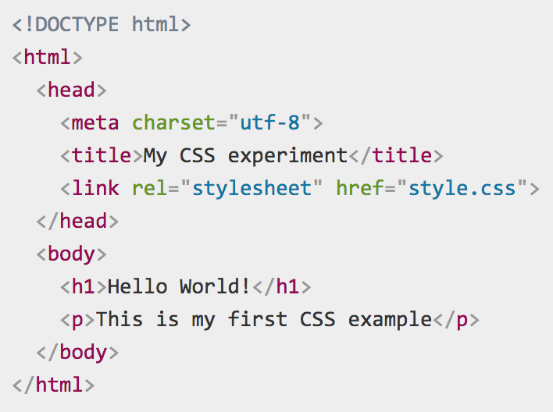
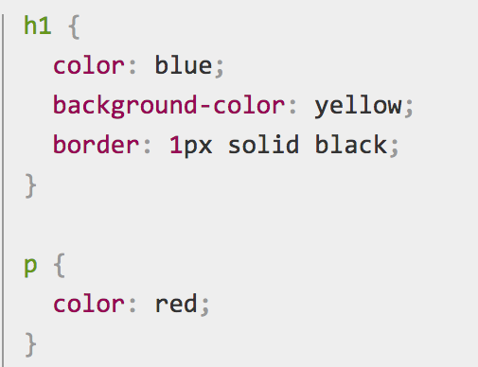
Example
index.html
style.css

Slide 14
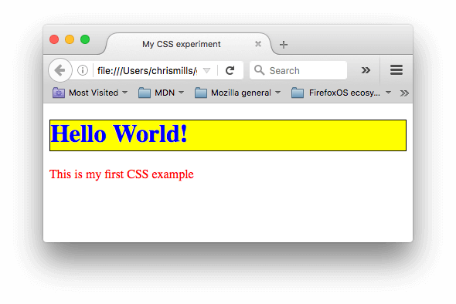

Slide 15
Two rules

Slide 16
The first rule starts with an h1 selector, which means that it will apply its property values to the <h1> element. It contains three properties and their values:
The first one sets the text color to blue.
The second sets the background color to yellow.
The third one puts a border around the header that is 1 pixel wide, solid (not dotted, or dashed, etc.), and colored black.

Slide 17
The second rule starts with a p selector, which means that it will apply its property values to the <p> element.
It contains one declaration, which sets the text color to red.

Slide 18
Rules Applied to HTML document

Slide 19
Browser Render

Slide 20
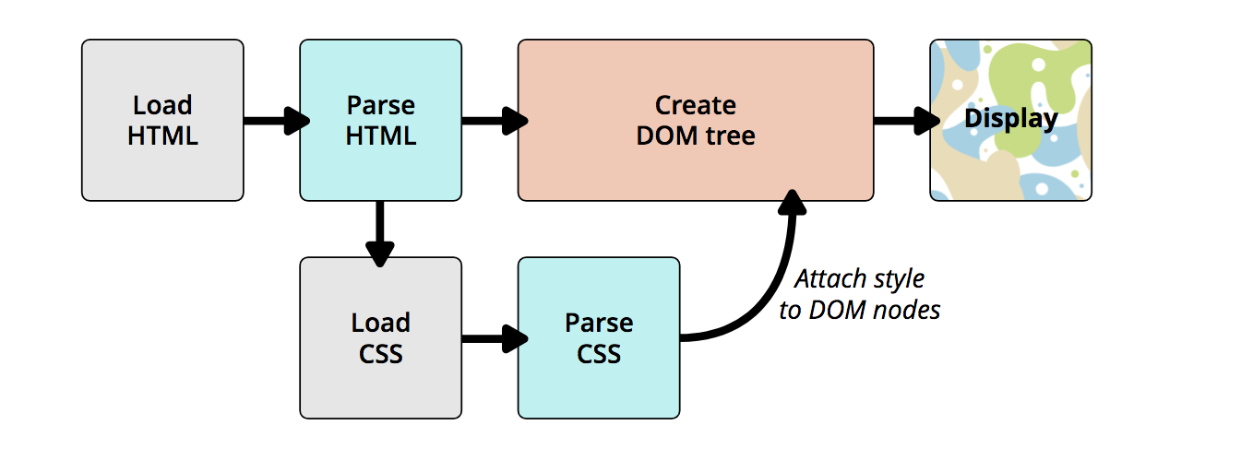
How CSS Does it Work?
The browser converts HTML and CSS into the DOM (Document Object Model). The DOM represents the document in the computer's memory. It combines the document's content with its style.
The browser displays the contents of the DOM.

Slide 21
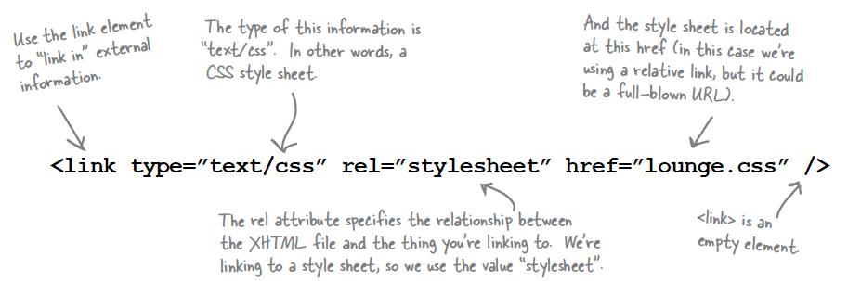
<link> element
Notes:
Most often Used in the <head> tag

Slide 22
One Stylesheet - Multiple html pages
Index.html
<head>
<title>App Store</title>
<link type="text/css" rel="stylesheet" href=“style.css" />
</head>
movies.html
Style.css
<head>
<title>Movies</title>
<link type="text/css" rel="stylesheet" href="style.css" />
</head>
music.html
<head>
<title>Music</title>
<link type="text/css" rel="stylesheet" href="style.css" />
</head>

Slide 23
Rules
Selectors
Declarations
Properties
Values

Slide 24
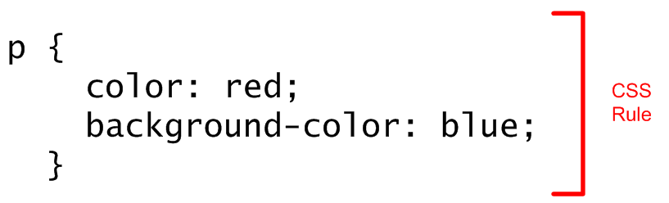
CSS Rule

Slide 25
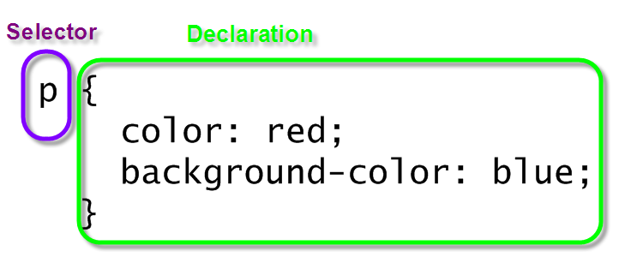
Selector and Declarations

Slide 26
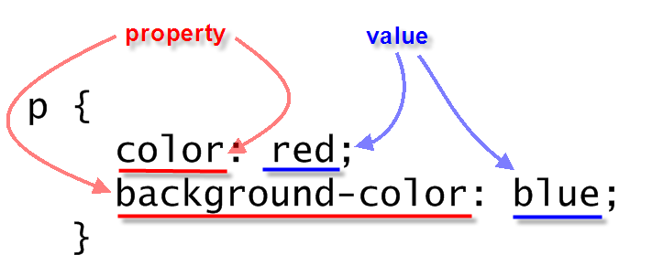
Properties & Values

