Slide 1
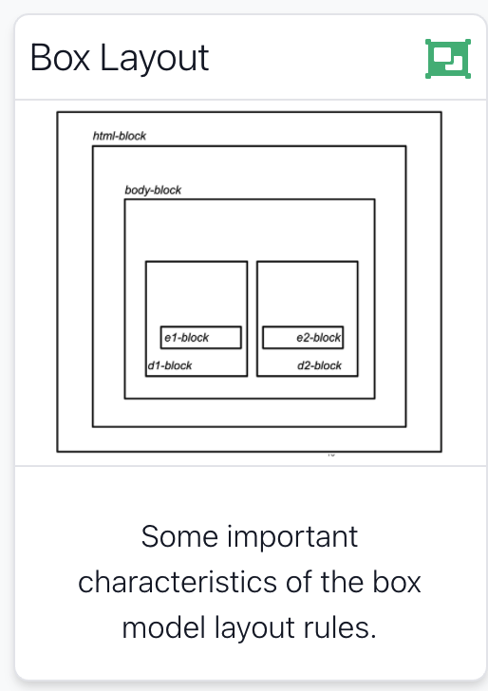

Slide 2
Agenda
The DOM, HTML Parsing & Rendering
Formatting concepts in CSS
A simple, worked example of multicolumn layout
A worked example of a “tabbed” multicolumn layout
2

Slide 3
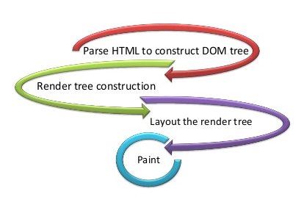
Parsing & Rendering
A web browser typically reads and renders HTML documents in two phases:
the parsing phase
the rendering phase.
During the parsing phase, the browser reads the markup in the document, breaks it down into components, and builds a Document Object Model (DOM) tree.
The DOM is a in-memory data structure, typically traversed by Java Script code
3

Slide 4
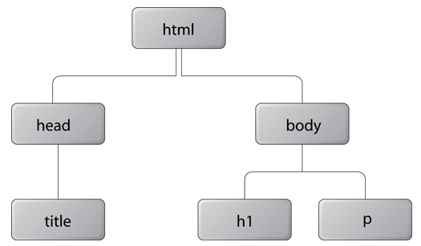
DOM Tree
<!DOCTYPE html>
<html>
<head>
<title>Widgets</title>
</head>
<body>
<h1>Widgets</h1>
<p>Welcome to Widgets, the number one company
in the world for selling widgets!</p>
</body>
</html>
Each object in the DOM tree is called a node.
At the top of the tree is a document node, which contains an element node called the root node
It branches into two child nodes—head and body—which then branch into other children.
4

Slide 5
Parents, Grandparents, Children, Grandchildren, Siblings
Inheritance
A child node is structurally subordinate to its parent node - the child’s tags are nested inside the tags of the parent.
A node can be called a descendant node if it’s a child, grandchild, and so on, of another node.
A node can be called an ancestor node if it’s a parent, grandparent, and so on, of another node.
Nodes that have the same parent are called siblings. .
5

Slide 6
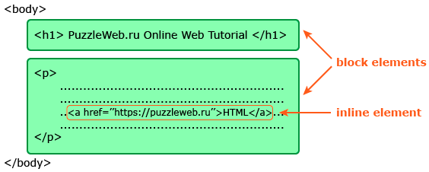
Block & Inline
When the DOM tree has been constructed, and any CSS style sheets have been loaded and parsed, the browser starts the rendering phase.
Each node in the DOM tree will be rendered as zero or more boxes.
A box is always rectangular, it has four sides with a 90° angle between each side.
HTML Elements are either block-level or inline-level.
block-level HTML elements generate block boxes - with line breaks between them
inline-level HTML elements generate inline boxes - without line breaks
6

Slide 7
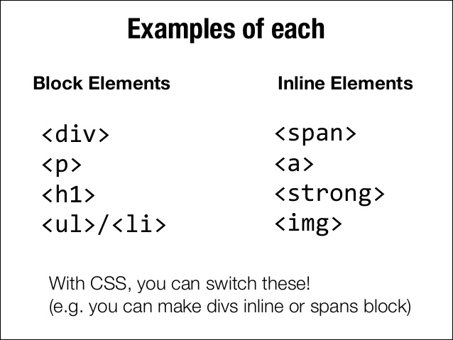

Slide 8
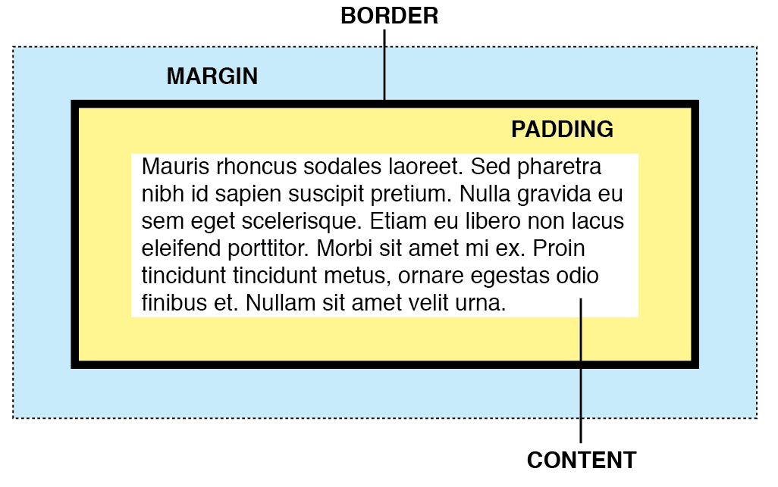
CSS Box Model
Some key concepts:
Box Terminology
Calculating Box Dimensions
The Containing Block
Collapsing Margins
7

Slide 9
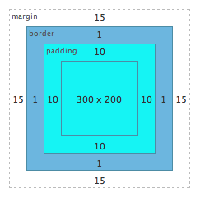
Box Terminology
.box {
width: 300px;
height: 200px;
padding: 10px;
border: 1px solid #000;
margin: 15px;
}
The content area in the centre, the padding around the content area, the border area, and the margin area.
The outer edge of the content area is called the content edge or inner edge;
the outer edge of the padding area is called the padding edge;
the outer edge of the border area is called the border edge;
and the outer edge of the margin area is called the margin edge or outer edge
8

Slide 10
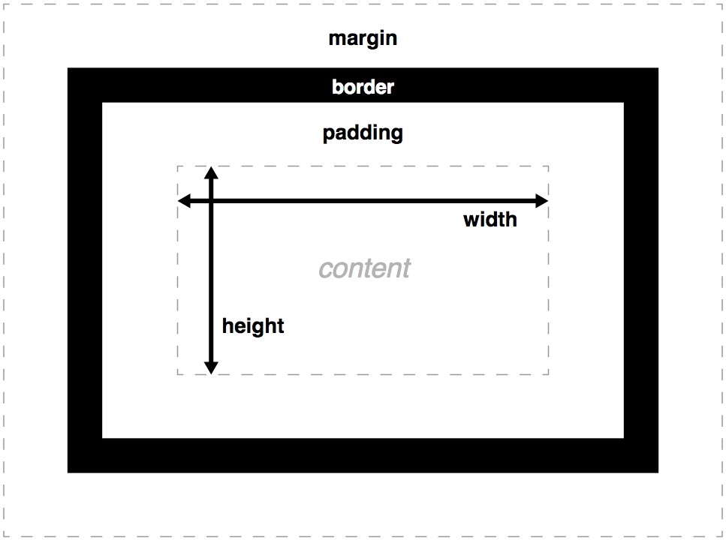
Calculating Box Dimensions
Block-level elements can only be rectangular.
Calculate the overall dimensions of a block-level element by taking into account the height and width of the content area, as well as any margins, padding, and borders that are applied to the element.
There are some short circuits to this!
9

Slide 11
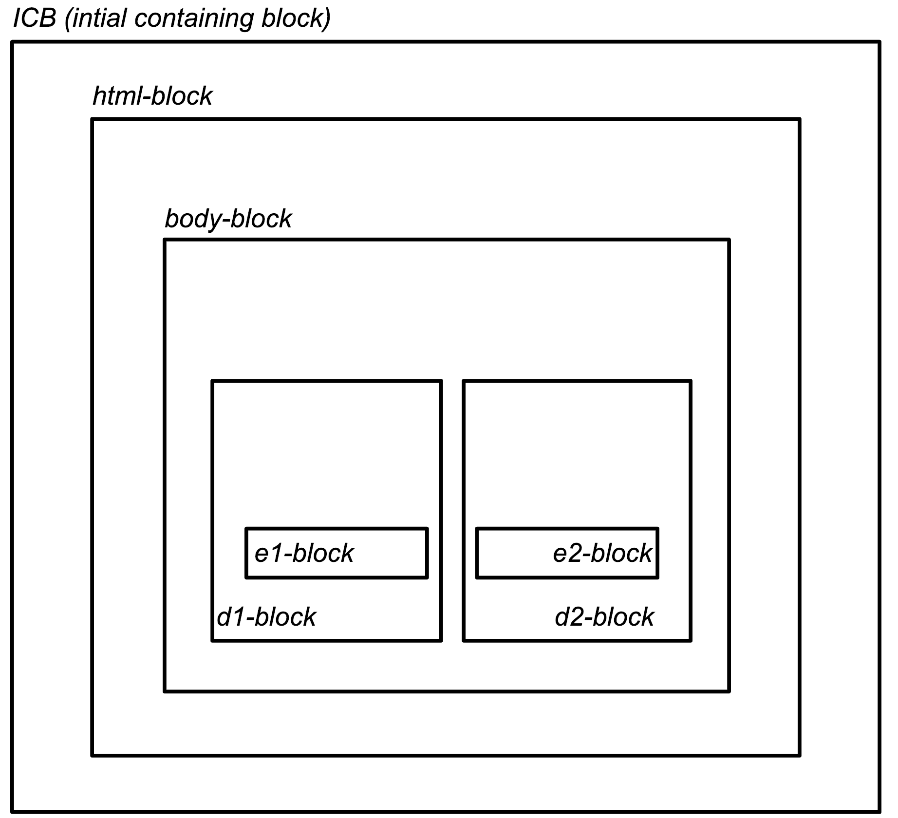
The Containing Block
CSS rendering comprises the tasks of laying out and rendering numerous boxes. Element boxes are positioned within a formatting context, which, by default, is provided by the box generated by a parent element.
When we specify the positions or dimensions of element boxes, we’re doing so relative to what’s known as the containing block, which is a very important concept in CSS layout.
The containing block for the root element is called the initial containing block, and has the same dimensions as the viewport - generally the browser window
The containing block for other elements is generally the immediate parent
10

Slide 12

Collapsing Margins
<h1>Weekly Deals</h1>
<h2>Business Bundle</h2>
h1 {
border: solid 1px;
margin-bottom: 50px;
}
h2 {
border: solid 1px;
margin-top: 50px;
}
When the vertical margins of two elements are touching, only the margin of the element with the largest margin value will be honoured, while the margin of the element with the smaller margin value will be collapsed to zero
In this example, the gap between the elements is only 50px, and the other (smaller if equal) margin has collapsed to zero
There are exceptions to this rule…
50px
11

