Slide 1
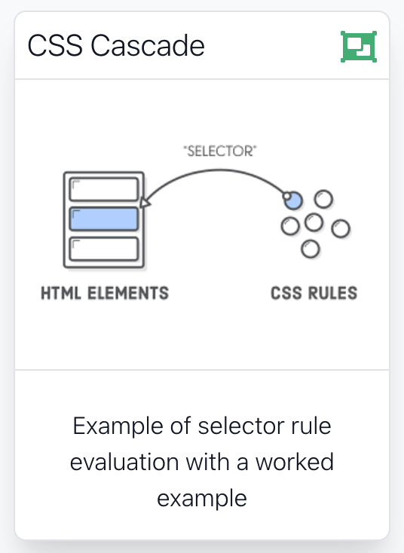

Slide 2
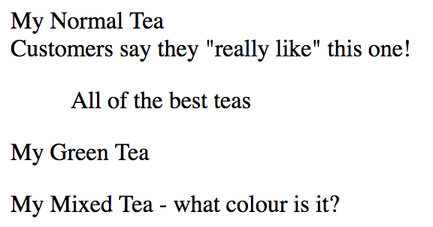
Rules, Classes, Elements - which ones get selected?
<body>
<p>
My Normal Tea <br>
Customers say they <q>really like</q> this one!
</p>
<blockquote>
All of the best teas
</blockquote>
<p class="greentea">
My Green Tea
</p>
<p class="greentea blueberry">
My Mixed Tea - what colour is it?
</p>
</body>

Slide 3
p {
color: black;
}
.greentea {
color: green;
}
p.greentea {
color: green;
}
p.raspberry {
color: blue;
}
p.blueberry {
color: purple;
}
<body>
<p>
My Normal Tea <br>
Customers say they <q>really like</q> this one!
</p>
<blockquote>
All of the best teas
</blockquote>
<p class="greentea">
My Green Tea
</p>
<p class="greentea blueberry">
My Mixed Tea - what colour is it?
</p>
</body>

Slide 4
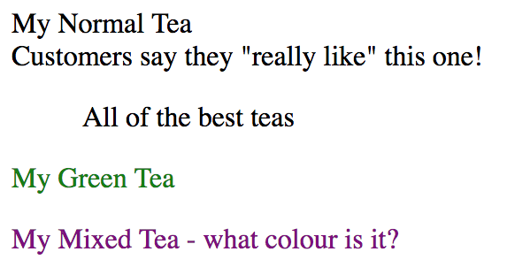
p {
color: black;
}
.greentea {
color: green;
}
p.greentea {
color: green;
}
p.raspberry {
color: blue;
}
p.blueberry {
color: purple;
}

Slide 5
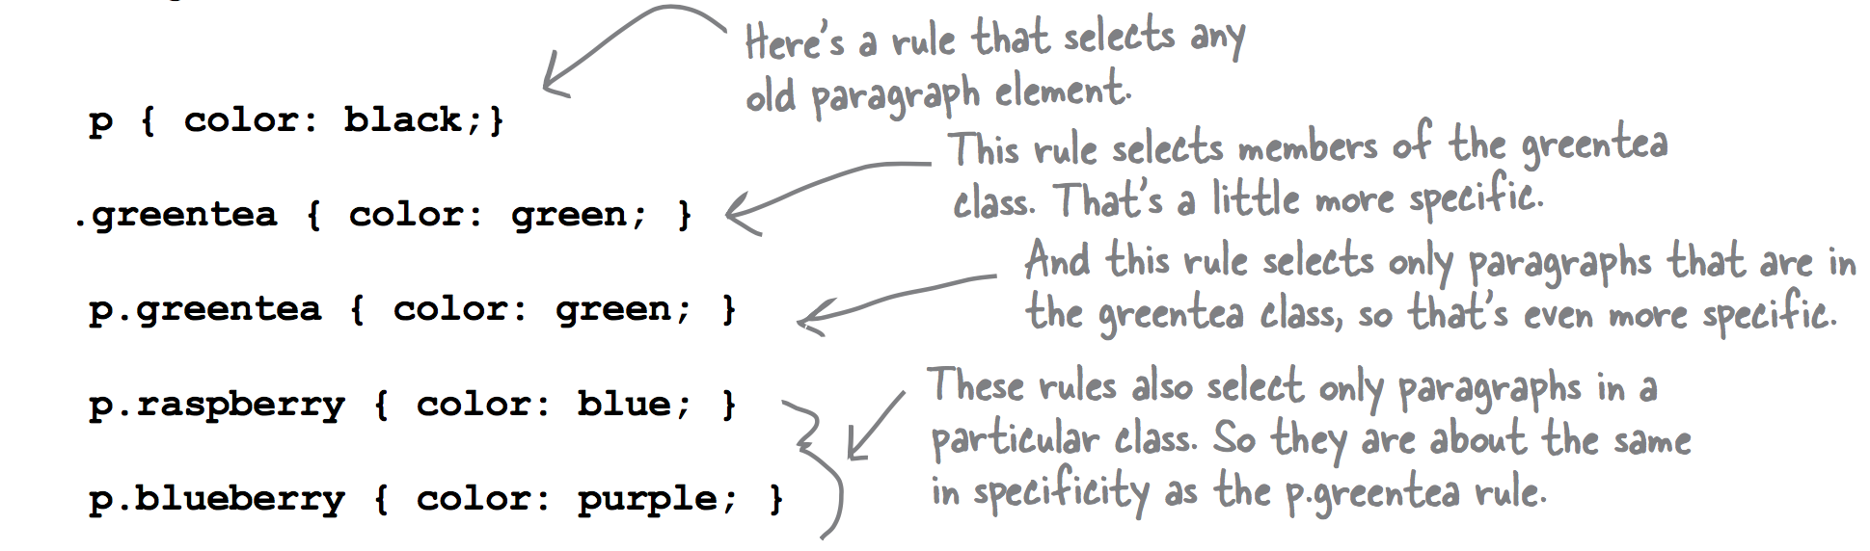

Slide 6
Rules, Classes, Elements - which ones get selected?
(1) Explicit Match: Do any selectors select your element?
Examine CSS rules for explicit match for element.
(2) Inheritance Match: What if no rules match the element:
Rely on inheritance.
Look at the element’s parents, and parents’ parents, and so on, until you find the property defined.
(3) Default Match: Still no explicit or inherited match
use the default value defined by the browser
(4) Most Specific Match: What if more that one match (of different rules)?
select rule that is the most specific

Slide 7
Example
p { color: black; }
.greentea { color: green; }
p.greentea { color: green; }
p.raspberry { color: blue; }
p.blueberry { color: purple; }
1- Explicit Match
2- Inheritance Match
<p>
My Normal Tea <br>
Customers say they <q>really like</q> this one!
</p>
<blockquote>
All of the best teas
</blockquote>
<p class="greentea">
My Green Tea
</p>
<p class="greentea blueberry">
My Mixed Tea - what colour is it?
</p>
3- Default Match
4- Most Specific Match
?

Slide 8
Ordering Match
Element belongs to two classes: greentea and blueberry.
p.greentea and p.blueberry all select the element, and are of equal specificity.
Which colour selected?
The one that is listed last in the CSS file.
5: Ordering Match: - If you can’t resolve a conflict because two selectors are equally specific
use the ordering of the rules in your style sheet file. That is, you use the rule listed last in the CSS file (nearest the bottom). And in this case, that would be the p.blueberry rule.
p.greentea { color: green; }
p.blueberry { color: purple; }
<p class="greentea blueberry">
My Mixed Tea - what colour is it?
</p>

Slide 9
Example
p { color: black; }
.greentea { color: green; }
p.greentea { color: green; }
p.raspberry { color: blue; }
p.blueberry { color: purple; }
1- Explicit Match
2- Inheritance Match
<p>
My Normal Tea <br>
Customers say they <q>really like</q> this one!
</p>
<blockquote>
All of the best teas
</blockquote>
<p class="greentea">
My Green Tea
</p>
<p class="greentea blueberry">
My Mixed Tea - what colour is it?
</p>
3- Default Match
4- Most Specific Match
5- Ordering Match

Slide 10
p {
color: black;
}
.greentea {
color: green;
}
p.greentea {
color: green;
}
p.raspberry {
color: blue;
}
p.blueberry {
color: purple;
}
<body>
<p>
My Normal Tea <br>
Customers say they <q>really like</q> this one!
</p>
<blockquote>
All of the best teas
</blockquote>
<p class="greentea">
My Green Tea
</p>
<p class="greentea blueberry">
My Mixed Tea - what colour is it?
</p>
</body>

Slide 11
Other Examples

Slide 12
CSS Selectors Summary (simple)
Selector | Applies to
p | All paragraphs in the document
.about | All elements in the document with a class value of about
#corporatehistory | The element in the document with an id value of corporate history (if present)
h1,h2,h3 | All first-, second-, and third-level headings in the document
.privacy, .copyright | All elements with a class of privacy or copyright
#header,#footer | The element assigned an id of header, and the element assigned an id of footer
p.footnote | All paragraphs assigned a class of footnote

Slide 13
CSS Selectors Summary (advanced)
Selector | Applies to
#bodycopy.usergenerated | An element that has been assigned both an id of bodycopy and a class of usergenerated
.navigation a | All links with an ancestor parent assigned a class of navigation
#primarynavigation li.current | All list items with a class of current and an ancestor parent with an id of primarynavigation
.about #bodycopy | Any element on the site with an id of bodycopy and an ancestor parent assigned a class of about
body#personalproducts, body#proproducts, body#enterpriseproducts | The body elements within the site assigned the ids personalproducts, proproducts, and enterpriseproducts
body#personalproducts #bodycopy, body#proproducts #bodycopy, body#enterpriseproducts #bodycopy | The elements assigned an id of bodycopy, within the documents suggested by the previous example
ol li ol li ol li | A list item in the third level of a nested ordered list

Slide 14
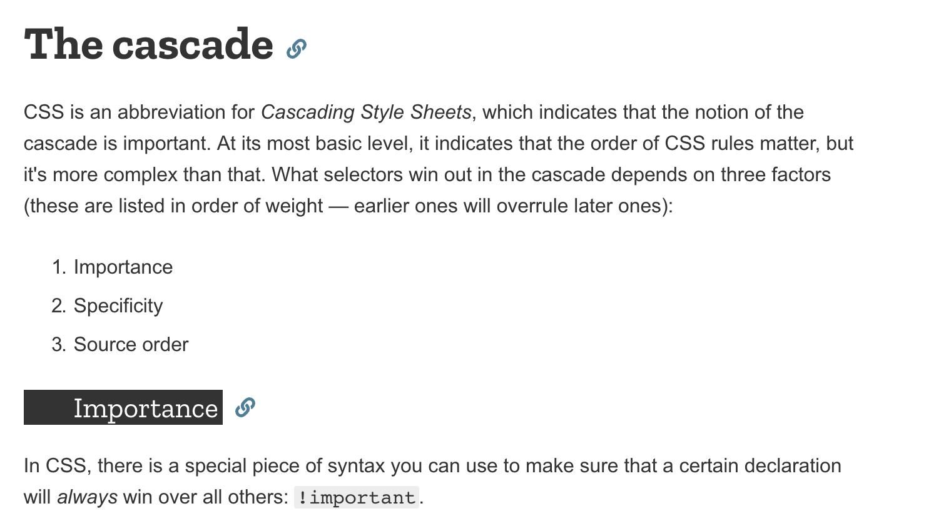
https://developer.mozilla.org/en-US/docs/Learn/CSS/Introduction_to_CSS/Cascade_and_inheritance

