Slide 1
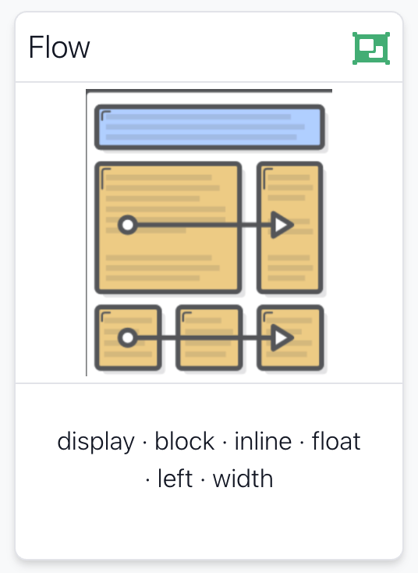

Slide 2
Block vs Inline
Display Property
Float Property

Slide 3
Block vs Inline
Display Property
Float Property

Slide 4
Block vs Inline Elements
Block elements are always displayed as if they have a line break before and after them
inline elements appear “in line” within the flow of the text in your page.
“Block elements stand on their own; inline elements go with the flow.”

Slide 5
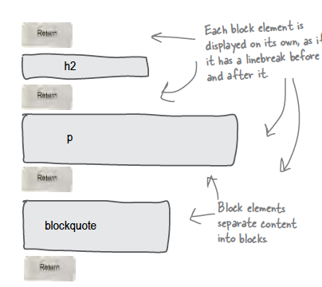
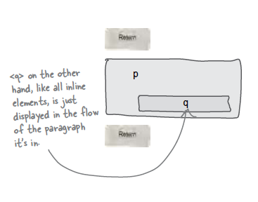
Examples
Block - h1, h2, p, blockquote
Inline - a, em, q

Slide 6
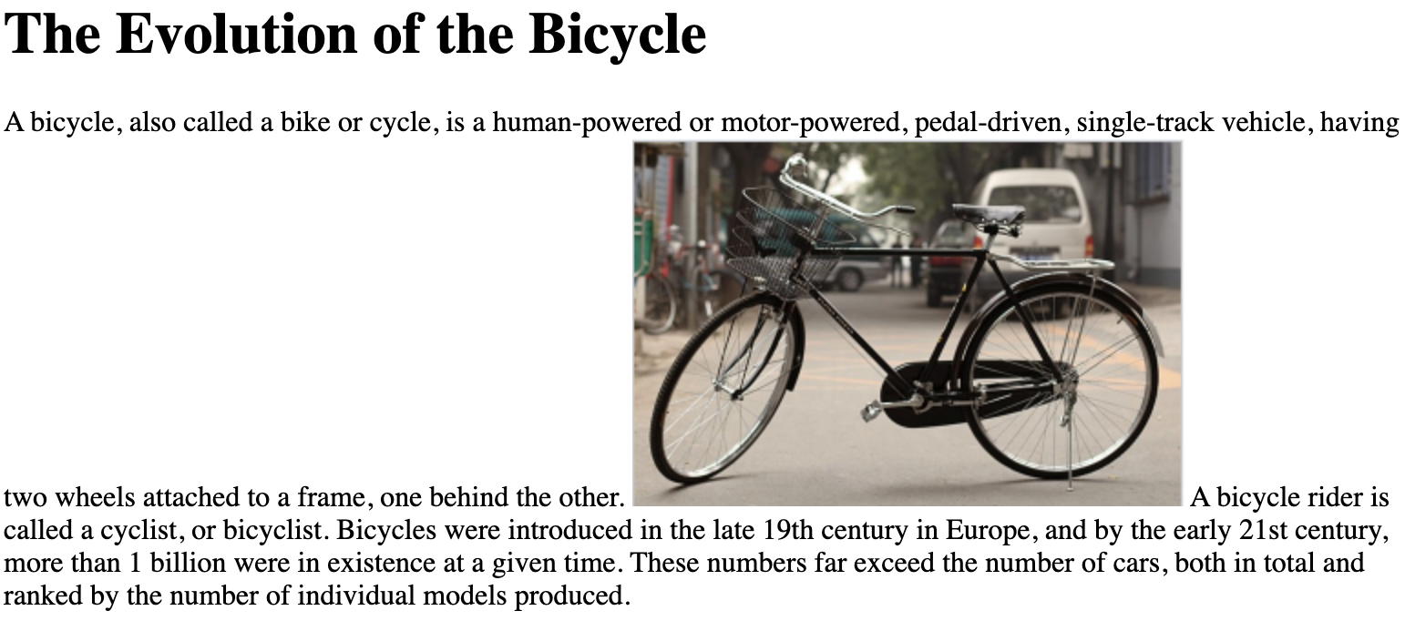
Block / Inline
“Block elements stand on their own; inline elements go with the flow.”
<body>
<h1>
The Evolution of the Bicycle.
</h1>
<p>
A bicycle, also called a bike or cycle, is a human-powered or
motor-powered, pedal-driven, single-track vehicle, having two
wheels attached to a frame, one behind the other.
<img src="./images/bike.png"> A bicycle rider is called a
cyclist, or bicyclist. Bicycles were introduced in the late 19th
century in Europe, and by the early 21st century, more than 1
billion were in existence at a given time. These numbers far
exceed the number of cars, both in total and ranked by the number
of individual models produced
</p>
</body>
<img> is an inline element.
The containing elements content flows around the image

Slide 7
Block vs Inline
Display Property
Float Property

Slide 8
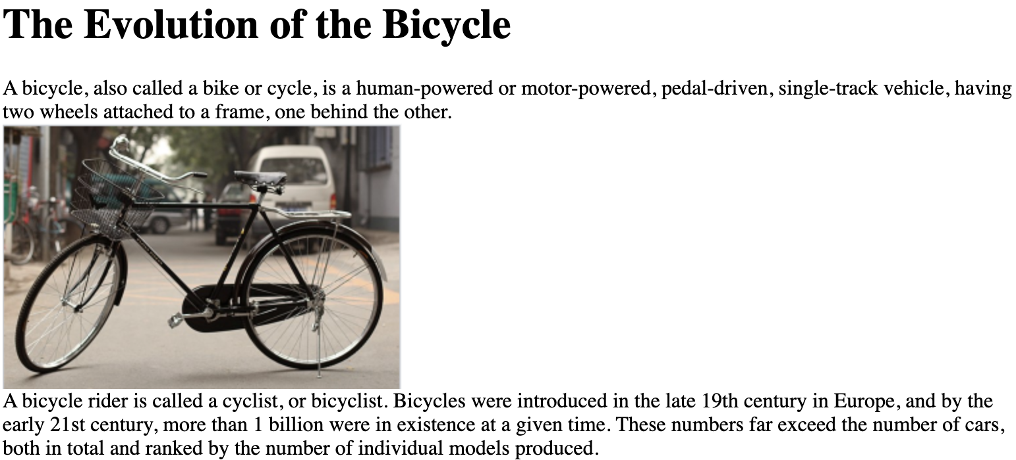
The display property allows you to turn an inline element into a block-level element or vice versa
Display Property
<body>
<h1>
The Evolution of the Bicycle.
</h1>
<p>
A bicycle, also called a bike or cycle, is a human-powered or
motor-powered, pedal-driven, single-track vehicle, having two
wheels attached to a frame, one behind the other.
<img src="./images/bike.png"> A bicycle rider is called a
cyclist, or bicyclist. Bicycles were introduced in the late 19th
century in Europe, and by the early 21st century, more than 1
billion were in existence at a given time. These numbers far
exceed the number of cars, both in total and ranked by the number
of individual models produced
</p>
</body>
Causes an inline element to act like a block-level element.
img {
display: block;
}

Slide 9
Block vs Inline
Display Property
Float Property

Slide 10
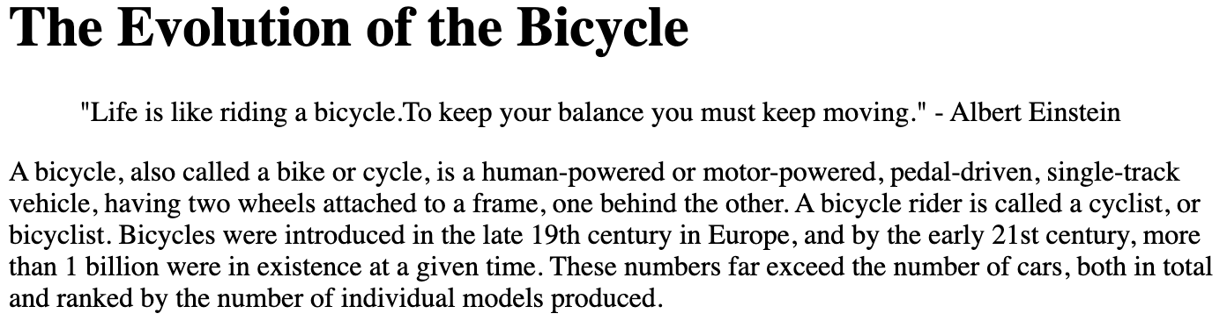
Normal Flow
<body>
<h1>
The Evolution of the Bicycle.
</h1>
<blockquote>
"Life is like riding a bicycle.To keep your balance you must keep
moving." - Albert Einstein
</blockquote>
<p>
A bicycle, also called a bike or cycle, is a human-powered or
motor-powered, pedal-driven, single-track vehicle, having two
wheels attached to a frame, one behind the other. A bicycle rider
is called a cyclist, or bicyclist. Bicycles were introduced in
the late 19th century in Europe, and by the early 21st century,
more than 1 billion were in existence at a given time. These
numbers far exceed the number of cars, both in total and ranked
by the number of individual models produced.
</p>
</body>
Elements flow on a page top to bottom, left to right

Slide 11
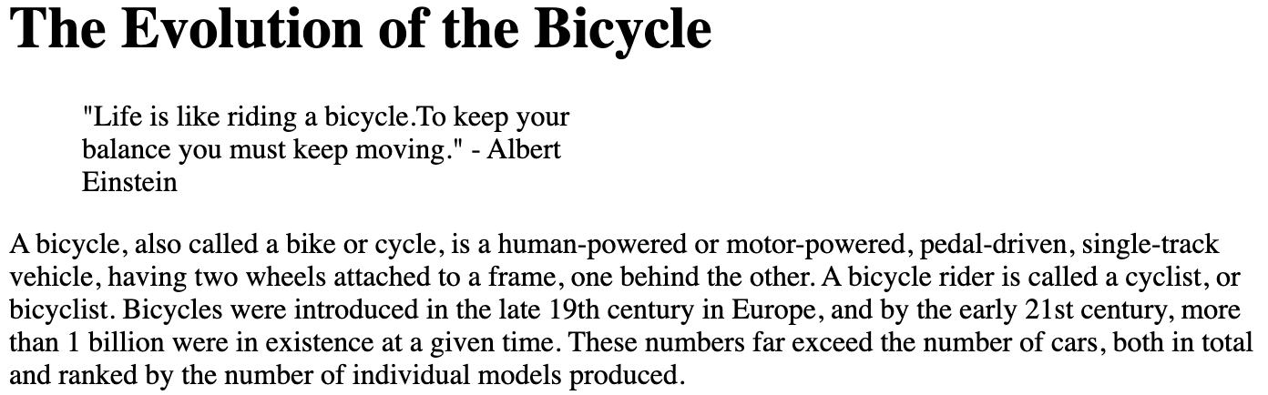
Width
The overall width of an element can be specified, but does not change normal flow
<body>
<h1>
The Evolution of the Bicycle.
</h1>
<blockquote>
"Life is like riding a bicycle.To keep your balance you must keep
moving." - Albert Einstein
</blockquote>
<p>
A bicycle, also called a bike or cycle, is a human-powered or
motor-powered, pedal-driven, single-track vehicle, having two
wheels attached to a frame, one behind the other. A bicycle rider
is called a cyclist, or bicyclist. Bicycles were introduced in
the late 19th century in Europe, and by the early 21st century,
more than 1 billion were in existence at a given time. These
numbers far exceed the number of cars, both in total and ranked
by the number of individual models produced.
</p>
</body>
blockquote {
width: 275px;
}

Slide 12
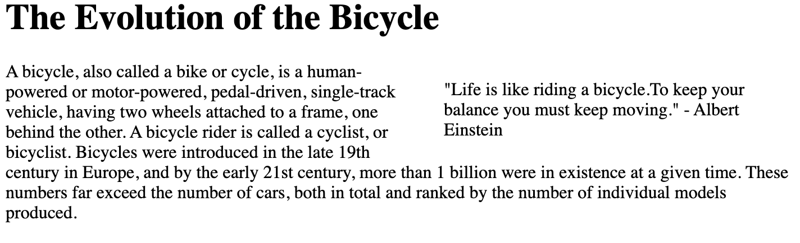
The float property allows you to take an element in normal flow and place it as far to the left or right of the containing element as possible.
float: right
<body>
<h1>
The Evolution of the Bicycle.
</h1>
<blockquote>
"Life is like riding a bicycle.To keep your balance you must keep
moving." - Albert Einstein
</blockquote>
<p>
A bicycle, also called a bike or cycle, is a human-powered or
motor-powered, pedal-driven, single-track vehicle, having two
wheels attached to a frame, one behind the other. A bicycle rider
is called a cyclist, or bicyclist. Bicycles were introduced in
the late 19th century in Europe, and by the early 21st century,
more than 1 billion were in existence at a given time. These
numbers far exceed the number of cars, both in total and ranked
by the number of individual models produced.
</p>
</body>
blockquote {
width: 275px;
float: right;
}
Anything else that sits inside the containing element will flow around the element that is floated

Slide 13
