Slide 1
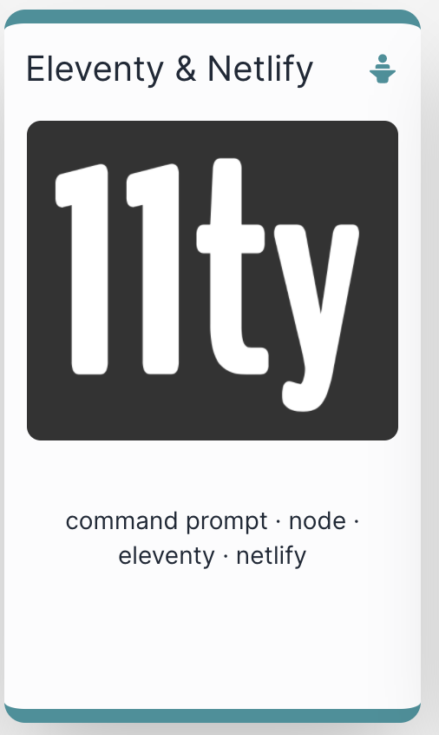

Slide 2
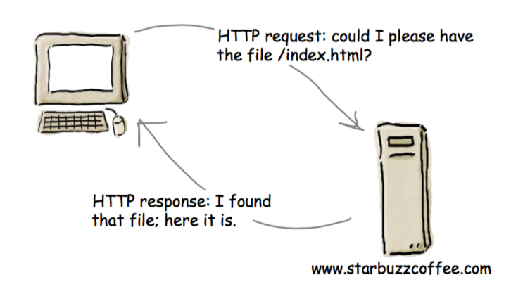
The Role of a Web Server
A Web Server is a program which is ‘listening’ on a particular ‘Port’ for HTTP Requests
When a requests is received, the server determines if the request can be ‘served’
If it can, then the server packages up a response and sends it
Requests are generated by browsers (usually), either by:
The user entering a url in the address bar of the browser
Or the user clicking on a link on a page

Slide 3
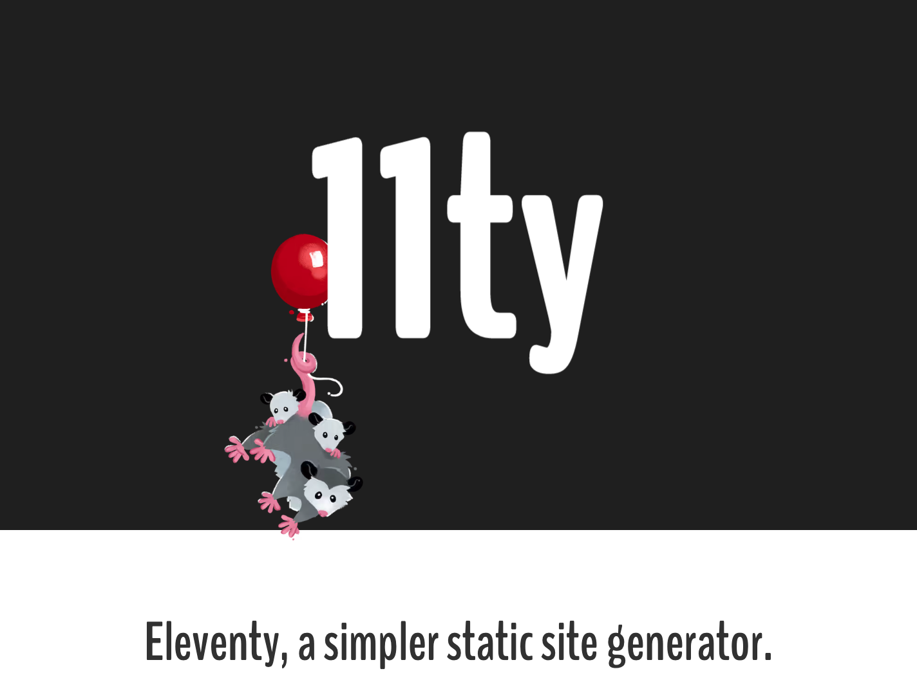
11ty
For professional web site development, you need a local web server. Otherwise, the site you develop will not be sufficiently tested.
11ty is a web server you can run on your own computer.
It behaves exactly like a web server used by a hosting company
In addition, 11ty provides Templates, Layouts & Partials + a range for other productivity features

Slide 4
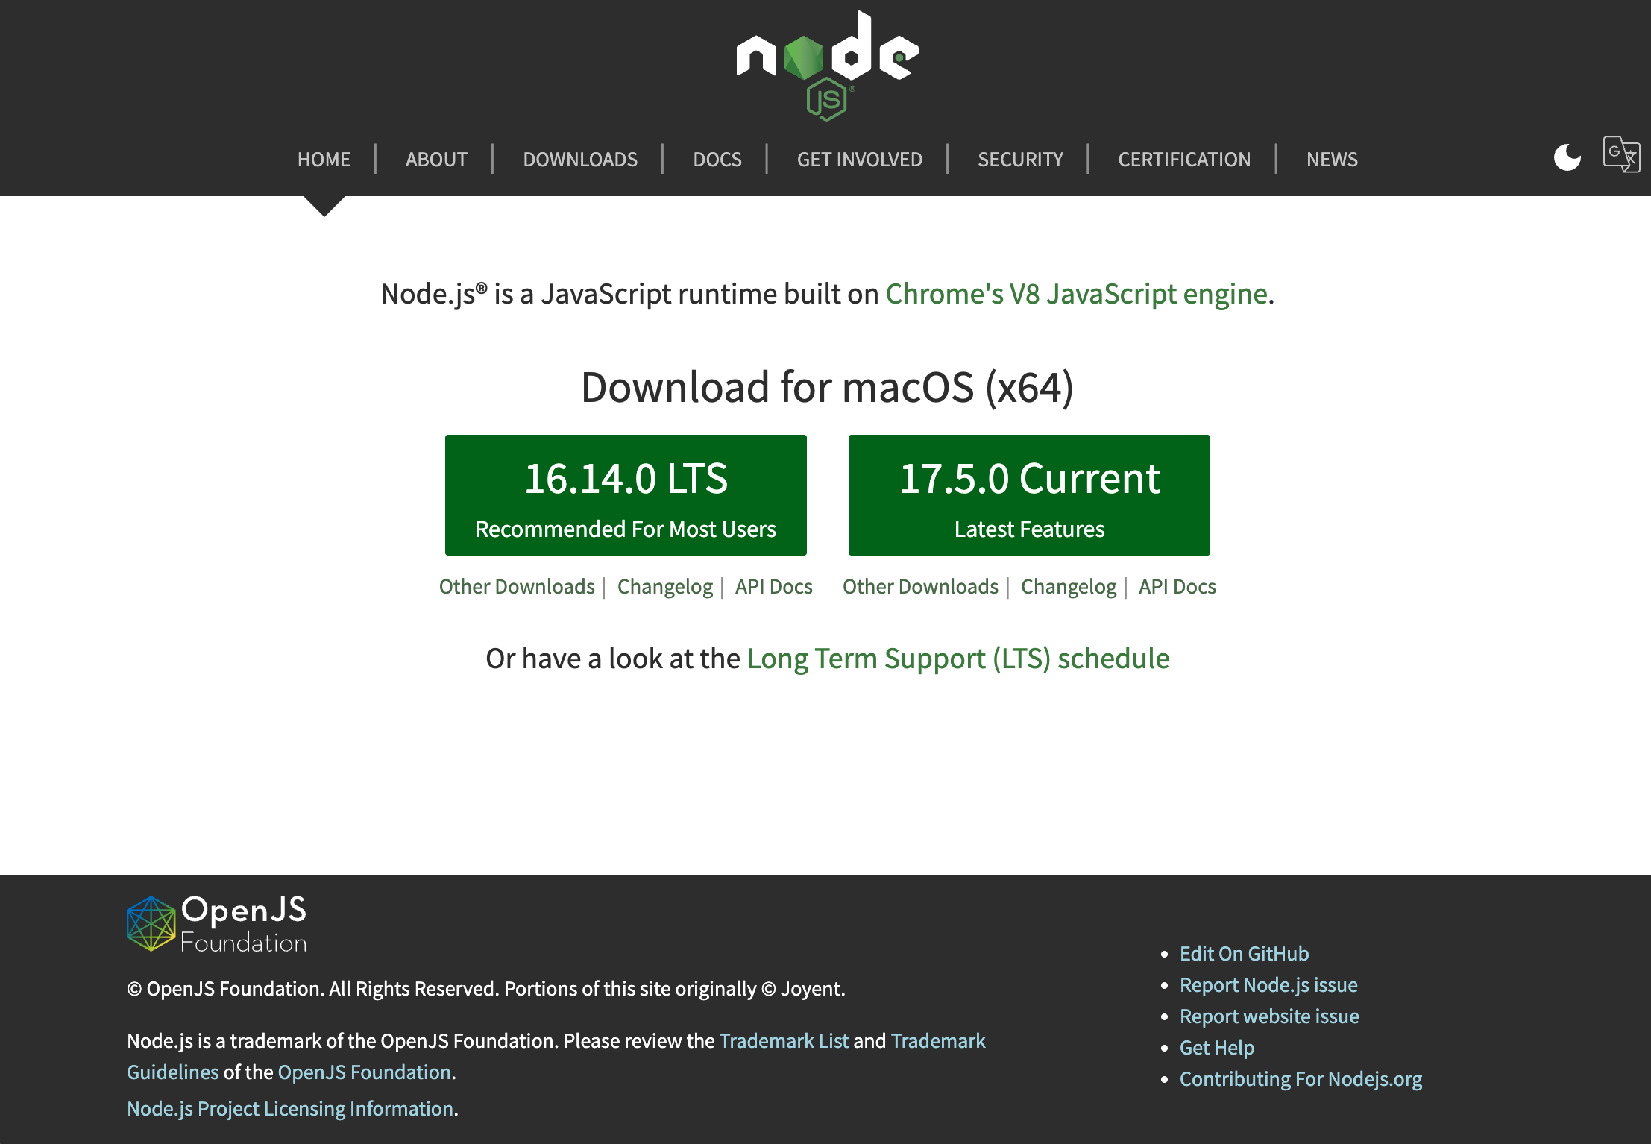
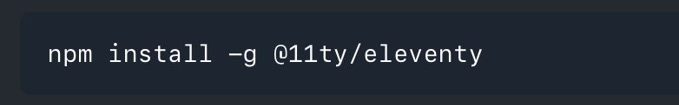
Installing 11ty
On your own machine:
First install Node.js
Then Install 11ty

Slide 5
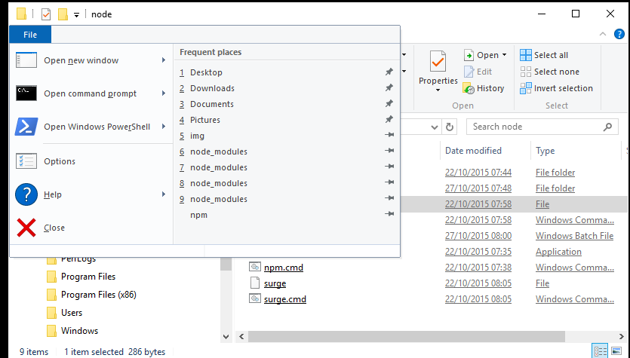
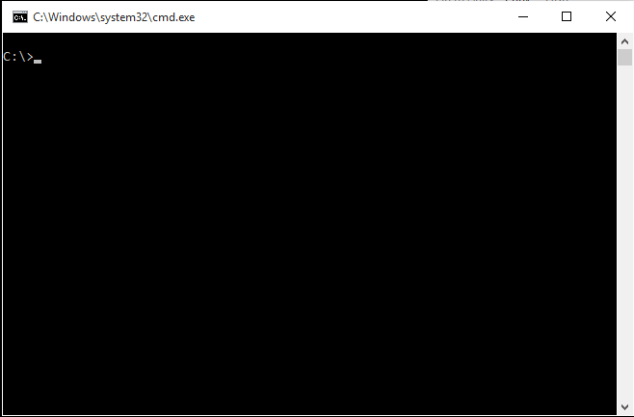
Run a Command Prompt

Slide 6
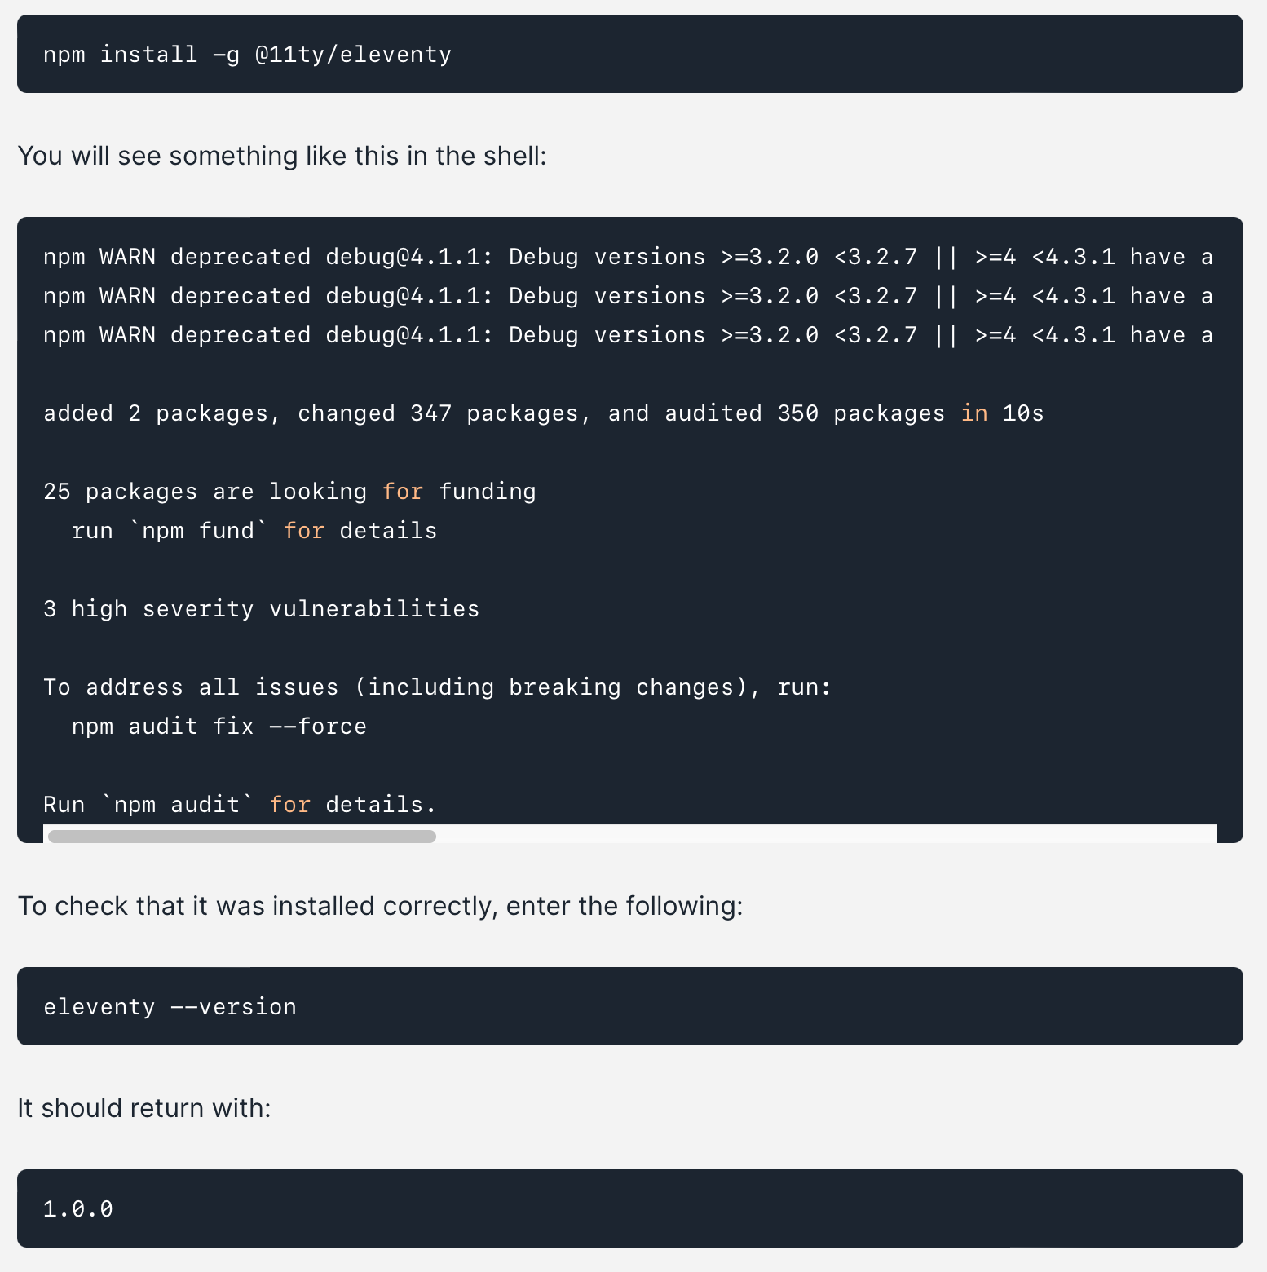
Install by running a command.
This installs a new command, which you use to run eleventy

Slide 7
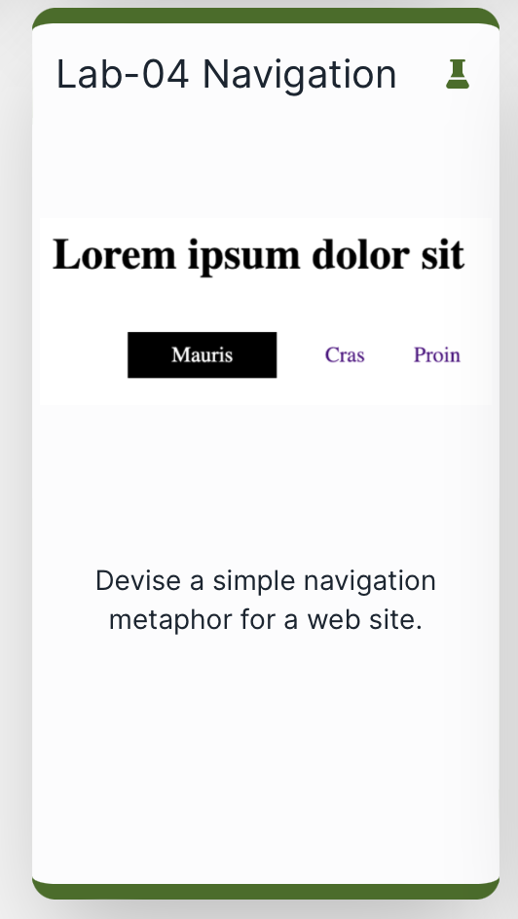
Serve the site from Lab-04 Navigation

Slide 8
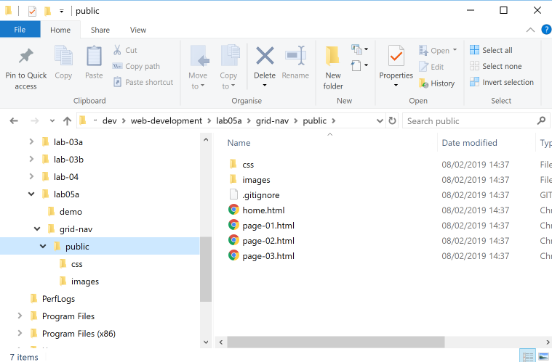
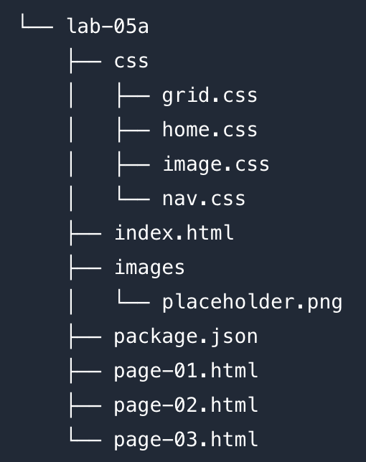
Expand the lab04 project zip file

Slide 9
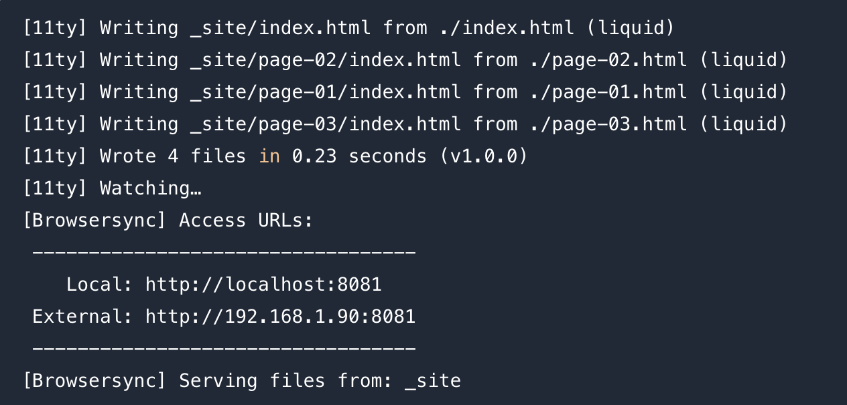
Launching the Eleventy Web Server
Enter this command from shell
Systems responds with this log

Slide 10
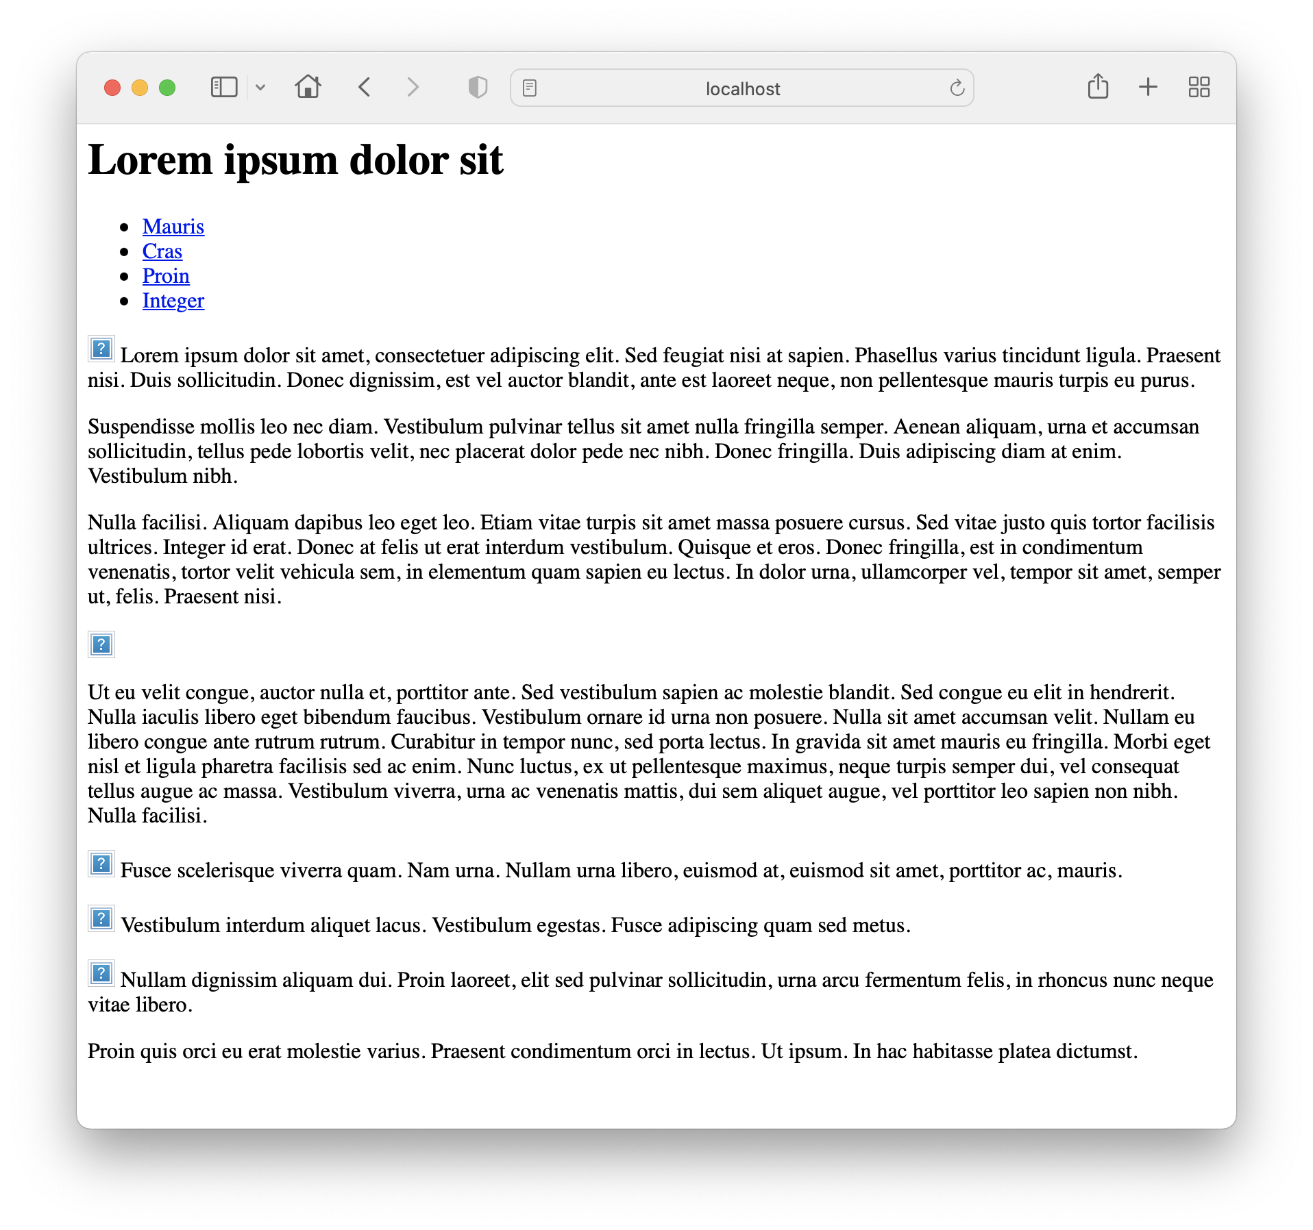
Browse to this url:
http://localhost:8081
The page should open, however it will still be 'broken' - no styles and no links.

Slide 11
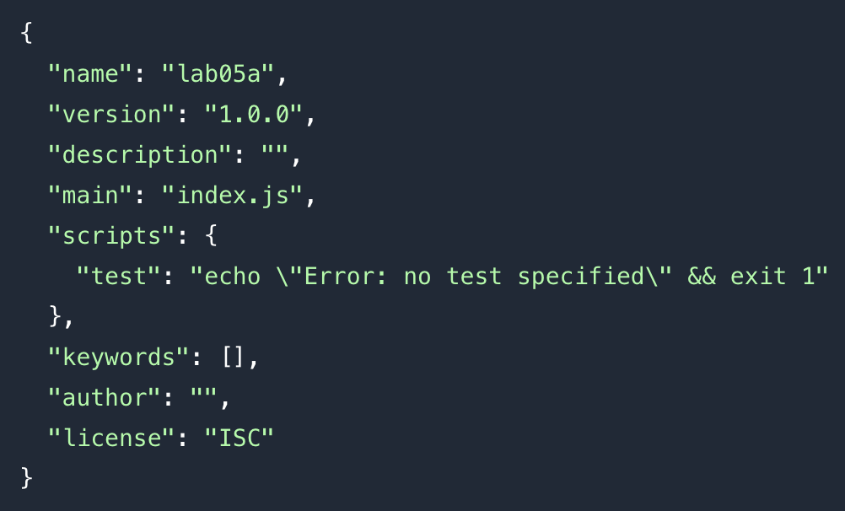
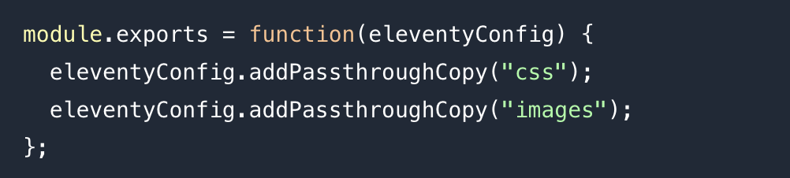
Configure an 11ty Project
package.json
Two configuration files required
Their contents are JSON/Javascript format.
These may be tweaked very occasionally
.eleventy.js:

Slide 12
Additional Project Adjustments: Paths
Replace all relative paths with absolute paths

Slide 13
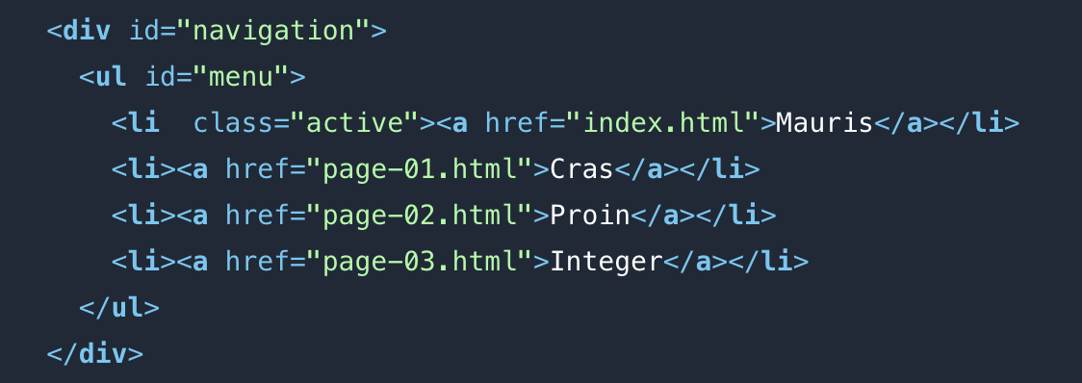
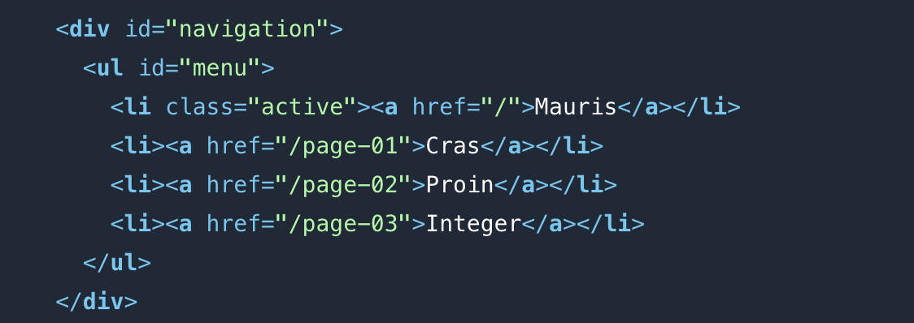
Additional Project Adjustments: Links
Simplify links + reset to absolute paths

Slide 14
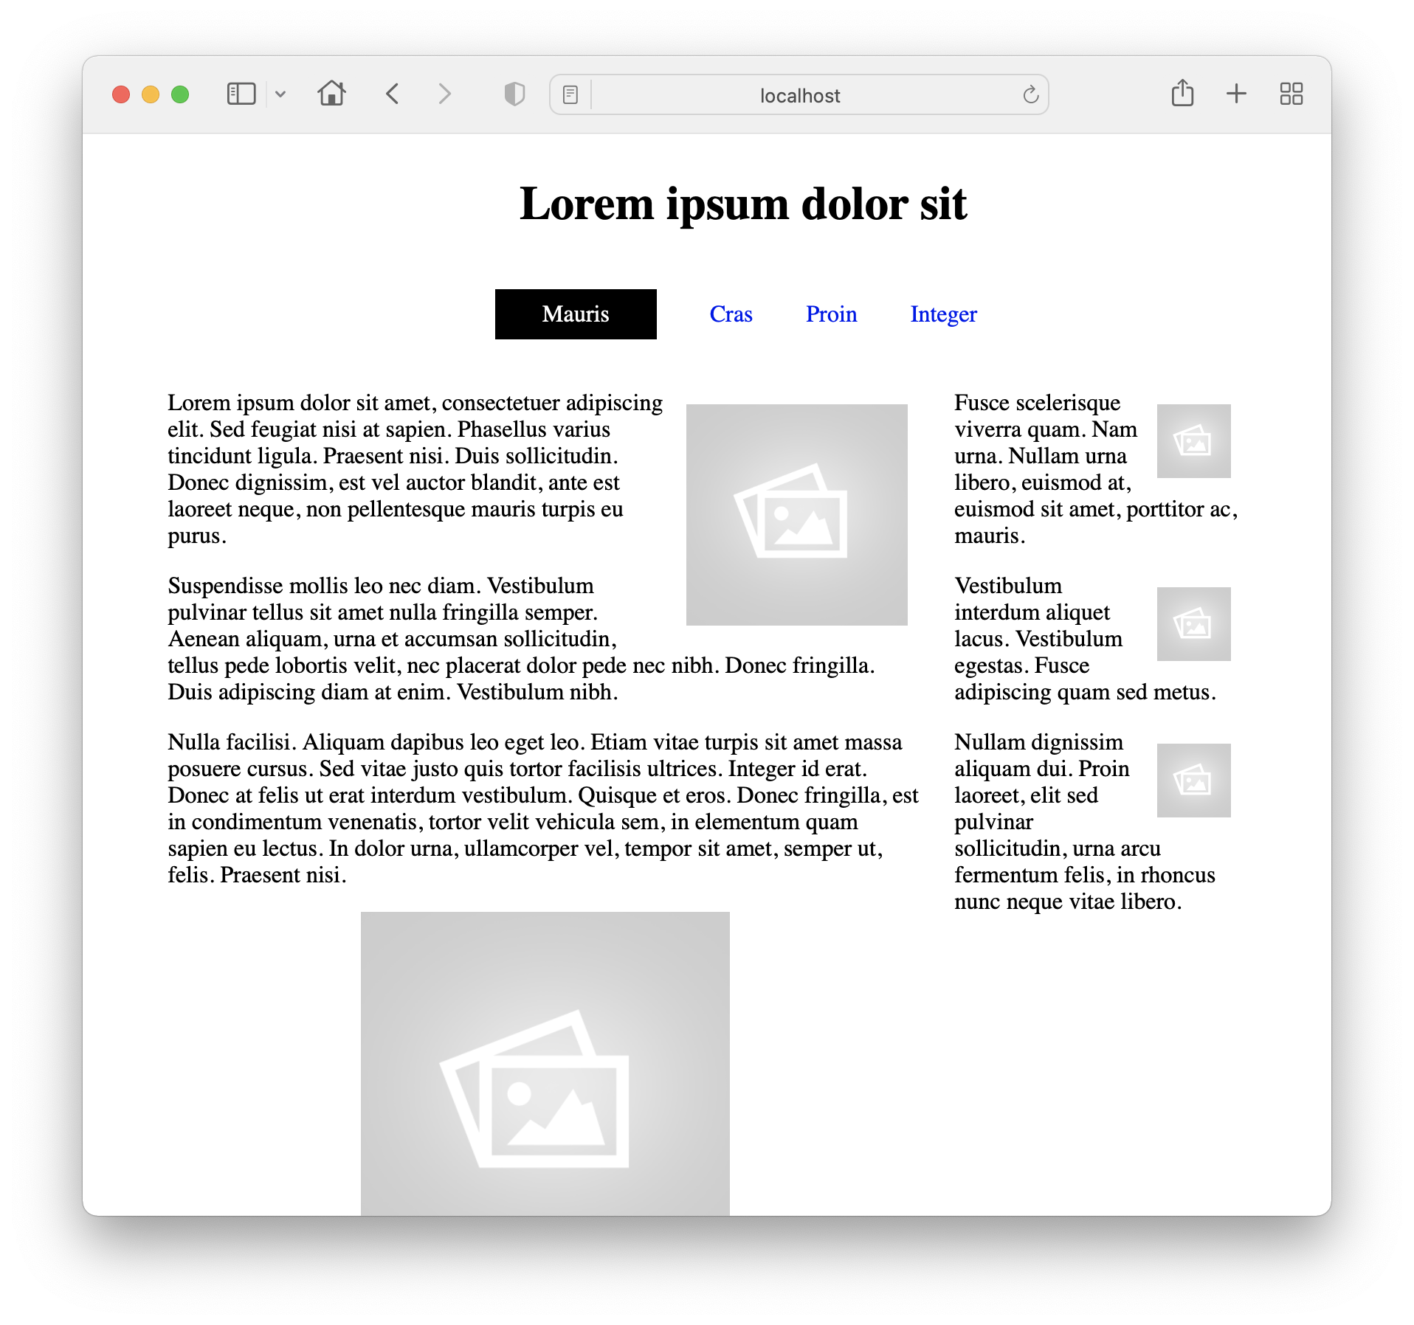
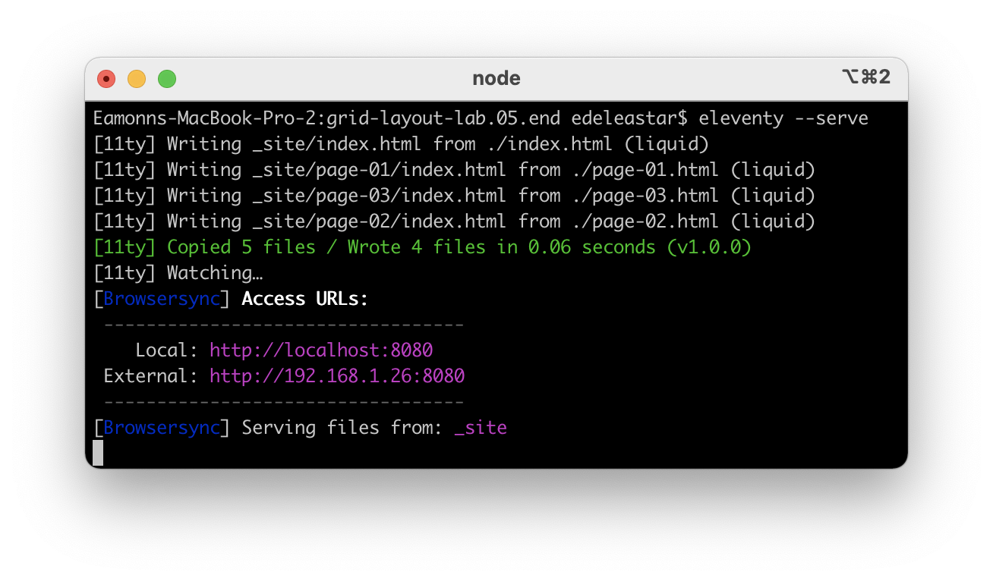
eleventy —server
As you edit the files, the server will automatically regenerate the site

Slide 15
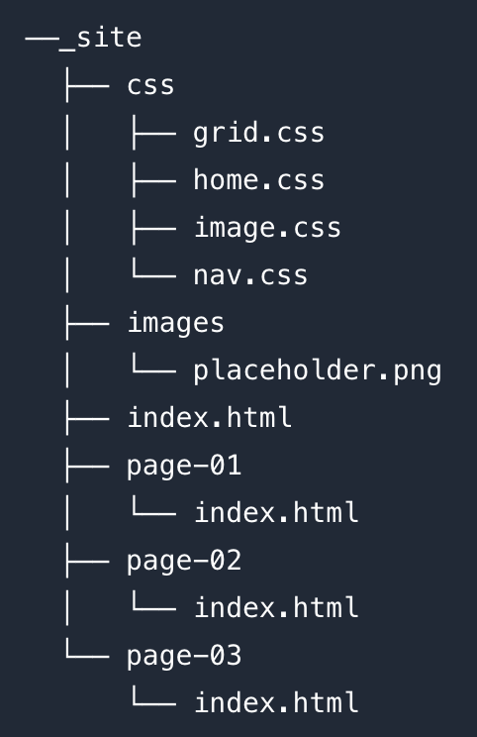
_site folder
Running ‘eleventy’ command will generate a version of the site to a _site folder inside the project
This is generated by eleventy, you should not edit or modify this subfolder in any way.
Every time you modify the main folder, this is regenerated by eleventy

Slide 16
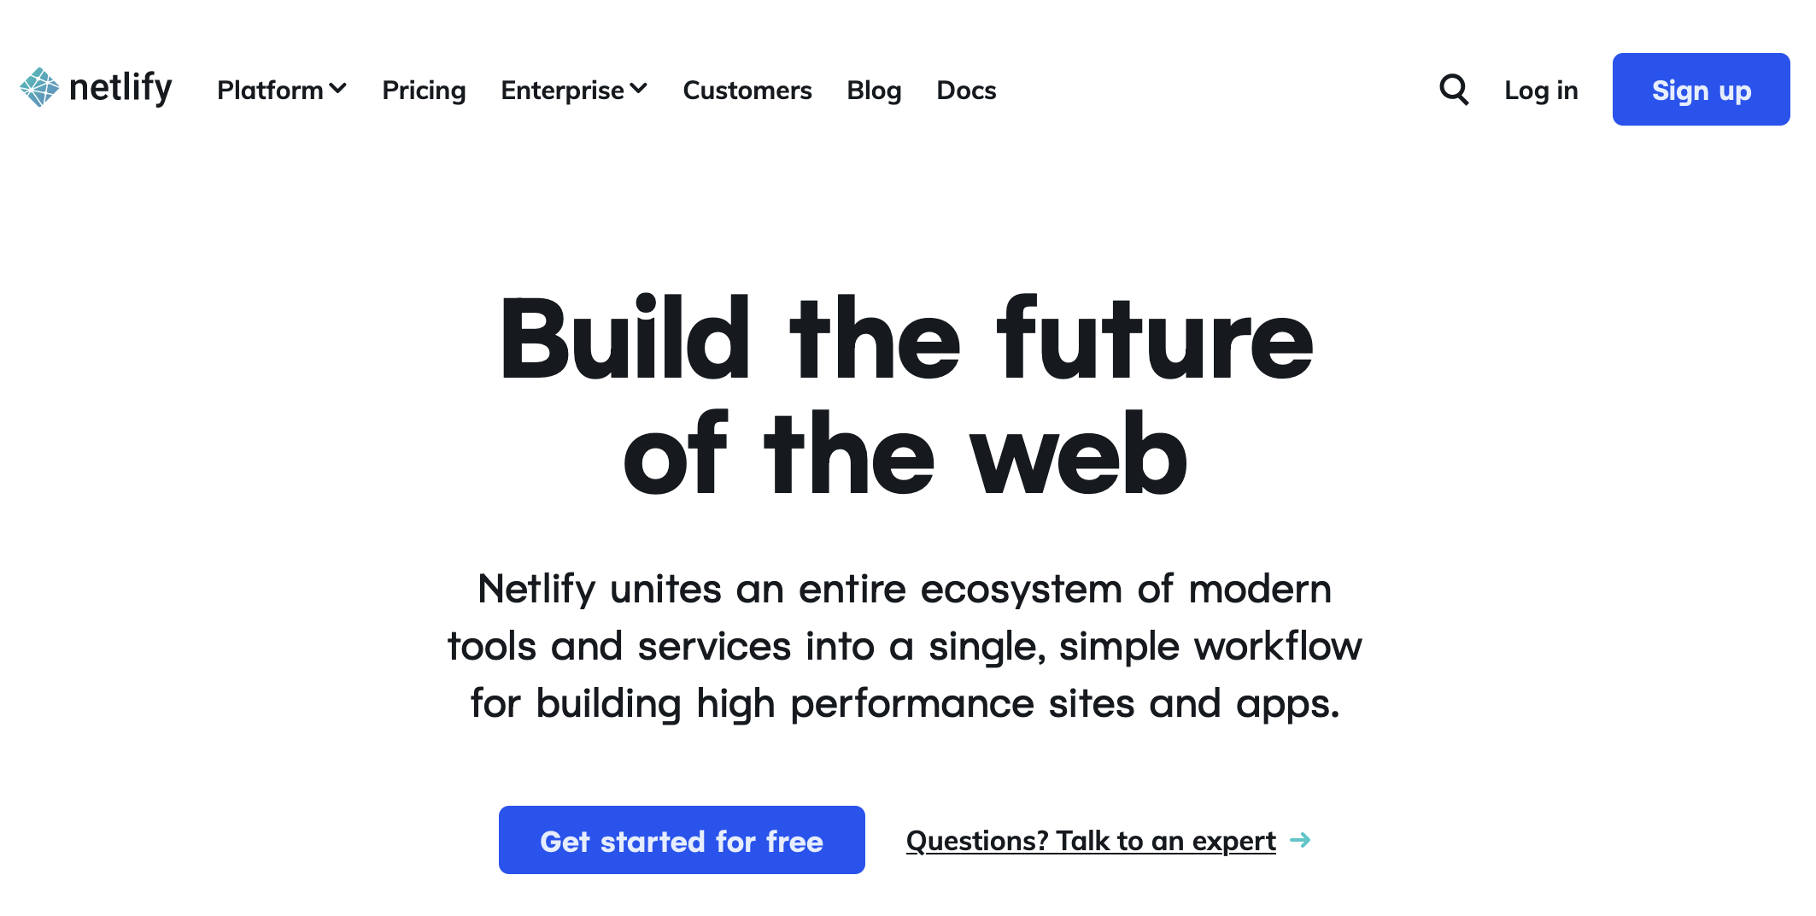
Deployment : Netlify

Slide 17
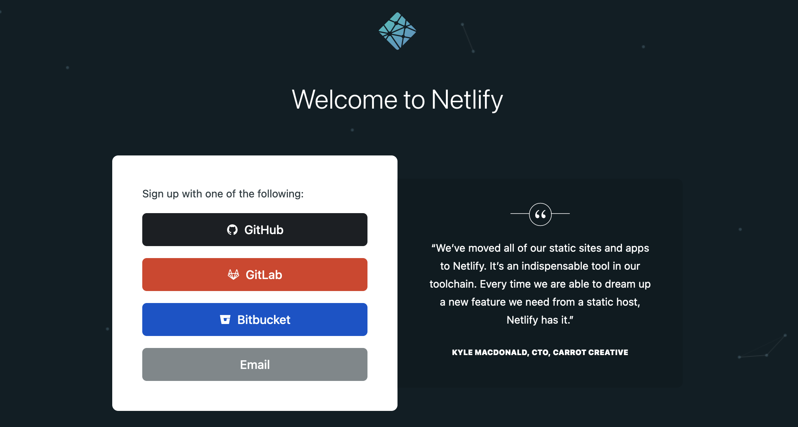

Slide 18
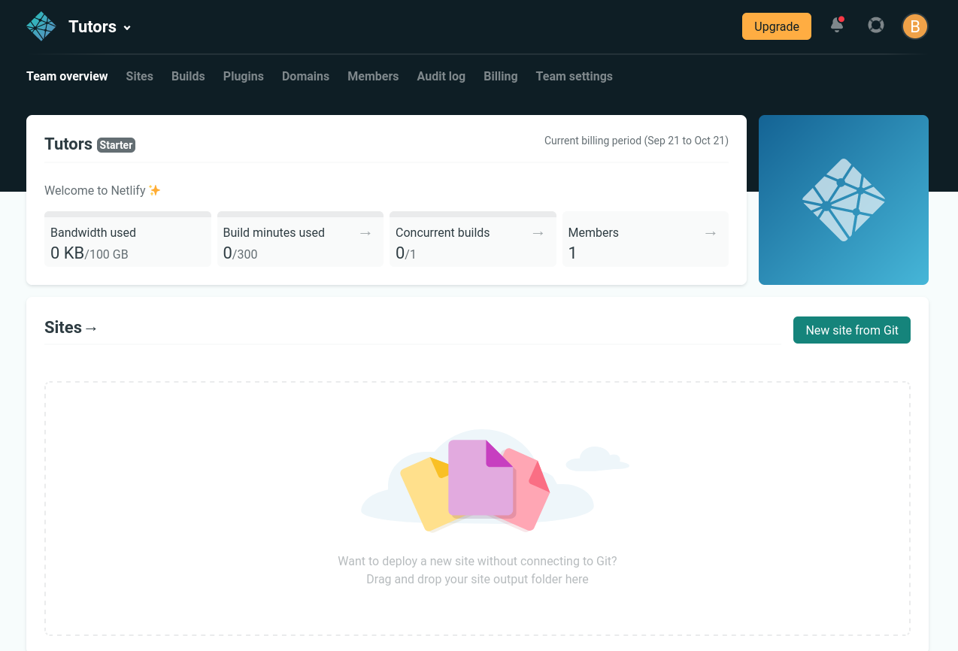
Drag & Drop the _site folder to Netlify browser window

Slide 19
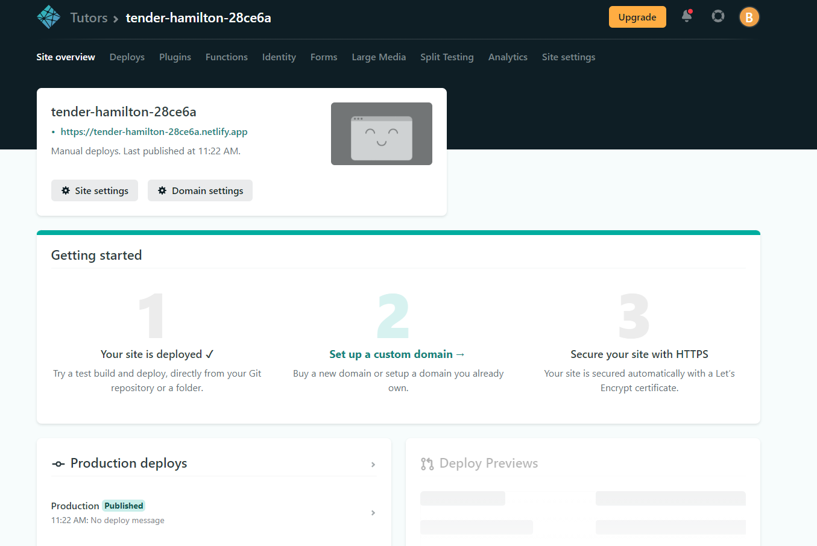
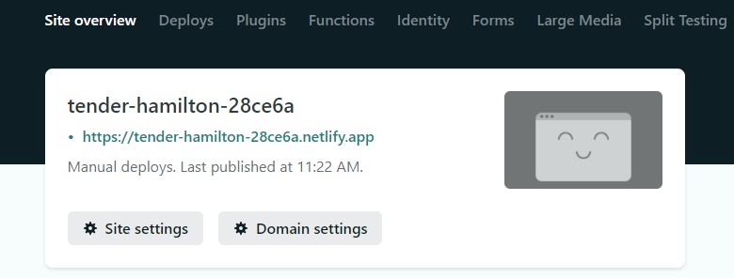
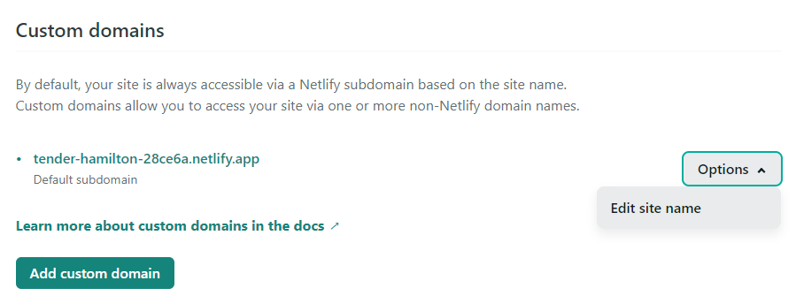
Deploy
Once _site is dropped onto netlify, the website will be deployed globally

Slide 20
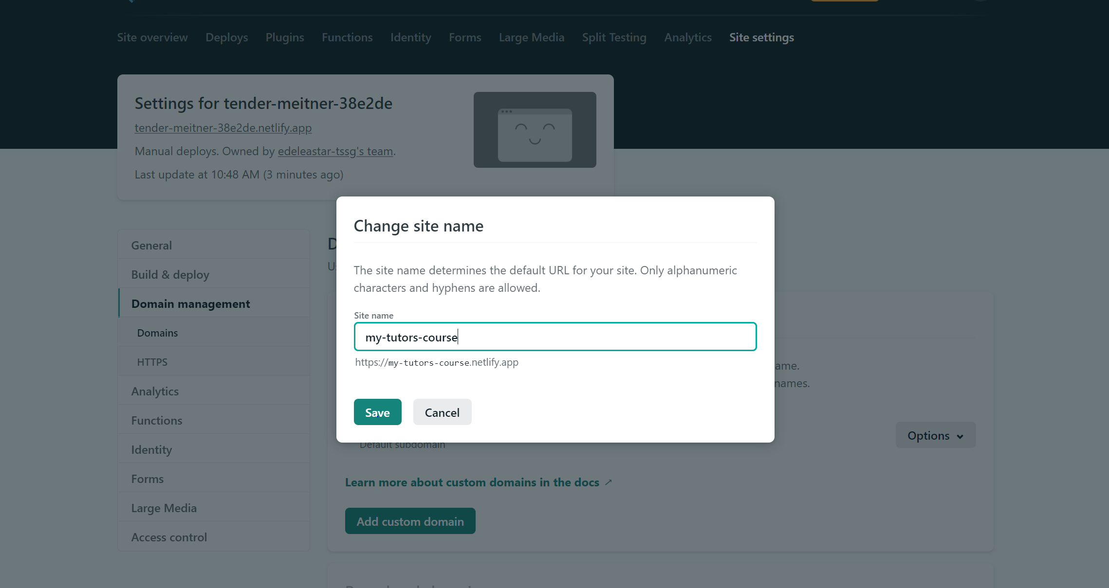
Customise Domain Name
Edit and replace the generated name.
Domain will end with .netlify.app

