Slide 1
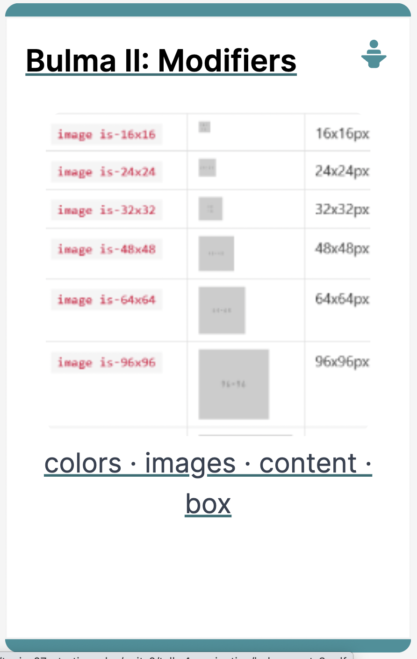
Notes:
Colors, Content, Box and Images

Slide 2
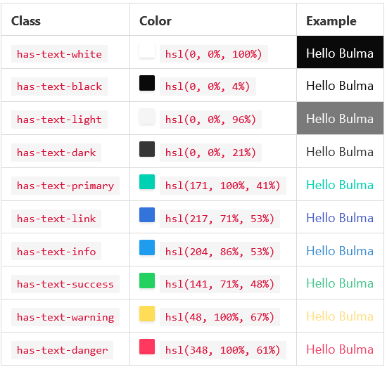
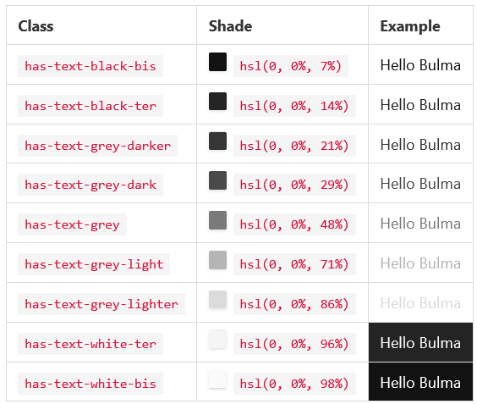
Bulma - Colors
Change the color of the text and/or background

Slide 3
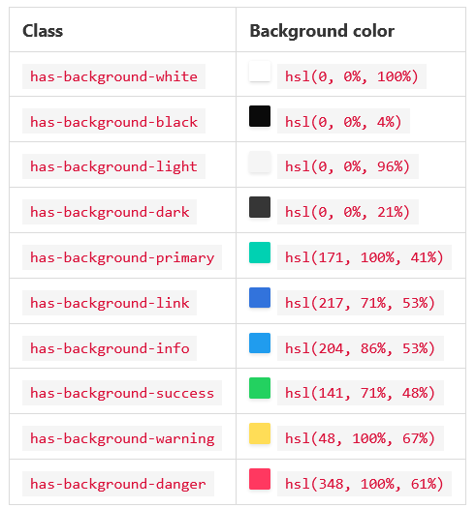
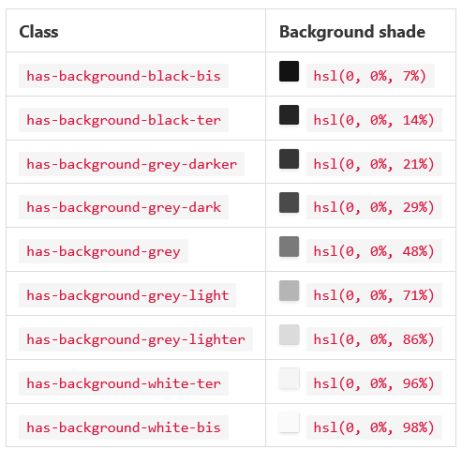
Bulma - Colors

Slide 4
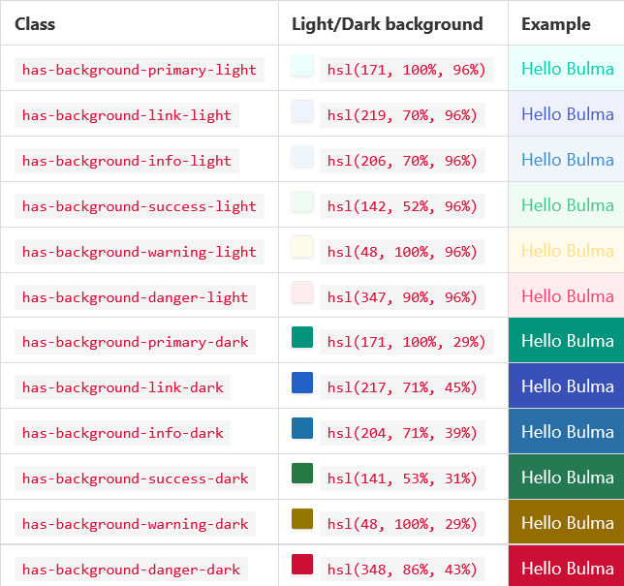
Bulma - Colors
You can use each color in their light and dark versions. Simply append *-light or *-dark.

Slide 5
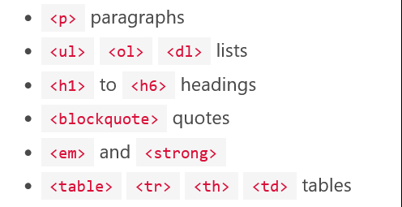
Bulma - Content
A single class to handle content
When you can't use the CSS classes you want, or when you just want to directly use HTML tags, use content as container
It can handle almost any HTML tag:

Slide 6
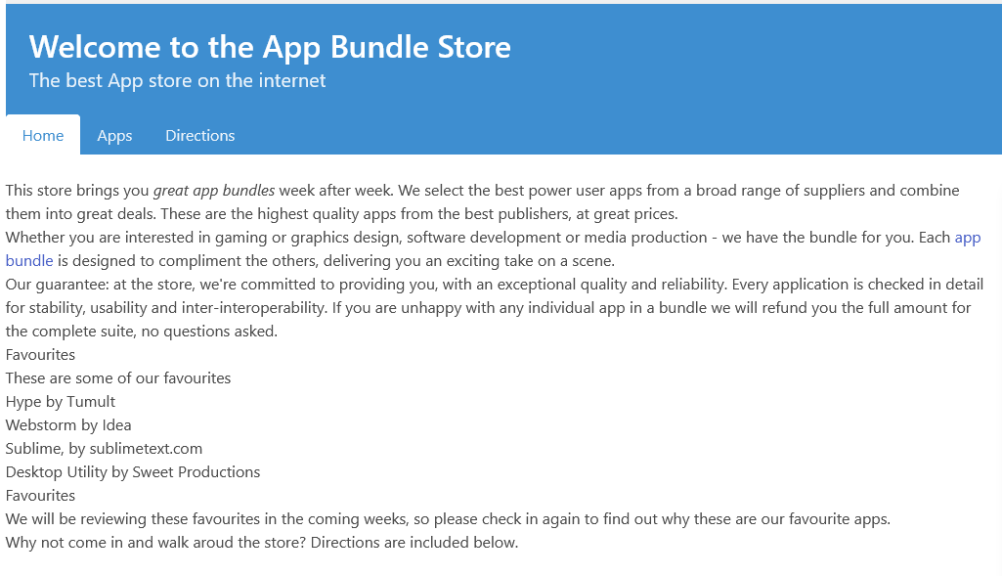
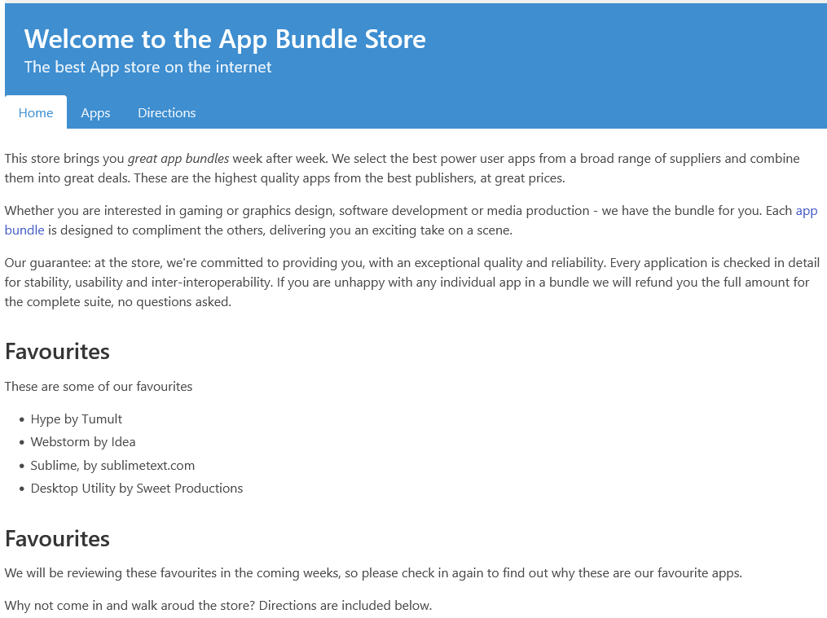
Bulma - Content
Here is an example of the content Bulma element with all the supported HTML tags:
You can use the is-small, is-medium and is-large modifiers to change the font size.
Without class=“content”
With class=“content”

Slide 7
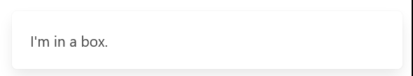

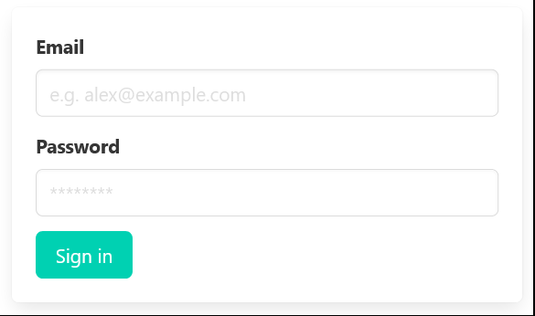
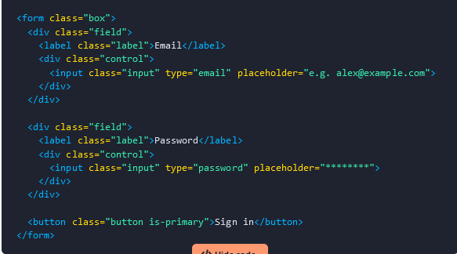
Bulma - Box
A white box to contain other elements
The box element is a simple container with a white background, some padding, and a box shadow.
Because it acts as a container, you can easily include other components, like form elements:

Slide 8
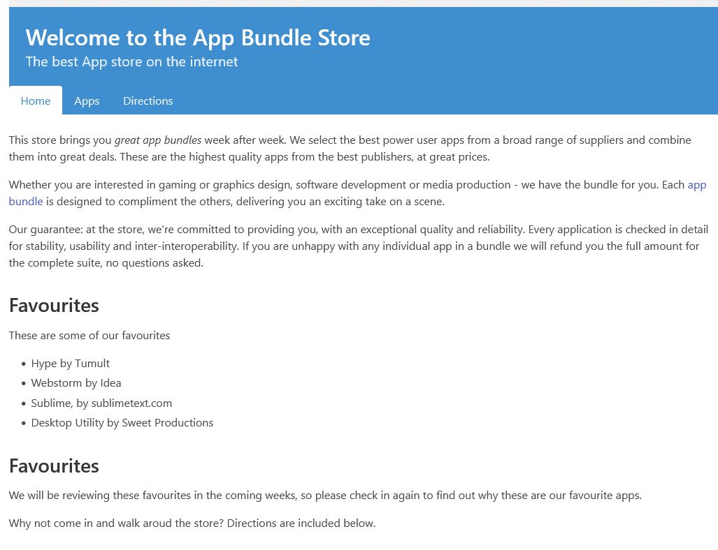
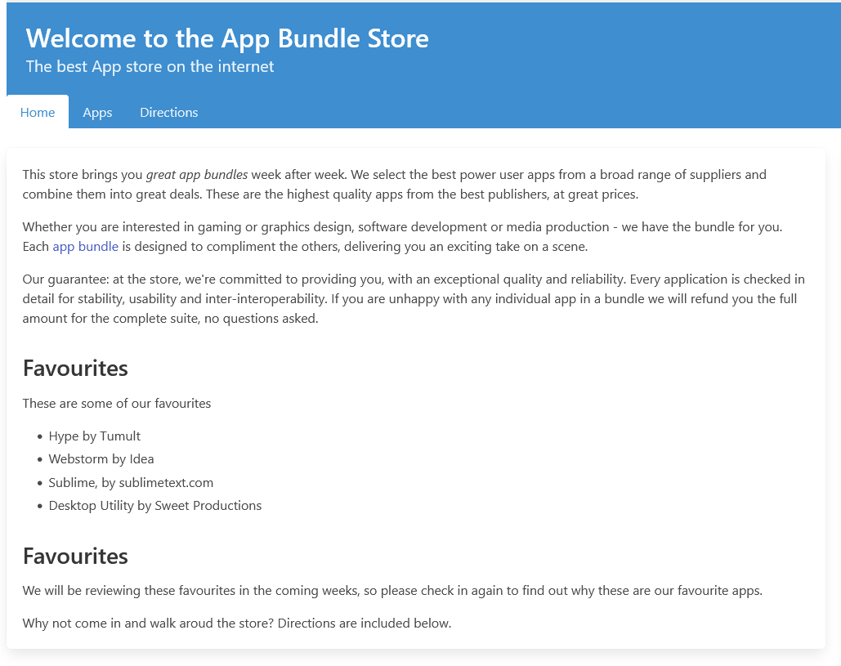
Bulma - Box
Without class=“box”
With class=“box”

Slide 9
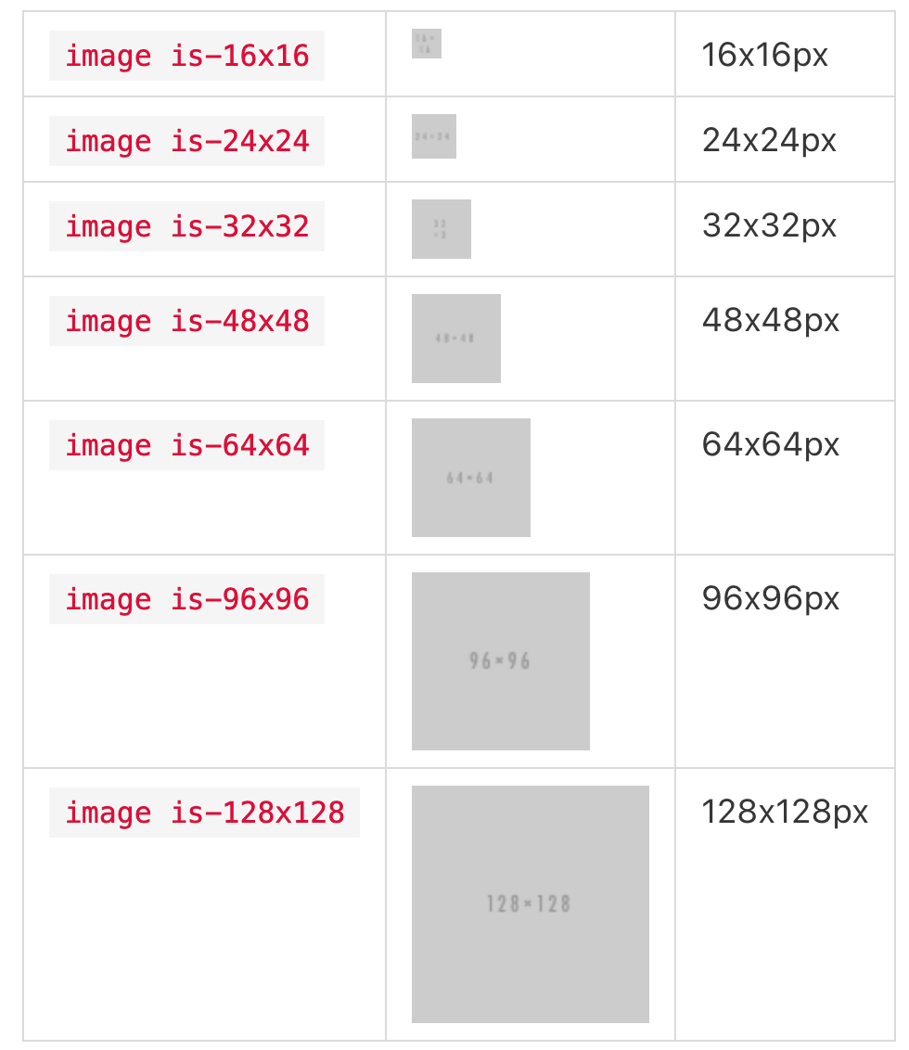
Bulma - Image
Bulma utilises image Containers
It uses precisely sized image areas
Ensures the layout isn’t impacted if images fail to load
There are 7 modifiers for image dimensions:

Slide 10
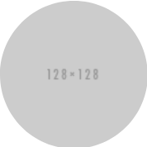
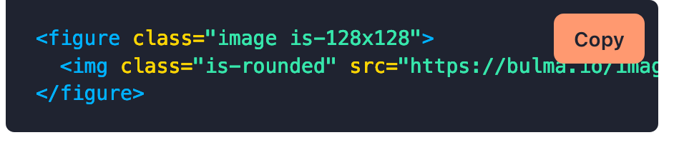
Bulma - Image Options
You can also make rounded images, using is-rounded class

Slide 11
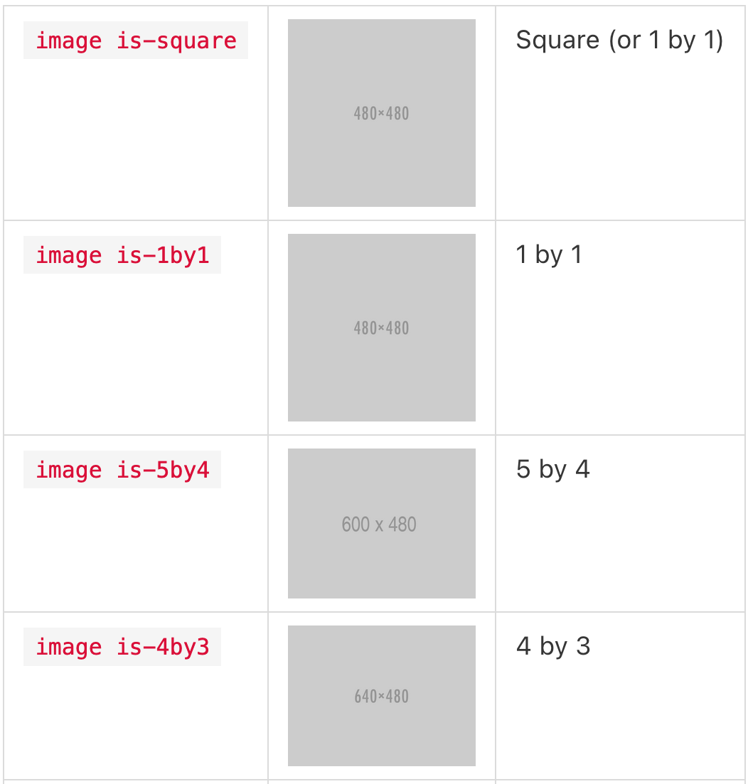
Responsive Image Ratios
If you don't know the exact dimensions but know the ratio instead, you can use one of the 16 ratio modifiers, which include common aspect ratios in still photography
https://bulma.io/documentation/elements/image/
The only requirement is for the parent element to already have a specific width
If you want the image to take up the full width of the container use is-fullwidth modifier

