Slide 1
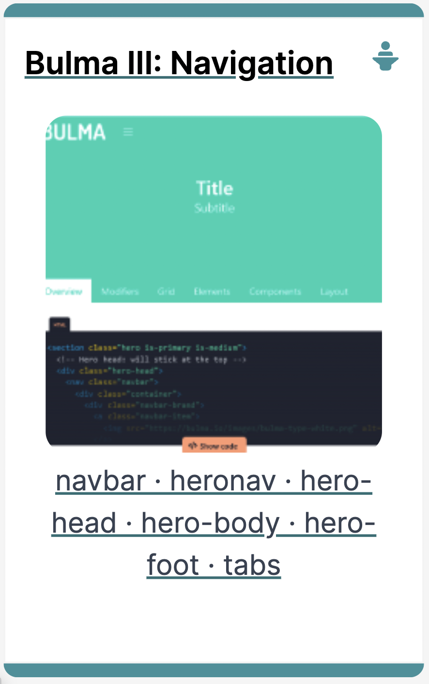

Slide 2


Bulma - Navigation
There are two ways of implementing navigation in Bulma
Navbar
HeroNav

Slide 3

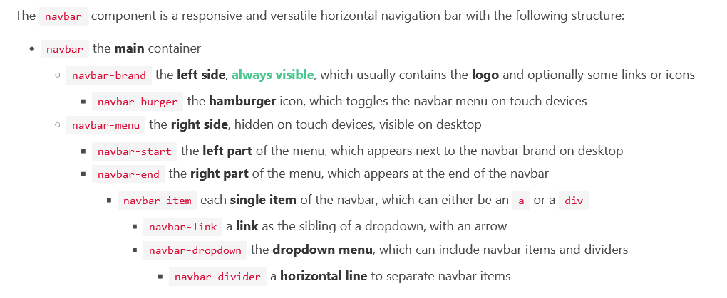
Bulma - Navbar
A responsive horizontal navbar that can support images, links, buttons, and dropdowns

Slide 4
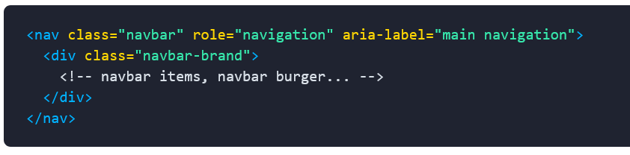

Bulma – Navbar Brand
The navbar-brand is the left side of the navbar. It can contain:
a number of navbar-item
the navbar-burger as last child
The navbar brand is always visible .
As a result, it is recommended to only use a few navbar items to avoid overflowing horizontally on small devices.

Slide 5


Bulma – Navbar Burger
The navbar-burger is a hamburger menu that only appears on touch devices.
It has to appear as the last child of navbar-brand.
It has to contain three empty span tags in order to visualize the hamburger lines or the cross (when active).

Slide 6
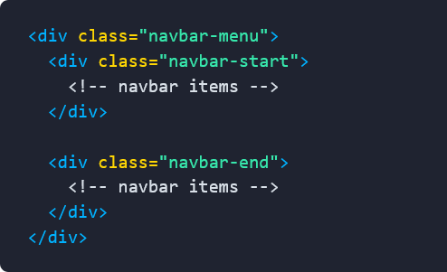
Bulma – Navbar start and navbar end
The navbar-start and navbar-end are the two direct and only children of the navbar-menu
On desktop >= 1024px:
navbar-start will appear on the left | navbar-end will appear on the right

Slide 7
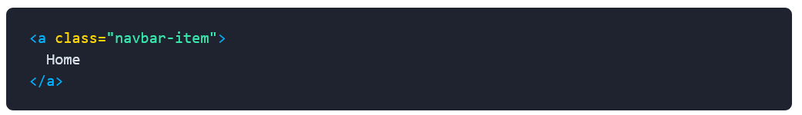
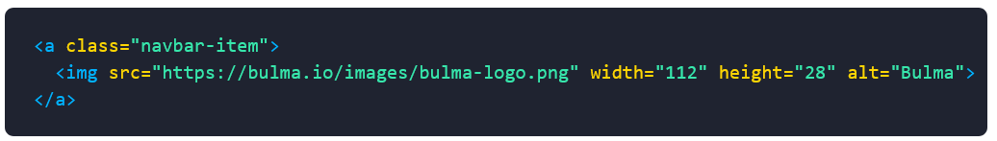
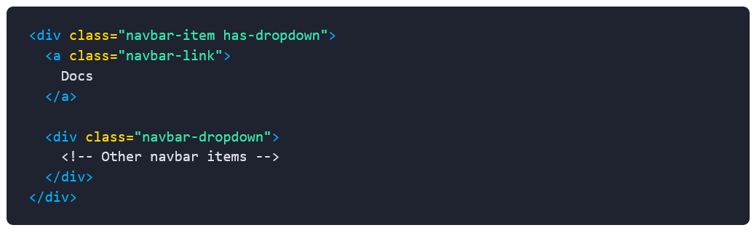
Bulma – Navbar item
A navbar-item is a repeatable element that can be:
a navigation link
a container for the brand logo
the parent of a dropdown menu
a child of a navbar dropdown
a container for almost anything you want

Slide 8
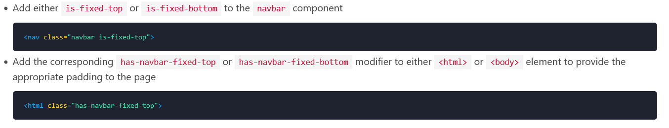
Bulma – Fixed Navbar
You can fix the navbar to either the top or bottom of the page

Slide 9


Bulma – Hero Nav
An imposing hero banner is used to showcase something, it can also contain a menu
There can be three parts in a Bulma Hero, hero-head, hero-body, hero-foot
hero-head
hero-body
hero-footer

Slide 10
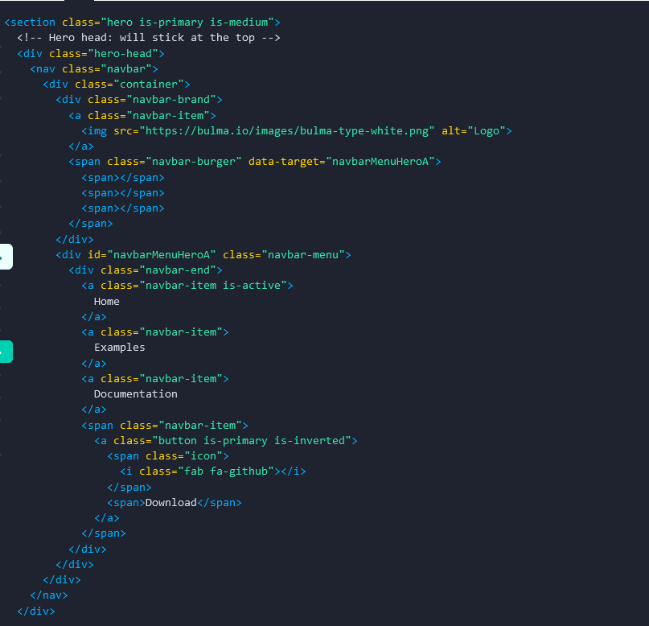
4
5
1
2
hero classifier with is-primary and is-medium modifiers
hero-head classifier
navbar-brand classifier
navbar-burger classifier
navbar-end classifier to right align menu items
3
4
5

Slide 11
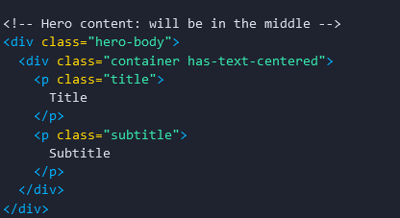
Bulma – Hero Body
1
hero-body classifier
has-centered-text modifier to centre text in the hero
Hero title and subtitle classifiers
2
3
1
3

Slide 12
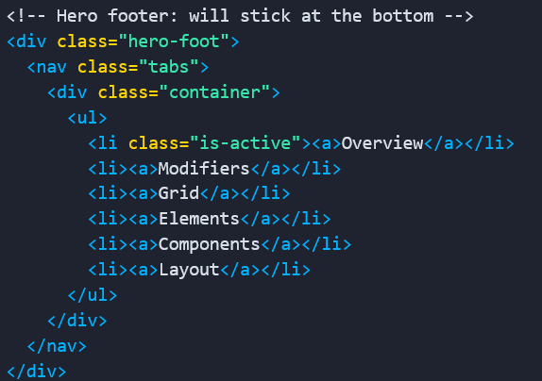
4
Bulma – Hero Foot
3
1
2
hero-foot classifier aligns content to bottom of the hero.
Uses nav semantic element with a tabs classifier
is-active classifier to reverse the colors
List of tabs in the menu
3
4

