Slide 1
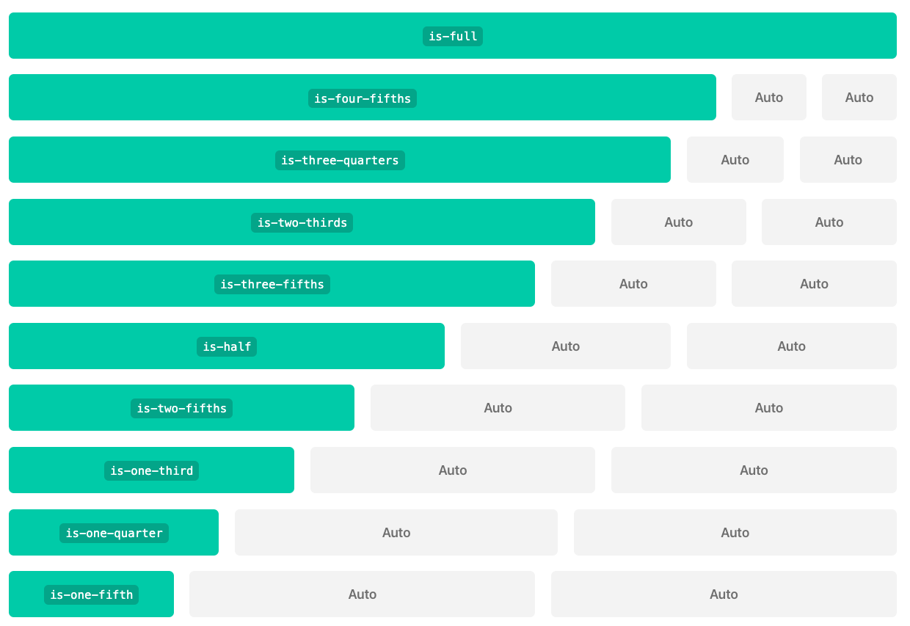
Bulma
Columns

Slide 2
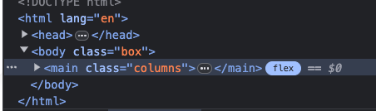
Basics
<body class="box">
<main class="columns">
<div class="column is-1 has-text-centered">
<p class="notification is-primary"><code class="html has-text-black">is-1</code></p>
</div>
<div class="column is-1 has-text-centered">
<p class="notification is-primary"><code class="html has-text-black">is-1</code></p>
</div>
<div class="column is-1 has-text-centered">
<p class="notification is-primary"><code class="html has-text-black">is-1</code></p>
</div>
<div class="column is-1 has-text-centered">
<p class="notification is-primary"><code class="html has-text-black">is-1</code></p>
</div>
<div class="column is-1 has-text-centered">
<p class="notification is-primary"><code class="html has-text-black">is-1</code></p>
</div>
<div class="column is-1 has-text-centered">
<p class="notification is-primary"><code class="html has-text-black">is-1</code></p>
</div>
<div class="column is-1 has-text-centered">
<p class="notification is-primary"><code class="html has-text-black">is-1</code></p>
</div>
<div class="column is-1 has-text-centered">
<p class="notification is-primary"><code class="html has-text-black">is-1</code></p>
</div>
<div class="column is-1 has-text-centered">
<p class="notification is-primary"><code class="html has-text-black">is-1</code></p>
</div>
<div class="column is-1 has-text-centered">
<p class="notification is-primary"><code class="html has-text-black">is-1</code></p>
</div>
<div class="column is-1 has-text-centered">
<p class="notification is-primary"><code class="html has-text-black">is-1</code></p>
</div>
<div class="column is-1 has-text-centered">
<p class="notification is-primary"><code class="html has-text-black">is-1</code></p>
</div>
</main>
</body>
The columns layout is a flexbox that has 12 columns
The flexbox is created via the “columns” class
Each individual column is created by a child element with the class “column”
There are numerous ways of sizing your columns, this example used the “is-n” were n is the ”colspan” of each column, that is:
”is-1” will span 1 column
“is-4” will span 4
”is-12” will span 12

Slide 3
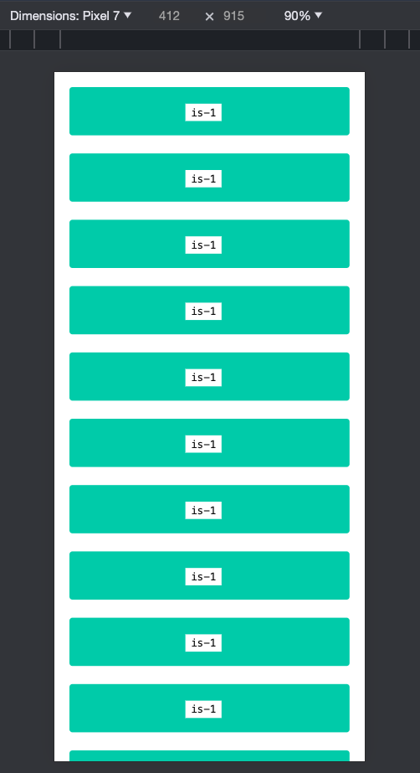
Columns are responsive

Slide 4
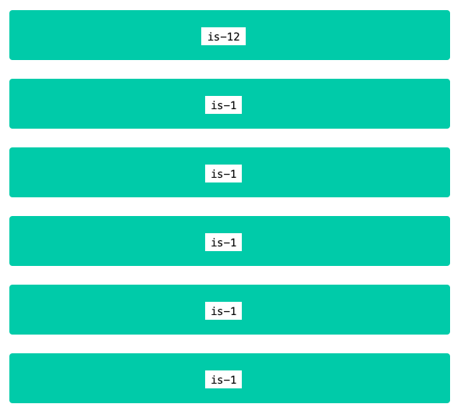
is-12
<header class="columns">
<div class="column is-12 has-text-centered">
<p class="notification is-primary"><code class="html has-text-black">is-12</code></p>
</div>
</header>

Slide 5
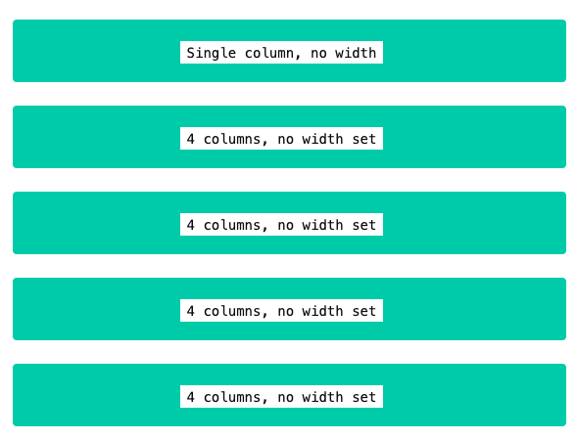
No width defined = equal width
<header class="columns">
<div class="column has-text-centered">
<p class="notification is-primary"><code class="html has-text-black">Single column, no width</code></p>
</div>
</header>
<main class="columns">
<div class="column has-text-centered">
<p class="notification is-primary"><code class="html has-text-black">4 columns, no width set</code></p>
</div>
<div class="column has-text-centered">
<p class="notification is-primary"><code class="html has-text-black">4 columns, no width set</code></p>
</div>
<div class="column has-text-centered">
<p class="notification is-primary"><code class="html has-text-black">4 columns, no width set</code></p>
</div>
<div class="column has-text-centered">
<p class="notification is-primary"><code class="html has-text-black">4 columns, no width set</code></p>
</div>
</main>

Slide 6
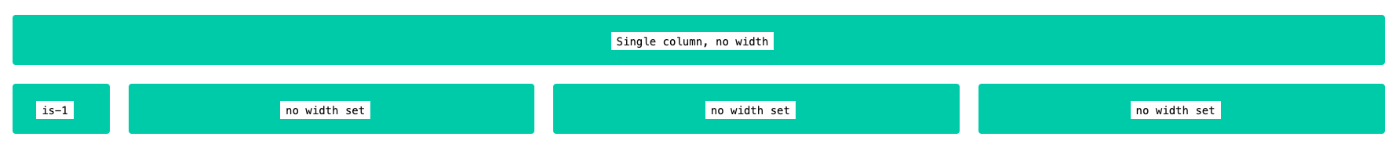
Some widths = auto sizing
<div class="column is-1 has-text-centered">
<p class="notification is-primary"><code class="html has-text-black">is-1</code></p>
</div>
<div class="column has-text-centered">
<p class="notification is-primary"><code class="html has-text-black">no width set</code></p>
</div>
<div class="column has-text-centered">
<p class="notification is-primary"><code class="html has-text-black">no width set</code></p>
</div>
<div class="column has-text-centered">
<p class="notification is-primary"><code class="html has-text-black">no width set</code></p>
</div>

Slide 7
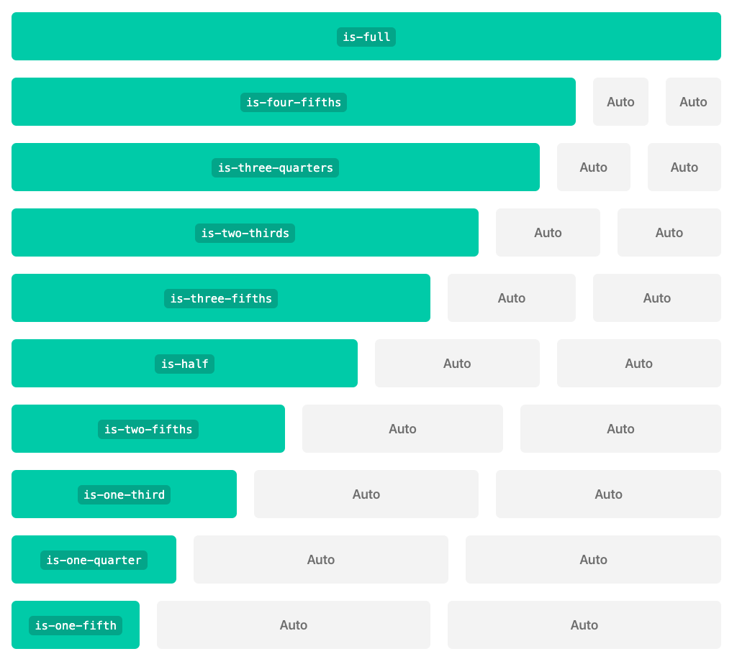
Fractional

Slide 8
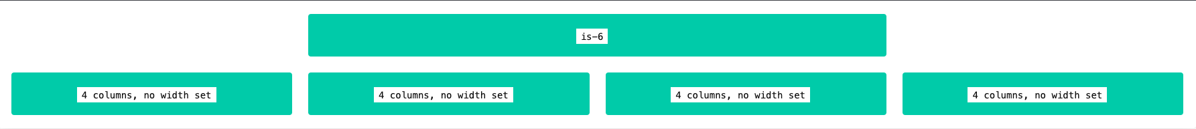
is-centered
<header class="columns is-centered">
<div class="column is-6 has-text-centered">
<p class="notification is-primary"><code class="html has-text-black">is-6</code></p>
</div>
</header>

Slide 9

is-multiline – will spill over to next line
<main class="columns is-multiline">
<div class="column is-4 has-text-centered">
<p class="notification is-primary"><code class="html has-text-black">is-4</code></p>
</div>
<div class="column is-4 has-text-centered">
<p class="notification is-primary"><code class="html has-text-black">is-4</code></p>
</div>
<div class="column is-4 has-text-centered">
<p class="notification is-primary"><code class="html has-text-black">is-4</code></p>
</div>
<div class="column is-4 has-text-centered">
<p class="notification is-primary"><code class="html has-text-black">is-4</code></p>
</div>
</main>
May be useful for looping and adding items

Slide 10

is-multiline is-centered
<main class="columns is-multiline is-centered">

Slide 11
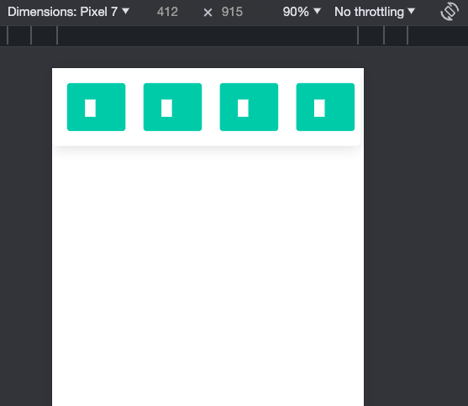
is-mobile – prevent vertical on mobile
<main class="columns is-mobile">

