Slide 1
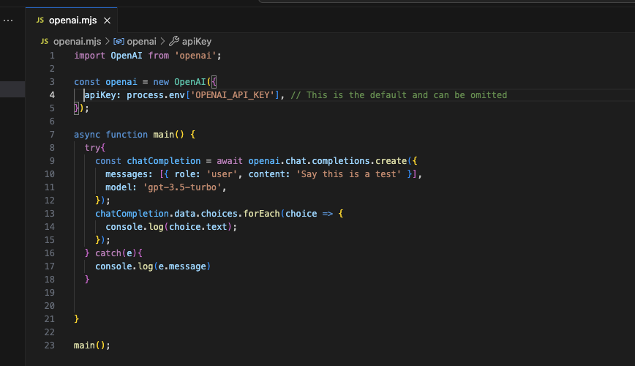
JavaScript
A Programming Language – An Introduction

Slide 2

What will we cover:
What is JavaScript?
What is Dynamic Typing?
An introduction to JavaScript variables
An introduction to JavaScript types

Slide 3
What is JavaScript?
JavaScript is a high-level, versatile, and dynamically-typed programming language primarily used for building interactive and dynamic content on the web.
It is a crucial component of web development alongside HTML and CSS. JavaScript allows developers to add functionality, interactivity, and behaviour to web pages.
JavaScript can also run on outside of the context of a browser thanks to the Node.js runtime that is built on top of Google Chromes V8 JavaScript engine

Slide 4
Dynamically Typed?
Dynamically typed means that the type of a variable is not explicitly declared and can change at runtime.
This contrasts with statically typed languages like Java, where variable types are explicitly declared and enforced at compile-time.

Slide 5


Dynamic Typing
public static void main(String[] args) { String name = "john"; name = 25; System.out.println(name); }
let name = "john";
name = 25;
console.log(name);
Result: java: incompatible types: int cannot be converted to java.lang.String
Result: 25
Note that this a “compile time” error, the code can never actually run.
The variable changes from a String to a Number at “runtime”

Slide 6
Compile time? Runtime?
Compile time and runtime are two distinct phases in the lifecycle of a program, referring to when specific processes occur during the development and execution of software.
Runtime
Occurs during program execution.
Involves memory allocation, dynamic behavior, and error handling.
Runtime errors may occur during execution.
Developers handle runtime errors using appropriate mechanisms.
Compile Time
Occurs before program execution.
Involves checking and translating source code.
Detects and reports compile-time errors.
Responsibility lies with the developer.

Slide 7

Putting that all together
JavaScript is a dynamically typed programming language.
It is an interpreted language (not compiled) that is interpreted at runtime. (Some versions use ”Just in Time” (JIT) compilation, but we won’t go there yet)
Java is a statically typed programming language that is compiled before execution.

Slide 8
Learning JS: Variables - const
As with other programming languages, JavaScript has variables
Variables are containers for all the values we use within our programmes
const numberOfApples = 2; // a variable to store the number of apples
const numberOfBananas = 3; // a variable to store the number of bananas
const numberOfFruits = numberOfApples + numberOfBananas;
console.log(`I have ${numberOfFruits} fruits in total.`)

Slide 9
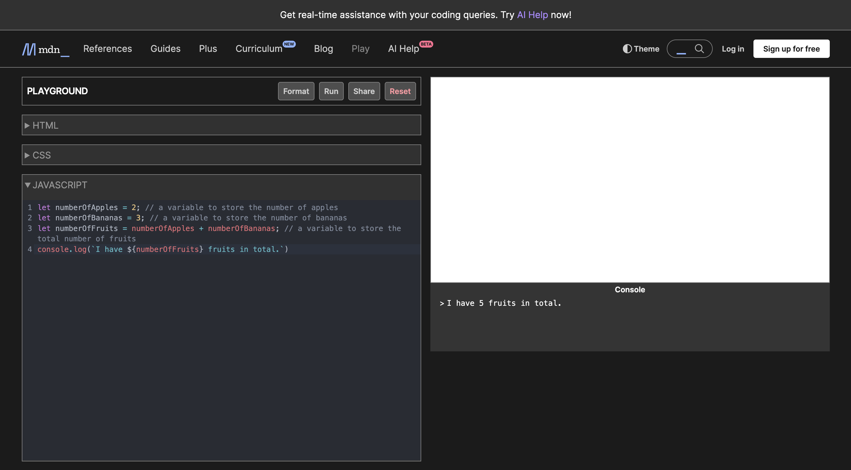
Can I try this out?
Run Code with this Button
Review Output Here
Type Code Here
https://developer.mozilla.org/en-US/play

Slide 10
Deep Dive:
This constant is called “numberOfApples”
All declarations and statements should end in a semicolon
const numberOfApples = 2;
Declare a CONSTANT
This constant has a value of 2

Slide 11
What is a constant?
A constant must be initialized when declared
Once a constant is initialized, it’s value cannot be changed
If the value is an object, the internals of the object can still change
This is similar to declaring a variable “final” in Java
const numberOfApples = 2; // a variable to store the number of apples
const numberOfBananas = 3; // a variable to store the number of bananas
const numberOfFruits = numberOfApples + numberOfBananas;
console.log(`I have ${numberOfFruits} fruits in total.`)
final int numberOfApples = 2; final int numberOfBananas = 3; final int numberOfFruits = numberOfApples + numberOfBananas; System.out.println("I have " + numberOfFruits + " fruits");

Slide 12
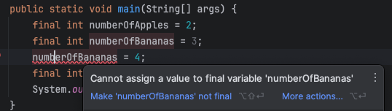

Constants, final….
final int numberOfApples = 2; final int numberOfBananas = 3; numberOfBananas = 4;
const numberOfApples = 2;
const numberOfBananas = 3; numberOfBananas = 4;
The IDE tells us there’s an error
Runtime Error: variables.js:3
numberOfBananas = 4;
^
TypeError: Assignment to constant variable.
Compile Time Error: cannot assign a value to final variable numberOfBananas

Slide 13
Learning JS: Variables - let
Use the let keyword to create a variable that can change
Another way of saying this is, Use the let keyword to create a variable that is mutable
const price = 200;
let allowCredit = true;
if(price > 100) {
allowCredit = false;
}
console.log(allowCredit); // false

Slide 14
Deep Dive:
This variable is called “allowCredit”
All declarations and statements should end in a semicolon
let allowCredit = true;
Declare a variable
This variable has a value of true

Slide 15
When to use const or let???
Use const by default. If the value needs to remain constant, it helps prevent accidental reassignments.
Use let when you know the value will change, such as in loops or when the variable's value needs to be reassigned.
In general, it's good practice to use const when possible to make your code more robust and easier to reason about, only resorting to let when mutability is necessary.

Slide 16
When to use const or let???
Using const by default helps to enforce immutability
If you are new to programming, immutability can be daunting, so we won’t delve into it
Just know that it has been shown that immutability can help reduce bugs and maintenance effort
adjective. im·​mu·​ta·​ble (ˌ)i(m)-ˈmyü-tə-bəl. : not capable of or susceptible to change.

Slide 17
Learning JS: Variables
We now have 2 ways of creating variables
const
Use const when the value of the variable is not expected to change.
It is often used for constants and values that remain constant throughout the program.
let
Use let when the value of the variable is expected to change during the program execution.
It is commonly used for loop counters and variables whose values may be reassigned.

Slide 18
Learning JS: Variables
// multiple declaration
const firstName = 'John', lastName = 'Doe';
let first = "John", last = "Doe";

Slide 19
Learning JS: Variables
// initialize later
let myName;
let myAge;
if(someStatementIsTrue) {
myName = "John";
myAge = 25;
} else {
myName = "Doe";
myAge = 30;
}

Slide 20

Learning JS: Variables – What is var ?
var myName;
var myAge;
Back when JavaScript was first created, this was the only way to declare variables.
The design of var is confusing and error-prone.
let was created in modern versions of JavaScript, a new keyword for creating variables that works somewhat differently to var, fixing its issues in the process.

Slide 21
Learning JS: Variables – Naming Variables
var myName;
var myAge;
You can call a variable pretty much anything you like, but there are limitations.
Generally, you should stick to just using Latin characters (0-9, a-z, A-Z) and the underscore character.
Do not use underscores, stuck to lower camel case – lowercase first letter, any “new word” begins with capital
firstName, lastName, finalOutputValue
Make variable names intuitive, so they describe the data they contain.
Don't just use single letters/numbers, or big long phrases.
Avoid using JavaScript reserved words as your variable names
var,function,let, and for as variable names.
Browsers recognize them as different code items, and so you'll get errors.

Slide 22
Learning JS: Variables – Types - Number
Number values represent floating-point numbers like 37 or -2.95.
A number literal like 200 in JavaScript code is a floating-point value, not an integer.
There is no separate integer type in common everyday use
Numbers in JavaScript can exhibit some bizarre behaviour, for now, we’ll keep it simple with the above
const price = 200;
price === parseInt("200", 10); // true
typeof price; // "number”
200 / 3 // 66.66666666666667 const distance = 2.5

Slide 23
Learning JS: Variables – Types - String
The String object is used to represent and manipulate a sequence of characters.
Strings are useful for holding data that can be represented in text
Strings are IMmutable – IMpossible to change
Strings will be covered in more detail later
const string1 = "A string primitive";
const string2 = 'Also a string primitive';
const string3 = `Yet another string primitive`;

Slide 24
Learning JS: Variables – Types - Boolean
The Boolean object represents a truth value: true or false.
const started = true;
const stopped = false;

Slide 25
Learning JS: Variables – Types - Object
In programming, an object is a structure of code that models a real-life object.
A simple object could represent a box and contain information about its width, length, and height
An object could represent a person and contains data about their name, height, weight, what language they speak, how to say hello to them, and more.
Objects are often used as associative arrays or “maps” in JavaScript
const dog = { name: "Spot", breed: "Dalmatian" };
console.log(dog.name); // Spot
typeof dog; // "object"
typeof dog.name; // "string"

Slide 26
Learning JS: Variables – Types - Array
Like other languages, arrays can hold multiple values and are accessed via the index of the value
Arrays in JavaScript are zero-indexed, that is, the first index is zero
Technically, an array in JavaScript Array is syntactic sugar for an Object that behaves like an array in other languages
If that doesn’t make sense now, don’t worry, it is initially beneficial to think of them separately
const foods = ["apple", "banana", "cherry"];
foods[0]; // apple
typeof foods; // "object"
Array.isArray(foods); // true
foods[4] // undefined
// can mix types inside a single array
const mixed = [1, "apple", true, { name: "John" }, [1, 2, 3]];

Slide 27
Learning JS: Variables – Types
There are other types, but for now we are fine to stick with
Numbers
Strings
Arrays
Objects
Booleans

Slide 28

Recap: What did we cover?
Dynamic Typing
Compile time vs Runtime
Variables – let & const
Types – a brief intro to
Number
String
Array
Objects
Boolean

