Slide 1
JavaScript
String, Coercion, Objects

Slide 2
Today
Strings
Null
Undefined
Strings and Numbers
Conditional
Coercian

Slide 3

String Concatenation and Template Literals
const firstName = 'John';
const lastName = 'Doe';
const fullName = `${firstName} ${lastName}`;// John Doe – Template Literal
const fullName2 = firstName + ' ' + lastName;// John Doe - Concatenation
const a = 5;
const b = 10;
"Fifteen is " + (a + b) + " and not " + (2 * a + b) + "."// Fifteen is 15 and not 20.
const multiline = `This is a
multiline
string with backticks
we can use variables like ${a} and ${b} in it
and expressions like ${a + b} too`;

Slide 4
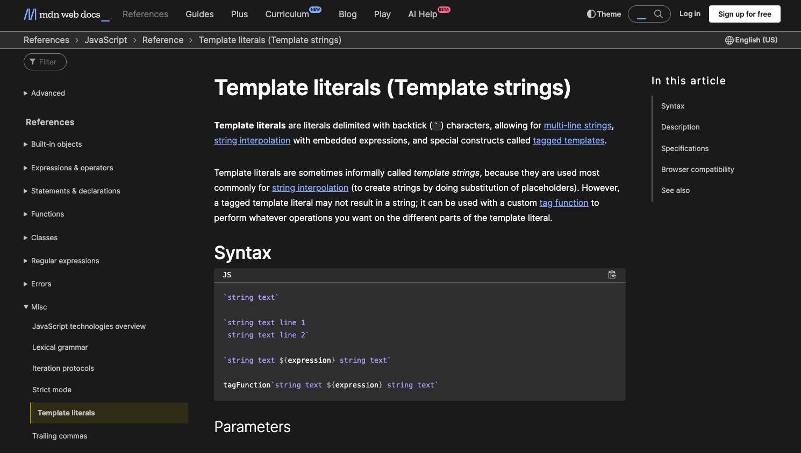
Docs
https://developer.mozilla.org/en-US/docs/Web/JavaScript/Reference/Template_literals

Slide 5
Undefined
// Any variable that is created in JavaScript
// that is not assigned a value is undefined: const noValue; // The value here will be undefined //You can also explicitly set a variable to undefined: const favoriteFood = "Candy"; // Changed your mind const favoriteFood = undefined;

Slide 6
Null
// Null is not the same as undefined.
It signifies an intentional absense of data. const secondEmailAddress = null;
It is important to remember that null and undefined are different types in JavaScript
This can be a confusing feature of JavaScript, even for people who know other programming languages.
The distinction can seem somewhat arbitrary when you're first learning the language, but as you get more comfortable the distinction will become clearer.

Slide 7
Figuring out a variable's type
In JavaScript, we have a keyword called typeof that returns the type of the variable.
typeof ""; // - "string" typeof 5; // - "number" typeof false; // - "boolean" typeof undefined; // - "undefined" typeof null; // this is not what we expect,
// it returns "object"!

Slide 8
Converting to a string: toString
The toString method will convert any value which is not undefined or null into a string
const num = 5; const bool = true; num.toString(); // "5"; bool.toString(); // "true";

Slide 9
Converting to a number using parse
There are several ways you can convert a value to a number.
One way is to parse the number, using parseInt or parseFloat:
Each function will look at a string from left to write and try to make sense of the characters it sees as numbers.
parseInt("2"); // 2 parseFloat("2"); // 2 parseInt("3.14"); // 3 parseFloat("3.14"); // 3.14 parseInt("2.3alkweflakwe"); // 2 parseFloat("2.3alkweflakwe"); // 2.3 parseInt("w2.3alkweflakwe"); // NaN (not a number) parseFloat("w2.3alkweflakwe"); // NaN (not a number)

Slide 10
Converting to a number using Number
This doesn't parse, it simply tries to convert the entire string directly to a number
Number("2"); // 2 Number("3.14"); // 3.14 Number("2.3alkweflakwe"); // NaN Number("w2.3alkweflakwe"); // NaN

Slide 11
Converting to a number using +
This doesn't parse, it simply tries to convert the entire string directly to a number.
+"2"; // 2 +"3.14"; // 3.14 +"2.3alkweflakwe"; // NaN +"w2.3alkweflakwe"; // NaN

Slide 12
Boolean Logic
Write conditional logic using boolean operators
List all of the falsey values in JavaScript
Use if/else and switch statements to include conditional logic in your JavaScript code
Explain the difference between == and === in JavaScript
Convert between data types explicitly in JavaScript

Slide 13
Conditional Logic
An essential part of writing programs is being able to execute code that depends on certain conditions. For example:
You want the navigation bar on your website to look different based on whether or not someone is logged in
If someone enters their password incorrectly, you want to let them know; otherwise, you want to log them in
You're building a tic-tac-toe game, and want to know whether it's X's turn or O's turn
You're building a social network and want to keep person A from seeing person B's profile unless the two of them are friends

Slide 14
const instructor = 'Brenda'; // we begin with an "if" statement
// followed by a condition in ()
// and a block of code inside of {} if (instructor === 'Brenda') { console.log('Yes!'); } else { console.log('No'); }
Always true
Notice that we used a === instead of =.
Anytime that we use more than one equals operator (we can either use == or ===) we are doing a comparison (comparing values).
When we use a single equals operator =, we are doing an assignment (setting a variable equal to some value).

Slide 15
const favoriteFood = prompt('What\'s your favorite food?'); if (favoriteFood === 'pizza') { console.log('Woah! My favorite food is pizza too!'); } else { console.log('That\'s cool. My favorite food is pizza.'); }
In this version, the boolean expression will be true/false depending on the value entered in ‘prompt’

Slide 16
Difference between “==“ and “===“
Two different operators for comparison: the double and triple equals.
Both operators check whether the two things being compared have the same value, but there's one important difference.
== allows for type coercion of the values,
=== does not.
To understand the difference between these operators, we first need to understand what is meant by type coercion.

Slide 17
Type Coercion 1
Add a number and a string.
In a lot of programming languages, this would throw an error, but JavaScript is more accommodating
It evaluates the expression 5 + "hi" by first coercing 5 into a string, and then interpreting the "+" operator as string concatenation.
So it combines the string "5" with the string "hi" into the string "5hi"
5 + 'hi'; // '5hi'

Slide 18
Type Coercion 2
JavaScript expects the values inside of parentheses that come after the keyword if to be booleans.
If you pass in a value which is not a boolean, JavaScript will coerce the value to a boolean according to the rules for truthy/falsey values (more on this later)
if ('foo') { console.log('this will show up!'); } if (null) { console.log('this won\'t show up!'); }

Slide 19
Type Coercion 3
A very common way to coerce a stringified number back into a number.
By prefacing the string with the plus sign, JavaScript will perform a coercion on the value and convert it from a string value to a number value.
+'304'; // 304

Slide 20
Coercion
In REAL LIFE: Do not rely on coercion
We typically only need to parse a number from a string on user input
parseInt or parseFloat or actual data types as soon as possible in your program (typically as soon as input is read) is the best way to think about it
Do not pass around numbers as strings more than you have to and remember, never use ==

Slide 21
“==“ Vs “===“ again
==
loose
===
strict
5 == '5'; // true 'true' == true; // false true == 1; // true undefined == null; // true
5 === '5'; // false 'true' === true; // false true === 1; // false undefined === null; // false
== allows for coercion while === doesn't.
If you don't want to have to think about coercion in your comparisons, stick to ===.
IN REAL LIFE: DO NOT USE ==, forget about it

Slide 22
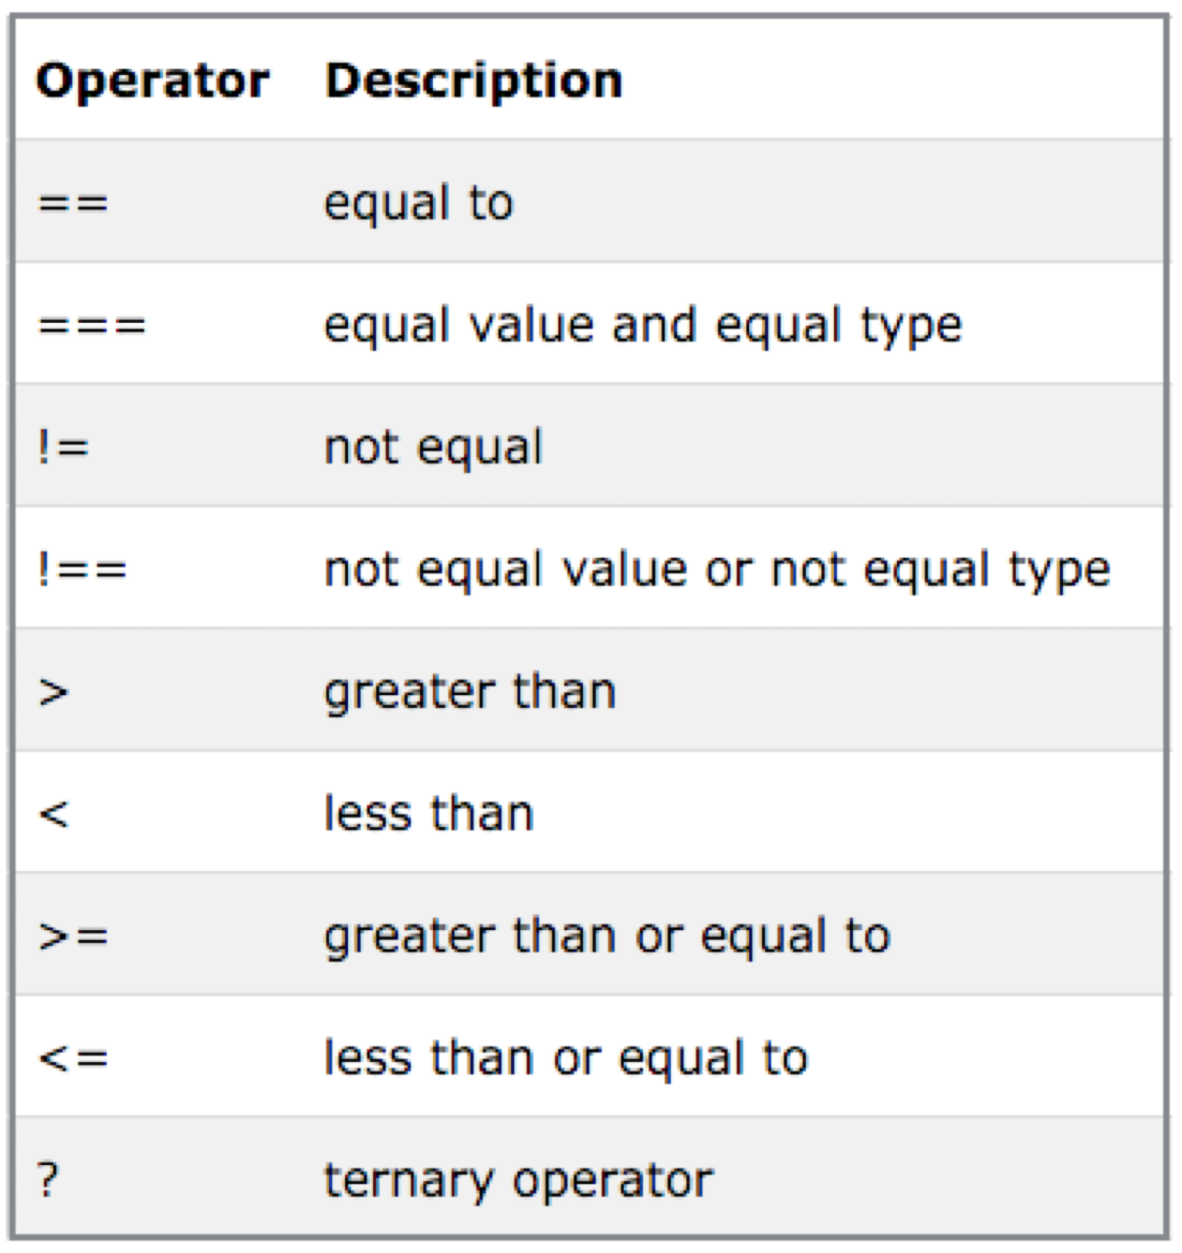
Comparison Operators
const x = 4; if (x <= 5) { console.log('x is less than or equal to five!'); } else { console.log('x is not less than or equal to five!'); }

Slide 23
Falsey Values
Some values (aside from false) are actually false as well, when they're used in a context where JavaScript expects a boolean value
Even if they do not have a "value" of false, these values will be translated (or "coerced") to false when evaluated in a boolean expression.
6 Falsey Values in Javascript
0 "" null undefined false NaN // (short for not a number)

Slide 24
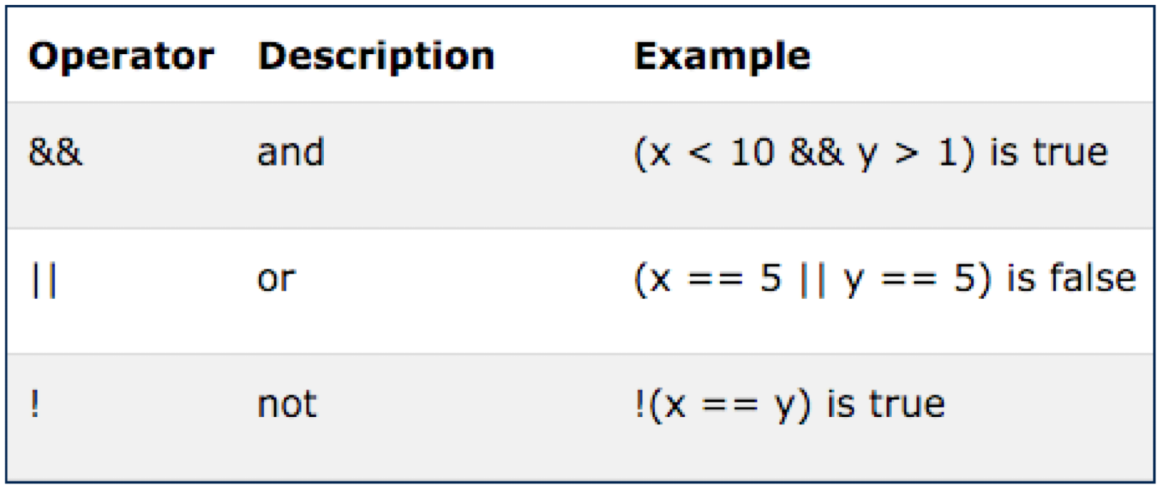
Logical Operators

Slide 25
If-Else
Sometimes you may have more than two conditions to check.
In this case, you can chain together multiple conditions using else
if (number >= 1000) { console.log('Woah, thats a big number!'); } else if (number >= 0) { console.log('Thats a cool number.'); } else { console.log('Negative numbers?! Thats just bananas.'); }

Slide 26
Switch
Another way to write conditional logic is to use a switch statement.
While these are used less frequently, they can be quite useful when there are multiple conditions that can be met.
Notice that each case clause needs to end with a break so that we exit the switch statement.
switch (feeling) { case 'happy': console.log("Awesome, Im feeling happy too!); break; case 'sa': console.log('Thats too bad, I hope you feel better soon.'); break; case 'hungry': console.log('Me too, lets go eat some pizza!'); break; default: console.log('I see. Thanks for sharing!'); }

Slide 27
Modulus Operator
5 % 3 === 2 // true (the remainder when five is divided by 3 is 2) const num = prompt('Please enter a whole number'); if ( num % 2 === 0 ) { console.log('the num variable is even!') } else if ( num % 2 === 1) { console.log('the num variable is odd!') } else { console.log('Hey! I asked for a whole number!'); }

Slide 28
Object Data Types
Whereas primitive data typed variables hold individual values. e.g:
numbers
strings
boolean etc…
Object types can hold more than one value. e.g.:
a number AND a string.
2 numbers and a boolean and a string
3 strings and 2 numbers
Objects are central to creating interesting and powerful programs

Slide 29
Creating an Object
Introduces singe variable called ‘homer’.
This is an object with two fields
firstName, containing ‘homer’
lastName, containing ‘simpson’
const homer = { firstName: 'homer', lastName: 'simpson', };

Slide 30
Objects with Strings & Numbers
const bart = { firstName: 'bart', lastName: 'simpson', age: 10, }; console.log(bart);
An object containing 2 strings and a number.
{ firstName: 'homer', lastName: 'simpson' }

Slide 31
Anatomy of an Object
name of the object
const homer = { firstName: 'homer', lastName: 'simpson', age: 50, };
attributes (fields) of the object
attribute (field) values for the homer object
a specific attribute - called ‘age’

Slide 32

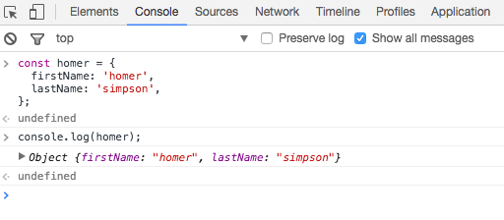
Objects in the Console
We can paste code directly in the console for experimentation purposes
Can be useful when learning or to clarify your understanding about some syntax/feature

Slide 33
Objects with Functions
const marge = { firstName: 'marge', lastName: 'simpson', age: 10, sayHello() { console.log('Hello from me!'); }, }; marge.sayHello();

Slide 34
name of the object
const marge = { firstName: 'marge', lastName: 'simpson', age: 45, sayHello() { console.log('Hello from me!'); }, };
console.log(marge); console.log(marge.firstName); console.log(marge.age);
marge.sayHello();
data attributes (fields) of the object
attribute values for the object
a function attribute of the object
accessing marge’s fields
calling the function within the marge object.

Slide 35
this refers to the ‘current’ object. Ned in this case
const ned = { firstName: 'ned', lastName: 'flanders', age: 45, speak() { console.log('How diddley do? says ' + this.firstName); }, }; ned.speak();
How diddley do? says ned

