Slide 1
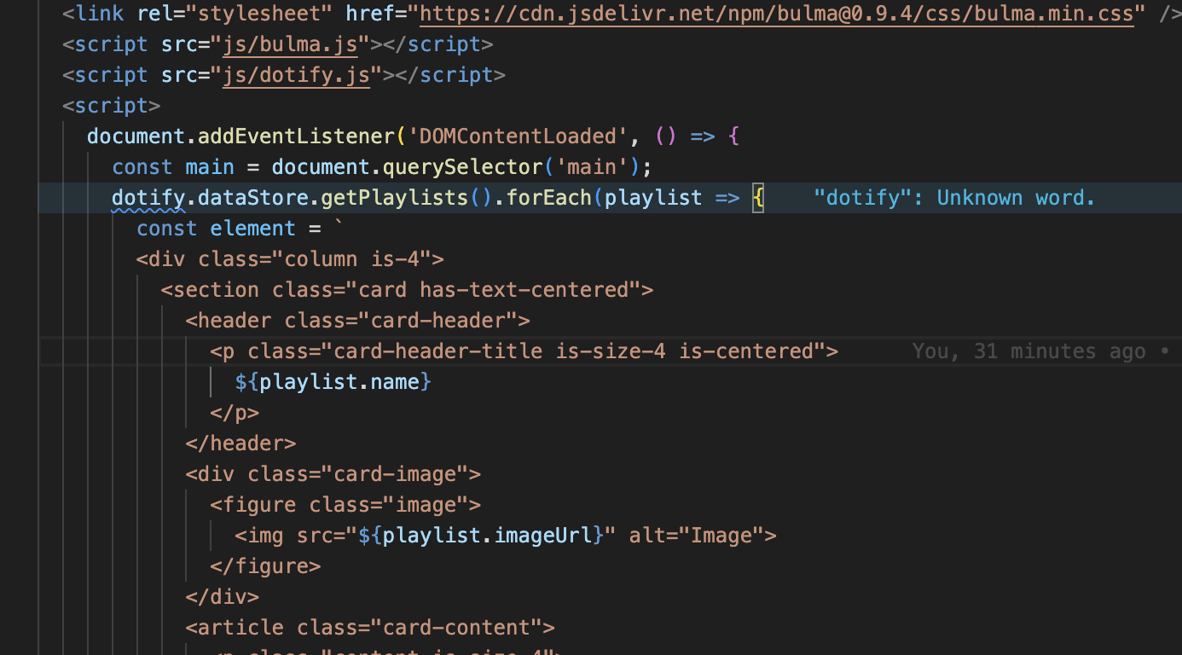
JavaScript on your Web Page
Script Tags Web Development 1 John Rellis

Slide 2

The Script Element (tag)
The <script> HTML element is used to embed executable code or data; this is typically used to embed or refer to JavaScript code.
The <script> element can also be used with other languages, such as WebGL's GLSL shader programming language and JSON.

Slide 3
The Script Element – Inline Script
The <script> element can hold JavaScript within its content
This allows you to put JavaScript right in your HTML file

Slide 4
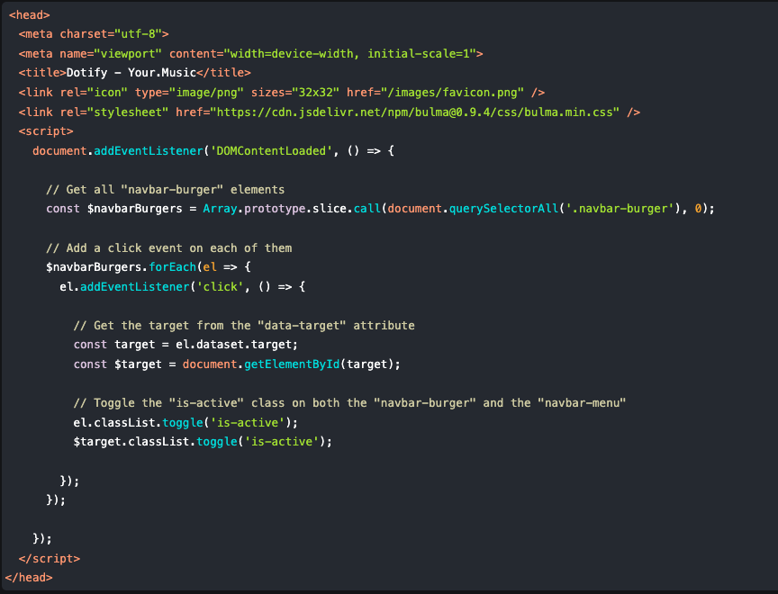
The Script Element – Inline Script

Slide 5
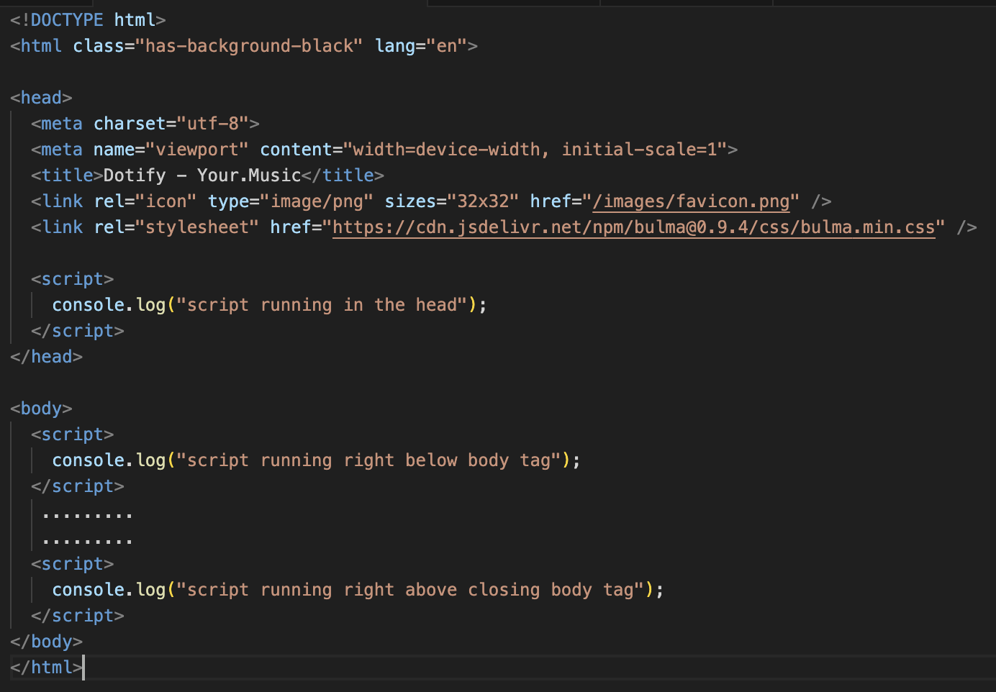

The Script Element – Inline Script
Inline scripts run in the order they tag is placed on the page

Slide 6
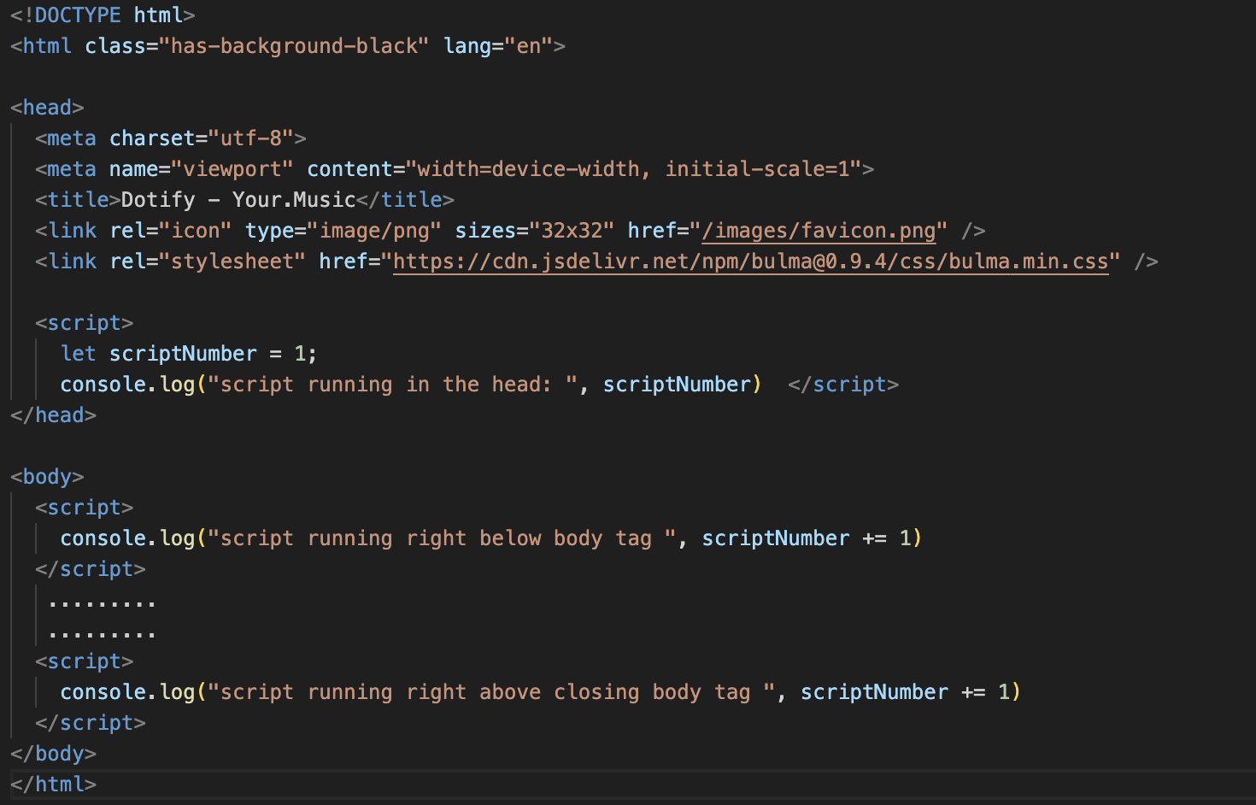

The Script Element
Scripts that run on the same page are all executed within the same scope.
Scope is the term used to describe where the script is running, what variables it can see and potentially augment
This can cause some confusion and it is understandable
Scripts are not executed in isolated environments, they are executed within the context, or scope, of the page

Slide 7
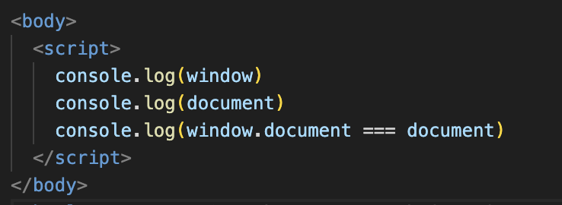

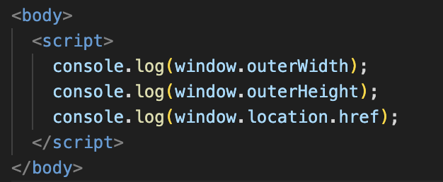

Tell me more about scope
Within the scope of the web page, we have access to
window - The Window interface represents a window containing a DOM document; the document property points to the DOM document loaded in that window.
document - The Document interface represents any web page loaded in the browser and serves as an entry point into the web page's content, which is the DOM tree.
Window is typically talked about as the “global scope” and global variables can exist here
It is generally bad to rely on the global scope

Slide 8




Wait, what is console.log?
The console.log() static method outputs a message to the console. The message may be a single string (with optional substitution values), or it may be any one or more JavaScript objects.
The console object provides access to the debugging console.
The specifics of how it works vary from browser to browser or server runtimes (Node.js, for example), but there is a de facto set of features that are typically provided.
https://developer.mozilla.org/en-US/docs/Web/API/console/log_static

Slide 9

The Script Element – src file
The <script> element can also hold a path to a file in the src attribute
This allows you to separate your JavaScript from your HTML

Slide 10
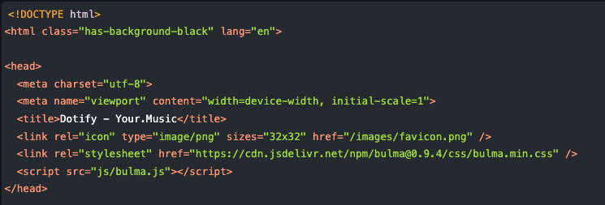

Slide 11
The Script Element – src file
Scripts run this way also share the same scope, the document variable is available to you.
This can be convenient but can introduce a lot of bugs so beware

Slide 12
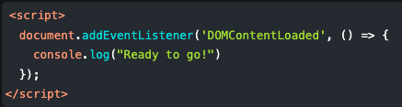
The Script Element - DOMContentLoaded
You may notice in the JavaScript that we added in the last lab that we added an event listener called “DOMContentLoaded”
Don’t worry, we haven’t really covered events or listeners
However, using this event listener it is possible to wait until the entire HTML page is loaded before running your JavaScript
This can be useful to populate dynamic values

Slide 13
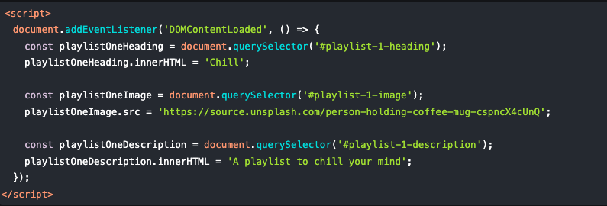
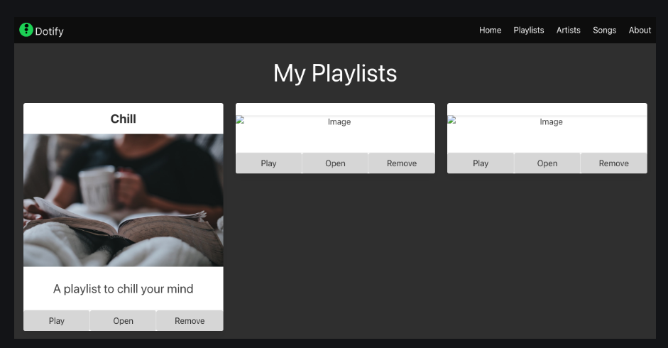
JS in Dotify Lab
Remember, in previous lectures we learned about DOM manipulation using the JS console in our browser
In this lecture we have seen how we can add JS to a webpage
We will now combine both ideas to add JavaScript to our Dotify playlists page
In our lab we will
Refactor Dofity so that it’s Hamburger menu JavaScript is in a separate file
Debug issues with our JavaScript directly in the browser
Learn about and use DOMContentLoaded
Add content to our playlist cards using JavaScript

