Slide 1
HTML Tables
An Introduction
Web Development 1
John Rellis

Slide 2
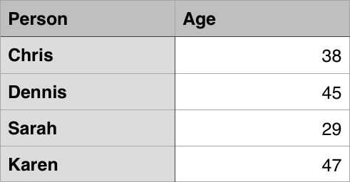

What is a table?
A table is a structured set of data made up of rows and columns (tabular data). A table allows you to quickly and easily look up values that indicate some kind of connection between different types of data, for example a person and their age, or a day of the week, or the timetable for a local swimming pool.

Slide 3
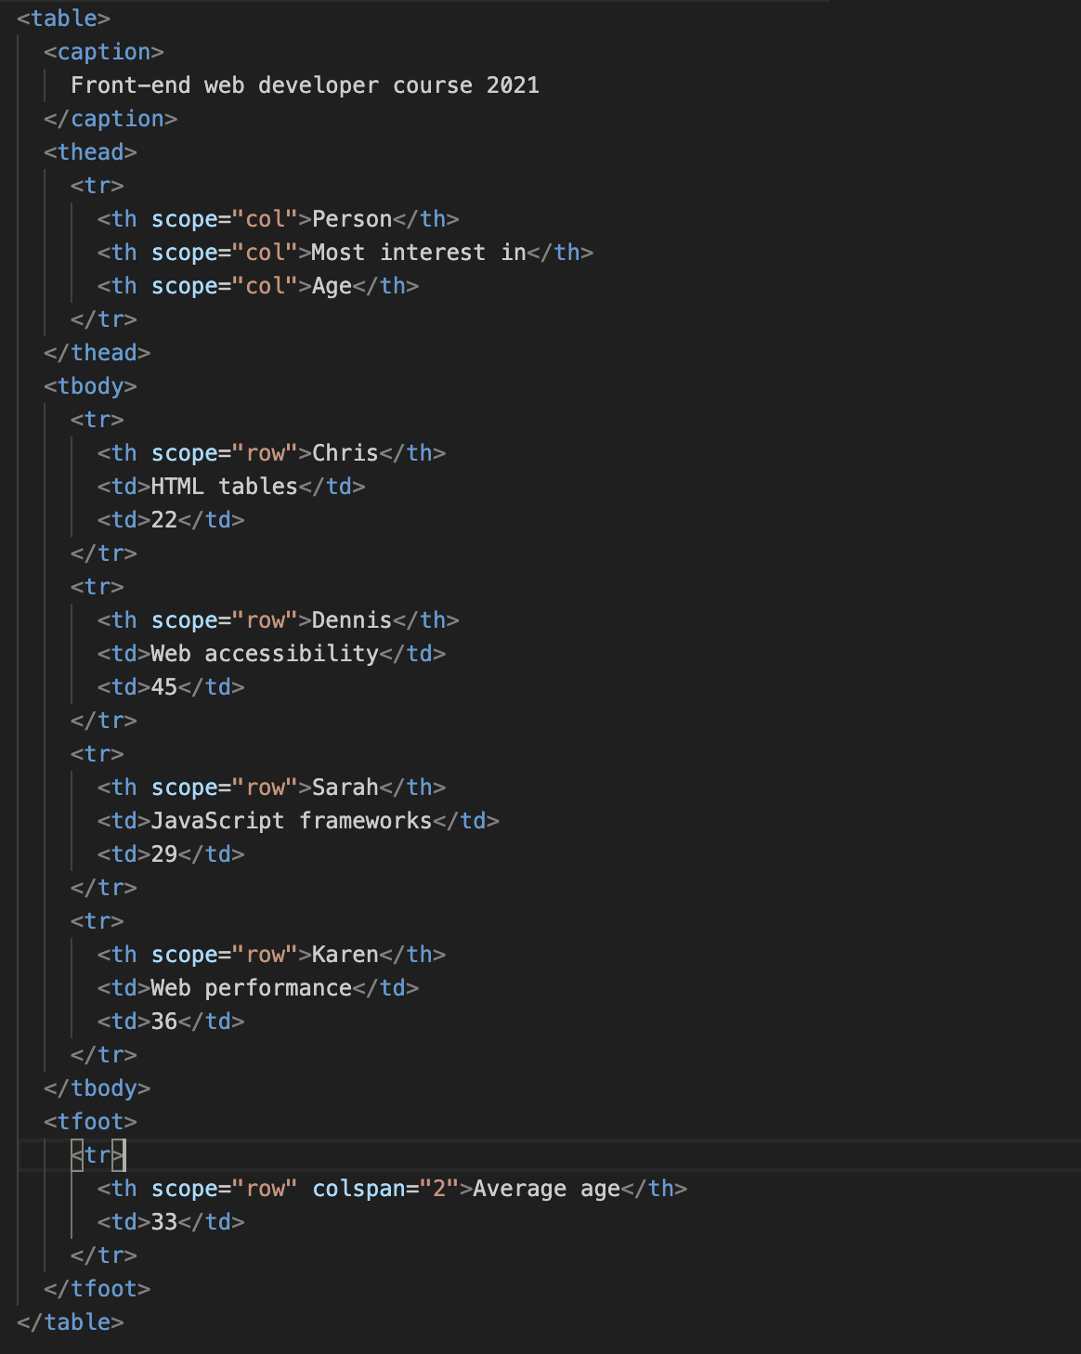
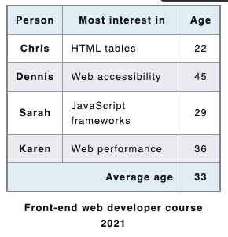
<table>: The Table element
The <table> HTML element represents tabular data—that is, information presented in a two-dimensional table comprised of rows and columns of cells containing data.
https://developer.mozilla.org/en-US/docs/Web/HTML/Element/table

Slide 4
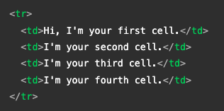
Rows and Columns
A table is made up of rows and columns
The intersection of rows and columns are data cells
A row is denoted by the <tr> tag
A data cell is denoted by the <td> tag
A <tr> will have many children <td>

Slide 5
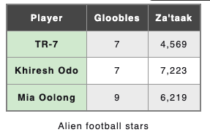
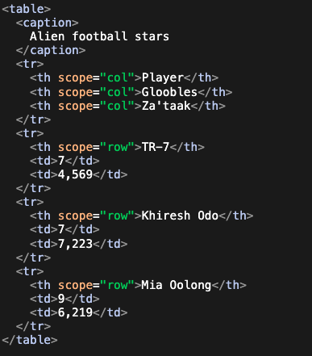
<thead>: The Table Head element
The <thead> HTML element encapsulates a set of table rows (<tr> elements), indicating that they comprise the head of a table with information about the table's columns. This is usually in the form of column headers (<th> elements).
The <th> HTML element defines a cell as the header of a group of table cells and may be used as a child of the <tr> element. The exact nature of this group is defined by the scope and headers attributes.

Slide 6
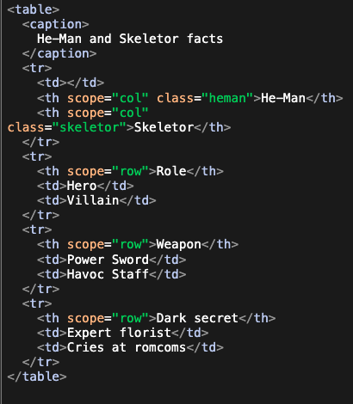
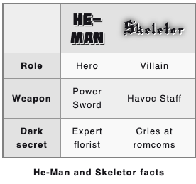
<caption>: The Table Caption element

Slide 7
Scope attribute
Defines the cells that the header (defined in the <th>) element relates to.
Possible enumerated values are:
row: the header relates to all cells of the row it belongs to;
col: the header relates to all cells of the column it belongs to;
rowgroup: the header belongs to a rowgroup and relates to all of its cells;
colgroup: the header belongs to a colgroup and relates to all of its cells.
If the scope attribute is not specified, or its value is not row, col, rowgroup, or colgroup, then browsers automatically select the set of cells to which the header cell applies.

Slide 8
rowspan & colspan
rowspan
Contains a non-negative integer value that indicates for how many rows the data cell spans or extends.
The default value is 1; if its value is set to 0, it extends until the end of the table grouping section (<thead>, <tbody>, <tfoot>, even if implicitly defined), that the cell belongs to. Values higher than 65534 are clipped to 65534.
colspan
Contains a non-negative integer value that indicates how many columns the data cell spans or extends.
The default value is 1. User agents dismiss values higher than 1000 as incorrect, setting to the default value (1).

Slide 9
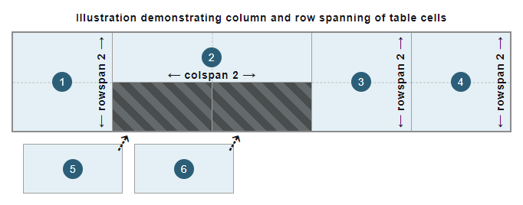
rowspan & colspan

Slide 10
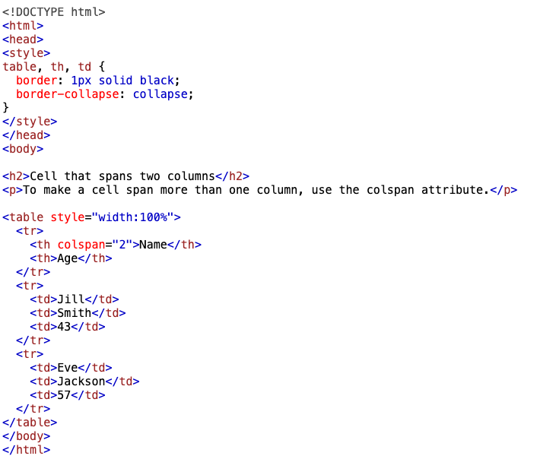
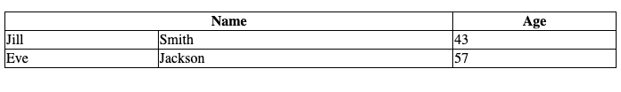
rowspan & colspan

Slide 11
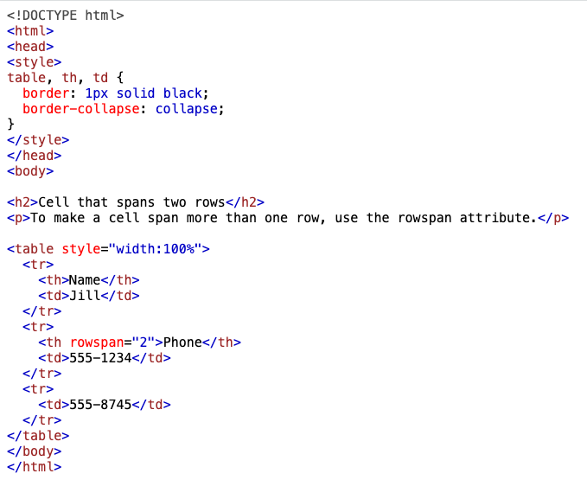

rowspan & colspan

Slide 12
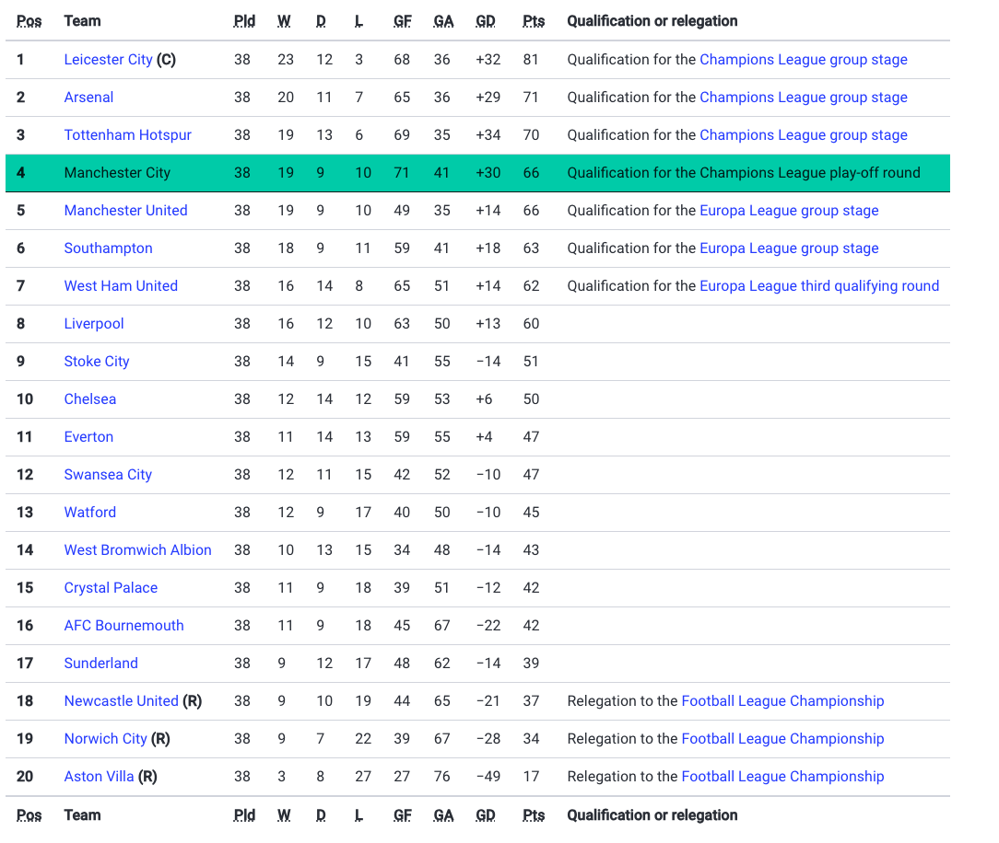
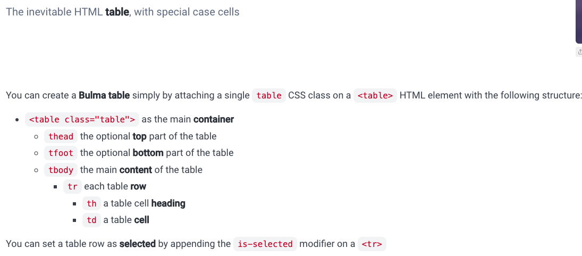
Bulma Table
https://bulma.io/documentation/elements/table/

Slide 13
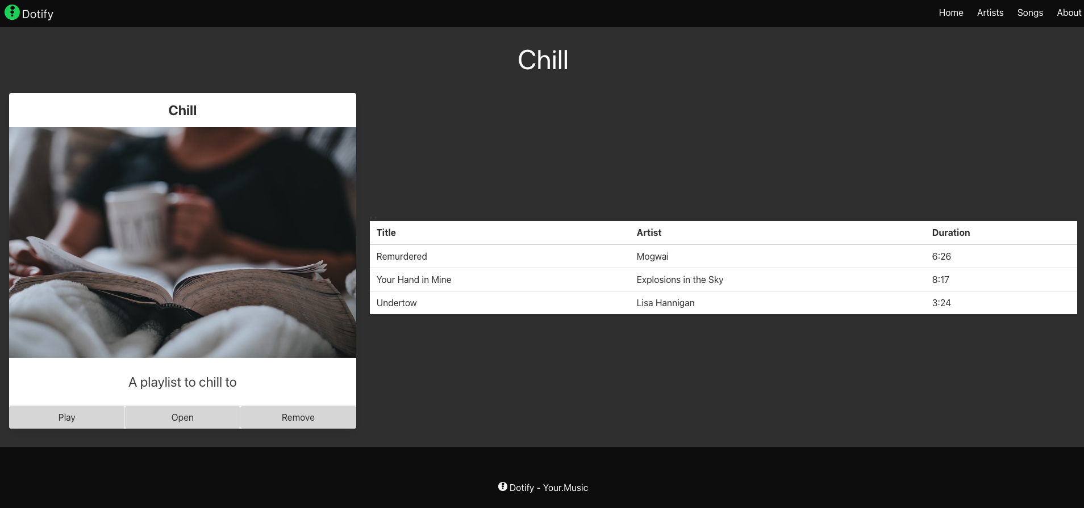

Slide 14
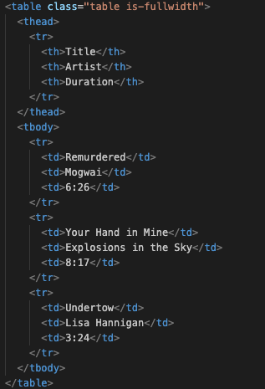
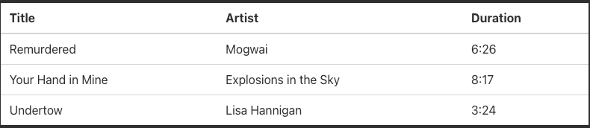
Notice the repetition

Slide 15
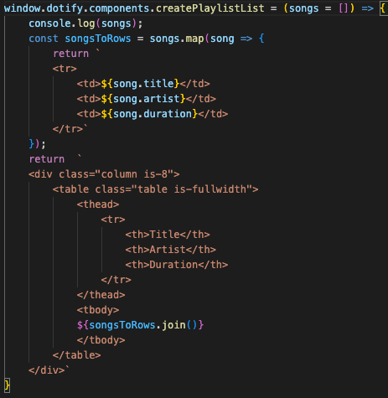
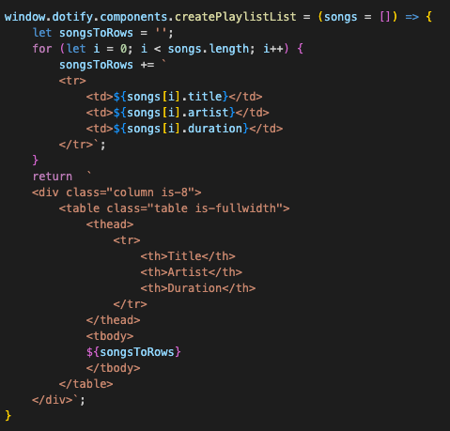
Iterate an array of objects
➔

