Slide 1

Query Parameters
Web Development 1
John Rellis

Slide 2

URL Query Parameters
Include data in your URL
https://example.com/?name=Jonathan%20Smith&age=18
It is made up of multiple key value pairs, key=value
Each pair is separated by &
Value must be encoded

Slide 3
URL encoding for a “space”
parameter
value
parameter
value
https://example.com/?name=Jonathan%20Smith&age=18
query string
Question mark is a separator signifying the start of the query string, It isn’t part of the query string.
“&” separates key and value pairs

Slide 4

URL Encoding
URL encoding is a mechanism used to convert characters that are not allowed or reserved in a URL into a format that can be safely transmitted over the internet.
This ensures that URLs remain valid and can be correctly interpreted by web browsers and servers.
URL encoding works by replacing unsafe characters with a special sequence of characters called percent-encoding or percent-escaping.
In percent-encoding, each unsafe character is replaced with a percent sign (%) followed by two hexadecimal digits that represent the character's ASCII value.
For example:
The space character ( ) is encoded as %20.
The ampersand (&) is encoded as %26.
The question mark (?) is encoded as %3F.

Slide 5

Examples
https://www.example.com/about#team%20info
https://www.example.com/search?q=hello%20world&category=science%26tech
https://www.example.com/products%20and%20services

Slide 6
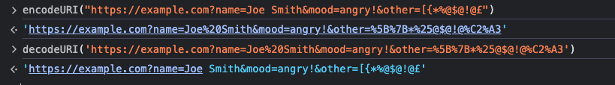
encodeURI and decodeURI
Function available in the global scope of the browser

Slide 7
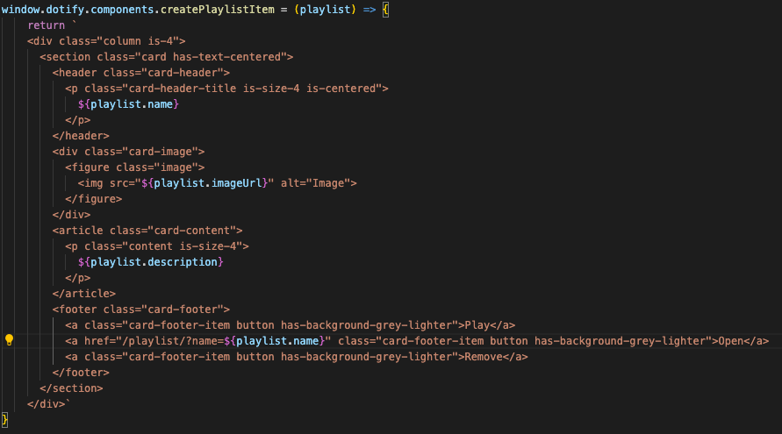
Linking with URL Params
Adding URL params from our data

Slide 8
Reading Query Parameters
http://localhost:8080/playlist/?name=Chill
const urlParams = new URLSearchParams(window.location.search);
const playlistName = urlParams.get('name');
http://localhost:8080/cityFocus/?city=Berlin
const urlParams = new URLSearchParams(window.location.search);
const currentCity = urlParams.get(city');

Slide 9
document.addEventListener('DOMContentLoaded', () => {
const urlParams = new URLSearchParams(window.location.search);
const playlistName = urlParams.get('name');
const playlist = dotify.dataStore.list().find(item => item.name === playlistName);
document.getElementById('page-heading').textContent = playlist.name;
const main = document.querySelector('main');
main.innerHTML = main.innerHTML + dotify.components.createPlaylistItem(playlist);
main.innerHTML = main.innerHTML + dotify.components.createPlaylistList(playlist.songs);
});

