Slide 1

Dates in JavaScript
An Introduction
Web Development 1
John Rellis

Slide 2
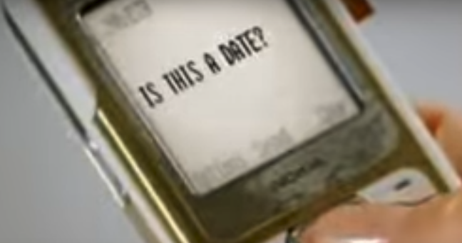
Is this a date?
2022-03-01
1646092800000
2022-03-01T00:00:00+00:00
03-01-2022
Tuesday, March 1, 2022

Slide 3
Is this a date?
Yes, these all represent the same date
2022-03-01
1646092800000
2022-03-01T00:00:00+00:00
03-01-2022
Tuesday, March 1, 2022

Slide 4
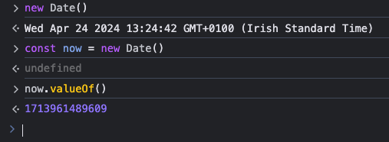
Working with Dates in JavaScript
JavaScript has a built in Date class
It’s awful
……..
……..
Well, not too bad, but we won’t be using it too much

Slide 5
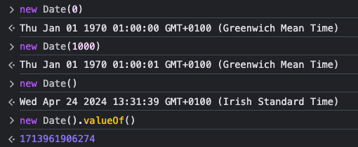
The secret to working with dates
Dates are merely a value in milliseconds since the epoch
Epoch is midnight at the beginning of January 1, 1970, UTC
Essentially, dates are a wrapper on a millisecond value
These can then be formatted to calendar notation with or without timezones
When working with dates as strings, you should always include a timezone
But we are going to skim the surface, since, well, it gets complicated

Slide 6
Date time string format
There are many ways to format a date as a string.
The JavaScript specification only specifies one format to be universally supported: the date time string format, a simplification of the ISO 8601 calendar date extended format.
The format is as follows:
YYYY-MM-DDTHH:mm:ss.sssZ

Slide 7
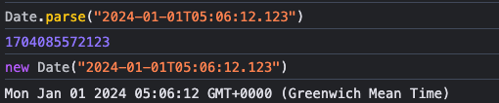
Date time string format
YYYY-MM-DDTHH:mm:ss.sssZ
YYYY is the year, with four digits (0000 to 9999), or as an expanded year of + or - followed by six digits. The sign is required for expanded years. -000000 is explicitly disallowed as a valid year.
MM is the month, with two digits (01 to 12). Defaults to 01.
DD is the day of the month, with two digits (01 to 31). Defaults to 01.
T is a literal character, which indicates the beginning of the time part of the string. The T is required when specifying the time part.
HH is the hour, with two digits (00 to 23). As a special case, 24:00:00 is allowed, and is interpreted as midnight at the beginning of the next day. Defaults to 00.
mm is the minute, with two digits (00 to 59). Defaults to 00.
ss is the second, with two digits (00 to 59). Defaults to 00.
sss is the millisecond, with three digits (000 to 999). Defaults to 000.
Z is the timezone offset, which can either be the literal character Z (indicating UTC), or + or - followed by HH:mm, the offset in hours and minutes from UTC.
https://tc39.es/ecma262/multipage/numbers-and-dates.html#sec-date-time-string-format

Slide 8
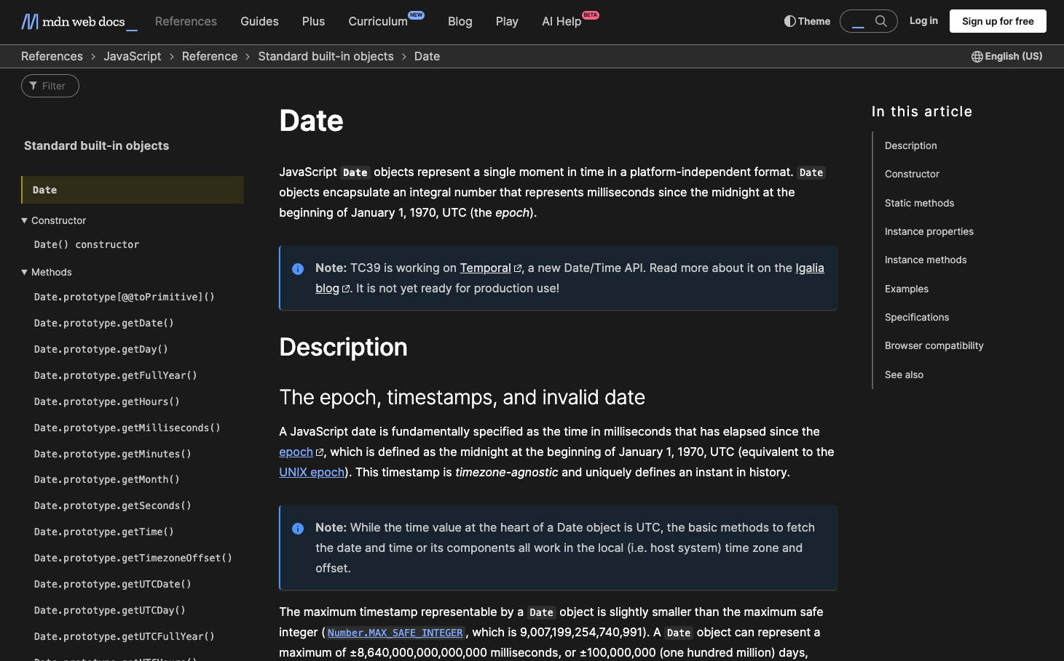
The API
https://developer.mozilla.org/en-US/docs/Web/JavaScript/Reference/Global_Objects/Date

Slide 9
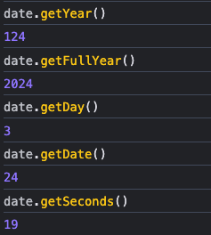
Why don’t you like the JS Date?
Wed Apr 24 2024 13:47:19 GMT+0100 (Irish Standard Time)
What?
And numerous other annoyances
What?

Slide 10
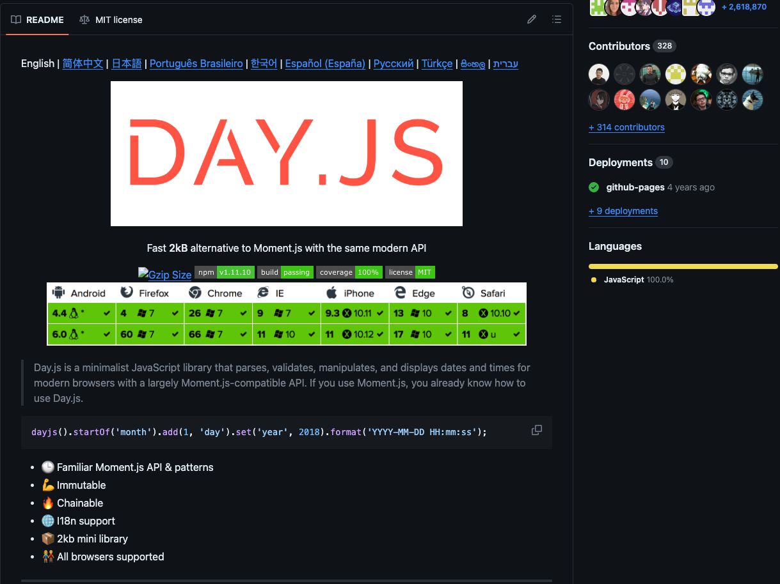
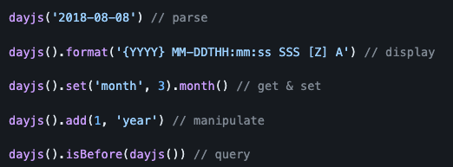
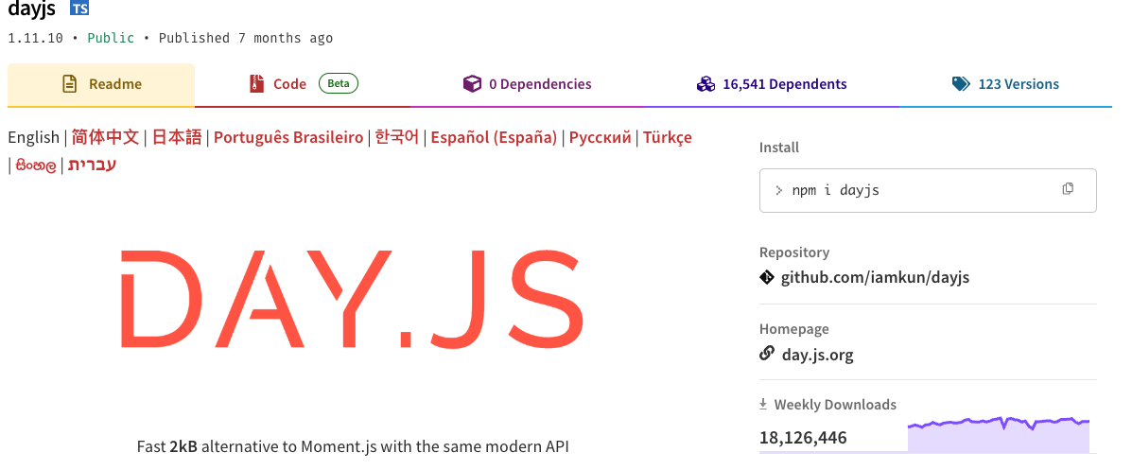
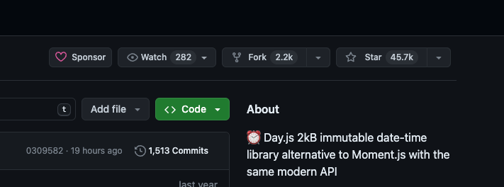
So…….?

Slide 11
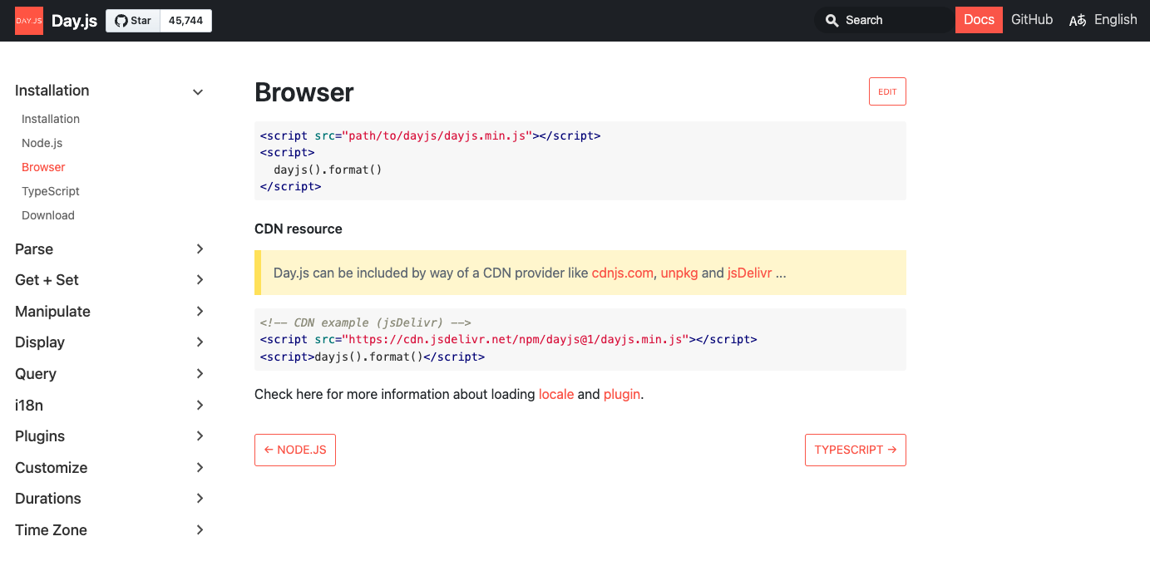
https://day.js.org/docs/en/installation/installation

Slide 12
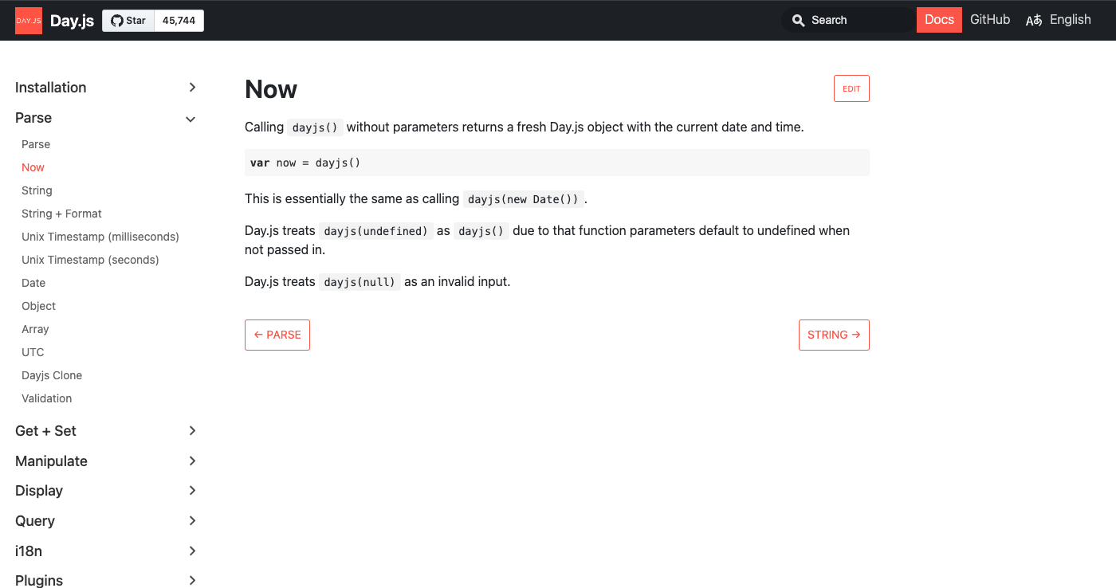

Slide 13
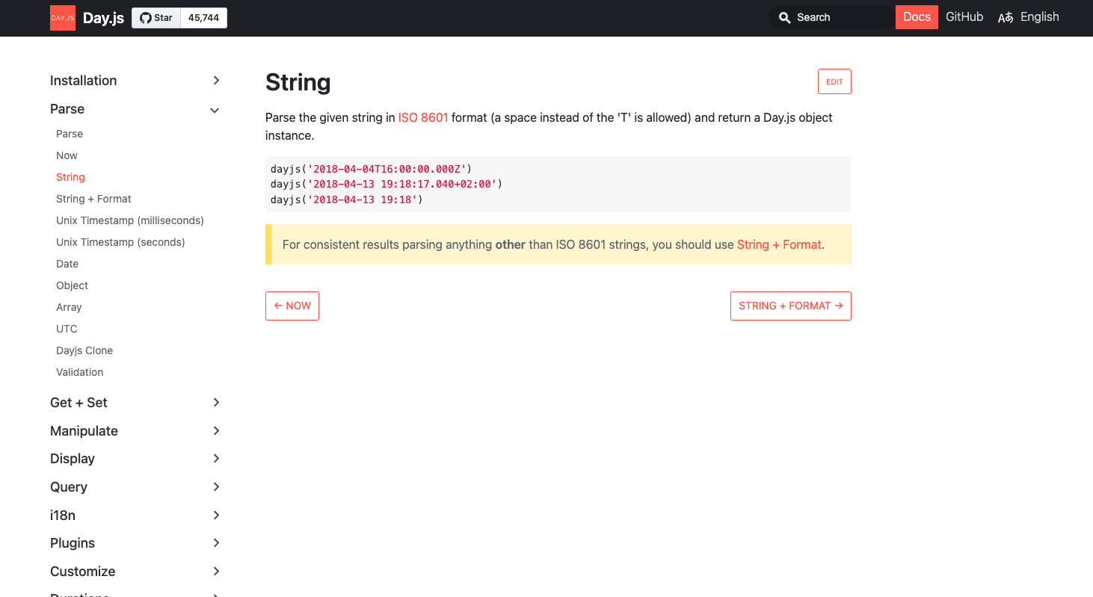

Slide 14
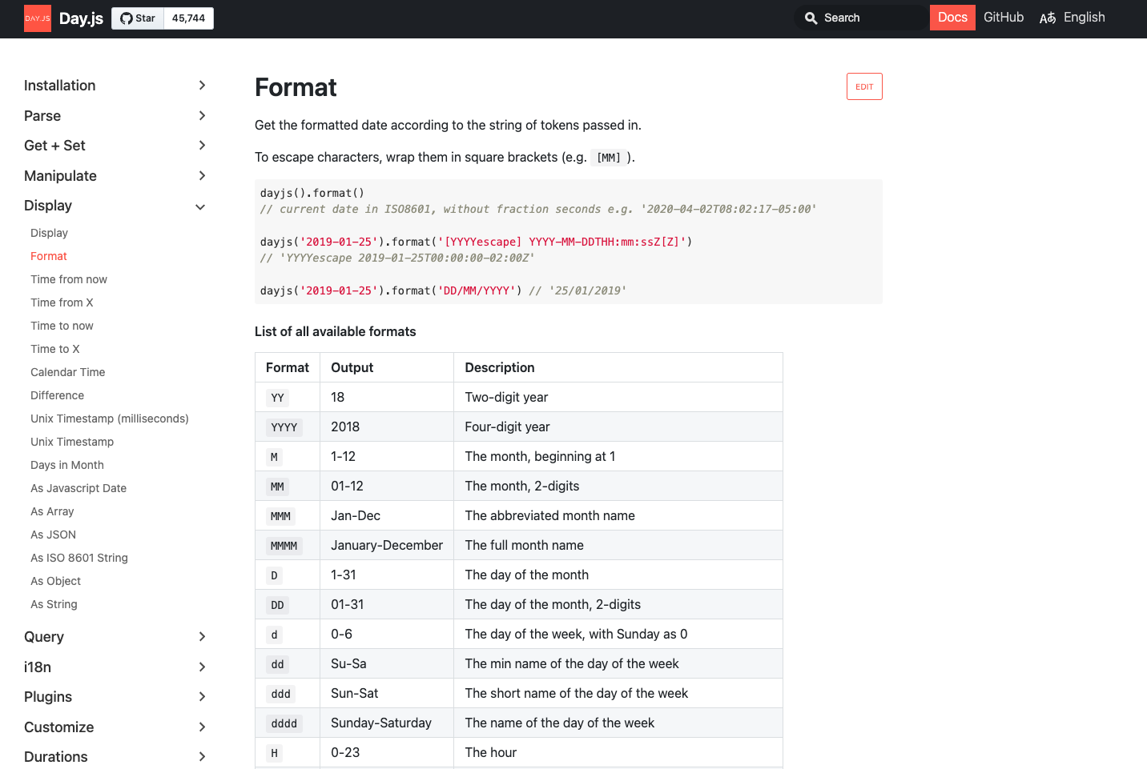

Slide 15
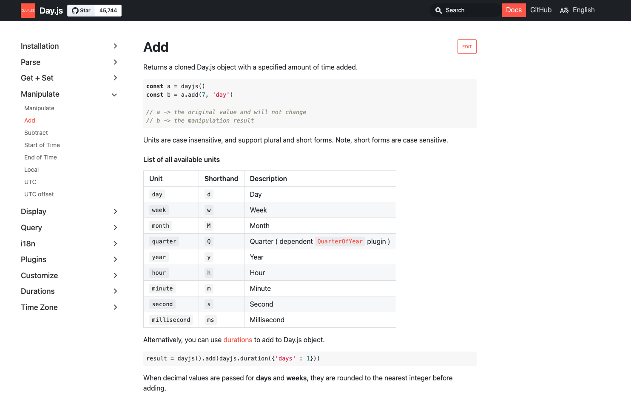

Slide 16
const now = dayjs(); // create a new date object that represents this time
const currentHour = now.hour(); // 0 - 23 as a number
console.log(currentHour) // 14 as a number
console.log(now.format("HH")) // 14 string - https://day.js.org/docs/en/display/format
console.log(now.format("hh")) // 02 as a string - 12 hour format
console.log(now.format("dddd")); // Wednesday
console.log(now.format("ddd")); // Wed
console.log( now.add(1, 'day').format("dddd")); // Thursday - getting tomorrow
console.log(now.add(2, 'day').format("dddd")); // Friday - getting day after tomorrow
console.log(now.second()) // https://day.js.org/docs/en/get-set/second
console.log(now.hour()) // https://day.js.org/docs/en/get-set/hour

Slide 17
