Slide 1
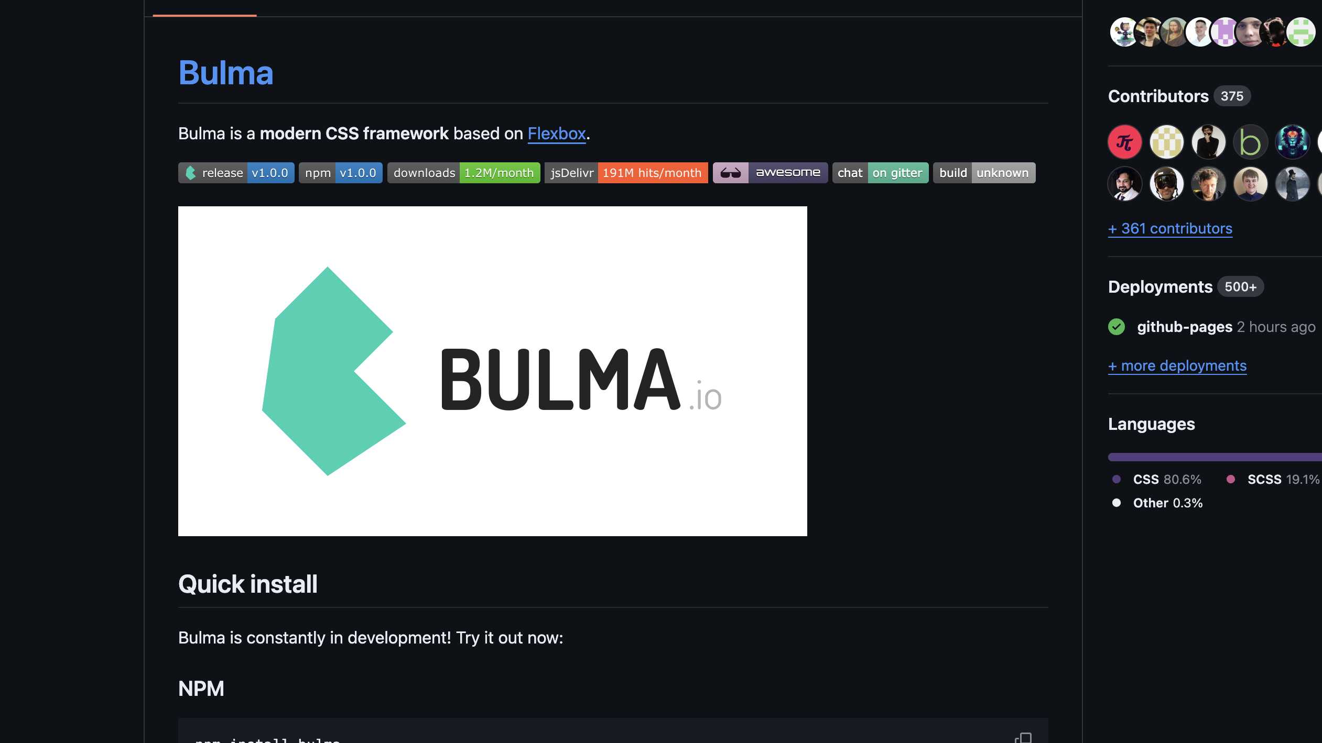
README
Web Development 1
John Rellis

Slide 2
What is a README?
A README is a file often included in software projects or code repositories.
Its purpose is to provide essential information about the project, such as how to install and use the software, any dependencies required, contribution guidelines, licensing information, and often some background about the project and its developers.
It's typically written in plain text or Markdown format and serves as a starting point for anyone who wants to understand or contribute to the project.

Slide 3
What makes a good README?
A good README should provide clear and concise information to users and potential contributors about the project. Here are some key elements that contribute to a good README:
Project Description: Clearly explain what the project does and its purpose. This gives readers an immediate understanding of what problem the project aims to solve.
Installation Instructions: Provide step-by-step instructions on how to install and set up the project, including any dependencies or prerequisites needed.
Usage: Explain how to use the project, including examples if applicable. This section should guide users on how to interact with the software or library effectively.
Configuration: If the project requires configuration settings or options, document them here. This helps users customize the project to their specific needs.
Examples: Include example code or use cases to demonstrate how the project can be used in real-world scenarios. This can help users understand the project's capabilities better.
Documentation: Provide links or references to more detailed documentation if available. This could include API references, user guides, or tutorials.
Contributing Guidelines: If you welcome contributions from others, outline how they can contribute to the project. This may include guidelines for reporting issues, submitting feature requests, or making code contributions.
License: Clearly state the project's license to inform users of their rights and restrictions regarding the use and distribution of the project. We won’t worry too much about this
Contact Information: Provide contact information for the project maintainer or team in case users have questions or need support.
Acknowledgements: Optionally, you can acknowledge contributors, libraries, or other projects that have been helpful in the development of your project.

Slide 4
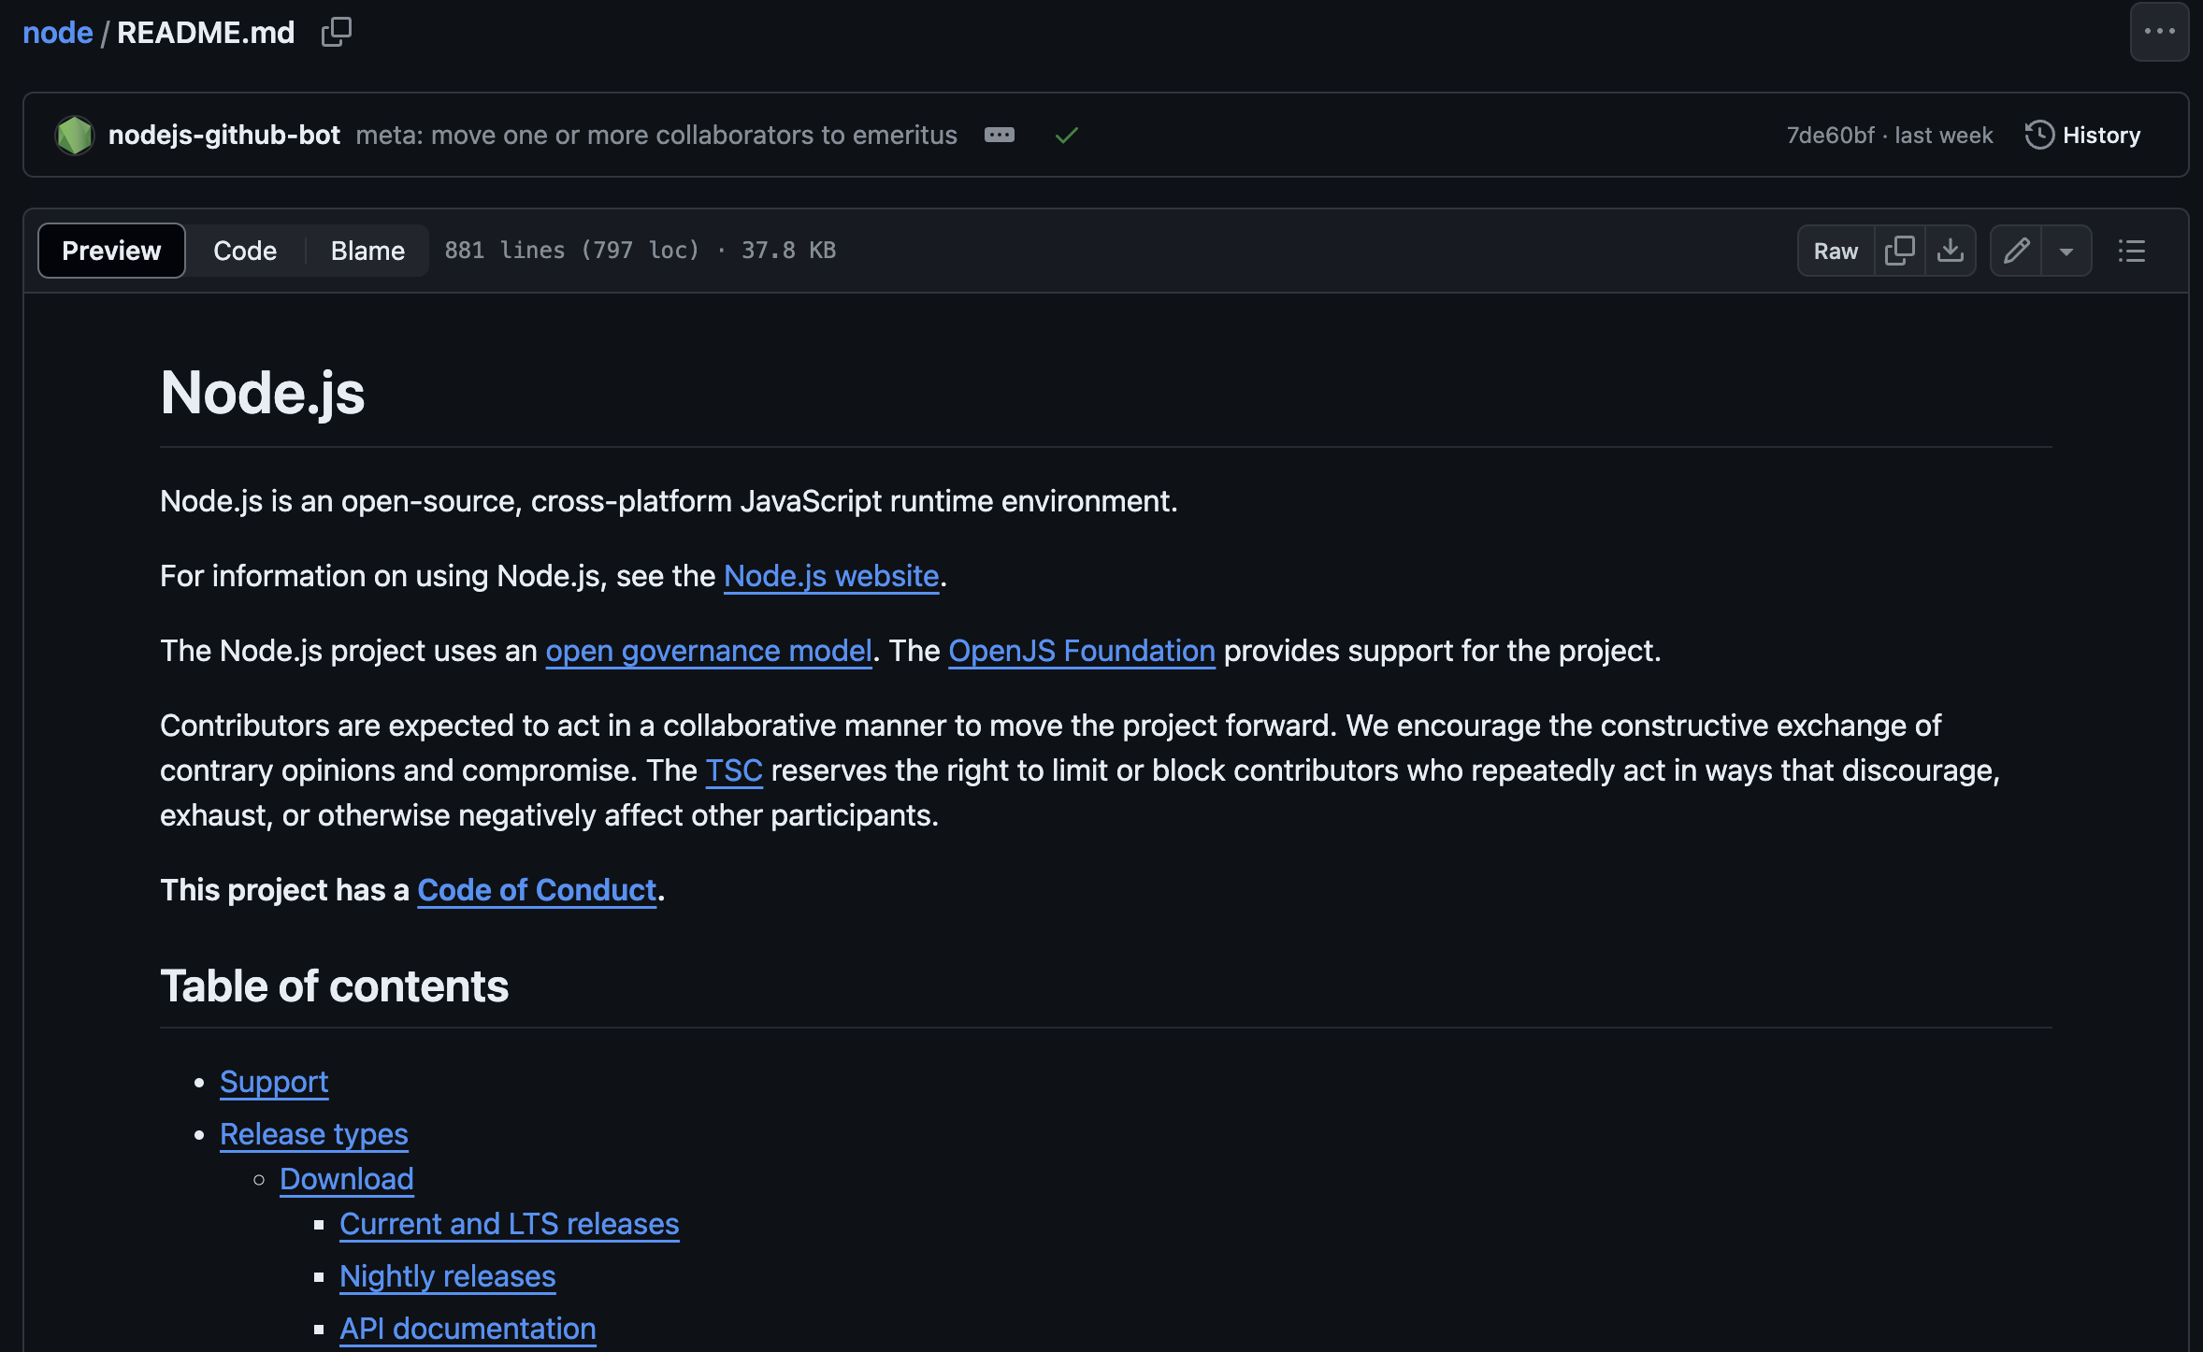
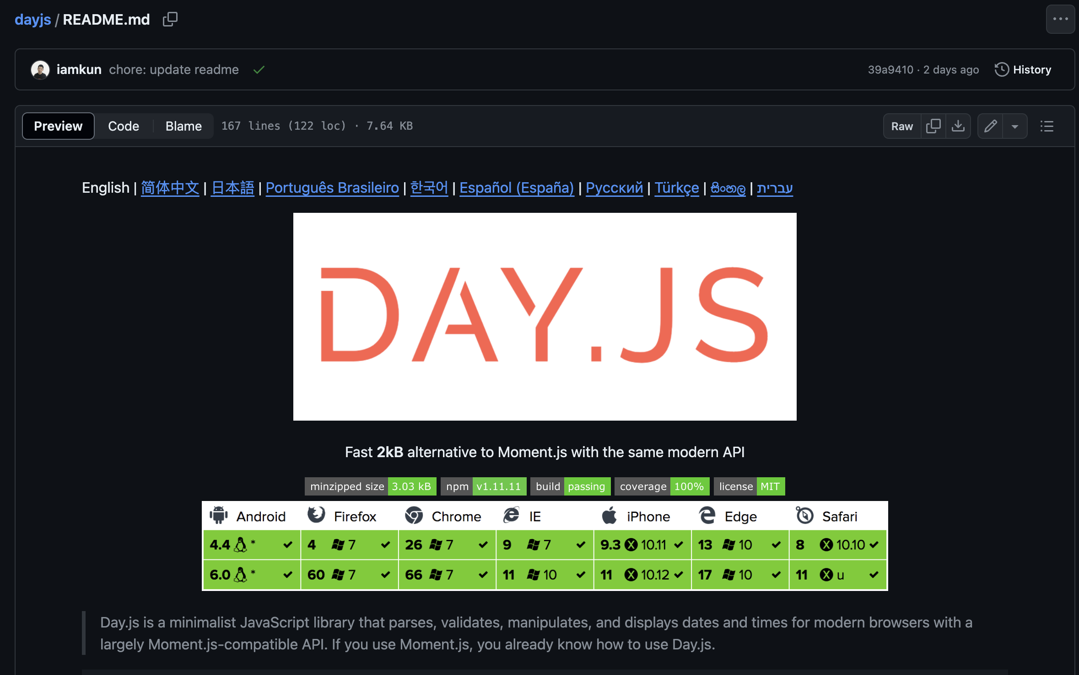
Examples
https://github.com/jgthms/bulma/blob/main/README.md
https://github.com/iamkun/dayjs/blob/dev/README.md
https://github.com/nodejs/node/blob/main/README.md

Slide 5
Wait….
Are READMEs related to git or github?
Not necessarily, however, github took the step of prominently rendering READMEs on the repository homepage
This really led to a massive increase in importance of the README

Slide 6
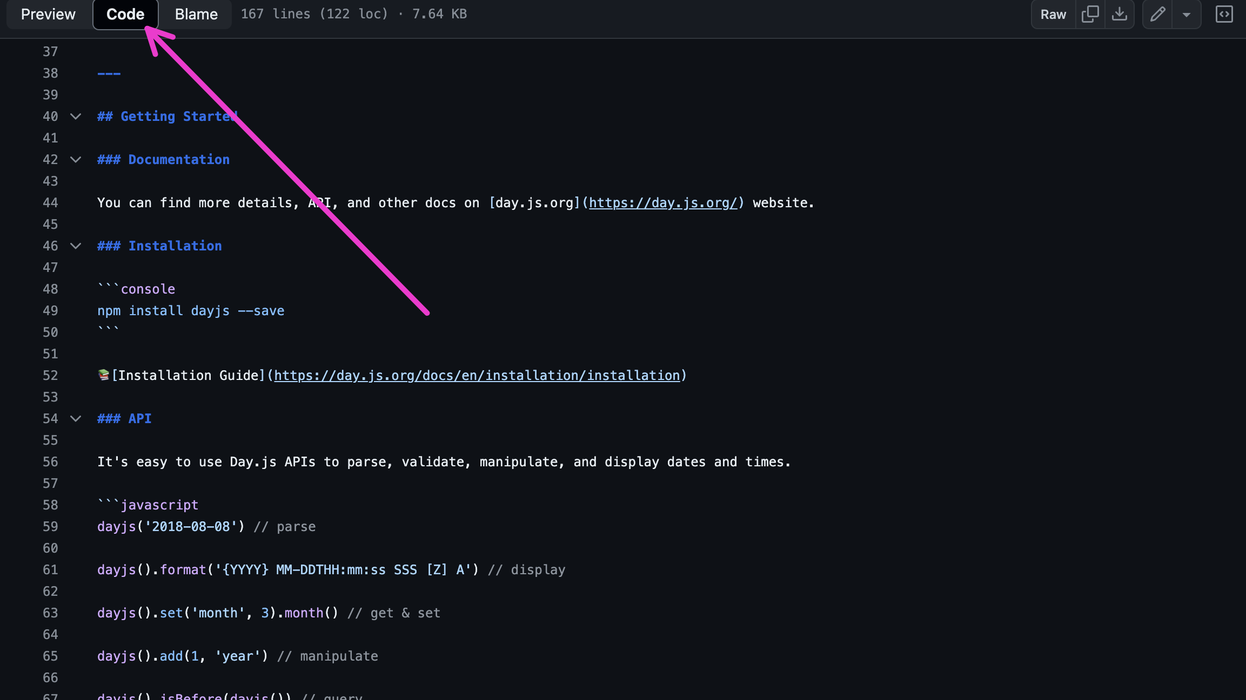
Check the source…

Slide 7

What syntax is this?
Markdown is a lightweight markup language with plain-text formatting syntax.
It's often used to format documentation, README files, forum posts, and other types of text-based content.
Markdown allows you to add formatting elements like headers, lists, emphasis (such as bold or italic text), links, images, and code blocks using simple and intuitive syntax.
A lot of markdown processors support raw HTML too and allow a mashup of markdown and HTML
Check out: https://markdownlivepreview.com/

Slide 8
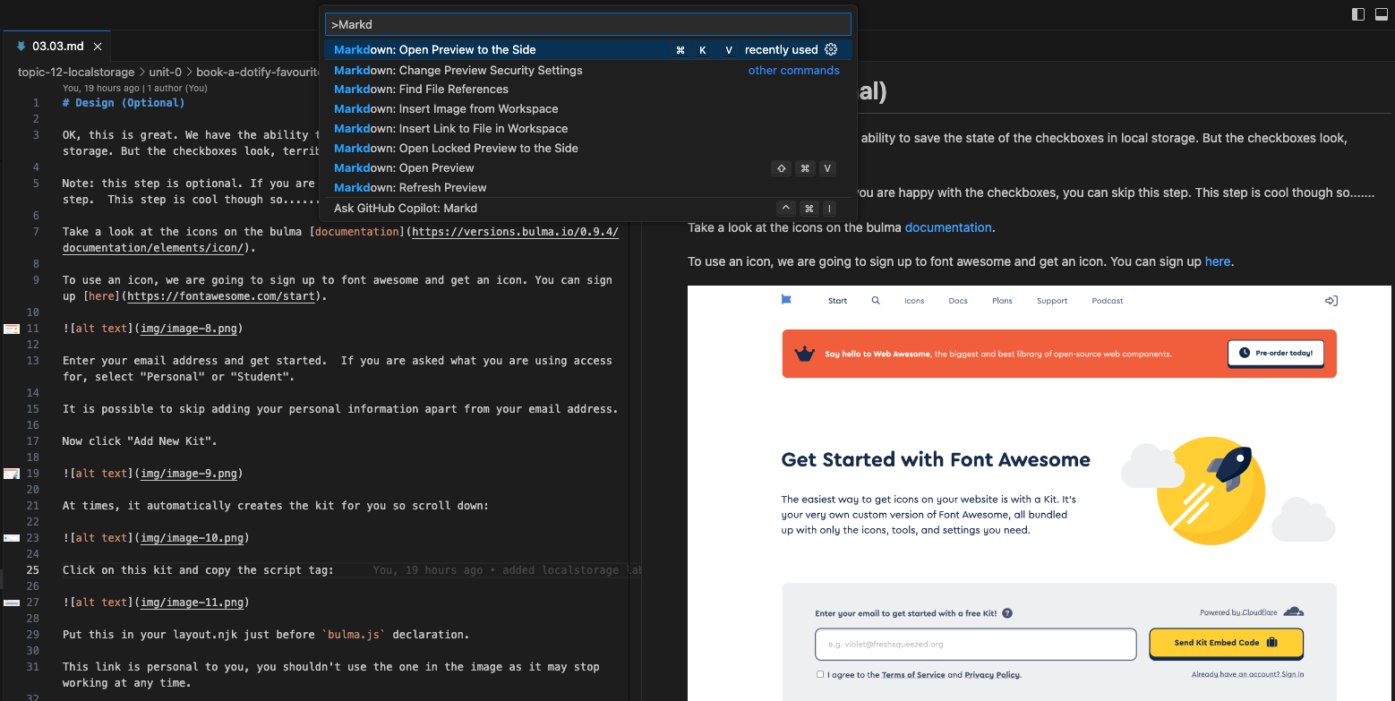
Or preview in VS Code

Slide 9
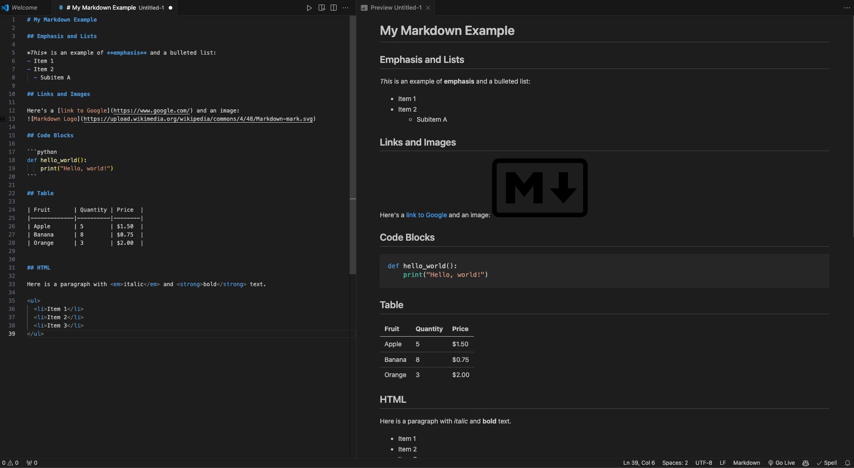

Slide 10
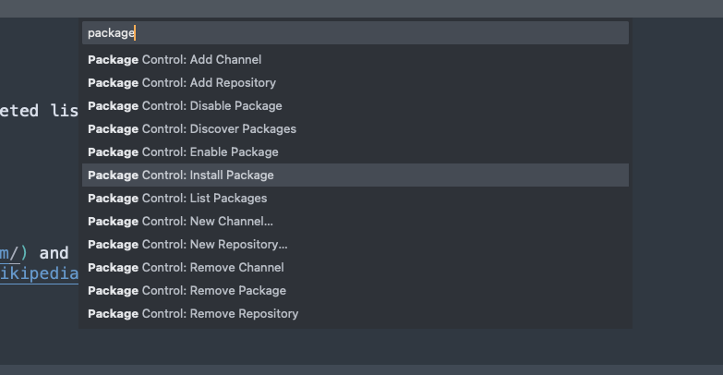
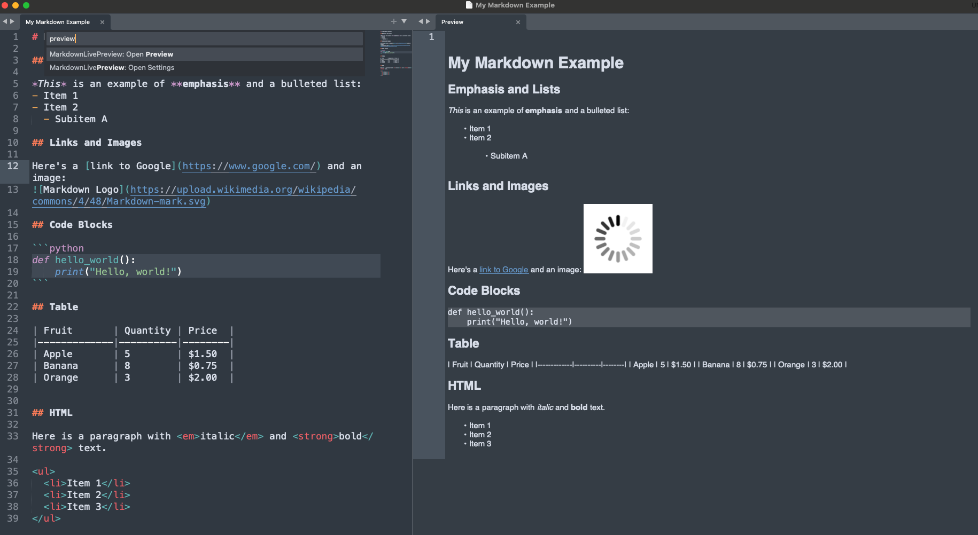
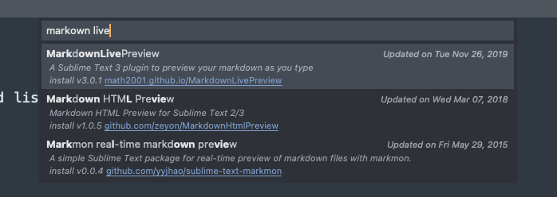
Also install the Monokai-Extended package and restart sublime. Not as easy as vscode.

Slide 11
More
https://github.com/adam-p/markdown-here/wiki/Markdown-Cheatsheet
https://www.markdownguide.org/cheat-sheet/

Slide 12

For your assignment
Create a markdown file called README.md in the root directory
1
Add as many of the recommended fields as possible
2
Use some imagery to sell your site
3
Be sure to preview it in vscode or sublime
4

