Slide 1

Kent Chadwick | kent.chadwick@waltoninstitute.ie | HDIP 2019-21

Slide 2
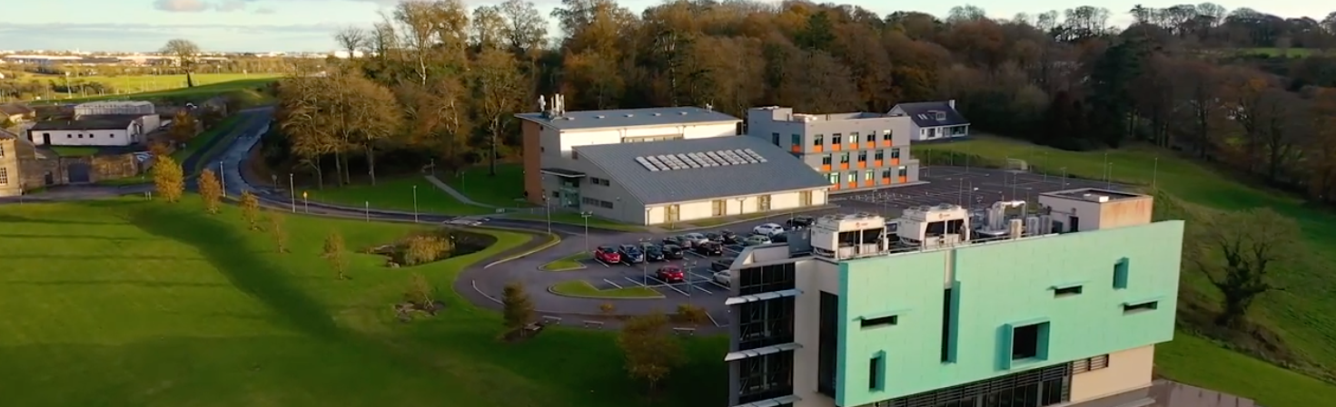
Walton Institute is a cornerstone of ICT research and development activity in Ireland since 1996, undertaking cutting edge research blending fundamental science with real world commercial applications.
Formerly known as the Telecommunications Software & Systems Group (TSSG), the aim of the Institute is to investigate futuristic next-generation technologies, to verify their capabilities and applicability for today’s society, and to work in collaboration with industry to ensure their commercialisation.

Slide 3
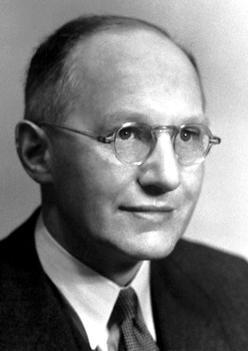
Ernest Walton
Walton Institute is named after the renowned physicist and Nobel laureate, Dr. Ernest Walton. Born in Co. Waterford, Dr. Ernest Walton dedicated his life to academia receiving numerous prizes for excellence in physics and mathematics and, most notably, the Nobel Prize in physics in 1951 for being the first to split the atom.

Slide 4

Infrastructure & Testbeds
Satellite Communications
Quantum Computing
Quantum Communications
Artificial Intelligence & Machine Learning
Adaptive and Autonomous Algorithms
Internet of Everything
Knowledge Defined Networking
Security and Reliability
Fog Data Analytics
Beyond 5G Wireless Communications
Pervasive Sensing & Embedded Systems
eTextiles and Smart Materials
Extended Reality

Slide 5



Slide 6

Getting Through the HDIP

Slide 7


