Slide 1
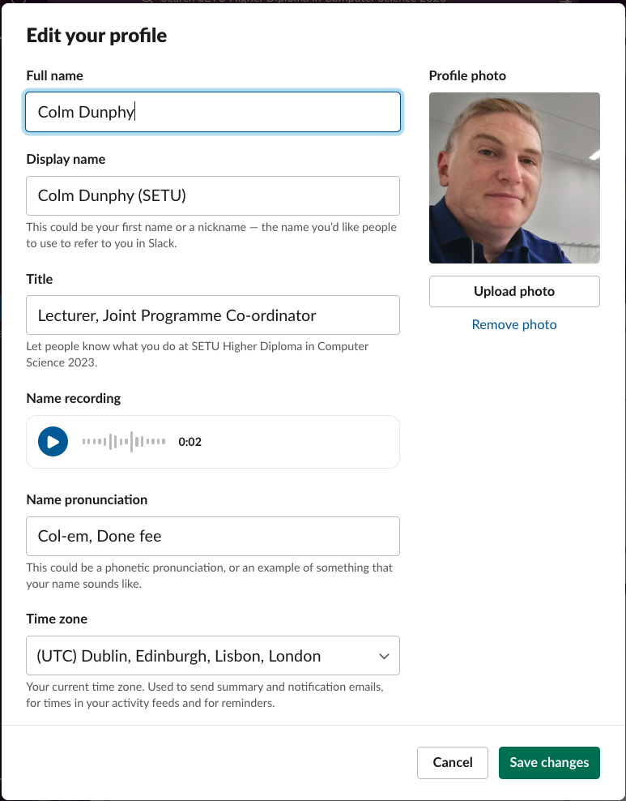
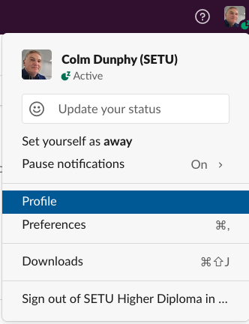
Profile
Update your profile (click the photo/image top right)
Photo
Display Name
Title
Name Recording ***
Name Pronunciation

Slide 2
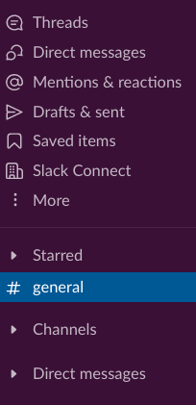
SideBar
Channels + Browse Channels
- #general
- #watercooler
- #connections
- #induction-workshop
Public / private
EXERCISE: If you haven’t done so already, browse for the #connections channel, read at least one introduction, then Write your own introduction.

Slide 3
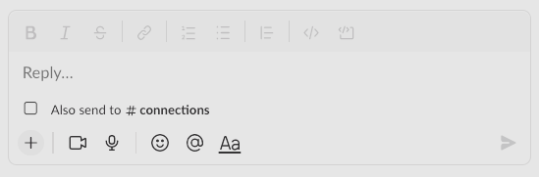
Direct Messages (DMs) +
type their name
EXERCISE: Find out the person’s name next to you, and send them a DM of “Hi”
EXERCISE: Reply to the DM you receive
EXERCISE: Exchange a photo each
EXERCISE: Take a Screenshot and upload it/post it. (Not sure how? Ask by typing on the #induction-workshop) If you know how please reply.
(TIP: Screenshotting:
PrintScrn
Windows Sniping Tool
Windows key + shift + s)
Mac - Shift + Cmd + 3 (or 4 or 5).

Slide 4
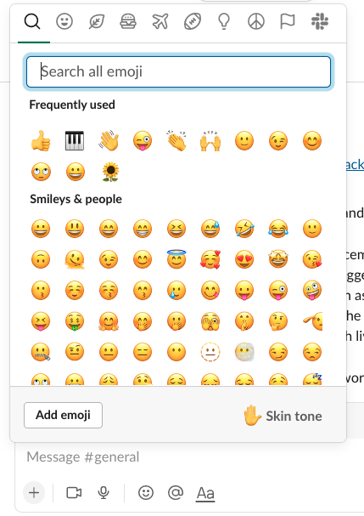
Reactions
EXERCISE: Respond with a suitable reaction to a DM you have received
Give me thumbs up if you are still here!
Give me smiley face if you are happy!
What country were you born in? (use an emoji reaction)
What is your background? (use an emoji reaction)

Slide 5

PRACTICAL EXERCISE:
Colm – Post Question on the #induction-workshop (e.g. Favourite Band?)
Everyone is to respond
Now get them to reply to delete their answers, select the question and reply to the thread instead using the floating toolbar (wait for everyone)
Review the answers in the thread and add a love emoji/reaction to the best answer you see (besides your own). Save 3 other replies that you like (add to save items from the floating toolbar)

Slide 6
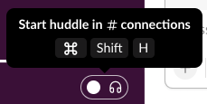
What county are you residing in now?
Use this information to create a GROUP DM – 4 people…
Select Direct Messages and type @the-persons-name @next-persons-name, etc
DEMO:
One group only, convert to a group call / huddle

Slide 7
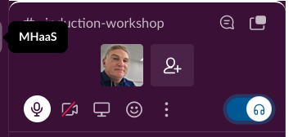
CALLS / Zoom / Huddles
DEMO:
Call
with audio
with video
Huddle
with audio
with video
share screen
closed captions
Zoom Call – (BETTER QUALITY)
with audio
with video
share screen
closed captions
So now you know how to create remote study groups

Slide 8
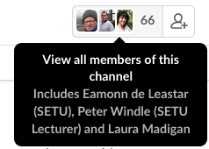

MISCELLANEOUS
BACK / FORWARD / HISTORY
Clicking this gives you a list of everyone on the course (that has joined Slack)

Slide 9
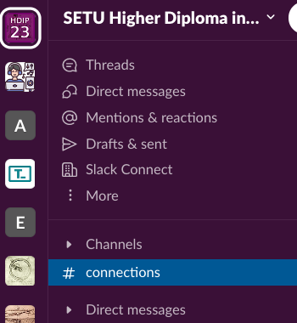
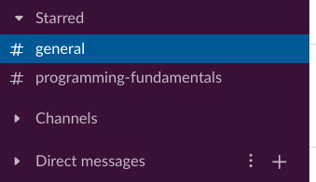
Expand Channels. right click on your favourite channels (#general, #programming-fundamentals, #web-development) and select STAR channel

Slide 10
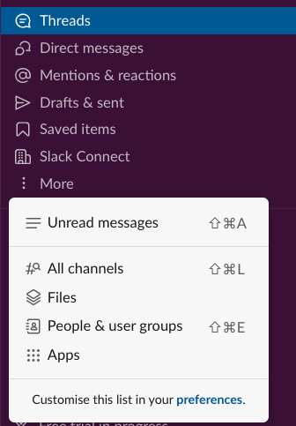
The options below allow you filter your feed to show different things…

Slide 11
Finally a Socrative Quiz
https://api.socrative.com/rc/RhLWnD

