Slide 1

H. Dip. In Computer Science (Online) ICT Skills II Overview
Diarmuid O’ Connor (doconnor@wit.ie)

Slide 2
Agenda.
Context
This module’s focus

Slide 3
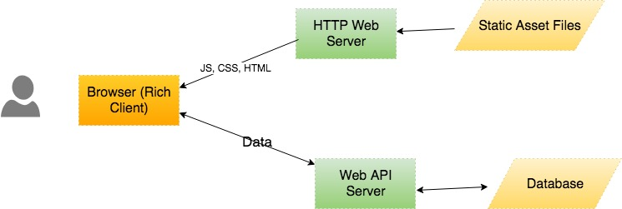
Modern Web Apps - Architecture

Slide 4
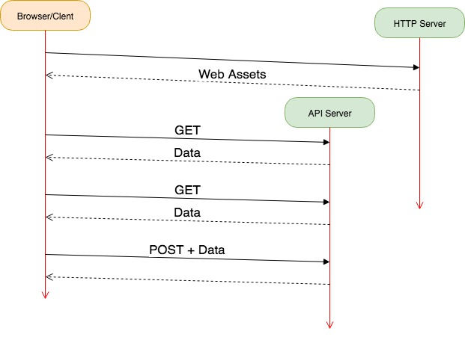
Modern Web Apps – HTTP Communications flow

Slide 5
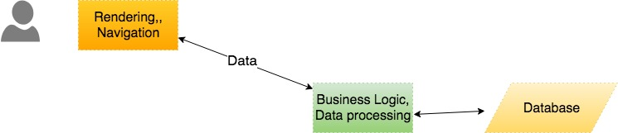
Modern Web Apps – Sub-system roles

Slide 6
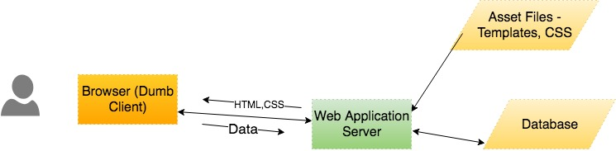
Traditional Web Apps – Architecture

Slide 7
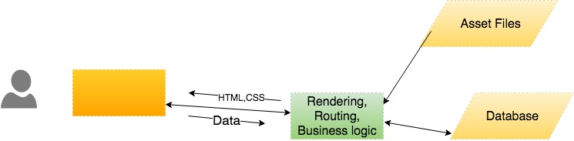
Traditional Web Apps – Sub-system roles.

Slide 8
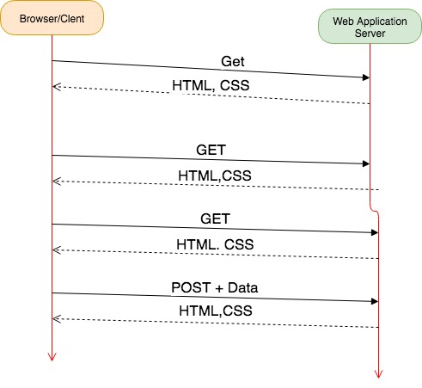
Traditional Web Apps – HTTP Communication flow.

Slide 9
Agenda
Context. ☑
This module’s focus

Slide 10
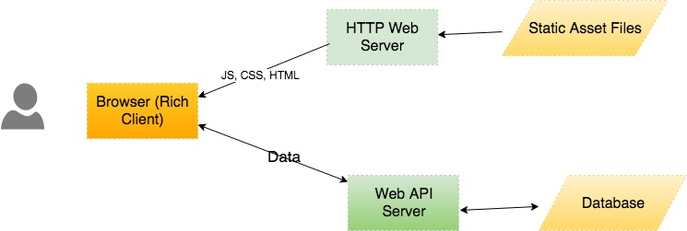

Modern Web Apps
A JavaScript library for building user interfaces

Slide 11
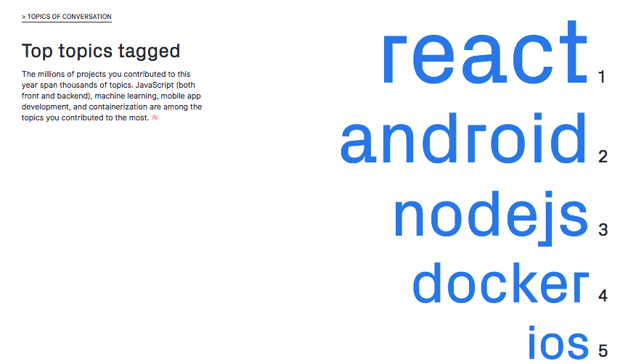
Ref : https://octoverse.github.com/projects

Slide 12
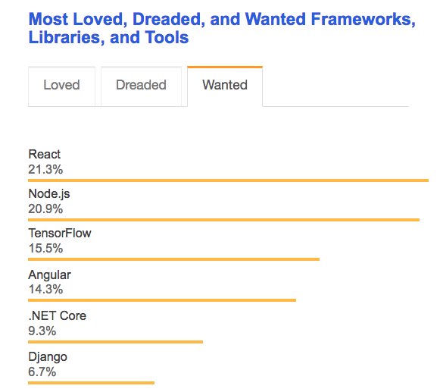
Ref : https://insights.stackoverflow.com/survey/2018

Slide 13
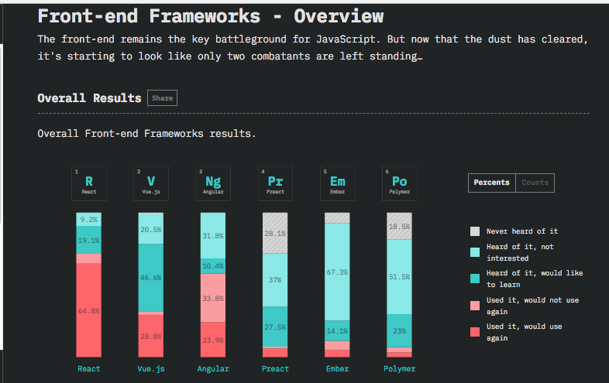
Ref : https://2018.stateofjs.com/front-end-frameworks/overview/

Slide 14
Agenda
Context.
This module’s focus:
Single Page App development, using React ☑

Slide 15
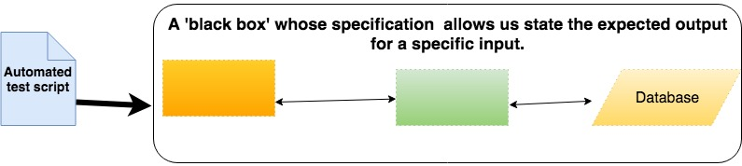

End-to-End Testing

Slide 16
Agenda
Context.
This module’s focus:
SPA development, using React ☑
End-to-End testing ☑

Slide 17
Questions?

