Slide 1
Summer School Project
Enhancing Gym App Functionality
Produced
by:
Eamonn de Leastar
Dr. Siobhán Drohan

Slide 2
Expectations
Evolve the Gym application to realise additional features.
Application must be a Web Application
Can be implemented in:
Play (Java & Play Framework 1.x)
OR
Glitch (Javascript, Node & Express)
Submitted as a github repo on September 3

Slide 3
Rubric | Axes of Change
Baseline | Scheduled Classes
Good | Assessment Booking
Excellent | Goals
Outstanding | Fitness Programmes

Slide 4
Rubric | Axes of Change
Baseline | Scheduled Classes
Good | Assessment Booking
Excellent | Goals
Outstanding | Fitness Programmes

Slide 5

Scheduled Classes - Trainers
Enable trainers to perform CRUD on scheduled classes (e.g. Boxercise, Pilates, HIIT, etc.).
Typical data stored for scheduled classes would be:
class name
duration of the class
capacity of the class
difficulty level
time, date, etc.
For each scheduled class, there should be a defined number of classes in the suite e.g. HIIT will run for 7 weeks.

Slide 6
Scheduled Classes - Members
Enable members to view and search the scheduled classes.
Members should be able to enrol in the scheduled classes. Allow the member to enrol in two ways:
Enrol in one specific class on a specific date.
Enrol in all classes in the suite.
Enrolment in classes is subject to available space.
Members should be able to un-enrol from classes too.

Slide 7
Rubric | Axes of Change
Baseline | Scheduled Classes
Good | Assessment Booking
Excellent | Goals
Outstanding | Fitness Programmes

Slide 8

Assessment Booking - Members
Enable members to book an assessment with a Trainer of their choice on any date in the future they choose (assuming the Trainer is free at that time).
CRUD should be implemented on Assessment Bookings for members.

Slide 9
Assessment Booking - Trainers
Trainers can perform CRUD on assessment bookings such as:
view them,
cancel them,
update the assessment details associated with these bookings.
schedule a future assessment with a member.

Slide 10
Rubric | Axes of Change
Baseline | Scheduled Classes
Good | Assessment Booking
Excellent | Goals
Outstanding | Fitness Programmes

Slide 11

Goals/Targets
Trainers can set goals for members.
Members can set goals for themselves.
A goal has a:
future date
description
future assessment measurement goals
a status indicating if the goal is:
open (i.e. > three days in the future),
achieved,
missed,
awaiting processing (i.e. a current assessment needs to be done to process it).

Slide 12
Goals/Targets - Member
Each time a member logs in, check whether they have any open goals or goals awaiting processing:
If they have no goals of this status, prompt them to set a goal (they don’t have to do it).
If they have an goals of this status and the date is today or in the past, check if an assessment was done in the past three days:
If one was done, compare the assessment stats and determine (you decide here) whether the member’s goal should be set to achieved or missed their goal.
If one wasn’t done, ensure the status of the goal is set to awaiting processing and prompt the member to book an assessment with a trainer of their choice.

Slide 13
Rubric | Axes of Change
Baseline | Scheduled Classes
Good | Assessment Booking
Excellent | Goals
Outstanding | Fitness Programmes

Slide 14

Fitness Programmes
A Fitness Programme comprises 5 exercises sessions.
A Trainer can perform CRUD on Fitness Programmes.
Members can view their Fitness Programme and individual sessions.

Slide 15
Fitness Programmes - Trainers
Trainers can set up a Fitness Programme for a Member.
A Trainer builds a Fitness Programme by choosing from the following session types:
a list of standard, predefined session programmes.
a bespoke session programmes developed by the trainer (i.e. comprising a mix of Resistance Weights and/or Cardiovascular Exercise Equipment such as Treadmill, Rower, Bike, etc.
a scheduled class.

Slide 16
But what if I want to develop my own app?

Slide 17
No problem!
Just develop your idea, from scratch up to and including the complexity of Assessment Booking (i.e. the Good band).
Rubric | Axes of Change
Baseline | Scheduled Classes
Good | Assessment Booking
Excellent | Goals
Outstanding | Fitness Programmes

Slide 18
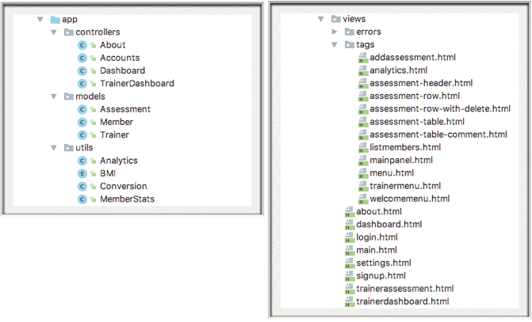
How to Measure the Complexity of your app?
PlayGym Metrics:
3 Models
4 Controllers
12 Partials
8 Views

Slide 19
Approximate Target
Rubric | Axes of Change
Baseline/Good | Scheduled Classes
Excellent/Outstanding | Assessment Booking
6 Models
7 Controllers
16 Partials
10 Views
Very Approximate !

