Slide 1
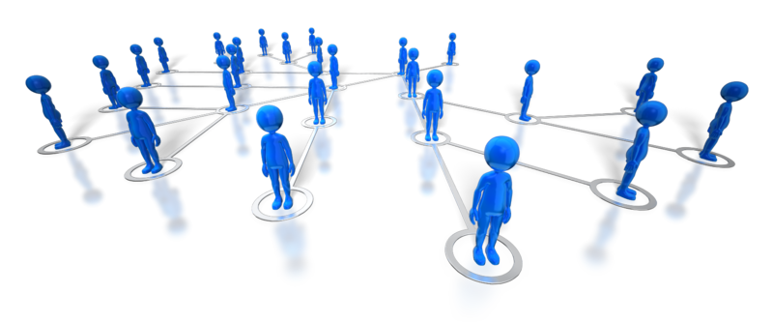
Managing Multi-Site Development Teams
Shane McCormack
Director Development CTS Sunlife

Slide 2
About me
TSSG 2001-2003 MSc
Research Assistant
Eontec/Siebel/Oracle 2003-2004
Graduate SW Engineer
Sunlife Financial 2004-Present
SW Engineer
Senior SW Engineer
Associate Director IT
Director IT

Slide 3









About Sun Life Financial
International provider of financial products and services. CAN$891 Billion assets under management.
151 years in business.
#1 provider in Canada; #6 in US; rapid growth in Asia.
30,000 employees across 17 countries.
380 in Waterford supporting the US and Canadian businesses.

Slide 4
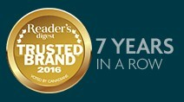


Sun Life Products & Services
Financial Planning & Advice
Life Insurance
Health, Dental, Accident and Disability Insurance
Investment and Retirement Savings
International Life Insurance & Investments for High Net Worth Individuals

Slide 5
Sun Life Financial in Ireland
Established 1998
Addition of Canadian helpdesk in 2000
Helpdesk doubled again in 2003 with acquisition of Clarica
IT organisation began growing in 2004
Reductions due to changes in US business model in 2008/2009/2010
Annuities business sold in 2013. 88 Waterford employees moved to ‘Delaware Life’ (now se2).

Slide 6
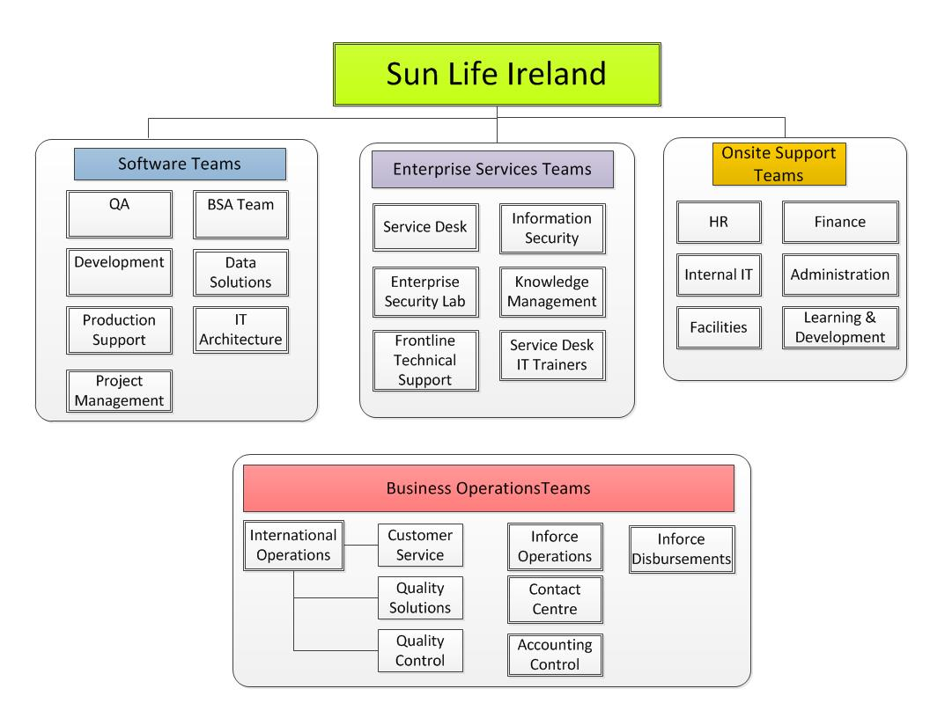
Our Waterford Teams

Slide 7
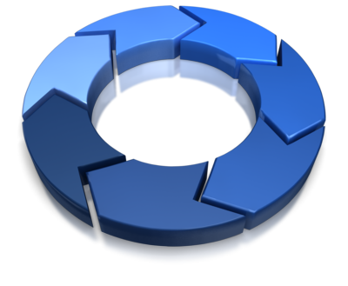
Factors
Culture
Type of work
Scope of work
Work experience
Communication
How you/they work
Notes:
In a high power distance cultures the following may be observed:
. Those in authority openly demonstrate their rank. . Subordinates are not given important work and expect clear guidance from above. . Subordinates are expected to take the blame for things going wrong. . The relationship between boss and subordinate is rarely close/personal. . Politics is prone to totalitarianism. . Class divisions within society are accepted.
In a low power distance culture:
. Superiors treat subordinates with respect and do not pull rank. . Subordinates are entrusted with important assignments. . Blame is either shared or very often accepted by the superior due to it being their responsibility to manage. . Managers may often socialise with subordinates. . Liberal democracies are the norm. . Societies lean more towards egalitarianism.
Intercultural Business Communication Tips
If you are working with or going to a country with a higher PDI than yours then:
- give clear and explicit directions to those working with you. Deadlines should be highlighted and stressed. - do not expect subordinates to take initiative. - be more authoritarian in your management style. Relationships with staff may be more distant than you are used to. - show respect and deference to those higher up the ladder. This is usually reflected through language, behaviour and protocol. - expect to encounter more bureaucracy in organizations and government agencies.
If you are working with or going to a country with a lower PDI than yours then:
- don't expect to be treated with the usual respect or deference you may be used to. - people will want to get to know you in an informal manner with little protocol or etiquette. - be more inclusive in your management or leadership style as being directive will be poorly interpreted. - involve others in decision making. - do not base judgements of people on appearance, demeanor, privileges or status symbols.

Slide 8
Sunlife Distributed Teams Matrix
-8 -5 GMT +5.30 +9.30
Ireland
(KEY)
Boston
Windsor
India
Kansas
City
Australia

Slide 9

Intercultural Differences
Intercultural Study (Cultural Differences in Business Communication; John N. Hooker)
Cultural differences
Relationship-based and Rule-based Cultures
Power Distance
This dimension relates to the degree of equality/inequality between people in a particular society.
Negotiation and Decision Making
Intercultural Business Communication - NB
The key to cross-cultural business is understanding one’s business partners well enough to make cultural adjustments.
E.G: Kansas City vs Boston vs Waterford vs Hyderbaad

Slide 10
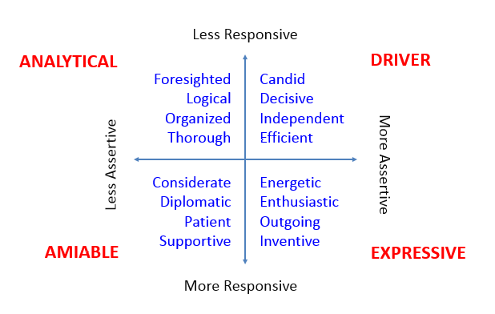
Intercultural Differences – Social Styles
Try to understand each others styles
Development teams typically have a lot of people in the Analytical quadrant
PMs tend to be Drivers
People who like doing presentations/singing, etc. are Expressives
Amiables are the personable people in the team who help to keep people connected.

Slide 11
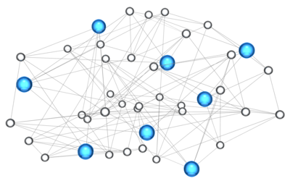
Distributed Development Vs. Outsourcing
Distributed Development
Extension of the team
Working directly/continuously with the main team
Outsourcing
Fully implemented work
Specific Skillsets or
Generally lower cost center
Notes:
Who is building what?
How should you break up the work
Fully designed/documented features
Remote team member

Slide 12
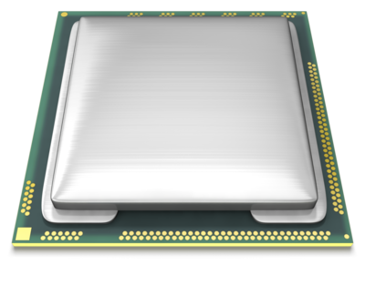
Keep in House
Architecture/Design
Tech Leads
Core Systems
Engine Technology
Hardware
DBs

Slide 13

Out of House
2nd - 3rd tier technology
User Interface
Billing
M & E
Bug Fixing/Scripting
Identify strong Tech Leads in a remote team
Good English
Strong technical abilities
Leadership qualities

Slide 14

Work History
What typical products have they developed
Small/large scale
Complexity
References
Ability to travel
** Try before you buy…

Slide 15
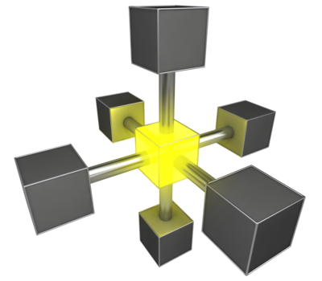
It is all about Communication…..
What is the communication plan
Who owns the overall vision
Who is responsible at each site for making decisions
Avoid centralized decision making
Continuously share the vision

Slide 16
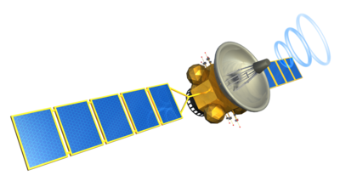
It is all about Communication…..
Provide multiple communication paths
Daily Standups
Video Chat
Continuous communication
Text Chat
Phone
**Ensure these systems work and are always available**

Slide 17
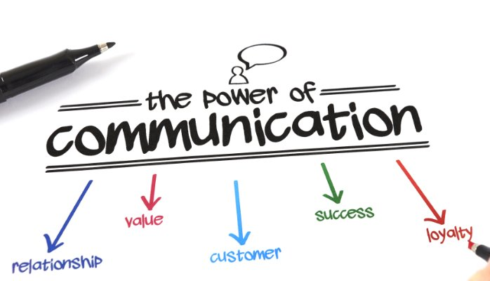
It is all about Communication…..

Slide 18
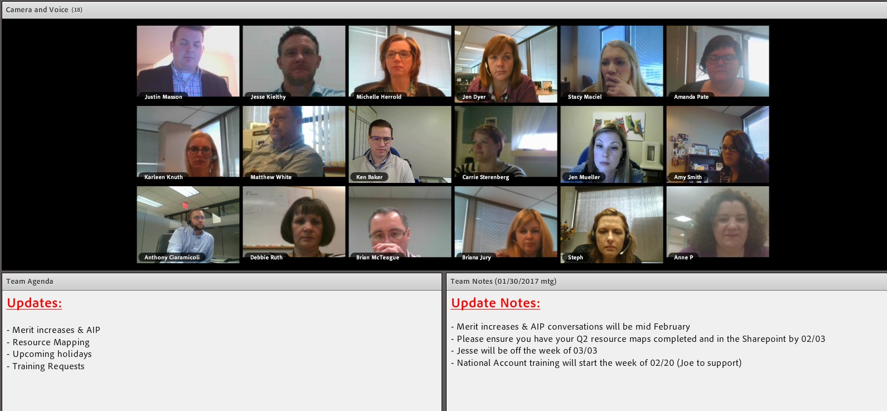
Using technology – team meetings

Slide 19
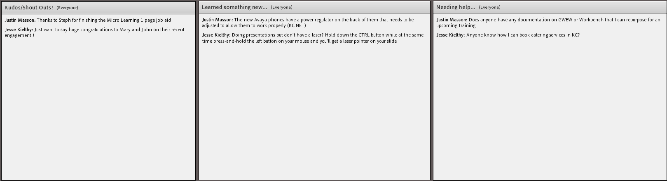
Using technology – team meetings

Slide 20
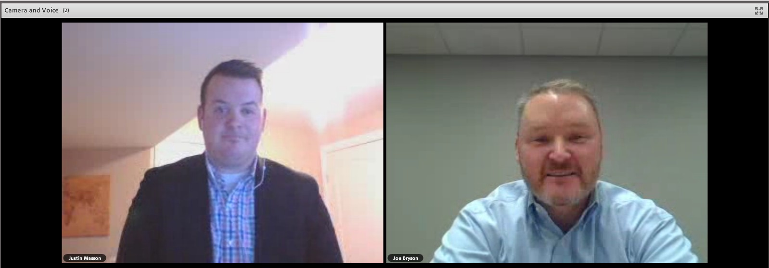
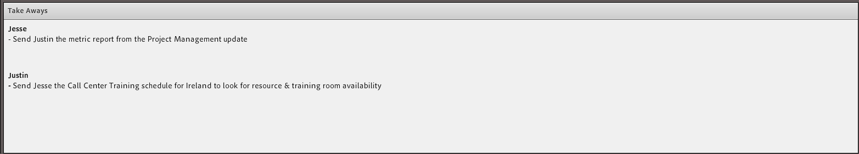
Using technology – 1-to-1 meetings

Slide 21

Get your teams face to face
Key points for person to person contact
Inception
What is the concept/goal for the project
Talk about how things will work
Expectations on quality
Development/Production
Review final designs
How are we splitting the work
Post Production
Process for managing defects
Process for shutting the product down
Notes:
Secondary thoughts:
More difficult to blame someone you know than someone on the other side of a chat box.

Slide 22

Dealing with time zones
What are the common working hours
Can you shift development times closer?
Who stays late/who gets up early?
Multiple time zone impact
Consider impact to efficiency when selecting partners and development type
Central Hub i.e Waterford
Notes:
The greater the time change the stronger the remote leadership must be
At a certain point in time gap you are better off outsourcing than distributed development

Slide 23

Know your team members
How do individuals work in each geo location?
Self Starters (SLF Perm Leads)
Ability to handoff work with little oversight
Can work from basic information
Directed Developers (EBIX contractors India)
Require specific direction and oversight
Prefer well documented instructions
Notes:
Individualism
In a country that scores highly on the individualism scale the following traits are common:
. A person's identity revolves around the "I" . Personal goals and achievement are strived for . It is acceptable to pursue individual goals at the expense of others . 'Individualism' is encouraged whether it be personality, clothes or music tastes . The right of the individual reign supreme; thus laws to protect choices and freedom of speech
In a country that scores low on the individualism scale the following traits are common:
. "We" is more important that "I" . Conformity is expected and perceived positively. . Individual's desires and aspirations should be curbed if necessary for the good of the group. . The rights of the family (or for the common good) are more important. . Rules provide stability, order, obedience.

Slide 24

Project Methodologies
What methodologies will each location use
Agile, Waterfall, Lean/Kanban
What is the level of experience with the selected methodologies
Do the remote teams choices work with the main teams
How are the key metrics tracked
Does everyone understand their role

Slide 25
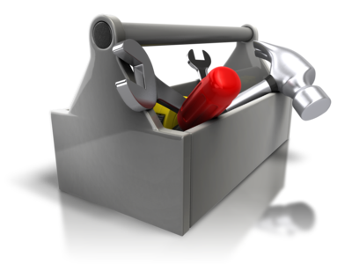
Project Management Suite
Unified project management tool
Accessible from each remote location
Allows remote location to manage “their” work
Support the development methodologies teams use
Agile, Waterfall, Lean/Kanban
Encourage communication process
Allow project leadership to get a high level view of project data
Ability to dig into the details

Slide 26
Dev Ops Strategy/Tools
In developing our DevOps strategy we wanted all teams to speak the same language, and have a shared understanding and skills accessible from each remote location.
Break down the silos that had been built over time, bringing teams closer together and aligning resources to delivering products, so that we can be more agile, nibble, developing and releasing high quality products quickly, efficiently and reliably.
Remotely accessible tools such as Git, SVN, Jenkins,Sonar Cube, Ancible, Harvest etc

Slide 27
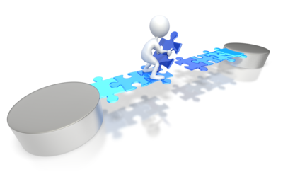
Summary
Culture
Type of work
Scope of work
Work experience
Communication
How you/they work

Slide 28


Slide 29


