Slide 1
Identity in the real world

Slide 2
Identity (and Access Management)
in the
Real (IT) World
The Onawa(re)y

Slide 3
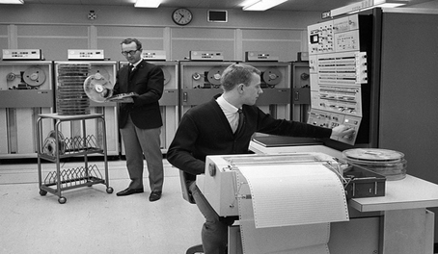
The Real IT World?

Slide 4
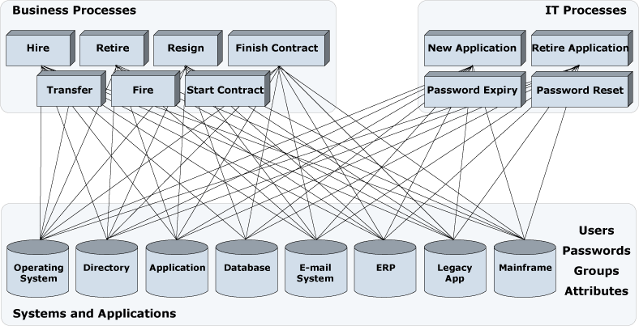
“A Gothic House of Horror” (Martin Taylor former Barclay’s CEO)

Slide 5
Who has ACCESS to WHAT?
How can we control it all?

Slide 6



What is Identity Management?
Identity Governance
Access Management
Data
Governance

Slide 7
IAM the Onawa(re)y
Professional Services
Strategy
Roadmap
Project implementation
Architecture
Design
Managed Services/ SaaS
Support
Onsite/Offsite
Onaware R&D
Product Selection
Construct
Test
Sustain
Onics
Virtual Cloud
Atlas
…

Slide 8
Research and Development

Slide 9
Working in R&D
Full Stack Development
Front end, business logic, databases
Continuously learn and adapt
New technologies
Freedom to explore
Always something new
Involvement in multiple stages of the SDL
Requirements, Development, Testing, Release
Work as part of a team
Interface with Clients

Slide 10
Technologies
Languages
Java
Groovy
JavaScript
Frameworks
Spring
Grails
Selenium
Rails
Cordova
Databases
MySQL
ElasticSearch
MongoDB
Ruby
Front End
HTML
JavaScript
JQuery
Angular
Version Control
GIT/SCM
Build
Ant, Ivy
Jenkins
Nexus
App Servers
Apache
Nginx
Tomcat

Slide 11
Current Projects
Atlas
Automated testing tool for IAM applications
User defines tests in high level English
Converted and executed as Selenium Web Driver tests
Onics
Analytics Tool
Customisable queries, charts, dashboards
Aims to address IAM specific issues
Connectory
User friendly connector development
Wizard based approach
Connectors can be built, validated and deployed to production

Slide 12
Placement at Onaware

Slide 13
What I got / You will get during Placement
The Team
You will be assigned a mentor
Everyone in the office is really friendly and always available
Go out for office lunches, drinks & other fun social days
Working on projects that are useful
Work Placement – Connectory.
Currently 2 students on placement from the course that are working on plugins that are going to be useful for the different teams in Onaware
-Environment Comparison Plugin
-Log Viewer Plugin

Slide 14
Training / Bootcamp
Bootcamp – Learn to crawl before you walk
All people on work placement will go through “Bootcamp”
Overview of how Onaware works and the tools & technologies used
During Bootcamp you will
Get some development experience
Learn how to work in a professional I.T. environment
Learn how to work to deadlines for customers
Bootcamp Deliverables
Daily SCRUMs
Code Reviews
Small Project mimicking Customer requirements.

Slide 15
How ICT Skills got me employed full-time
The Modules are relevant
Everyday in my job I use the things that you may have already covered:
-Linux/Windows OS Command Line (Systems)
-Development using GGTS/Eclipse (Web Development (Java))
-Database structures/querying (Databases (MySQL))
-Setting up VM’s & Some Networking (Systems & Networking)
-Front End development (Web Development)
-Securing your apps (Security)
Onaware have success with people from ICT Skills
Currently have 5 people with us who did the course
Know your level at this point in your I.T. life

Slide 16
Identity in the Real World
Identity and Access Management in The Real IT world.
WHO has access to WHAT and How Onaware Operates in this field
Questions?

