Slide 1
Web Development
BSc Applied Computing / Forensics / Entertainment Systems
Eamonn de Leastar (edeleastar@wit.ie)
Dr. Brenda Mullally (bmullally@wit.ie)

Slide 2
HTML Page Structure & Publishing

Slide 3
Learning Outcomes
Understand the structure of an HTML Element, and be able to recognize its variants.
Be able to read and compose a relative path, and be able to distinguish it from an absolute path.
Understand the implications of nesting of elements, and in particular be able to distinguish between correct and incorrect nesting.
Be able to differentiate between block and inline elements
Understand the general context of wireframing

Slide 4
Agenda
Elements, Attributes, & Documents
Linking
Nesting
Linebreak, Block & Inline Elements
Structuring a Page / Wireframing

Slide 5
Agenda
Elements, Attributes, & Documents
Linking
Nesting
Linebreak, Block & Inline Elements
Structuring a Page / Wireframing

Slide 6
Components of an HTML Element
    <ElementName AttributeName(s)=“value”>
    Content
</ElementName>
Start Tag
End Tag

Slide 7

<title>
<title>My DVD Shop</title>
ElementName: <title>
No attributes
Content: My DVD Shop
ElementName </title>

Slide 8
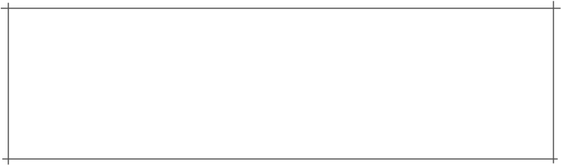
<p>
</p> Trouble prone teen Percy Jackson is about to be
kicked out school but thats the least of his
problems.</p>
ElementName: <p>
No attributes
Content: Trouble prone teen Percy Jackson is about to be kicked out school but thats the least of his problems
ElementName: </p>

Slide 9
<a>
<a href="about/directions.html">detailed directions</a>
ElementName: <a>
  Attribute:
    name: href
    value: “about/directions.html”
Content: detailed directions
ElementName </a>

Slide 10
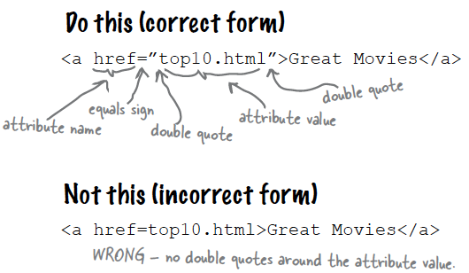
Attributes
Attributes give you a way to specify additional information about an element.

Slide 11
<img>
<img src="../images/PJackson.jpg">
ElementName: <img>
  Attribute:
    name: src
    value:"../images/PJackson.jpg"
Content: empty
ElementName - none (for the moment)

Slide 12
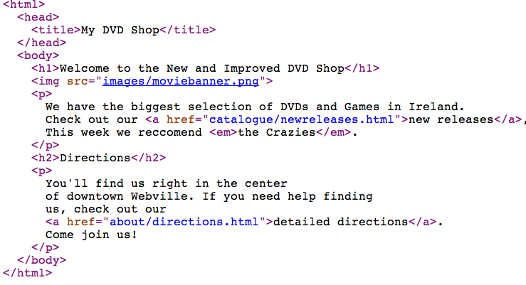
HTML Document Structure
html
  head
    title
  body
    h1
    p
    etc...

Slide 13
Agenda
Elements, Attributes, & Documents
Linking
Nesting
Linebreak, Block & Inline Elements
Structuring a Page / Wireframing

Slide 14
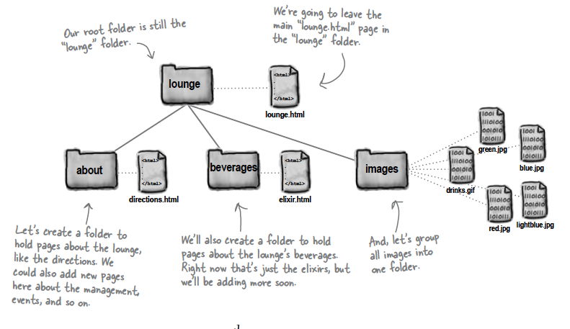
Linking

Slide 15
Links: Absolute vs Relative
Absolute
  Complete path to a file on the hard disk: e.g:
    /webdevlabs/lab02/imagestatoo.jpg
    /webdevlabs/lab01/mydvds.html
Relative:
  Trace route from “current position” to the destination
  “..” means go up one level
  Directory name may prefix filename

Slide 16
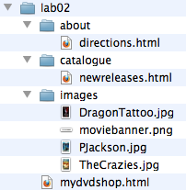
Relative Link Examples
If we are in “lab02” then “about/directions.html” is a relative link from the current folder to the catalogue folder, and to the files “directions.html” in that folder
If we are in the catalogue folder, and we wish to link to one of the images, the link “../images/pjackson.jpg” means “go up one level, and then down into the “images” folder and then link to pjackson.jpg”
Avoid absolute links!
<a href="catalogue/newreleases.html">new releases</a>
<img src="../images/DragonTattoo.jpg">
<a src="faq.html">FAQ</a>

Slide 17
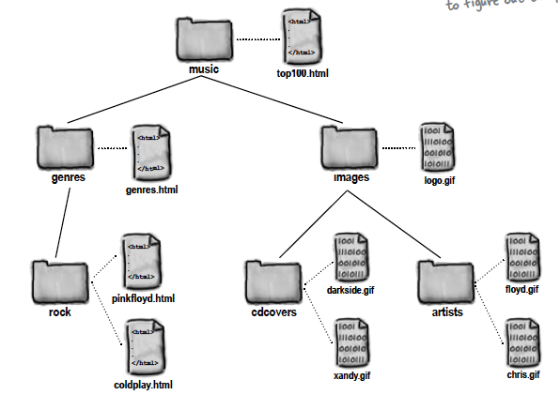
Site Example

Slide 18
Agenda
Elements, Attributes, & Documents
Linking
Nesting
Linebreak, Block & Inline Elements
Structuring a Page / Wireframing

Slide 19
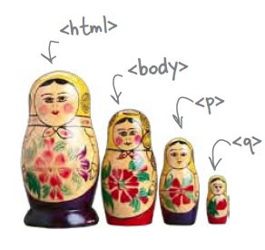
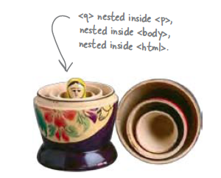
Nesting
When we put one element inside another element, we call that nesting.
We say, the <p>element is nested inside the <body>element.
We put a <body>element inside an <html>element, a <p>element inside a <body>element etc.

Slide 20
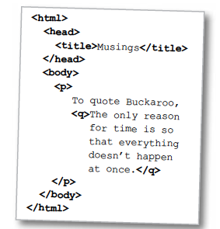
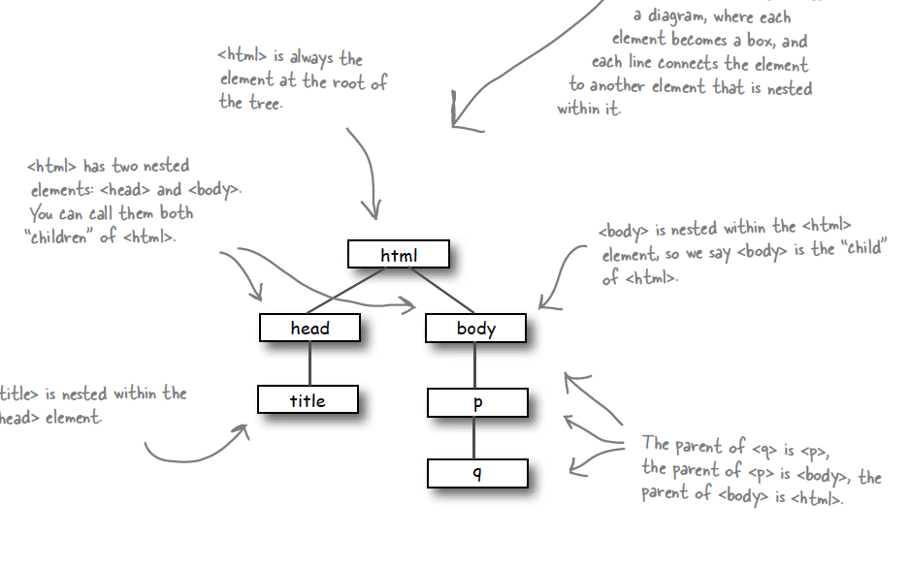
Nesting - Tree Structure
Text

Slide 21
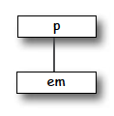
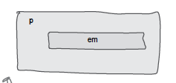
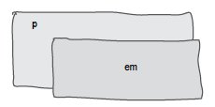
Nesting can be Incorrect!
<p>I’m so going to blog <em>this</em></p>
Good
<p>I’m so going to blog <em>this</p></em>
Bad
?

Slide 22
Agenda
Elements, Attributes, & Documents
Linking
Nesting
Linebreak, Block & Inline Elements
Structuring a Page / Wireframing

Slide 23
Line Breaks
Break: <br> </br>
An Empty element: - sometimes shortened to:
  <br></br>
or just
  <br>
or
  <br />

Slide 24
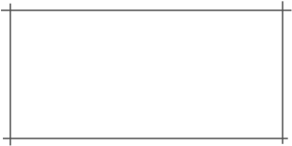
Block vs Inline Elements
Block elements are always displayed as if they have a line break before and after them
inline elements appear “in line” within the flow of the text in your page.
“Block elements stand on their own; inline elements go with the flow.”

Slide 25
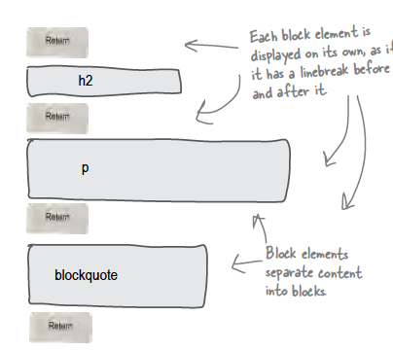
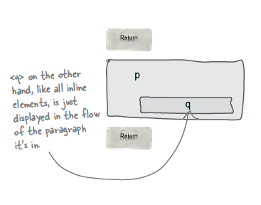
Examples
Block - h1, h2, p, blockquote
Inline - a, em, q

Slide 26
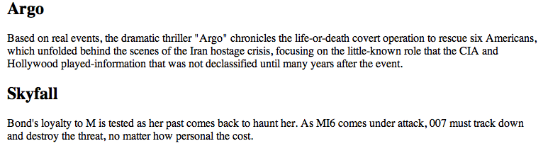
Example
<h2>Argo</h2>
<p>
Based on real events, the dramatic thriller "Argo" chronicles the life-or-death covert operation
to rescue six Americans, which unfolded behind the scenes of the Iran hostage crisis,
focusing on the little-known role that the CIA and Hollywood played-information that was not
declassified until many years after the event.
</p>
<h2>Skyfall</h2>
<p>
Bond's loyalty to M is tested as her past comes back to haunt her. As MI6 comes under attack,
007 must track down and destroy the threat, no matter how personal the cost.
</p>
<h2>Argo</h2>
block
<p>
Based on real events, the dramatic thriller "Argo" chronicles the life-or-death covert operation
to rescue six Americans, which unfolded behind the scenes of the Iran hostage crisis,
focusing on the little-known role that the CIA and Hollywood played-information that was not
declassified until many years after the event.
</p>
block
<h2>Skyfall</h2>
block
<p>
Bond's loyalty to M is tested as her past comes back to haunt her. As MI6 comes under attack,
007 must track down and destroy the threat, no matter how personal the cost.
</p>
block
linebreak
inline

Slide 27
Agenda
Elements, Attributes, & Documents
Linking
Nesting
Linebreak, Block & Inline Elements
Structuring a Page / Wireframing

Slide 28
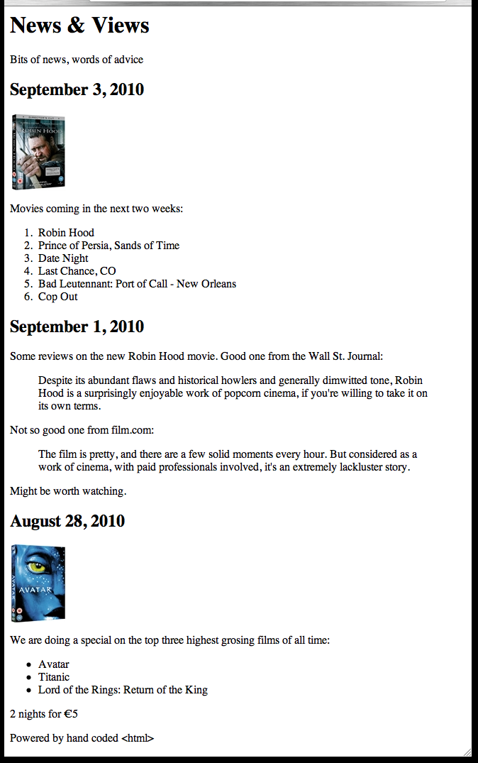
Planning a Document (1)
Visualizing End Result

Slide 29
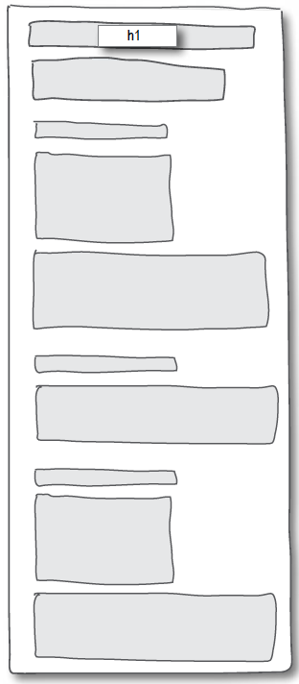
Planning a Document (2)
Identify Block Structure

Slide 30
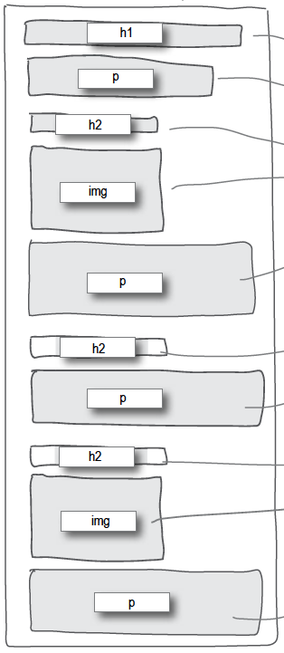
Planning a Document (3)
Select suitable elements

Slide 31
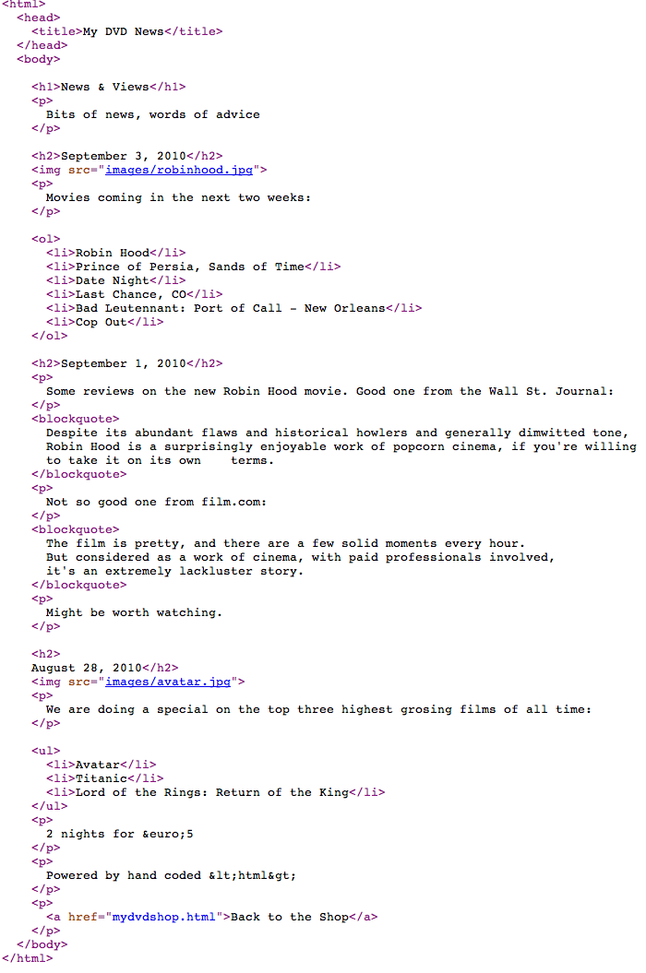
Planning a Document (4)
Build Content

Slide 32
Wire framing
A website wireframe is a basic visual guide used in interface design to suggest the structure of a website and relationships between its pages.
A webpage wireframe is a similar illustration of the layout of fundamental elements in the interface. Typically, wireframes are completed before any artwork is developed.

Slide 33
Agenda
Elements, Attributes, & Documents
Linking
Nesting
Linebreak, Block & Inline Elements
Structuring a Page / Wireframing

Slide 34
Learning Outcomes
Understand the structure of an HTML Element, and be able to recognize its variants.
Be able to read and compose a relative path, and be able to distinguish it form an absolute path.
Understand the implications of nesting of elements, and in particular be able to distinguish between correct and incorrect nesting.
Be able to differentiate between block and inline elements
Understand the general context of wireframing

