Slide 1
Web Development
BSc Applied Computing / Forensics / Entertainment Systems/ IOT
Eamonn de Leastar (edeleastar@wit.ie)
Dr. Brenda Mullally (bmullally@wit.ie)

Slide 2
HTML Tables & Forms
Web Development

Slide 3
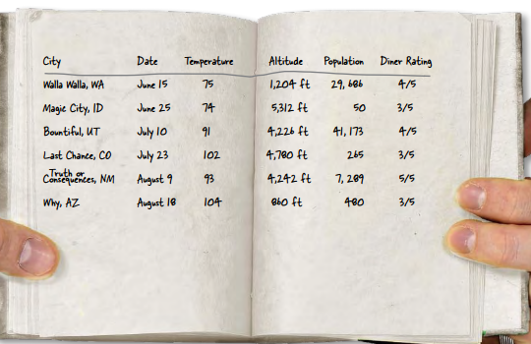
HTML Tables
Sometimes you need to present tabular data, perhaps for inventory of products or a catalog of albums.

Slide 4
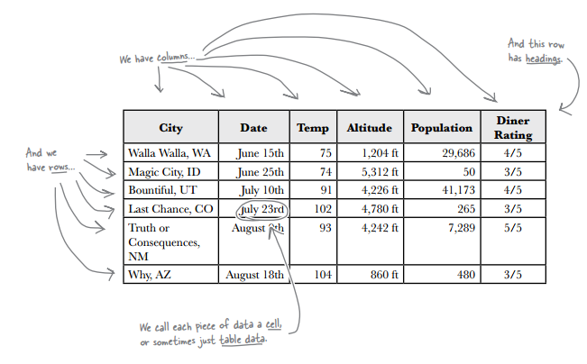
HTML Tables
You can create table-like layout using <div>’s and CSS but that is for layout purposes, and isn’t related to content itself.
HTML has a <table> element to take care of marking up tabular data.

Slide 5
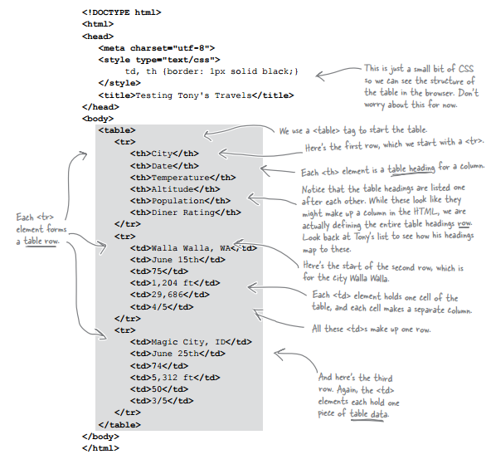
HTML Tables
Rows
Columns
Headers

Slide 6
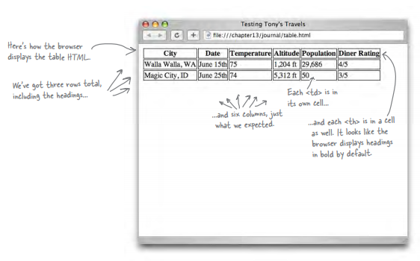

HTML Tables

Slide 7
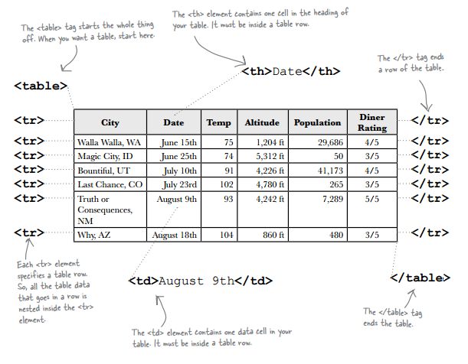
HTML Tables
You’ve seen four elements used to create a single table:
<table>
<tr>
<th>
<td>.

Slide 8
HTML Tables
Table give you a way to specify tabular data in your HTML.
Tables consist of data cells within rows. Columns are implicitly defined within the rows.
The number of columns in your table will be the number of data cells you have in a row.
In general, tables are not meant to be used for presentation: that’s the job of CSS

Slide 9

HTML Tables
Adding a caption – you can improve your table by adding a caption.
The caption is displayed in the browser. By default, most browsers display this above the table. If you don’t like the default location of the caption, you can use CSS to reposition it. Older browsers don’t support repositioning the caption. Always put the caption at the top of the table in the HTML and use CSS to reposition it to the bottom if that’s where you want it.

Slide 10
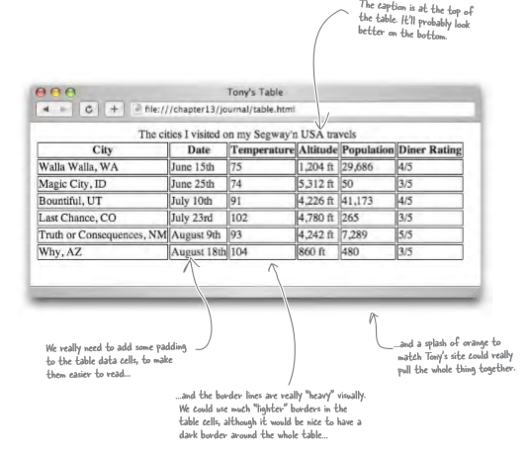
HTML Tables

Slide 11
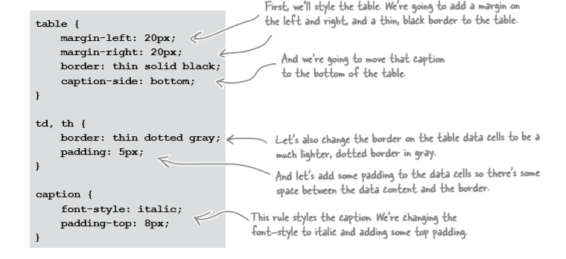
HTML Tables

Slide 12
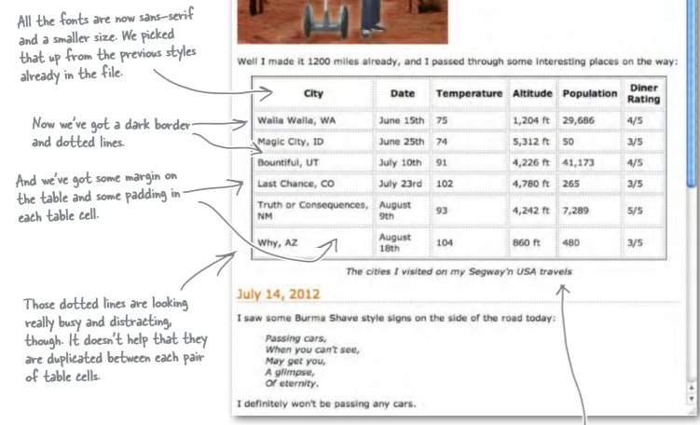
HTML Tables

Slide 13
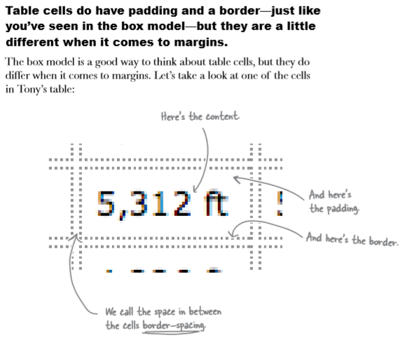
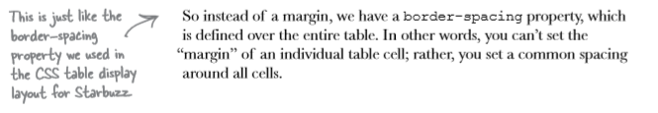
HTML Tables
Table cells look liked they just use the box model too.. They’ve got padding and a border.
Do they also have margin?

Slide 14
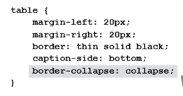
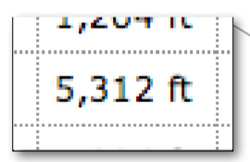
HTML Tables
We would like to have just one border around each table cell.
There is a way to solve the double border issue we can set the border-collapse property.
This means there is no border spacing between cells. It combines two borders beside each other into one border.
This “collapses” two borders into one.

Slide 15
HTML Tables
You can then style the contents of the table, for example you may want date, temperature, and diner rating to be centre-aligned. Perhaps right alignment on the altitude and population.
You could define two classes, one for centre-aligned and one for right-aligned. Then just use the text-align property in each. Then add the appropriate class to the correct <td> elements.

Slide 16
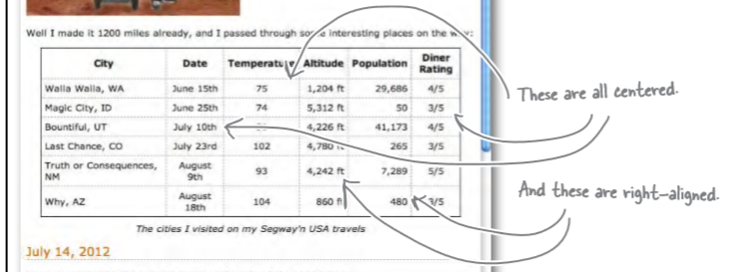
HTML tables

Slide 17
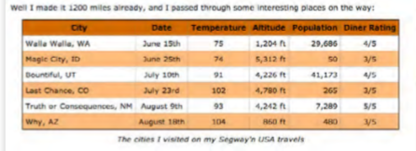
HTML tables
Style the header to have one background color and then alternate rows to have another color.
You can do this by placing the appropriate class name into every other <tr>

Slide 18
HTML tables
Instead of placing the class name into every other <tr> we can use another more advanced CSS method.
pseudo-classes is used to style elements based on their state, you may have seen the (a:hover pseudo-class).
For this example we can use the nth-child pseudo-class.
We can write a CSS rule to colour the even nth-child elements for the table row.

Slide 19
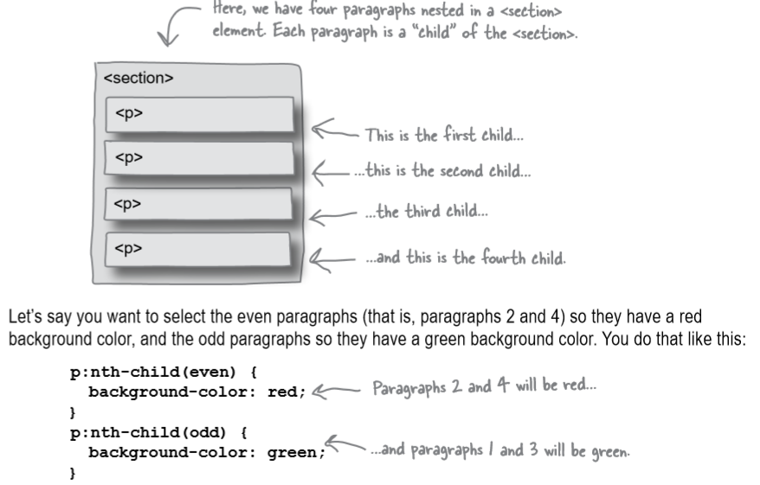
HTML tables

Slide 20
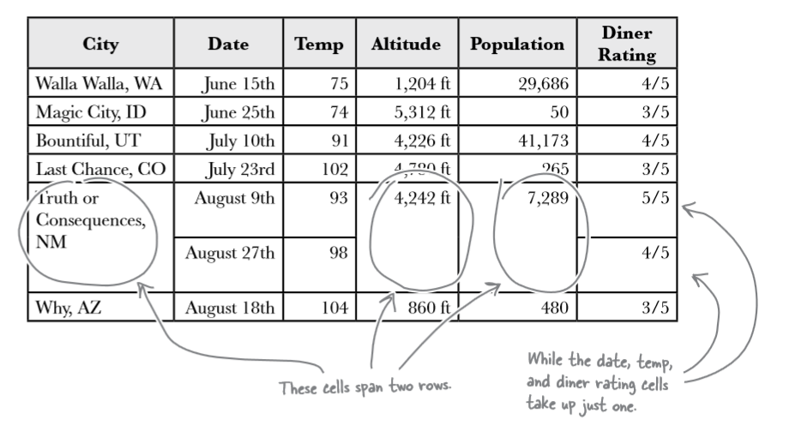
HTML tables
Sometimes tables have varying size cells. This is possible to define in HTML

Slide 21
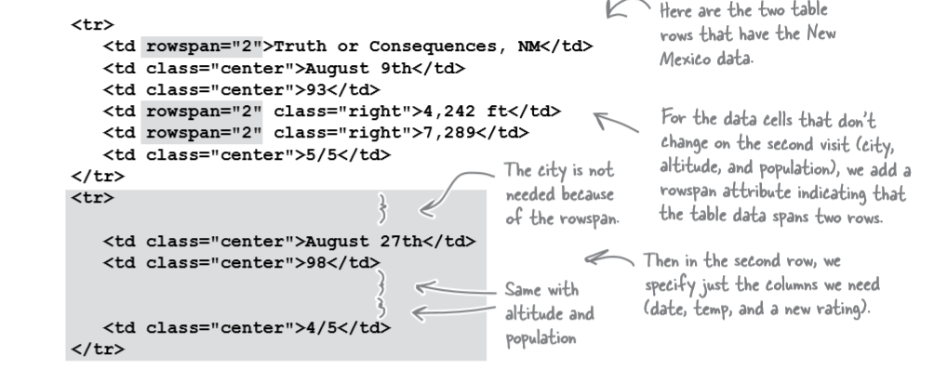
HTML tables
We use the attribute rowspan to define those cells that span more than one row.

Slide 22
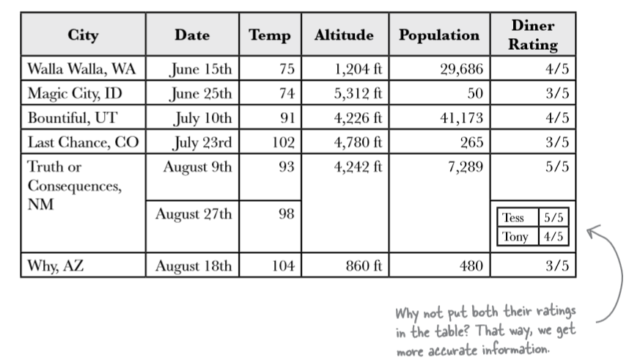
HTML tables
What about displaying two values in one cell?
It looks like a table within a table, we can do this by placing a <table> inside a <td>

Slide 23
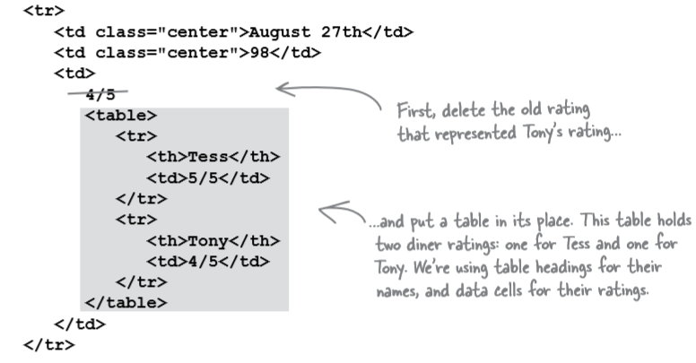
HTML tables

Slide 24
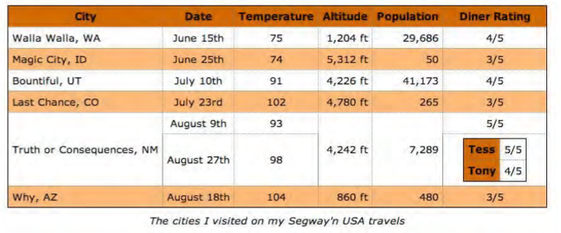
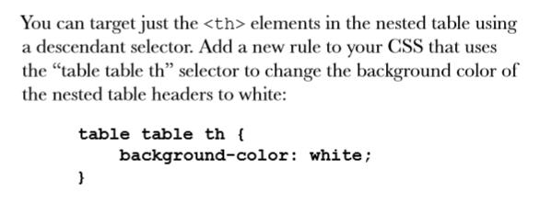
Ideally we don’t want the <th> for Tess and Tony to have the orange background colour.
This rule reads, for any table header in a table nested within another table give it a background colour white.

