Slide 1
We Built 15 Tools.
The Agent Wanted a REPL.
Nuno Campos
Co-Founder & CTO, Witan Labs
Previously LangChain, LangGraph
AI Engineering London • April 2026
Notes:
Title card. No preamble needed — the title tells the story.

Slide 2
50% → 92%
4 months, 4 codebases, 29,000 lines of eval infrastructure
The single biggest decision: replacing 15 discrete tools
with one REPL
Notes:
I'm going to tell you a story about building an agent that reads and modifies Excel spreadsheets. We started at 50% accuracy on a financial analysis benchmark and got to 92%. This talk is about what actually moved the needle — and what didn't. The short version: we kept building more tools, and the agent kept wanting to program. Once we let it, everything changed.

Slide 3
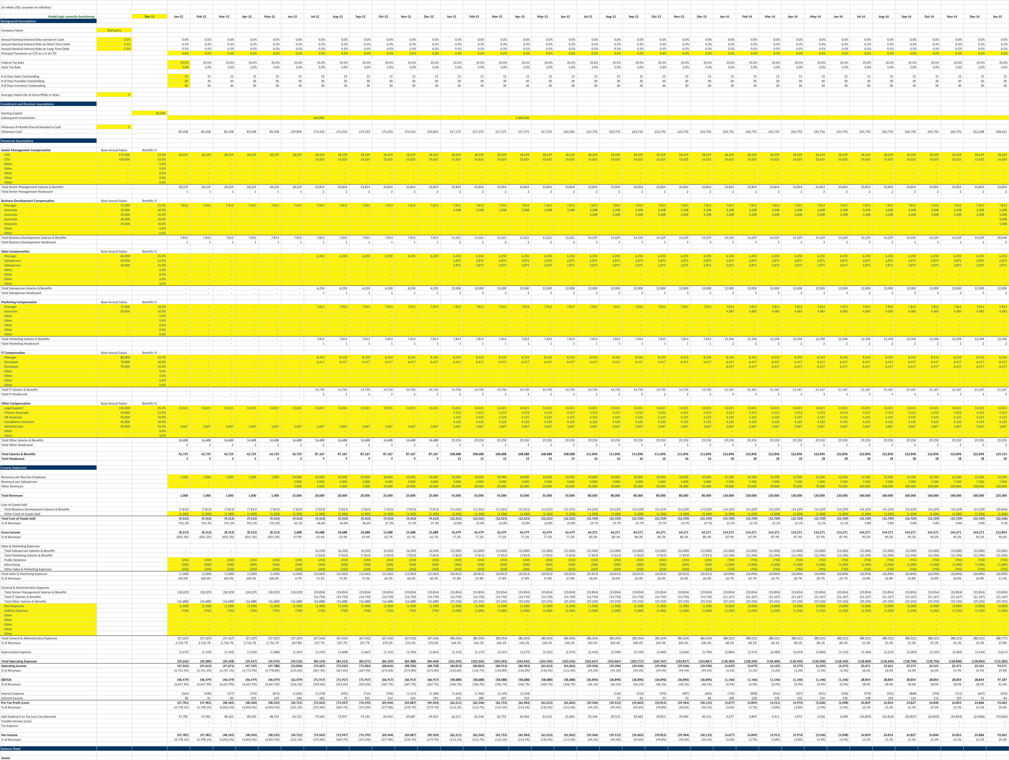
Spreadsheets are deceptively hard for AI
A human sees:
Revenue table, assumptions,
P&L summary, color-coded
sections, structure
An LLM sees:
10,000 cell values, cryptic
formulas, formatting metadata
it has no intuition for
=SUMPRODUCT((B$3:B$50="NEW")*(G$3:G$50))
Notes:
Spreadsheets are deceptively hard for AI. A human glances at a financial model and instantly sees structure — there's a revenue table here, assumptions in that yellow corner, a chart summarizing the P&L. They know "Q4" means the fourth column, parentheses mean negative numbers, the cell labeled "EBITDA" is derived from the ones above it. An LLM sees none of this. Give it a 20-sheet financial model and ask "what's the IRR?" and it has to figure out not just what IRR means, but which of 10,000 cells contains the answer, which sheet it's on, and whether that number is an input or a calculated output.

Slide 4
Attempt 1: Turn the spreadsheet into a database
Excel → SQLite
Every cell, formula, merged region, color block stored in relational tables
Agent: LangGraph + GPT-5
Tools: SQL query, write cell, insert row, delete range
Each tool call = a separate LLM round-trip
Result: 50%
Notes:
Our first instinct: transform the problem. LLMs are good at SQL, so we built a pipeline that converts entire workbooks into SQLite databases. The agent had a handful of tools — run a SQL query, write to a cell, insert a row. Each tool call was a separate round-trip to the model. Tested against SpreadsheetBench, 130 tasks. First result: 50% pass rate. Not great.

Slide 5
50% → 73%
Fixed one character in the extraction pipeline.
The agent had looked confused. Our instinct was
to blame the model.
The actual problem: the agent was reasoning
correctly over corrupted inputs.
Notes:
But then we found something. A one-character bug in our extraction code — a wrong function argument — was silently corrupting data for a large fraction of tasks. Fixing that single character moved us from 50 to 73%. More than any prompt engineering we'd done. The agent had looked confused — giving wrong answers, failing to find data. We blamed the model. But it was reasoning correctly over bad inputs. This became a recurring pattern: when the agent seems confused, suspect the plumbing. Agent failures that look like reasoning failures are frequently data pipeline bugs in disguise.

Slide 6
Attempt 2: Three agents, not one
Block Discovery
Edit Agent
Question Agent
Identifies workbook
structure
Modifies workbooks
via 5-step process
Answers questions
about contents
Low reasoning effort
High reasoning effort
Read-only
Key finding: "Define the end state before you touch a cell" was the single highest-leverage prompt instruction. The 5-step process (disambiguate, define end state, plan, execute, verify) caught errors during planning, not execution.
Notes:
Next we split into three agents. The important one was the edit agent's five-step reasoning process: disambiguate the request, define the desired end state, plan the implementation, execute, verify. This changed the kind of errors we got. Without it, the agent made irreversible mistakes mid-execution. With it, most errors surfaced during planning, where they're cheap. This worked better than giving the agent better tools, more context, or a stronger model. But the architecture was rigid. Discovery happened once. Three LLM calls per task was expensive. And we still had 15+ tools the agent was juggling.

Slide 7
The dead ends
We spent two weeks searching for the right static representation.
Representation | Why it failed
TSV views | Lost formatting and structural context
SQL views | Flat tables didn't capture visual structure
HTML tables | Too verbose, consumed too many tokens
DOT graphs | Useful for analysis, not for interaction
XML / XSLT | LLM struggled with the syntax
Representation
Why it failed
The answer was to stop looking for a static representation entirely.
Notes:
We also pivoted to TypeScript and .NET for better Excel fidelity. Then spent two weeks trying every possible way to represent a workbook to the LLM. TSV, SQL, HTML, Graphviz, XML. Each captured some aspects and lost others. The breakthrough came from abandoning the search entirely.

Slide 8
November 23rd: The REPL
One tool. One persistent Node.js REPL. A rich spreadsheet API.
Node.js REPL
.NET Engine
Agent Loop
→
→
writes JS code
Variables persist
across calls
Workbook state
persists
JSON-RPC over stdio
30+ functions: listSheets, findCells, readRange, traceToInputs, setCells, evaluateFormula ...
Sandboxed: no filesystem, no network, no subprocesses
Notes:
On November 23rd, we made the single most impactful decision of the project. We threw away all 15 tools and gave the agent one: a persistent Node.js REPL with access to a rich spreadsheet API. Instead of "read this cell", "search for this label", "write this value" as separate tools, the agent writes JavaScript code. Variables persist across calls. The API has 30+ functions for reading, searching, tracing formulas, and writing.

Slide 9
Before vs. After
BEFORE
10-15 tool calls
AFTER
1 tool call
Tool call 1: list_sheets()
→ ["Summary", "Data", "Inputs"]
Tool call 2: read_range("Summary!A1:D10")
→ cell values
Tool call 3: find_cells("Revenue")
→ [matches]
Tool call 4: read_cell("Summary!C10")
→ "$1,234,567"
...
const sheets = await xlsx.listSheets(wb);
const summary = await xlsx.readRangeTsv(
wb, `${sheets[0].name}!A1:D10`
);
const revenue = await xlsx.findCells(
wb, "Revenue", { context: 1 }
);
console.log(sheets, summary, revenue);
One call, three operations, all results visible together.
But it goes further than just batching.
Notes:
Here's what changed concretely. Before: exploring a workbook took 10 to 15 tool calls. Each one is an LLM round-trip — the model has to decide what to do, format the tool call, wait for a result, interpret it, decide the next step. After: the same exploration in one call. Three operations, all results visible together. But it goes further than just batching.

Slide 10
Why the REPL actually worked
1
Composability
2
State persistence
Multiple operations per call,
results feed into each other
Variables survive across calls,
build understanding incrementally
3
Flexible exploration
4
Trivial API evolution
Conditionals, loops, error recovery
— in a single tool call
Add a function, agent uses it.
No tool-layer plumbing.
let results = await xlsx.findCells(wb, "Net Revenue");
if (!results.length)
results = await xlsx.findCells(
wb, ["Total Revenue", "Net Sales", "Revenue"]
);
Notes:
Four reasons this worked beyond the obvious batching benefit. One: composability. Results of one operation feed into the next within the same call. Two: state persistence. The agent opens a workbook in call one, and the handle is still there in call two. It builds up understanding incrementally without re-querying. Three: flexible exploration. The agent can try something, check the result, and adapt — in a single tool call. Conditionals, loops, error recovery. This is something discrete tools fundamentally can't do. Four: API evolution. Adding a new capability means adding a function to the library. The agent picks it up immediately through the REPL. No tool schema changes, no registration, no plumbing. If your agent is making many small sequential tool calls that compose into a larger operation, you've probably reinvented a bad scripting language. Give it a real one.

Slide 11
Three hard rules
Each one a scar from a previous failure. Embedded in the system prompt.
1
"Zero new formula errors"
After every write, check for errors.
If your edit broke a formula, fix it before moving on.
2
"Use the model, not JavaScript math"
Read calculated values from the formula engine.
Never substitute your own arithmetic.
3
"Always cite sheet + address"
Every answer must reference where the data came from.
Summary!C10, not just "$1.2M".
Notes:
We also encoded three hard rules in the system prompt, each one a scar from a previous failure. "Zero new formula errors" — the agent used to make edits that silently broke downstream formulas. Now it checks after every write. "Use the model, not JavaScript math" — the agent used to calculate things in code instead of reading from the spreadsheet's formula engine. Sounds fine, except the spreadsheet's formulas are the source of truth, and the agent's arithmetic was sometimes wrong. "Always cite sheet and address" — every answer must be verifiable. This seems like a small thing but it changed how the agent approached problems. It couldn't just say "revenue is $1.2 million." It had to show where that number came from.

Slide 12
74% to 92% in two weeks
REPL
introduced
92.1%
152/165 tasks
0
timeouts
50s
avg runtime
18 points in two weeks from compounding small gains:
better search, new API functions, improved docs, backend bug fixes
Notes:
With the REPL in place, results improved fast. 74% on November 30th. 88% eleven days later. 92% three days after that. Zero timeouts, 50-second average. No single change was dramatic. Better fuzzy search, formula tracing functions, improved system prompt documentation, bug fixes in the .NET backend. Each one removed a class of failures, and the effects multiplied.

Slide 13
The test that contradicted our thesis
exec / REPL
verify CLI
The 92% approach
Already proven internally
Separate commands:
find, calc, render, lint
(not part of this test)
vs. openpyxl on 20 QnA tasks
Same model (Claude Opus 4.6) • Same runner • Same 20 tasks
We expected: our sophisticated tool wins.
Notes:
But this isn't a story that ends with "we built a thing and it worked." By February, we had two Witan workflows. The REPL approach that hit 92%. And a separate set of CLI commands — find, calc, render, lint — designed as standalone verification tools. We tested that second workflow against plain openpyxl — a basic Python library — on 20 QnA tasks. We expected our more sophisticated tool to win. It had a .NET formula engine, semantic linting, visual rendering. openpyxl can't even recalculate formulas.

Slide 14
openpyxl won.
 | openpyxl | Witan CLI
Pass rate | 85% | 70%
Avg tool calls | 21 | 42
openpyxl Witan CLI
The simpler approach won by 15 points.
Notes:
openpyxl won. 85 to 70. The simpler approach won by 15 percentage points, with half the tool calls. [Pause here — let it land.]

Slide 15
Why it lost (the mundane reasons)
1
A performance bug
Each CLI command took 50-130s. Per-cell recalculation
query instead of batch. 20+ ops per task → timeout.
2
Shell escaping
Sheet names with spaces ("SW Selections") broke across
three quoting layers: Claude Code SDK → zsh → .NET
3
Documentation was backwards
SKILL.md had the wrong quoting examples.
The agent followed our wrong instructions faithfully.
Meanwhile, openpyxl: Python strings. Millisecond file access. Zero infrastructure. Zero quoting issues.
Notes:
The reasons were mundane. A performance bug in the recalculation engine — it queried the dependency index per cell instead of in batch. Each command took 50 to 130 seconds. With 20+ operations per task, you blow the timeout. Sheet names with spaces broke across three quoting layers — the SDK, zsh, and the .NET parser. And our own documentation had the quoting examples backwards. The agent followed our wrong instructions faithfully. Meanwhile, openpyxl: Python strings, millisecond file access, zero infrastructure, zero quoting issues.

Slide 16
What the failure revealed
Two products emerged from one failed test:
exec
verify
The REPL externalized as a CLI
command any agent can use.
Single invocation, full exploration.
render, calc, lint as a lightweight
add-on for agents that already
have their own spreadsheet tools.
The most important test isn't the one that confirms your assumptions —
it's the one that reveals your product.
Notes:
But here's the thing. This test answered a question we hadn't quite asked: should the REPL be the external product? We'd built it as an internal tool for our own agent. The CLI comparison showed exactly why it worked — a single exec invocation runs an entire exploration script without the per-operation overhead that killed the CLI approach. So we externalized it. witan xlsx exec — any coding agent can use it, not just ours. The remaining CLI commands found their role as a lightweight verification add-on for agents that already use openpyxl or pandas. Two products from one failed test. We wouldn't have found either insight if the test had confirmed what we expected.

Slide 17
Domain knowledge outlived every tool
openpyxl
↓
xlwings
↓
Witan CLI
↓
REPL
Financial domain knowledge
Improved results on all four backends
→
How to interpret margins, profitability,
revenue cascades through COGS
Model type recognition
(DCF, LBO, three-statement)
Communication conventions
($1.2M not $1,234,567.89)
"Never calculate in your head what the
spreadsheet can calculate for you"
If you're building a domain-specific agent, the domain knowledge is the product.
The tools are replaceable.
Notes:
Here's something that surprised us. We went through four tool backends in four months. The financial domain knowledge — how to interpret margins, what "profitability" actually asks for, that revenue changes cascade through COGS and working capital — improved results on every single one of them. We structured it as reusable prompt components. A "financial expert mindset" skill that could be composed with any tool approach. It became the most reused component in the system. If you're building a domain-specific agent, the domain knowledge is the product. The tools are replaceable.

Slide 18
Stop using LLMs to grade LLMs
Started with: LLM-as-judge comparing output to gold standard
Problem: Inconsistent judgments that masked real regressions
Strategy | Method
Content | Set similarity (Jaccard ≥ 70%)
Structure | Row-level sequence alignment (dynamic programming)
Visual | Font / color / format comparison (≥ 90%)
Scenarios | Set inputs, recalculate, compare outputs
Text | LLM grading — only for genuinely subjective answers
Strategy
Method
29,000 lines of eval code 568 commits
Notes:
One more lesson. We started with an LLM comparing agent output to gold-standard workbooks. It was unreliable — inconsistent judgments that masked real regressions. We couldn't tell if a score change was the agent improving or the evaluator being flaky. We ended up with five specialized evaluation strategies. Set similarity for values. Dynamic programming sequence alignment for layout. Pixel-accurate comparison for formatting. And LLM grading only — only — for genuinely subjective text answers. 29,000 lines of TypeScript, 568 commits. The evaluation framework was nearly as complex as the agent itself. Every significant improvement in the project traced back to a benchmark result. Without rigorous, automated, deterministic evaluation, we'd be guessing.

Slide 19
Infrastructure bugs masquerade as reasoning failures
Agent can't find data
→
One-character extraction bug
50% → 73%
Agent uses wrong quoting
→
SKILL.md had backwards examples
Agent trusted docs
Agent times out constantly
→
Per-cell recalc query, not batch
50-130s per op
Agent retries endlessly
→
API returning empty results
11-40% success
When the agent seems confused, suspect the plumbing.
Notes:
This was a recurring theme throughout the project. Every time we thought the agent was confused or the model was failing, the actual problem was somewhere in the infrastructure. The one-character extraction bug that looked like model confusion. Documentation with backwards examples that the agent followed faithfully. A performance bug that looked like the agent being slow. An intermittent API failure that looked like the agent retrying for no reason. When the agent seems confused, suspect the plumbing first. This is probably the most practically useful thing I can tell you today.

Slide 20
What generalizes
1
If your agent makes many small sequential tool calls that compose into larger operations, you've reinvented a bad scripting language. Give it a real one.
2
Structured reasoning > better tools. "Define the end state before you act" caught more errors than any tool improvement.
3
Domain knowledge is the product. Tools are replaceable. What the agent knows about your domain is not.
4
Evaluate deterministically. LLM-as-judge is fine for vibes. For measuring progress, use programmatic comparison.
5
Blame the plumbing first. Agent "confusion" is usually a bug in the data, the docs, or the infrastructure.
Notes:
So what generalizes beyond spreadsheets? One. If your agent is making many small sequential tool calls that compose into a larger operation, you've reinvented a bad scripting language. Give it a real one. This applies anywhere — data analysis, code generation, system administration. Two. Structured reasoning beats better tools. Making the agent think before acting — defining the end state before executing — was more impactful than any tool we built. Three. Domain knowledge is the product. We went through four tool backends. The domain knowledge improved results on all of them and outlasted all of them. Four. Evaluate deterministically. LLM-as-judge is fine for vibes. For measuring real progress, use programmatic comparison wherever possible. Five. When the agent seems confused, blame the plumbing first. Check the data pipeline, the documentation, the API. The model is usually the last thing that's wrong.

Slide 21
We kept trying to constrain the agent
into tighter interactions.
It kept wanting to program.
Once we let it, everything changed.
Research log: github.com/witanlabs/research-log
CLI & Skills: github.com/witanlabs/witan-cli
Nuno Campos
Witan Labs
Notes:
We spent four months trying to make an LLM work with spreadsheets. We tried databases, specialized tools, multi-agent architectures, multiple representations. The breakthrough was giving up on constraining the agent and letting it program. The REPL didn't just improve performance — it collapsed complexity, made the API trivially extensible, and eventually became the product itself. If there's one thing to take away: stop building more tools. Build better environments. Thank you.

