Slide 1
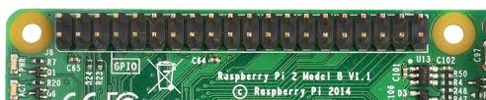
Raspberry Pi GPIO

Slide 2
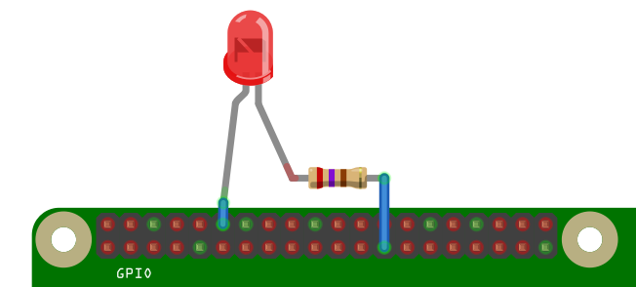
GPIO
The Pi has a row of pins along the top edge of the board called General Purpose Input Output(GPIO) pins.
Lets you connect your Pi to other things.

Slide 3
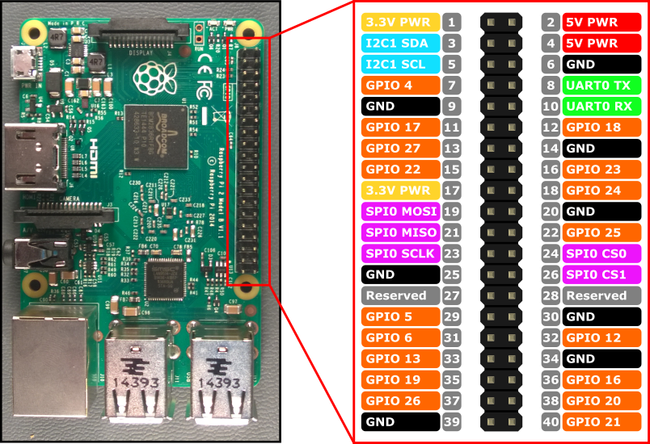
GPIO Pinouts
The 40 pins on the Raspberry Pi provide various different functions.

Slide 4
GPIO Pinouts
You'll see pins labelled as 3V3, 5V, GND and GPIO 2, GPIO 3,
Pin Label | Function | Description
3.3V | 3.3 Volts | Anything connected will receive 3.3 volts
5V | % Volts | Anything connected will receive 5 volts
GND | Ground | Zero volts. Used to complete a circuit
GPIO 5 | GPIO pin 5 | These pins are for general input and output and can be used to connect other electonic devices.
ID_SC/ID_SD/DNC | Other functions not addressed here

Slide 5
WARNING:
Randomly plugging wires and power sources into a Pi may destroy it, especially if using the 5V pins.
Bad things can also happen if you try to connect things to your Pi that use a lot of power; LEDs are fine, motors are not.
Make sure to check your circuit is OK before connecting it to the Pi or switching the Pi on.

Slide 6
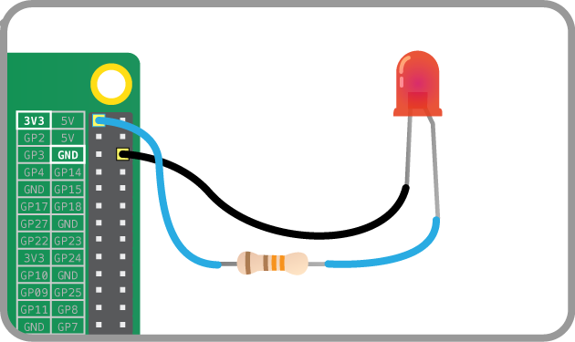
Simple Example – Lighting an LED
The LED is connected directly to the 3.3V and GND pins, and should light up. The longer leg of LED should be connected to the 3V3 pin

Slide 7
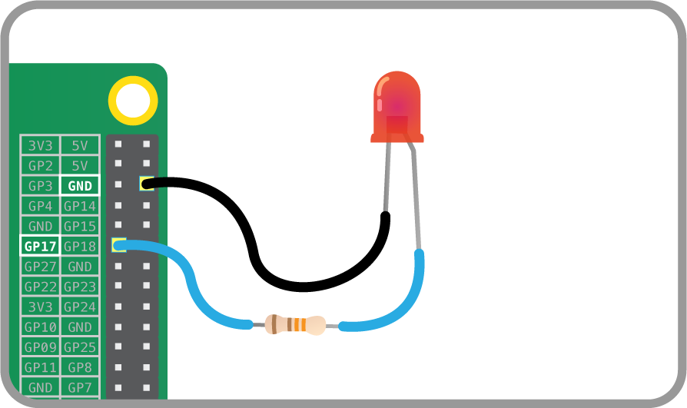
Control LED using Scratch
Connect pin 17 to LED (or you can use any numbered pin you wish)

Slide 8
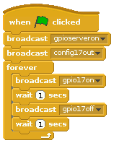
Control LED using Scratch
Open Scratch on the Pi. Create and run the following program. Before you run it, what will the following program do?

