Slide 1

Introduction to Coding
Variables and Operators
Produced
by:
Dr. Siobhán Drohan
Mairead Meagher
Department of Computing and Mathematics
http://www.wit.ie/

Slide 2
Topics list
Variables
Operators

Slide 3
Topics list
Variables
Operators

Slide 4
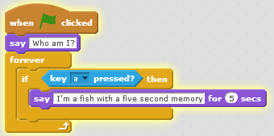
Variables
What if we wanted to keep a count of how many times they key ‘a’ was pressed?
We need to store this information somewhere.
This is where VARIABLES come in.

Slide 5
Variables
In a program we use variables to keep track of values:
e.g., the number of times the key ‘a’ was pressed.
A variable is an item of information whose value can change over time:
the value can vary, hence variable.
A variable has a:
name (also called an identifier)
type
value

Slide 6
Variables - example
Variable | Details
name | counter
type | stores whole numbers e.g. 1, 2, 3, etc.
value | When our program starts, the number of times the key ‘a’ is pressed is zero i.e. the counter variable is set to zero. Each time the key ‘a’ is pressed, the counter variable is increased by 1 (note the iteration/repetition here).
By using the counter variable, we can keep track of how many times the key ‘a’ was pressed.

Slide 7
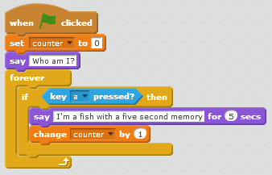
Using Variables: SomethingFishy4

Slide 8
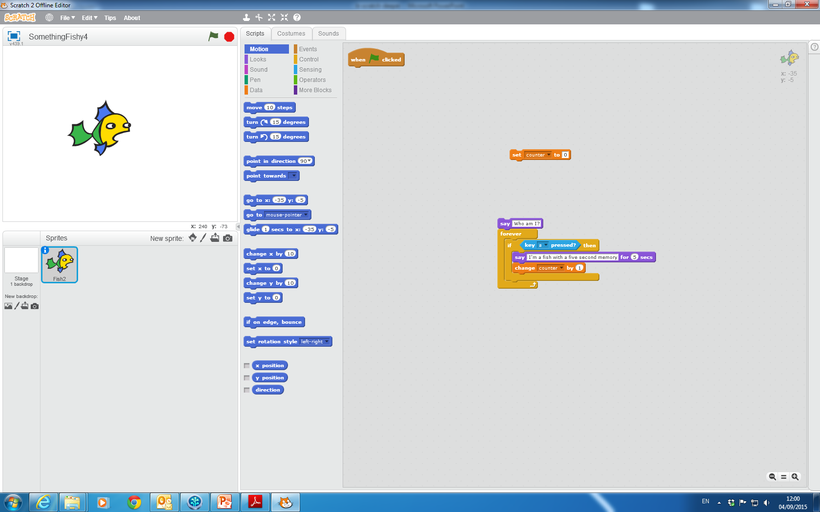
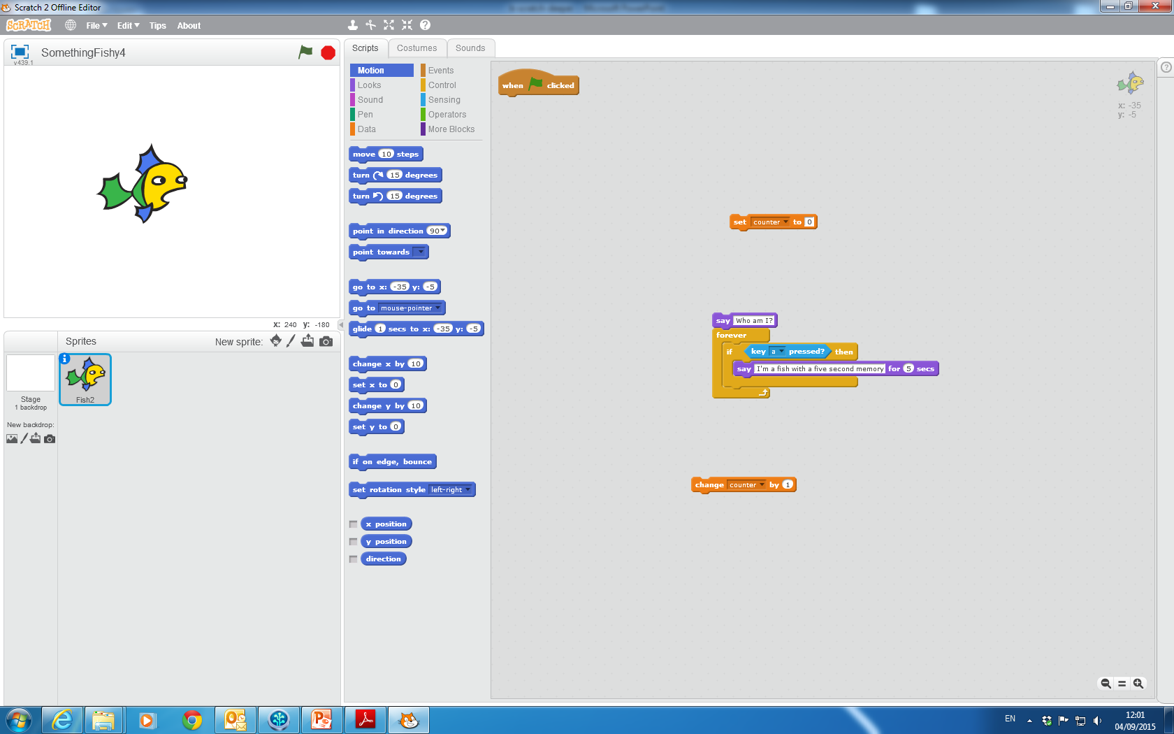
Using Variables
Sets the variable to specified value
Changes the variable by specified amount
If you have more than one variable, use the pull-down menu to select the variable name.

Slide 9
Topics list
Variables
Operators

Slide 10
Operators
Consider the following processing:
Only tell the user 3 times that “I’m a fish with a five second memory”.
If they ask a 4th time (press the ‘a’ key a 4th time), they should be informed that they have already been told 3 times. The program should stop running.

Slide 11
Operators
Consider the following processing:
Only tell the user 3 times that “I’m a fish with a five second memory”.
If they ask a 4th time (press the ‘a’ key a 4th time), they should be informed that they have already been told 3 times. The program should stop running.
To do this, we need to check what values
are stored the counter variable. This is where
OPERATORS come in.

Slide 12
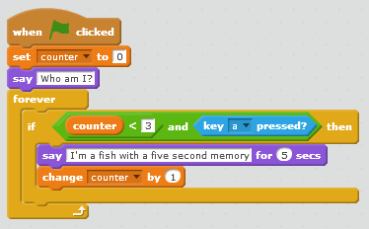
Using Operators: SomethingFishy5
Implementing the first rule…
Only tell the user 3 times that “I’m a fish with a five second memory”.

Slide 13
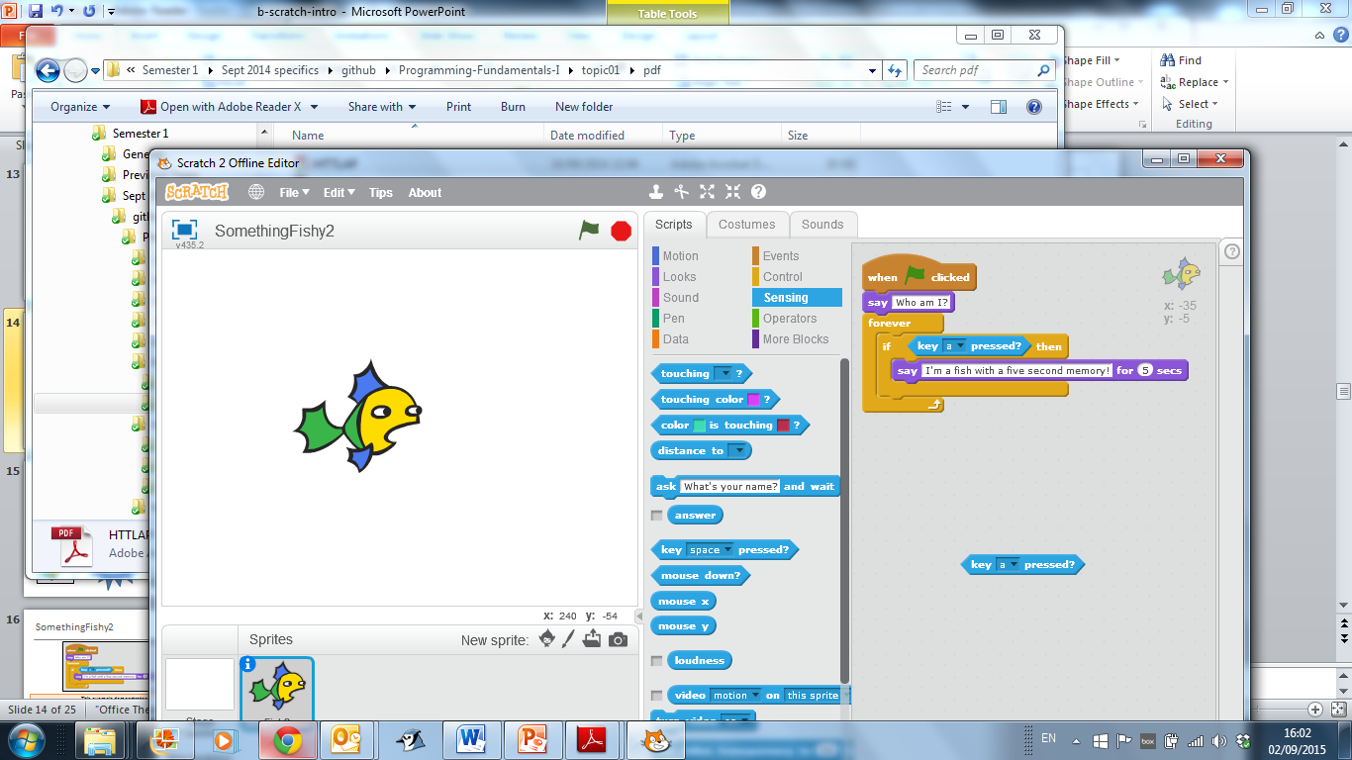
Recap: Conditions
A condition in programming is something that is either true or false.
Example: Reports true if key ‘a’ is pressed. Reports false if any other key is pressed.

Slide 14
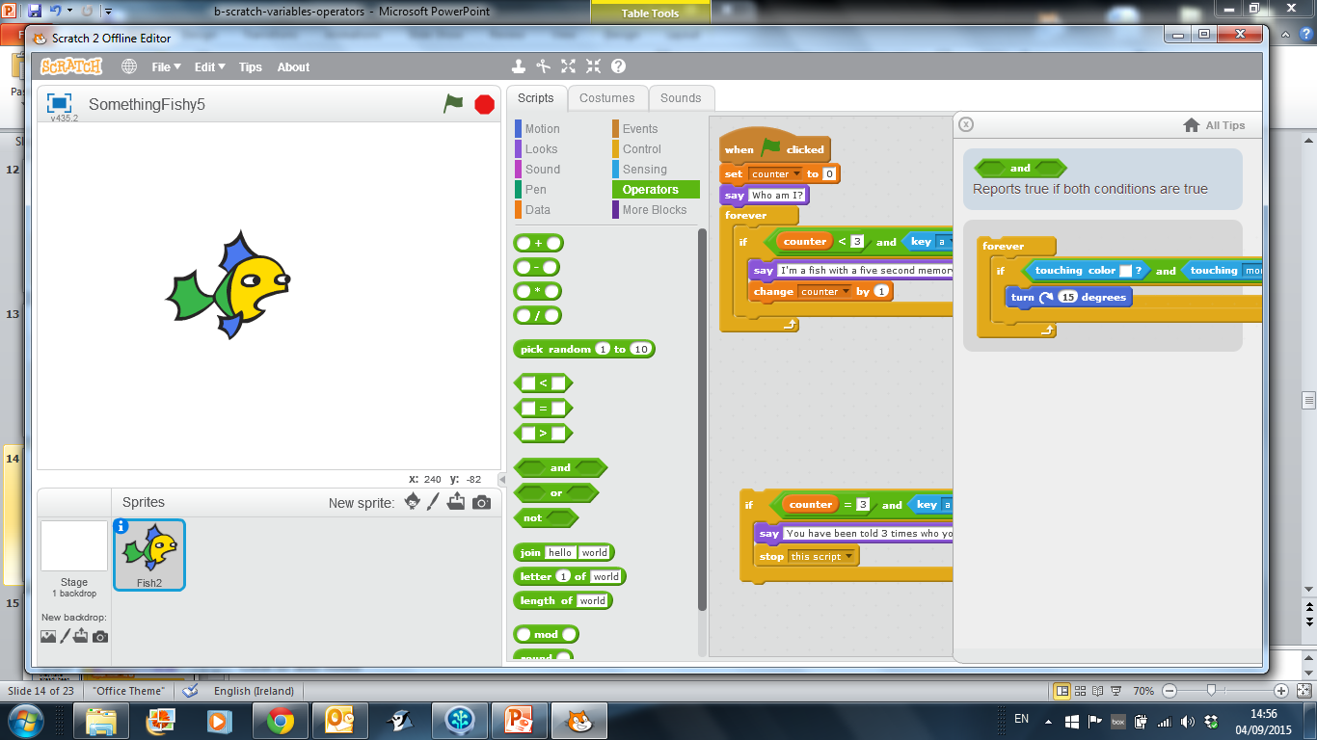
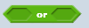
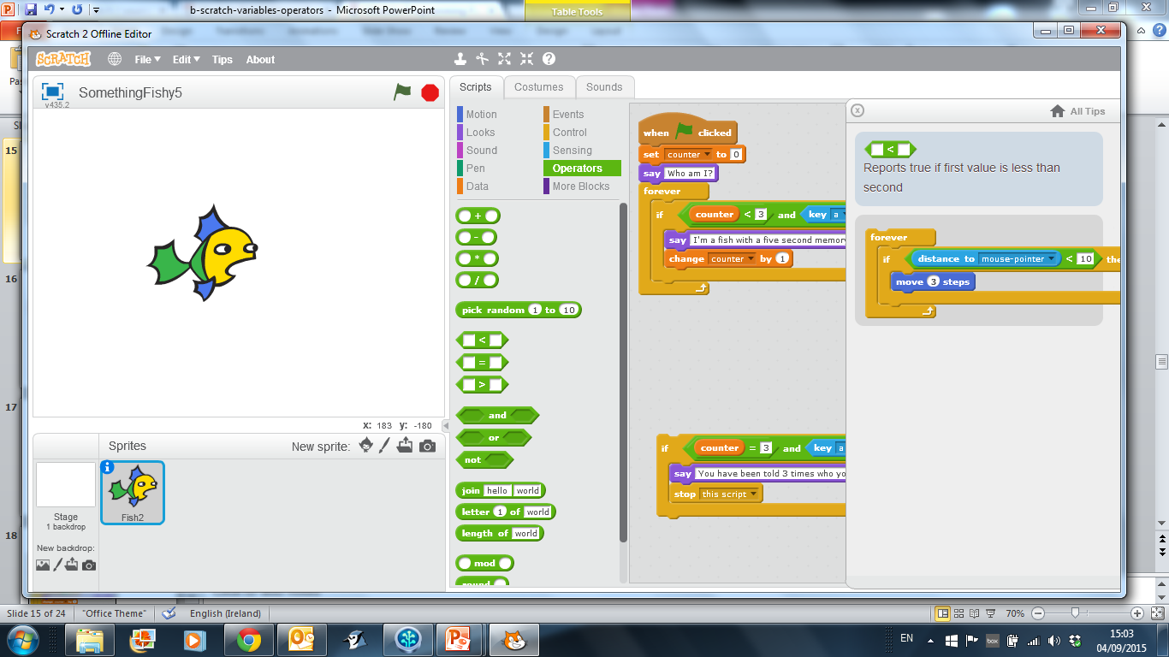
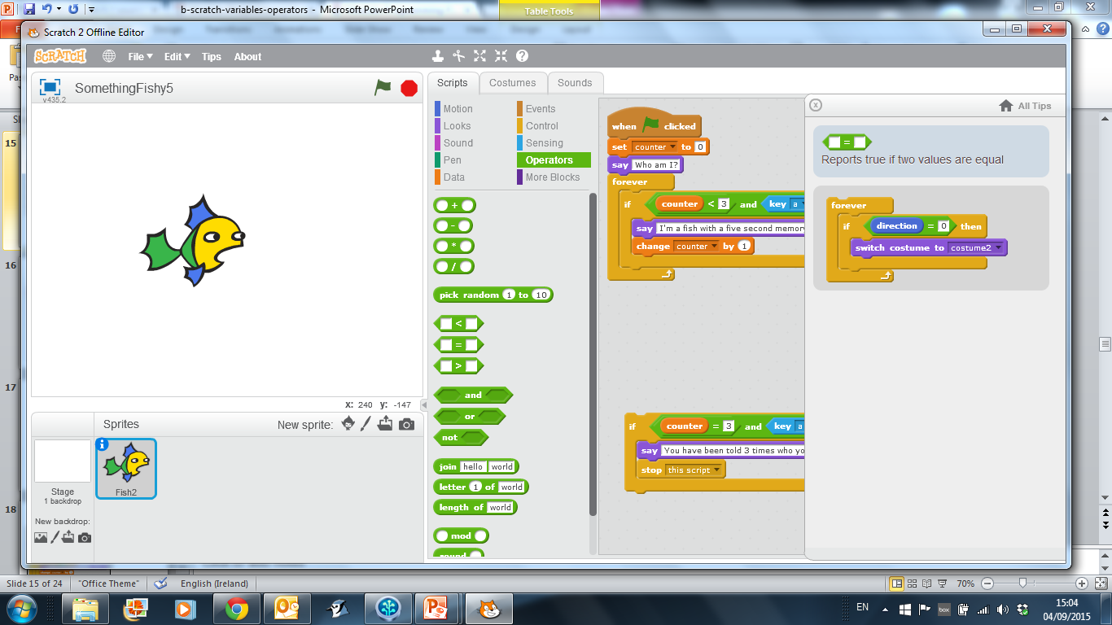
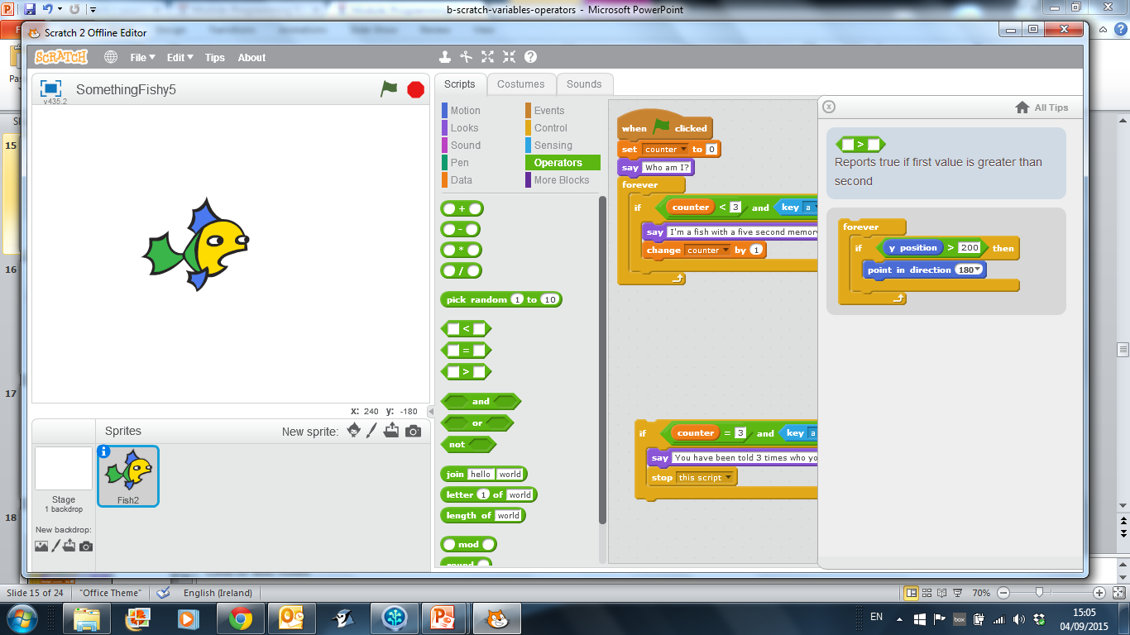
Using Operators
Logical Operators | Reports true if both conditions are true
 | Reports true if either condition is true
Equality / Relational Operators | Reports true if first value is less than second
 | Reports true if two values are equal
 | Reports true if first value is greater than second

Slide 15
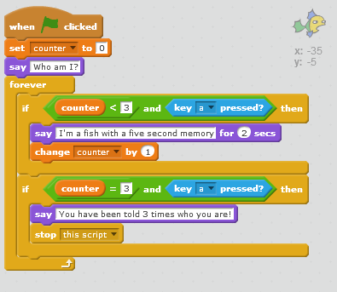
Using Operators: SomethingFishy5
Implementing the second rule:
If the user asks a 4th time (i.e. presses the ‘a’ key a 4th time), they should be informed that they have already been told 3 times.
The program should stop running.

Slide 16

Questions?

Slide 17
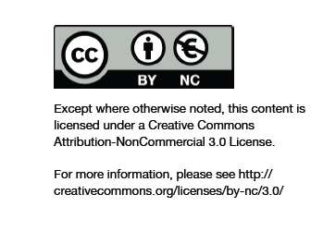
Department of Computing and Mathematics
http://www.wit.ie/

